Slide 1



Department of Computer Science and Engineering
Make it natural: Application for Managing Food waste and Excess food and plants in homes: A step to Minimize Food wastage
SDG no: 2,12,13,15&17
DHEVESH BC / 211420104065
DINESH KUMAR MP / 211420104068
LOKESH BHARATHWAJ T/ 211420104149
Mrs. S.T. Santhana Lakshmi Associate Professor, M.Tech (PhD)
Dr. N. Pughazendi Narayanan, M.E, PhD

Slide 2
Introduction
Food waste management is the process of reducing, recovering, and recycling food waste to minimize its negative impact on the environment and society.
According to the Food and Agriculture Organization (FAO) of the United Nations, one-third of all food produced globally is wasted each year, which amounts to about 1.3 billion tonnes.
The management of food waste involves several steps, including prevention, reduction, and diversion. Prevention involves reducing the amount of food waste generated by consumers and businesses through better planning, portion control, and food storage practices.

Slide 3
Objective of the project
Food waste is a growing concern in today's world, with an estimated one-third of all food produced for human consumption going to waste.
Food waste contributes to greenhouse gas emissions, depletes natural resources, and exacerbates food insecurity. So utilize them before it get spoiled.
The problem statement for food waste management, therefore, would be how to reduce food waste at its source, and how to manage it effectively to minimize its impact on the environment and society.
The fertilizer from the food waste will be natural , and if they are used in plants , the food plants will be healthier than before. Each and every time it will be better than before.
Donating the excess food to the nearby homes , can reduce the hunger.
Thus, the food waste during cooking and the excess food after consumption are managed.

Slide 4
Literature Survey
YEAR | TITLE AND JOURNAL | AUTHOR | DESCRIPTION | ADVANTAGES | DISADVANTAGES
2021 | SeVa: A Food Donation App for Smart Living | Christina Varghese, Drashti Pathak , Aparna S. Varde | focuses on creating an interesting mobile application (app) called SeVa that provides a ubiquitous platform wherein users can visualize available food resources in their local area and consequently gain access to food, thereby tackling two major issues, i.e. hunger and food waste. | Impacting AI in Smart Living for Smart Cities via ubiquitous access on mobile devices to knowledge about food, essential for health and sustainability | This app only works during pandemic situations
2021 | Do VIR: Virtualizing Food Donation Distribution through Mobile Application and Cloud-Based Supply Chain Management | Divy Chhibber, Aditi Tripathi , Sandip Ray | includes mobile smartphone application together with cloud-based services to create a virtualized infrastructure for enabling precise, in-time food donation | In-time Donation,Precision Donation,Donor Community Engagement. | This only includes the management of the excess food

Slide 5
Literature Survey
YEAR | TITLE AND JOURNAL | AUTHOR | DESCRIPTION | ADVANTAGES | DISADVANTAGES
2020 | Human Health Risks Concerning Food Waste Management | Elena-Diana Ungureau-Comanit1, Ersilia Lazar Cosbuc1, Petronela Cozma1, Camelia Smaranda1, Maria Gavrilescu1,2 | to identify the human health’s risk factors due to inadequate food waste management and recommend best management alternatives for the recovery and recycling of food waste. | Impacting AI in Smart Living for Smart Cities via ubiquitous access on mobile devices to knowledge about food, essential for health and sustainability | Gives an idea about the risk and the management of food waste but does’nt actually implement practicaly
2020 | FoodX, a System to Reduce Food Waste | Shinta Oktaviana R, Diana Ambarwati Febriani, Intan Yoshana, LR. Payanta | The Community collects excess food from eligible donor consumption to be distributed to people in Need (with and without volunteer),. | it has features such as accepting and declining to pick up donations, and making report to community about the quality of donation, and giving a picture of distribution process in location | need to work with other NGOs working on humanitarian issues, and with local governments

Slide 6
Existing System
Here, users can visualize available food resources in their local area and consequently gain access to food, thereby tackling two major issues, i.e. hunger and excess food waste during pandemic situations(covid). To access this app user requires mobile and internet as the users who are in need of food.
If food suppliers intend to donate food through the app, they can enter the type of food they would donate, the quantity of the item(s), date of expiry and so on.
Disadvantages: It only donates food to people who have mobile and internet services. This was created regarding the corona period(situation).

Slide 7
Proposed System
The proposed system helps in managing the excess food as well as the food waste by converting most the food waste into manure, that can be used as natural fertilizer to crops/plants and the excess food can be donated to nearby homes or the needy people.
Make it yourself (Self management)
Food waste: You can ask an agent/associate by clicking the chat option.
Excess food: the app can direct you to nearby homes.
Book an agent to sell the food waste or there is an option like manure is processed and given back to the user with certain amount charged. Book an agent to deliver the excess food to nearby homes.
And users can order organic fertilizers for their garden.

Slide 8
Software / Hardware used
Software:-
Android studio
WhatsApp Business
Visual Studio Code
Firebase Console
Google Console
Google services
Hardware:-
Internet connection
Computer
Android Mobile

Slide 9
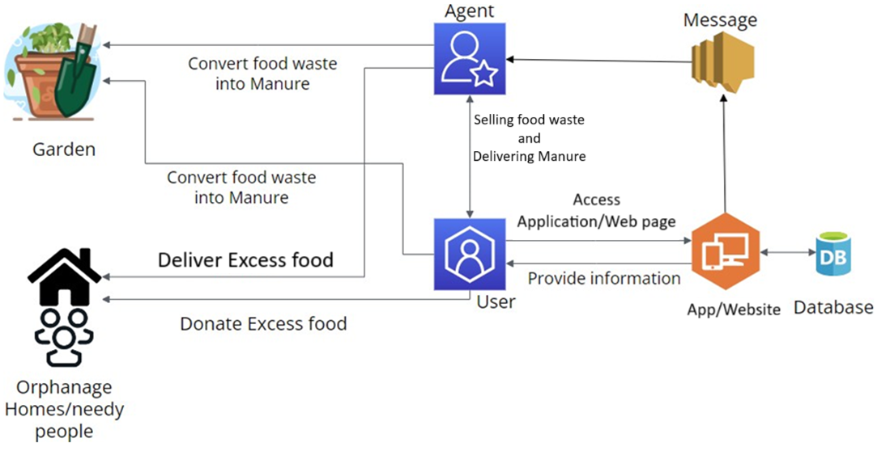
System Architecture

Slide 10
System Implementation
Android Studio
XML(Frontend-App)
Java(Backend-App)
Firebase Console
Stores user’s credentials
Stores images and bills
Google console
Gives access to map
Finds current location
Google Services
Gmail (Apply for agent job)
Google pay (Payment)
WA business
Customer-Administrator interaction
Contact Agent (Delivery service)
Visual studio code
HTML(Frontend-website)
CSS(Frontend-Website)
JavaScript(Backend-Website)

Slide 11
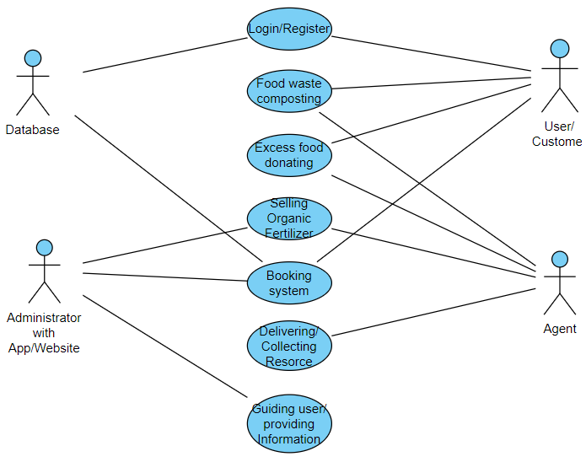
Usecase Diagram

Slide 12
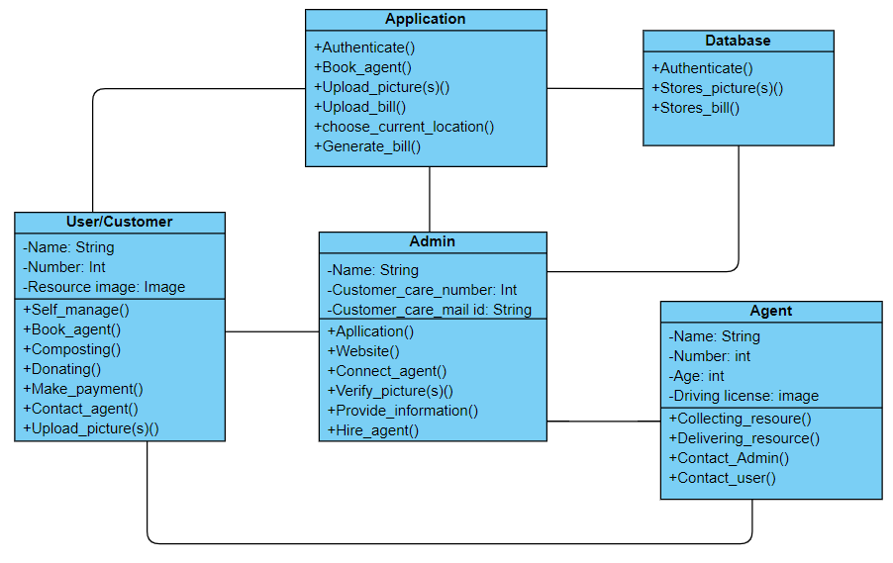
Class Diagram

Slide 13
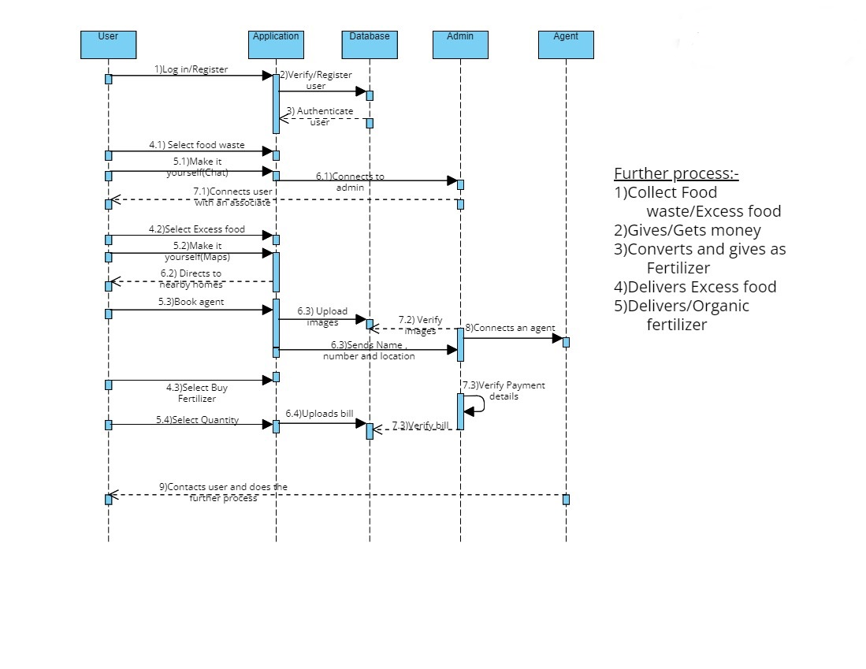
Sequence Diagram

Slide 14
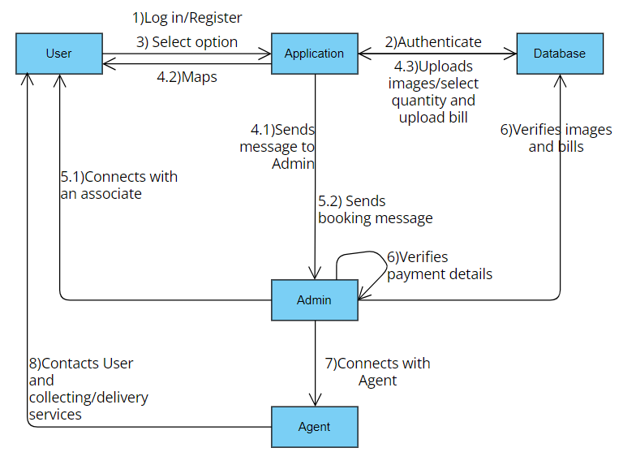
Collaboration Diagram

Slide 15
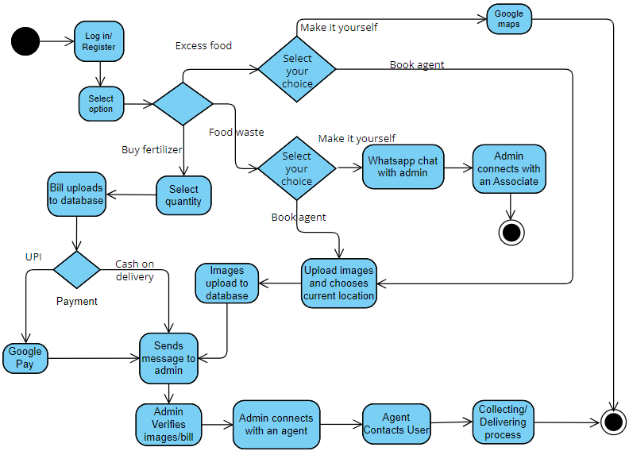
Activity Diagram

Slide 16
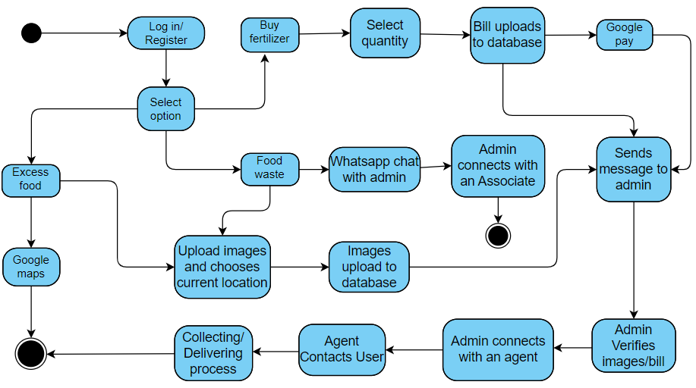
State Chart Diagram

Slide 17
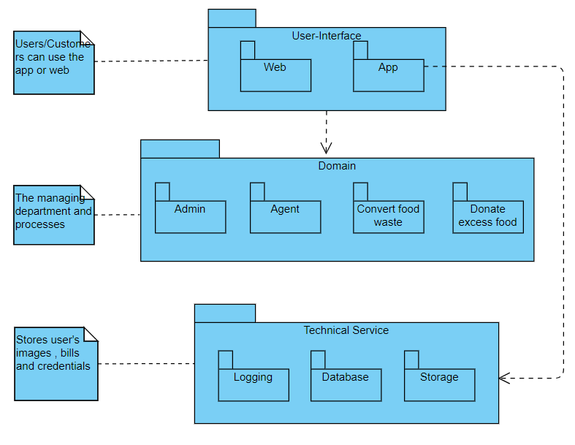
Package Diagram

Slide 18
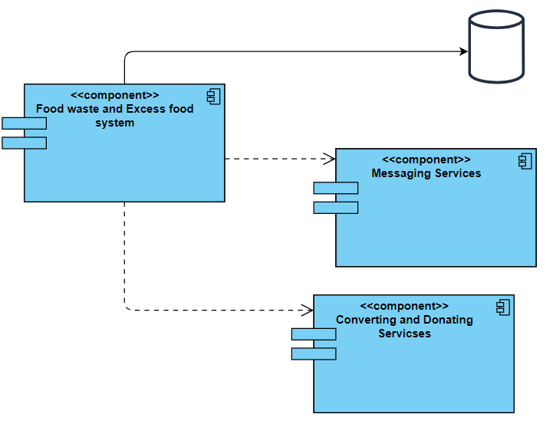
Component Diagram

Slide 19
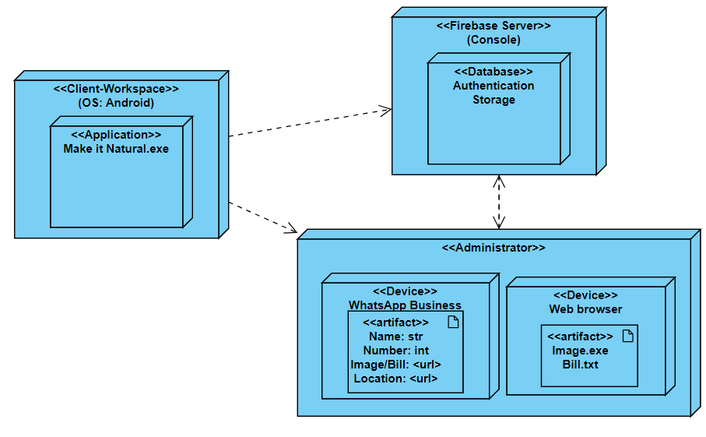
Deployment Diagram

Slide 20
Results and Discussion
User Registration and Login Functionality:
The registration and login processes seem to be functioning correctly, as indicated by the successful execution of test cases.
Both the "Register" and "Log in" buttons perform as expected, allowing users to register their credentials and subsequently log in to the system without any issues.
Food Waste and Excess Food Activities:
The "Food waste" and "Excess food" activities appear to function properly, presenting users with the option to either "Make it yourself" or "Book an agent."
Test cases related to these activities demonstrate successful navigation and interaction, with users being prompted appropriately based on their selections.

Slide 21
Results and Discussion
Booking Functionality:
The booking process, whether for making it yourself or booking an agent, seems to work smoothly according to the provided test cases.
Actions such as uploading images, selecting quantities, and confirming bookings are successfully executed without any failures.
Location-Based Functionality:
The system effectively retrieves and utilizes the user's current location, as demonstrated by the test cases related to selecting current locations and booking activities.

Slide 22
Results and Discussion
Payment Method Integration:
The integration of payment methods, including Cash on Delivery and UPI, appears to be seamless, with users prompted to select their preferred payment method without encountering any issues.
Overall System Reliability and Robustness:
The consistent passing of test cases across various functionalities suggests a high level of reliability and robustness in the system.
Users can interact with different features and perform actions as intended, indicating a well-designed and implemented system.

Slide 23
Results and Discussion
User Experience Considerations:
The autofill feature for user details enhances user experience by reducing manual input requirements, contributing to a smoother interaction flow.
The use of increment and decrement buttons for quantity selection adds convenience and intuitiveness to the user interface.
Data Management and Communication:
The successful uploading of booking details to the database and sending booking details to the manager indicates proper data management and communication protocols in place.

Slide 24
Reference Paper/ URL
[1] Divy Chhibber, Aditi Tripathi, Sandip Ray, “Do VIR:Virtualizing Food Donation Distribution throughMobile Application and Cloud-Based Supply ChainManagement”, 2021 IEEE International Conferenceon Consumer Electronics (ICCE).
[2] Elena-Diana Ungureau-Comanit1, Ersilia LazarCosbuc1, Petronela Cozma1, Camelia Smaranda1,Maria Gavrilescu1,2, “Human Health RisksConcerning Food Waste Management”, Grigore T.Popa University of Medicine and Pharmacy, WebConference, Romania, October 29-30, 2020.
[3] Swaraj Patil, Omkar Nikam, Suryakrishnan Nair,Aniket Raut, Vivian Brian Lobo, “Sustainable FoodWaste Management and Tracking System UsingBlockchain”, 2023 International Conference onAdvancement in Computation & ComputerTechnologies (InCACCT).
[4] Arvind Kumar Pandey, Pratik Patel, “An AndroidApplication Development for Food Donation: AGeographical Location Based Approach”, 2023 3rdInternational Conference on Advance Computing andInnovative Technologies in Engineering (ICACITE).
[5] Arfandi Andres, Edwin Setiawan Tanjaya,Ghaniyardi, Joshua Christian Sandhi, Harco LeslieHendric Spits Warnars, “Sharing Food withFoodLifeSavr Smartphone App”, 2022 SecondInternational Conference on Artificial Intelligenceand Smart Energy (ICAIS).

Slide 25
Reference Paper/ URL
[6] R. Kavitha, V Nuthan Prasad, Dankan Gowda V,Umayal M, Subhiksha K, Anitha K, “A NovelApproach for Identification and Donation of SurplusFood using Machine Learning-based Replate App”,2023 Second International Conference on AugmentedIntelligence and Sustainable Systems (ICAISS).
[7] Henry Agyemang, Sonith Riem, Samantha DiRenzo,John Ring, Jonathan T. Su, “Improved Food WasteProcessing Through Water Removal in a UniversityDining Hall”, 2023 Systems and InformationEngineering Design Symposium (SIEDS).
[8] Madushan Madhava Jayalath, R.M. ChandimaRatnayake,H. Niles Perera, Amila Thibbotuwawa,“Waste Minimization and Performance Improvementin Vegetable Supply Chains: A Case Study from aDeveloping Economy”, 2023 8th InternationalConference on Business and Industrial.
[9] Shinta Oktaviana R, Diana Ambarwati Febriani,Intan Yoshana, LR. Payanta, “FoodX, a System toReduce Food Waste”, 2020 3rd InternationalConference on Computer and InformaticsEngineering (IC2IE).
[10] Katakam Sudheepa, Padmashetti Rashmitha, P.Sardar Maran, “Food Wastage ManagementApplication using Android Studio”, 2023 2ndInternational Conference on Applied ArtificialIntelligence and Computing (ICAAIC).

Slide 26
Reference Paper/ URL
[11] Christina Varghese, Drashti Pathak, Aparna S.Varde,” SeVa : A Food Donation App for SmartLiving”, 2021 IEEE 11th Annual Computing andCommunication Workshop and Conference (CCWC).
[12] Elena-Diana Ungureau-Comanit1, Ersilia LazarCosbuc1, Petronela Cozma1, Camelia Smaranda1,Maria Gavrilescu1,””, Human Health RisksConcerning Food Waste Management.
[13] Shinta Oktaviana R, Diana Ambarwati Febriani,IntanYoshana, LR. Payanta, ” FoodX, a System toReduce Food Waste”, 2020 3rd InternationalConference on Computer and InformaticsEngineering (IC2IE).
[14] hsph.harvard,https://www.hsph.harvard.edu/nutritionsource/sustainability/food- waste/
[15] lawinsider,https://www.lawinsider.com/dictionary/excess- food#:~:text=Excess%20food%20means%20any%20remaining,students%20during%20a%20school%20day.

Slide 27

Thank you

