Slide 1



Department of Computer Science and Engineering
Phish Detect: Building and Deploying a Phishing URL Detection System with Machine Learning
Team Members Name / Register Number
EMMANUEL JOSHUA C 211420104074
ARUNKUMAR K V 211420104027
DILIP G 211420104067
Guide Name & Designation
Mrs. Sivakamy. N
Coordinator Name & Designation
Dr. Pughazendi N

Slide 2
ABSTRACT
Phishing attacks pose significant risks in today's digital landscape, exploiting human vulnerabilities to steal sensitive information.
Traditional phishing detection methods often rely on network-dependent features, raising concerns about privacy and usability.
The system prioritizes user privacy and usability by extracting feasible client-side features, minimizing reliance on external resources.
The project utilizes machine learning algorithms like Random Forest to classify URLs as phishing or legitimate.
The project emphasizes the importance of timely detection of phishing attacks to prevent users from falling victim to fraudulent activities.

Slide 3
INTRODUCTION
Phishing attacks exploit the trust of unsuspecting users by impersonating legitimate entities like banks or social media platforms to steal sensitive information.
Attackers employ deceptive tactics such as email spoofing, fake websites, social engineering, and malware distribution to deceive users and compromise their security.
The scale and sophistication of phishing attacks have increased, targeting individuals, businesses, and organizations across various sectors.
Phishing attacks not only pose a risk to individual users but also have severe implications for businesses and organizations in terms of data breaches and financial losses.
The introduction sets the stage for the importance of developing advanced detection systems like Phish Detect to safeguard users and organizations from phishing threats.

Slide 4
PROBLEM STATEMENT
Phishing attacks continue to pose a significant threat to individuals and organizations by deceiving users into divulging sensitive information such as passwords and financial details.
Existing phishing detection systems often rely on traditional rule-based methods or simple heuristics, which may not effectively adapt to evolving phishing techniques.
This project aims to address the limitations of current phishing detection methods by implementing a machine learning-based system capable of accurately identifying phishing URLs and providing a proactive defense against cyber threats.

Slide 5
PROPOSED SYSTEM
The proposed methodology involves collecting a dataset of URLs to train machine learning models for phishing detection.
Feature extraction techniques are applied to the URLs to capture relevant information that can differentiate between legitimate and phishing websites.
The dataset is preprocessed to handle missing values, encode categorical variables, and normalize numerical features for model training.
Cross-validation is employed to evaluate the performance of the machine learning models and ensure their generalization to unseen data.
The trained models are assessed based on metrics like accuracy, precision, recall, F1 score, and ROC-AUC to measure their effectiveness in phishing detection.

Slide 6
LITERATURE SURVEY
Paper ID | Title | Authors | Approach | Advantages | Disadvantages
1 | A Deep Learning-Based Framework for Phishing Website Detection | L. Tang and Q. H. Mahmoud | Machine Learning (Deep Learning) | High accuracy | May require large amounts of data for training
2 | Phishing or Not Phishing? A Survey on the Detection of Phishing Websites | R. Zieni, L. Massari and M. C. Calzarossa | Survey | Provides a comprehensive overview of existing techniques | Does not present new detection methods
3 | Phishing-Alarm: Robust and Efficient Phishing Detection via Page Component Similarity | J. Mao, W. Tian, P. Li, T. Wei and Z. Liang | Feature-based (Visual Layout) | Fast and efficient, may not be easily fooled by obfuscation techniques | May be less effective for phishings with different layouts
4 | Phishing URL Detection: A Real-Case Scenario Through Login URLs | M. Sánchez-Paniagua, E. F. Fernández, E. Alegre, W. Al-Nabki and V. González-Castro | Feature-based (URLs) | Focuses on a critical element of phishing websites | May not be effective for phishings that don't use suspicious URLs

Slide 7
LITERATURE SURVEY
5 | Characteristics of Understanding URLs and Domain Names Features: The Detection of Phishing Websites with Machine Learning Methods | I. Kara, M. Ok and A. Ozaday | Feature-based (URLs and Domain Names) | Leverages readily available information | May be vulnerable to techniques that manipulate URLs or domain names
6 | Fighting against phishing attacks: state of the art and future challenges | Gupta, B.B., Tewari, A., Jain, A.K. | Survey | Provides a high-level overview of the field | Does not present specific detection methods
7 | Phishing environments, techniques, and countermeasures: A survey | Ahmed Aleroud, Lina Zhou | Survey | Broader perspective on phishing landscape | Does not present specific detection methods

Slide 8
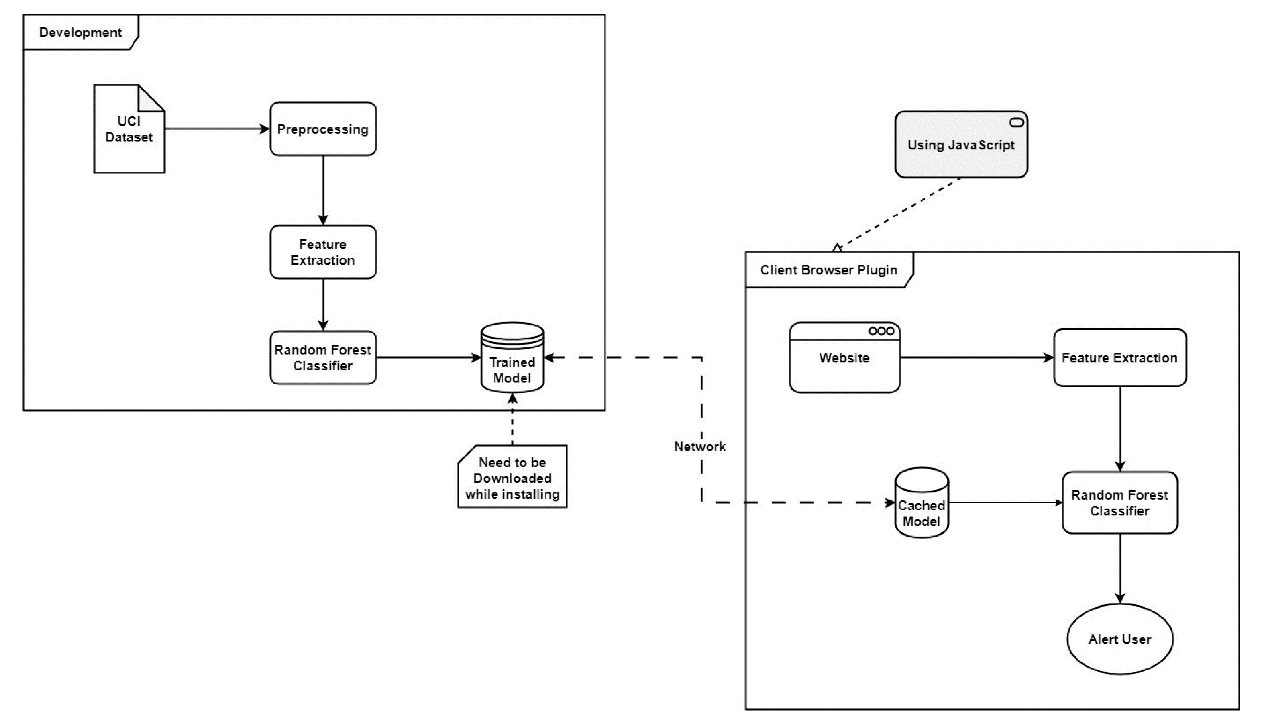
PROPOSED METHODOLOGY

Slide 9
MODULE DESCRIPTION
Data Collection Module: This module gathers a diverse dataset of URLs, including both legitimate and phishing websites, to train and test the machine learning algorithms.
Preprocessing Module: Responsible for cleaning and transforming the raw URL data into a format suitable for machine learning analysis, which may involve feature extraction and normalization.
Training Module: Utilizes machine learning algorithms, such as random forest classifiers, to train on the preprocessed data and learn to distinguish between legitimate and phishing URLs.
Validation Module: Evaluates the performance of the trained model using validation datasets to assess its accuracy, precision, recall, and F1 score.
Export Module: Converts the trained machine learning model into a deployable format, such as JSON, for integration into the browser plugin.

Slide 10
MODULE DESCRIPTION
Browser Integration Module: Integrates the machine learning model into a browser plugin, enabling real-time URL classification and phishing detection as users browse the internet.
User Interface Module: Develops a user-friendly interface for the browser plugin, displaying warnings or alerts to users when potential phishing websites are detected.
Testing Module: Conducts rigorous testing procedures to ensure the system accurately identifies phishing URLs and effectively alerts users to potential threats.
Performance Optimization Module: Focuses on enhancing the system's efficiency and speed to provide timely warnings and minimize any delays in phishing detection.
Deployment Module: Facilitates the deployment of the phishing detection system, ensuring seamless integration with popular web browsers and widespread availability for users seeking protection against phishing attacks.

Slide 11
RESULTS
The Random Forest classifier achieved a high accuracy rate in distinguishing between phishing and legitimate URLs.
The system demonstrated robust performance in real-time phishing detection during browsing sessions.
Evaluation metrics such as precision, recall, and F1 score indicated the system's effectiveness in identifying phishing attempts.
Cross-validation results confirmed the model's generalization ability and its capability to avoid overfitting.
The system's one-time download model for offline operation enhanced user privacy and reduced dependency on external servers.

Slide 12
CONCLUSION
The utilization of machine learning algorithms, particularly the Random Forest classifier, in the "Phish Detect" system has shown promising results in rapidly detecting phishing URLs.
Despite a slight decrease in accuracy due to using a reduced set of features, the system's emphasis on rapid detection and enhanced privacy enhances its usability.
The F1 score of 0.886 on the test set indicates the effectiveness of the system in accurately identifying phishing attempts.
The system's architecture allows for immediate classification of websites during browsing sessions, providing users with timely alerts and warnings about potential phishing attempts
The system's ability to analyze not only the main URL but also embedded sublinks within webpages enhances its capability to provide comprehensive protection against phishing attacks.

Slide 13
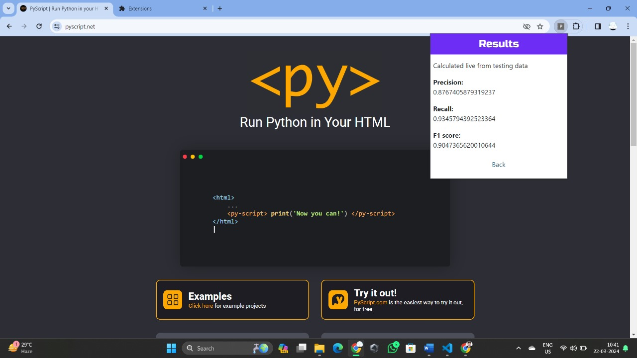
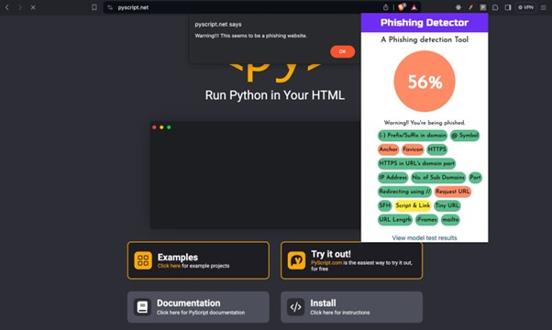
SCREENSHOTS

Slide 14


SCREENSHOTS

Slide 15
REFERENCES
[1] L. Tang and Q. H. Mahmoud, "A Deep Learning-Based Framework for Phishing Website Detection," in IEEE Access, vol. 10, pp. 1509-1521, 2022, 23 December 2021, doi: 10.1109/ACCESS.2021.3137636.
[2] R. Zieni, L. Massari and M. C. Calzarossa, "Phishing or Not Phishing? A Survey on the Detection of Phishing Websites," in IEEE Access, vol. 11, 22 February 2023, doi: 10.1109/ACCESS.2023.3247135.
[3] J. Mao, W. Tian, P. Li, T. Wei and Z. Liang, "Phishing-Alarm: Robust and Efficient Phishing Detection via Page Component Similarity," in IEEE Access, vol. 5, 23 August 2017, doi: 10.1109/ACCESS.2017.2743528.
[4] M. Sánchez-Paniagua, E. F. Fernández, E. Alegre, W. Al-Nabki and V. GonzálezCastro, "Phishing URL Detection: A Real-Case Scenario Through Login URLs," in IEEE Access, vol. 10, 18 April 2022, doi: 10.1109/ACCESS.2022.3168681.

Slide 16
REFERENCES
[5] Kara, M. Ok and A. Ozaday, "Characteristics of Understanding URLs and Domain Names Features: The Detection of Phishing Websites with Machine Learning Methods," in IEEE Access, vol. 10, 17 November 2022, doi: 10.1109/ACCESS.2022.3223111.
[6] Gupta, B.B., Tewari, A., Jain, A.K. “Fighting against phishing attacks: state of the art and future challenges” December 2017, https://doi.org/10.1007/s00521-016-2275-y.
[7] Ahmed Aleroud, Lina Zhou “Phishing environments, techniques, and countermeasures: A survey”, Volume 68, 17 April 2017, https://doi.org/10.1016/j.cose.2017.04.006.

