Slide 1



Department of Computer Science and Engineering
EMPLOYING SEASONAL DECOMPOSITION FOR DYNAMIC STOCK PRICE PREDICATION WITHIN THE REALM OF WEB-BASED APPLICATIONS
DHEEPAN BALAJI.L (211420104064)
GOWTHAM.S (2114220104064)
SUDHARSANAN.R(211420104337)
Guide Name & Designation
Mrs.D.JENNIFER M.TECH
Coordinator Name & Designation
Dr A.PUGHAZENDI M.E., Ph.D

Slide 2
Introduction
The proposed system is envisioned as a sophisticated web-based application that seeks to redefine the landscape of stock market analysis by seamlessly integrating fundamental data analysis with seasonal decomposition methods to provide accurate predictions of future stock prices.
The system leverages advanced analytical techniques and cutting-edge technology to provide users with the information they need to make informed decisions.
Fundamental analysis within the system entails a thorough examination of financial metrics, earnings reports, and market trends to ascertain the intrinsic value of stocks

Slide 3
Objective of the Project
Analyzes financial statements, earnings reports, and economic indicators to derive fundamental metrics and valuations.
Employs predictive models and insights generated by the analytics framework to inform algorithmic trading and investment strategies
Executes automated trades based on predefined rules and algorithms.
Provides users with recommendations for portfolio optimization and risk management

Slide 4
Literature Survey
year | Title and journal | author | description | advantages
2017 | Stock Market Predication Using A Linear Regression | Girish Kaushal | This technique utilizes a linear approach to model the relationship between dependent variable | Can provide insights into the linear relationship between variables.
2019 | Stock Closing Price Prediction using Machine Learning Techniques | Mehar Vijha | Various machine learning algorithms such as decision trees, random forests. | Flexibility to handle nonlinear relationships.

Slide 5
Literature Survey
year | Title and journal | author | description | advantages
2020 | Stock Market Prediction Using LSTM Recurrent Neural Network. | Adil MOGHARA | LSTM network recurrent neural network capable of learning long-term dependencies. | Helps in identifying the most suitable approach based on specific requirements.
2020 | A Survey on Stock Market Prediction Using Machine Learning Techniques. | Polamuri Subba Roa | employed in stock market prediction, including their strengths and weaknesses. | This approach combines time series analysis, econometric modeling, machine learning.
2021 | Stock Price Prediction Using Time Series, Econometric. | Ananda Chatterjee | machine learning techniques employed in stock market prediction | Utilizes the aspects of stock market behavior.

Slide 6
Existing System
the proposed system represents an innovative and practical solution, integrating diverse analytical modules into a unified framework. It empowers users with a comprehensive toolkit for making informed decisions in the dynamic and complex landscape of stock market prognostication.
The proposed system outlined in the abstract encompasses an advanced web-based predictive analytics framework designed for stock market forecasting.

Slide 7
Problem Statement
In the realm of finance and stock market prediction, the ability to accurately forecast stock prices is of paramount importance. Traditional methods of stock price prediction often rely on statistical models or machine learning algorithms trained on historical data. However, these methods may not fully capture the inherent patterns and dynamics present in stock price data, particularly those influenced by seasonal trends.
To address this challenge, this research aims to employ seasonal decomposition techniques within the realm of web-based applications for dynamic stock price prediction. Seasonal decomposition involves separating a time series into its constituent components, namely trend, seasonality, and noise. By isolating the seasonal component from the raw stock price data, it becomes possible to analyze and predict future price movements more accurately.

Slide 8
Module
1.Fundamental analysis
2.Technical analysis
3.News
4.AI chat
5.Stock market predication

Slide 9
Proposed System
The proposed system outlined in the abstract encompasses an advanced web-based predictive analytics framework designed for stock market forecasting. This innovative system integrates fundamental analysis, technical indicators, sentiment analysis, and a unique time series analysis approach to provide users with a comprehensive and actionable tool for navigating the complexities of financial markets
This comprehensive platform not only enhances the precision of market predictions but also provides investors and traders with a sophisticated toolkit for navigating the intricacies of modern financial markets with informed and strategic decision-making.

Slide 10
Software / Hardware used
Software Requirements:
• Windows 7or higher.
• Pycharm – an online python interpreter
Hardware Components:
• Processor – i3 or higher
• Hard Disk – 5 GB
• Memory – 1GB RAM
• Internet Connection

Slide 11
Architecture / Methodology used
Programming Libraries
Web Frameworks
Data Retrieval
Data Processing
Seasonal Decomposition

Slide 12
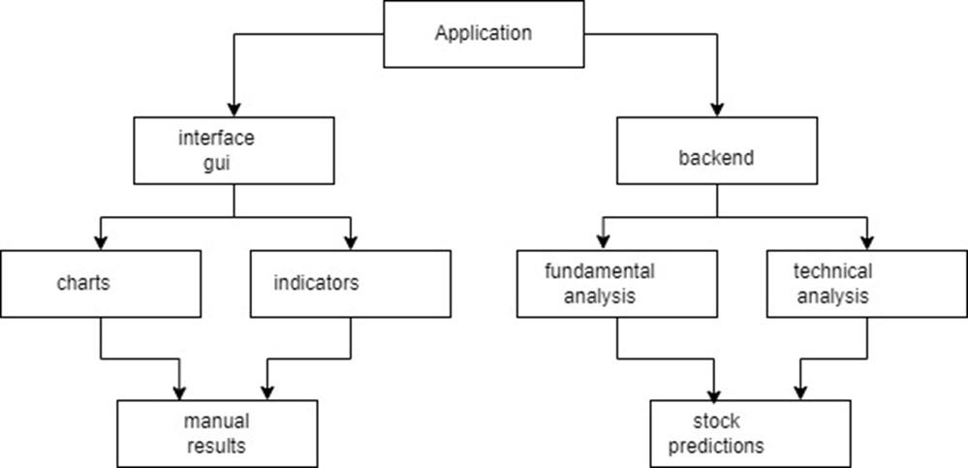
System Design - Flow Chart/DFD/ER

Slide 13
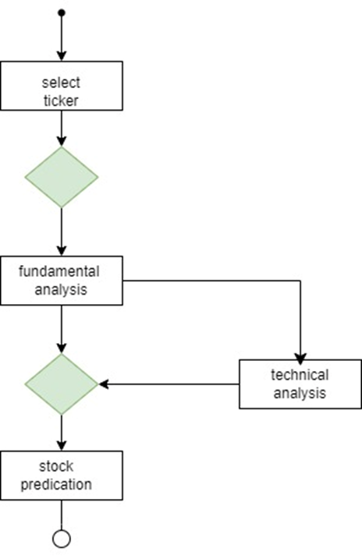
System Design - Flow Chart/DFD/ER

Slide 14
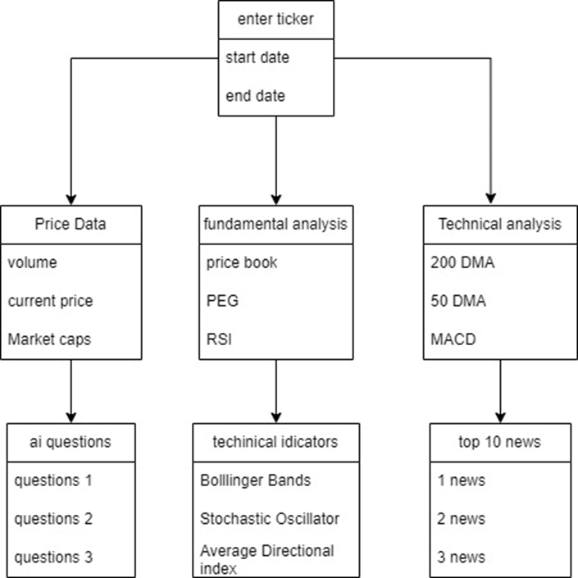
System Design - Flow Chart/DFD/ER

Slide 15
Module Description
1. DATASET
This innovative system integrates fundamental analysis, technical indicators, sentiment analysis, and a unique time series analysis approach to provide users with a comprehensive and actionable tool for navigating the complexities of financial markets. The system will provide a fun and interactive way for children to learn and development

Slide 16
Module Description
2.PREPROCESSING
The architecture of the predictive analytics framework for stock market forecasting is a sophisticated system comprising interconnected components designed to leverage advanced quantitative methodologies seamlessly. At its core, the framework ingests data from various sources including financial statements, earnings reports, economic indicators, news articles, and historical stock data

Slide 17
Module Description
3. LOAD DATA
Integrates outputs from fundamental analysis, technical analysis, sentiment analysis, and time series analysis to generate predictive models for stock market forecasting.
4.ANALYSE FEATURE
The predictive analytics framework's architecture for stock market forecasting is a multifaceted system built upon a foundation of robust data processing and analysis

Slide 18
Module Description
5. FINDING RESULT
In conclusion, the integration of advanced quantitative methodologies and sentiment analysis within a web-based predictive analytics framework represents a significant advancement in the field of stock market forecasting. Through the amalgamation of fundamental analysis metrics, technical indicators, sentiment analysis, and time series analysis, this research has demonstrated the potential to enhance the precision and effectiveness of predictive modeling in the dynamic and complex milieu of financial markets. The empirical analyses presented in this study provide compelling evidence of the efficacy of this integrated approach in capturing the multifaceted dynamics of stock market behavior. By leveraging sophisticated algorithms and state-of-the-art technologies, the proposed framework offers investors a sophisticated toolkit for navigating the intricacies of modern financial markets with informed and strategic decision-making capabilities.

Slide 19
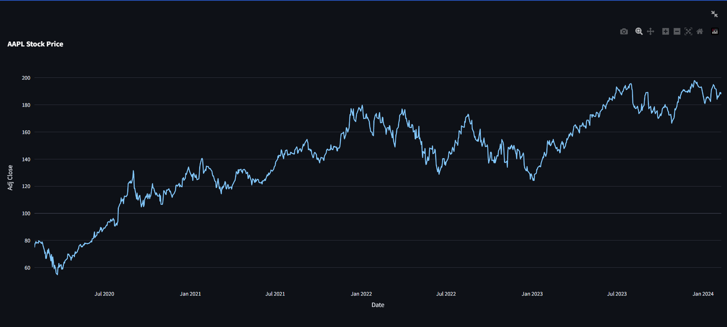
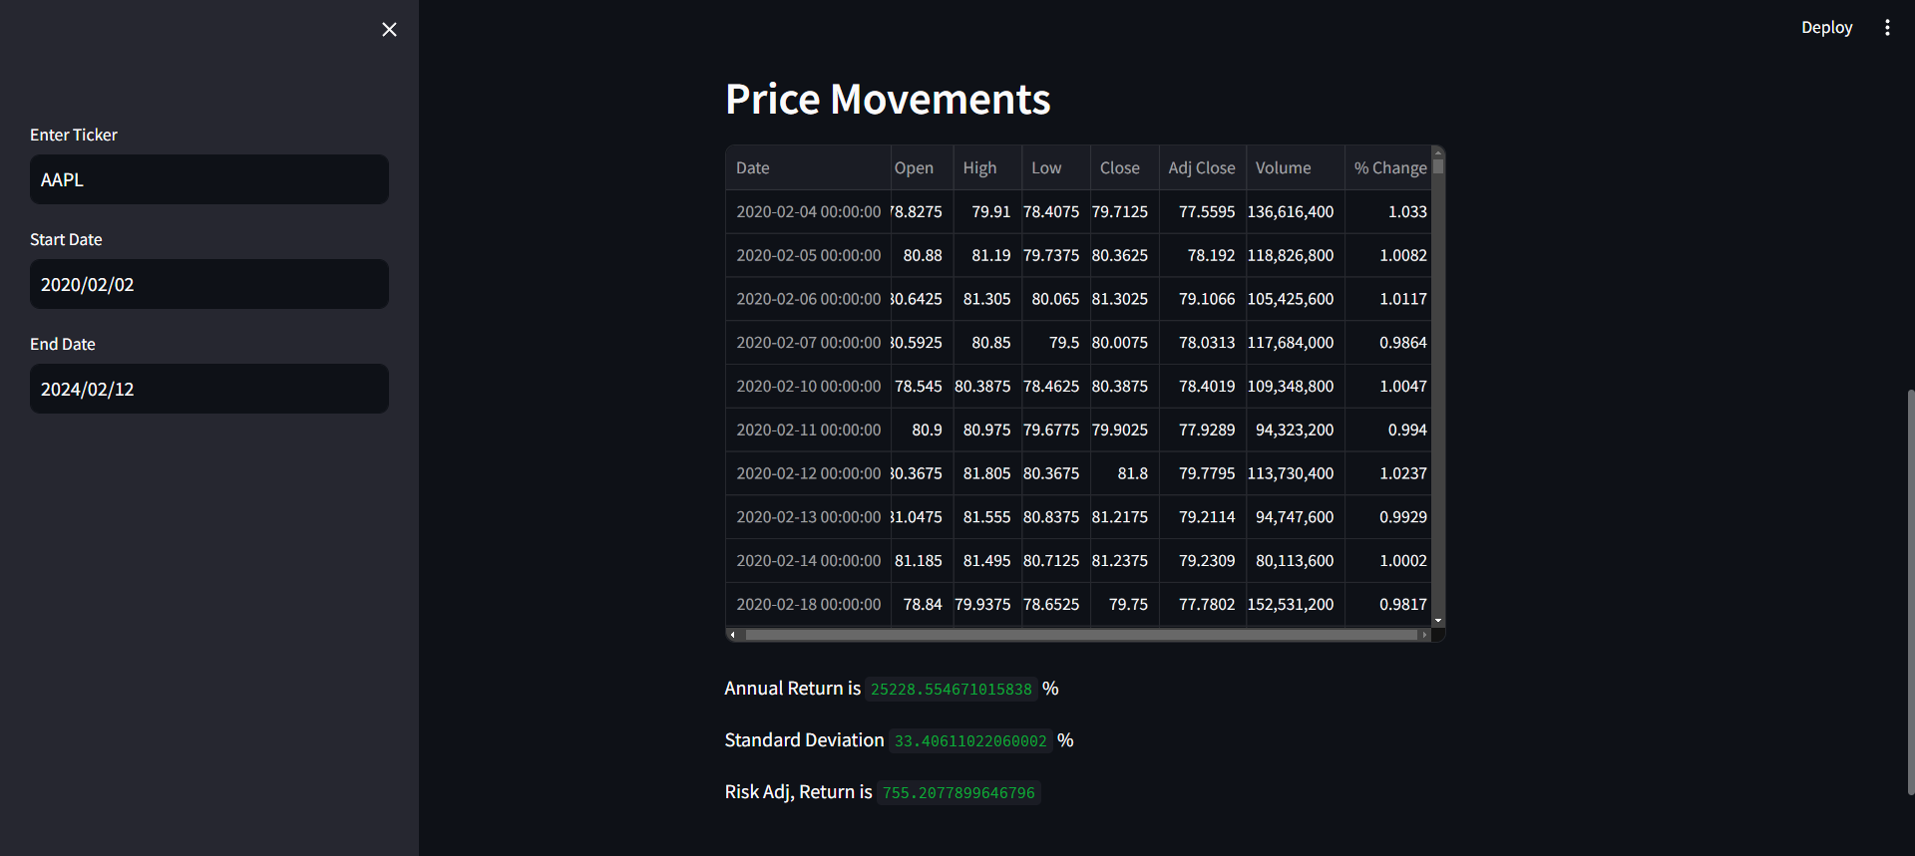
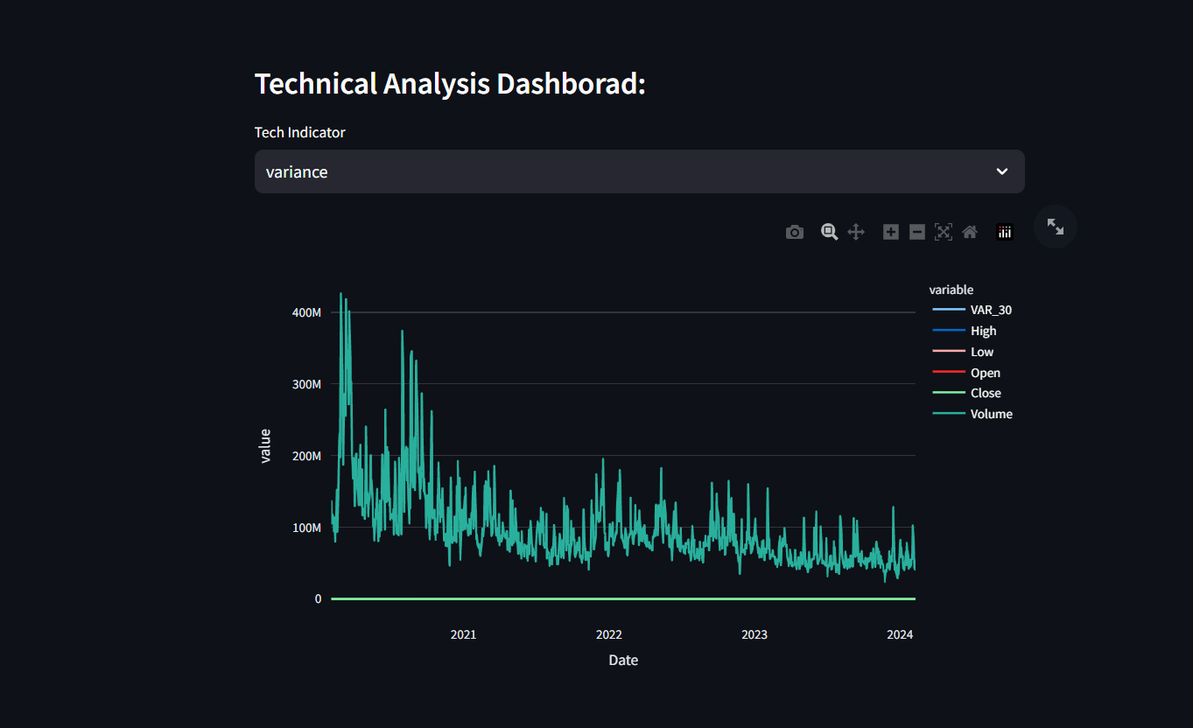
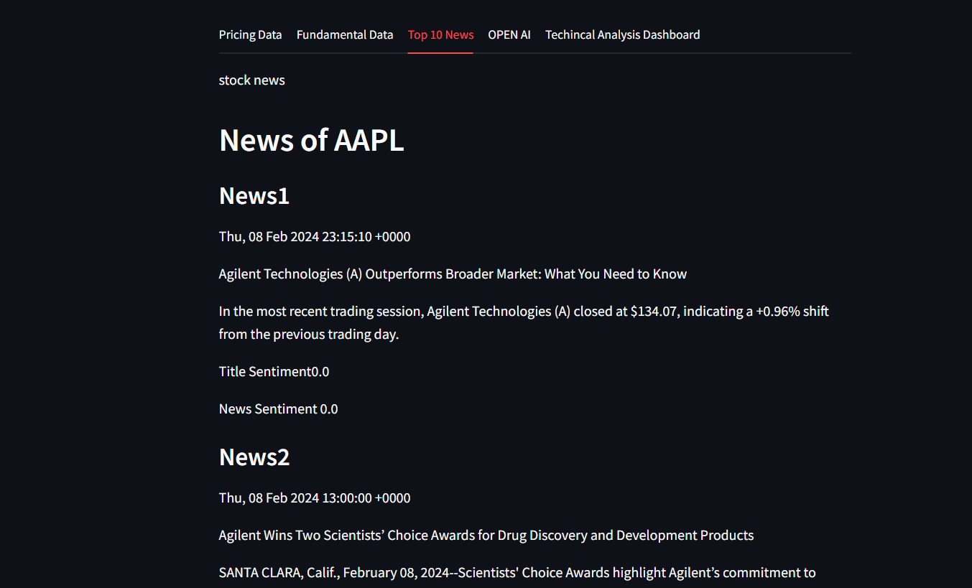
Testing /Performance Evaluation / Results
Fundamental analysis
Technical analysis
Technical indicators
Latest news

Slide 20
Testing /Performance Evaluation / Results

Slide 21
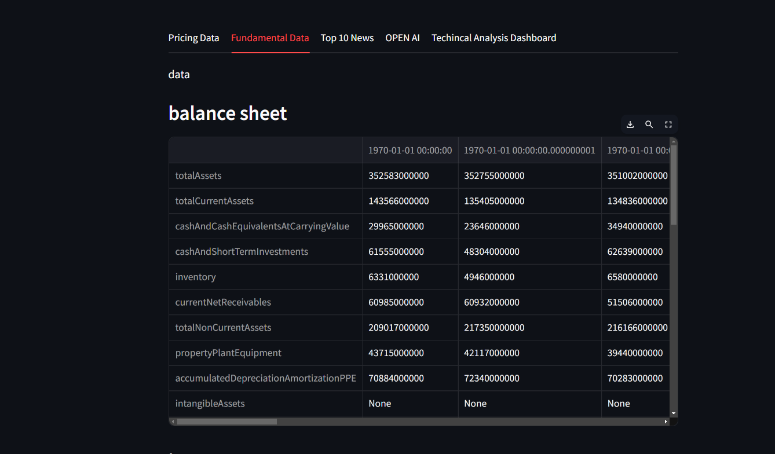
Testing /Performance Evaluation / Results

Slide 22

Screen Shots

Slide 23
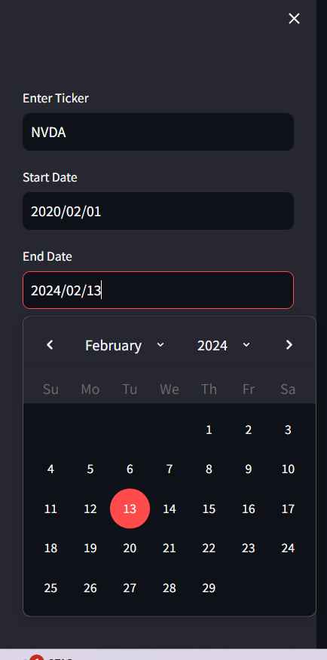
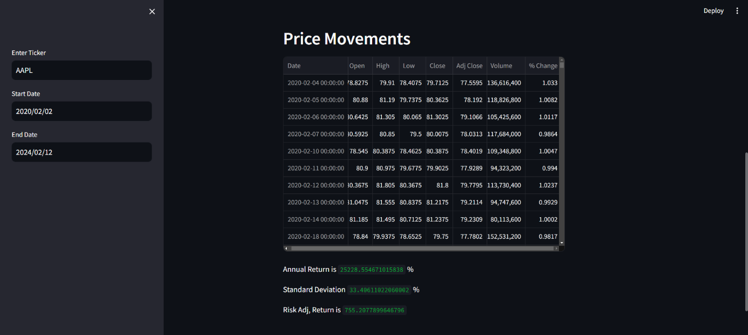
Screen Shots

Slide 24
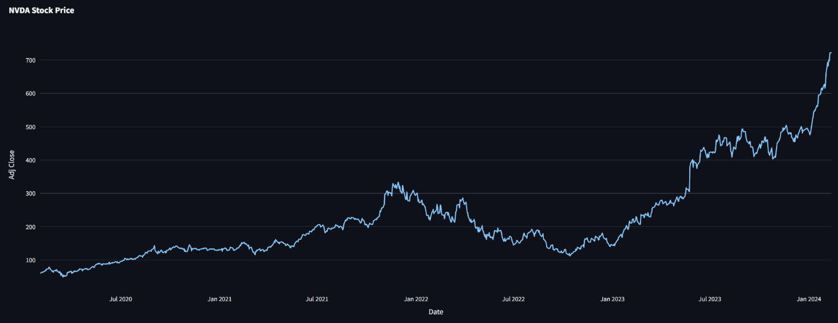
Screen Shots

Slide 25
Reference Paper/ URL
Girish Kaushal (2017) Stock Market Predication Using A Linear Regression,International Conference on Electronics, Communication and Aerospace Technology.]
Mehar Vijha (2019) Stock Closing Price Prediction using Machine Learning Techniques,International Conference on Computational Intelligence and Data Science (ICCIDS 2019).
[3]Adil MOGHARA (2020)Stock Market Prediction Using LSTM Recurrent Neural Network,International Workshop on Statistical Methods and Artificial Intelligence (IWSMAI 2020) .
[4]Polamuri Subba Roa(2020) A Survey on Stock Market Prediction Using Machine Learning Techniques , Springer Nature Singapore Pte Ltd. 2020.
[5]Ananda Chatterjee (2021) Stock Price Prediction Using Time Series, Econometric, Machine Learning, and Deep Learning Models , Journ.of Eco. Lib. vol. 3, no. 2, pp. 303 - 326, 2016.

Slide 26
Conclusion / Feature Enhancement
The empirical analyses presented in this study provide compelling evidence of the efficacy of this integrated approach in capturing the multifaceted dynamics of stock market behavior. By leveraging sophisticated algorithms and state-of-the-art technologies, the proposed framework offers investors a sophisticated toolkit for navigating the intricacies of modern financial markets with informed and strategic decision-making capabilities
Furthermore, the transformative potential of this integrated approach extends beyond the realm of academic research, with practical implications for algorithmic trading and investment strategies.

