Slide 1
HOSPITAL QUEUE INTELLIGENCE
Queue less.
Care more.
LIVE QUEUE / GENERAL MEDICINE
NOW SERVING
LIVE
GEN-005
Dr. Rohan Patil · Room 101
SQMS turns hospital waiting rooms into a live, fair, multilingual queue experience - from booking to consultation.
UP NEXT
EST. WAIT
GEN-006
12 min
General · priority 3
updates in real time
SMART QUEUE TIME MANAGEMENT SYSTEM
Project presentation / 2026
No patient login. Just a tracking code.
Track position, ETA and alerts from any phone.
REACT
EXPRESS
SOCKET.IO
SQLITE
Notes:
Open with the core promise: patients should not have to sit and guess. SQMS gives them a live token, a position, an ETA and alerts in their language, while giving staff a shared operational view.

Slide 2
THE CHALLENGE
Waiting is not the problem. Uncertainty is.
Hospitals already manage queues. The gap is information, fairness and coordination.
01
02
03
04
Waiting blind
Manual priority
Fragmented roles
No visibility
Patients do not know their position, expected wait or whether the doctor is running late.
Emergency and vulnerable patients are often prioritised verbally, without a consistent audit trail.
Reception, nursing and doctors work from separate lists, paper tokens or ad-hoc messaging.
Managers can see activity, but not trends, bottlenecks, no-shows or service performance.
Patients do not need to be first. They need to know when - and staff need one reliable queue to act on.
SQMS / Smart Queue Time Management
02
Notes:
Frame the problem around uncertainty rather than raw waiting time. Then describe the operational cost of manual priority and fragmented queues, and the management gap caused by missing analytics.

Slide 3
THE SOLUTION
One connected queue, from token to consultation.
SQMS combines patient self-service, live queue intelligence, role-based controls and operational analytics.
THE SHIFT
1
2
From a room full of
uncertainty to a
single source of truth.
Book without login
Follow live position
Same-day walk-in tokens or appointments up to 30 days ahead.
Token status, people ahead, predicted wait and estimated consultation time.
No patient account required
3
4
Priority is visible and consistent
Run the clinic
Reach every patient
Every role sees the same live state
Doctor controls, front-desk check-in, triage, pause and recall workflows.
English, Hindi and Marathi alerts through SMS, in-app and voice.
Every action is measurable
SQMS / Smart Queue Time Management
03
Notes:
Present the solution as four connected capabilities, not a list of screens. Emphasise that patient convenience and staff control are powered by the same queue state.

Slide 4
PATIENT JOURNEY
A clear path with no account and no guesswork.
A patient can take a token in under a minute, then track it from any browser.
1
2
3
4
5
Book or walk in
Get a token
Track live
Check in
Consult
Choose department, doctor, priority and language.
Receive a code such as GEN-261029-006.
See position, people ahead and a rolling ETA.
Self check-in for today's appointment, or arrive for a walk-in.
Called, started and completed through the doctor's queue.
EXAMPLE TOKEN
Position 3 · 12 min wait · Room 101
WORKS ON ANY PHONE
GEN-006
The tracking link opens directly - no app install, no patient login.
SQMS / Smart Queue Time Management
04
Notes:
Walk through the five-step patient journey. Point out that the patient does not need to create an account, and that check-in is available both through the patient link and the front desk.

Slide 5
QUEUE INTELLIGENCE
Priority that is fair. Waiting time that is explainable.
The queue is re-ordered whenever the underlying state changes - not just when a screen refreshes.
SERVICE ORDER
LIVE ETA MODEL
1
Emergency
FIRST
Position and wait
recalculated in real time.
Immediate clinical need
Senior · pregnant · differently abled
ETA = remaining time
+ patients ahead x doctor average
2
SECOND
Vulnerable-patient tier
New check-in
General
Priority change
3
THIRD
Routine and follow-up visits
Skip or recall
Pause or resume
Tie-breaker: first come, first served within the same tier.
The same model powers patient tracking and the public display.
SQMS / Smart Queue Time Management
05
Notes:
Explain the priority tiers and the FIFO tie-breaker. Then show that the ETA is not a static slot value: it is derived from the active patient's remaining time, queue length, doctor average and current pause state.

Slide 6
ROLE-BASED WORKFLOWS
Every role gets exactly the controls it needs.
Permissions are enforced in the interface, the API and the audit trail.
ADMIN
DOCTOR
NURSE
RECEPTION
Full oversight
Own clinic flow
Front desk + triage
Registration desk
Analytics & exports
Call next or specific
Check-in & booking
Book appointments
All queues & controls
Start / complete / skip
Priority updates
Check in & cancel
Staff/access management
Pause, resume, recall
Patient alerts
Search and alert
SCOPE
SCOPE
SCOPE
SCOPE
Hospital-wide
Own patients
Department
Department
One live queue state · consistent permissions · auditable actions
SQMS / Smart Queue Time Management
06
Notes:
Describe each role at the level of outcomes, not every button. Stress that permissions are enforced server-side, so hiding a UI control is not the only safeguard.

Slide 7
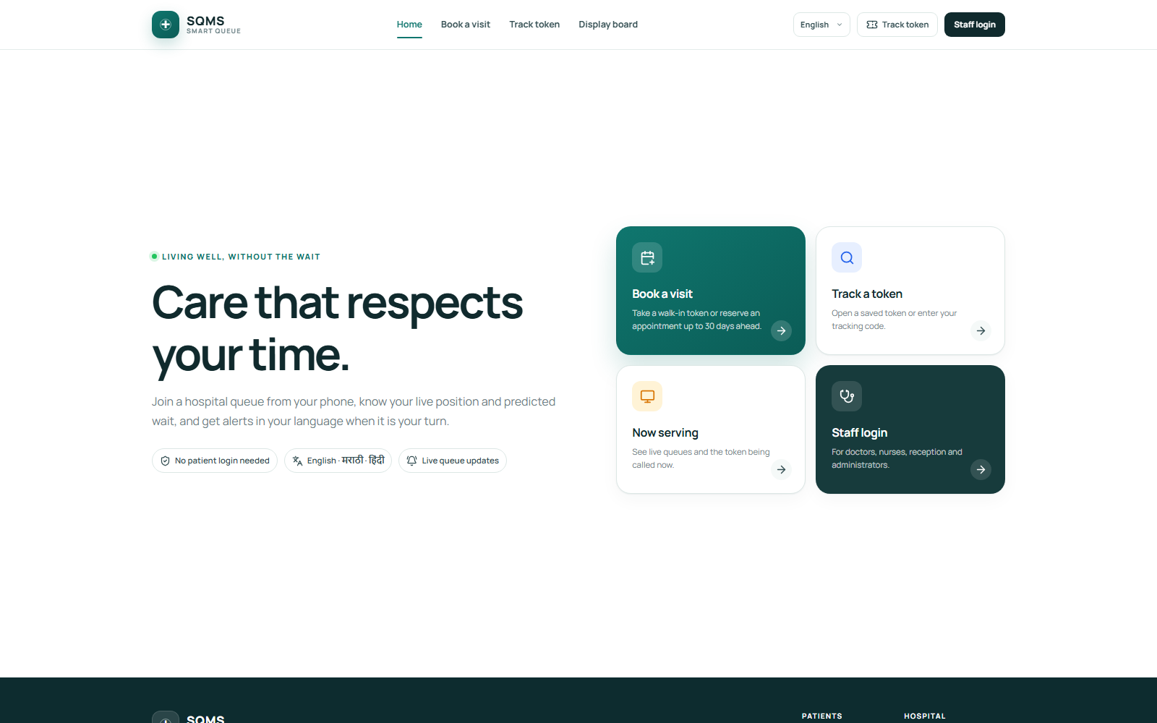
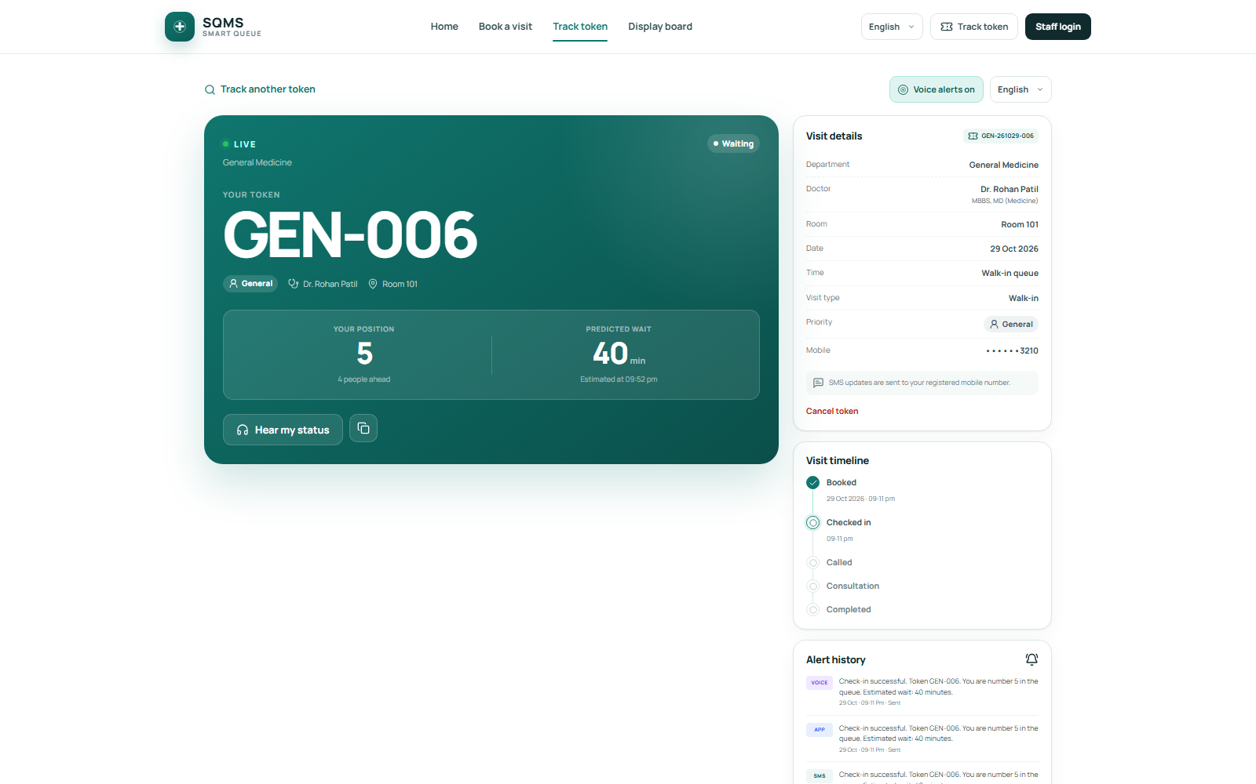
PATIENT EXPERIENCE
Book in seconds. Track without an account.
A responsive public portal makes the queue visible before the patient enters the hospital.
sqms.health / patient portal
sqms.health / track / GEN-...
Booking without friction
Confidence while waiting
Department, doctor, date, priority and language in one guided flow.
Live token, people ahead, ETA, room, timeline and notification history.
SQMS / Smart Queue Time Management
07
Notes:
This slide is a visual proof point. Point to the no-login booking form and the token tracking screen. Mention that the same tracking link is included in notifications.

Slide 8
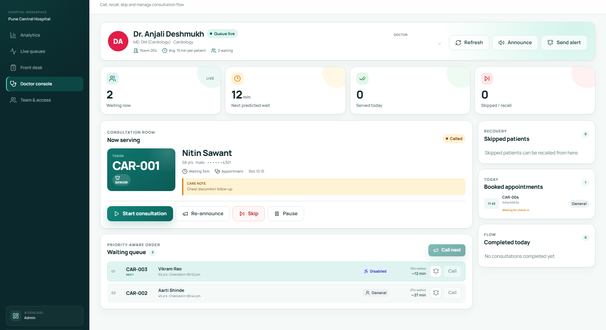
DOCTOR WORKSPACE
The entire clinic flow on one screen.
Current patient, waiting queue, booked patients and served history update live.
sqms.health / staff / queue
DOCTOR CONTROLS
Act on the queue
without leaving
the patient context.
Call next
Auto-selects the highest-priority waiting patient.
Call specific
Bring a particular token forward.
Start / complete
Maintain accurate consultation timing.
Skip / recall
Handle no-shows without losing the ticket.
Pause / resume
Communicate delays to everyone waiting.
SQMS / Smart Queue Time Management
08
Notes:
Highlight the current-patient panel and the recalculated queue beneath it. The important point is that every action feeds alerts, analytics and ETA calculations.

Slide 9
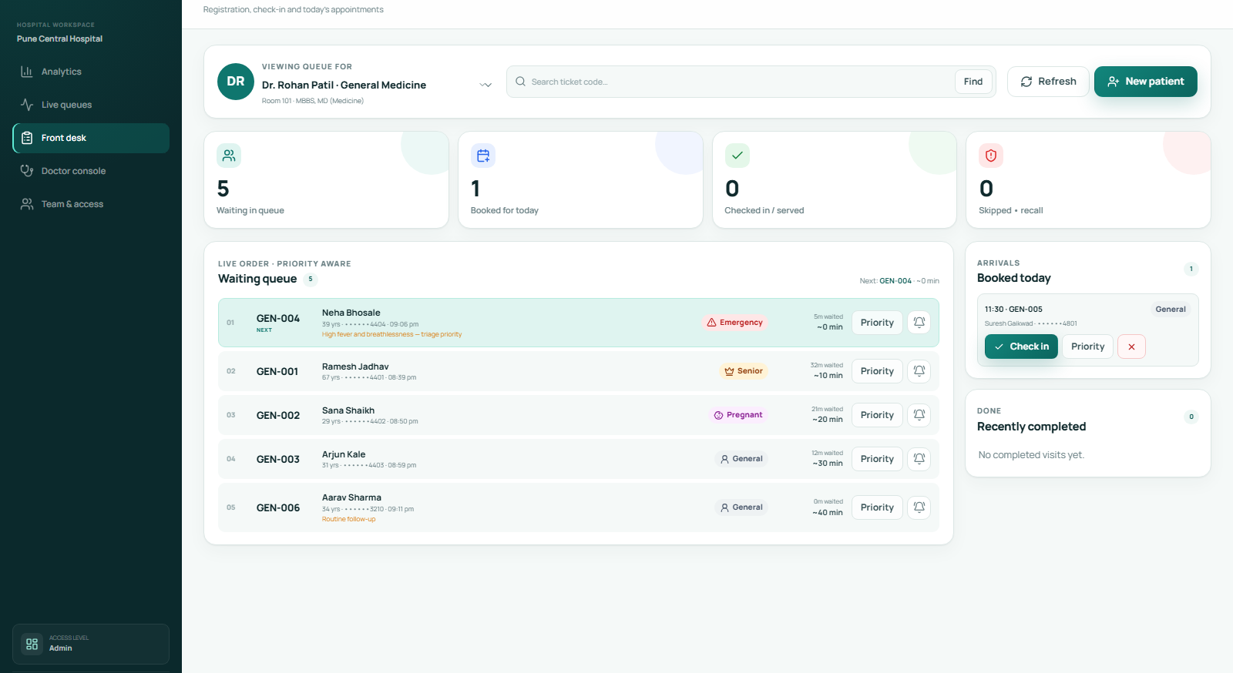
FRONT DESK
Registration, check-in and triage without lost tickets.
Reception and nursing share one operational view, with permissions that match their responsibilities.
sqms.health / staff / frontdesk
ONE SEARCH
Find any patient by ticket code.
Check in, update priority, send an alert or cancel - from the same result.
DESK CONTROLS
Create walk-in or appointment tickets
Self check-in support for patients
Triage priority with audit history
Cancel bookings and send notices
SQMS / Smart Queue Time Management
09
Notes:
Explain how the front desk closes the loop between booking and consultation. Search by ticket code is a key operational shortcut during busy periods.

Slide 10
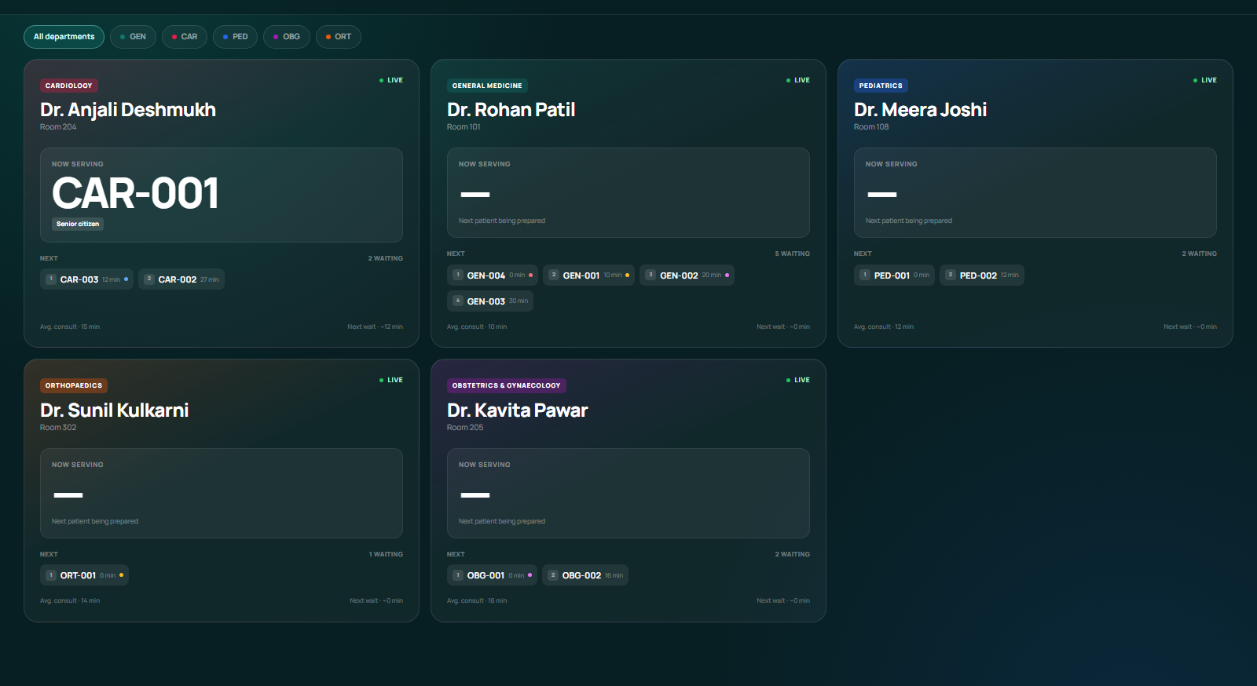
PUBLIC DISPLAY
A waiting room that can see what is happening.
A full-screen, multilingual board keeps patients informed and reduces repeated desk queries.
sqms.health / display
MULTILINGUAL BY DESIGN
One queue.
Three languages.
ENGLISH
English
MARATHI
मराठी
HINDI
हिन्दी
Auto-refresh + live socket updates keep the board current.
SQMS / Smart Queue Time Management
10
Notes:
The display board is not just a TV screen: it is a shared communication surface. It refreshes periodically and also listens for live queue changes.

Slide 11
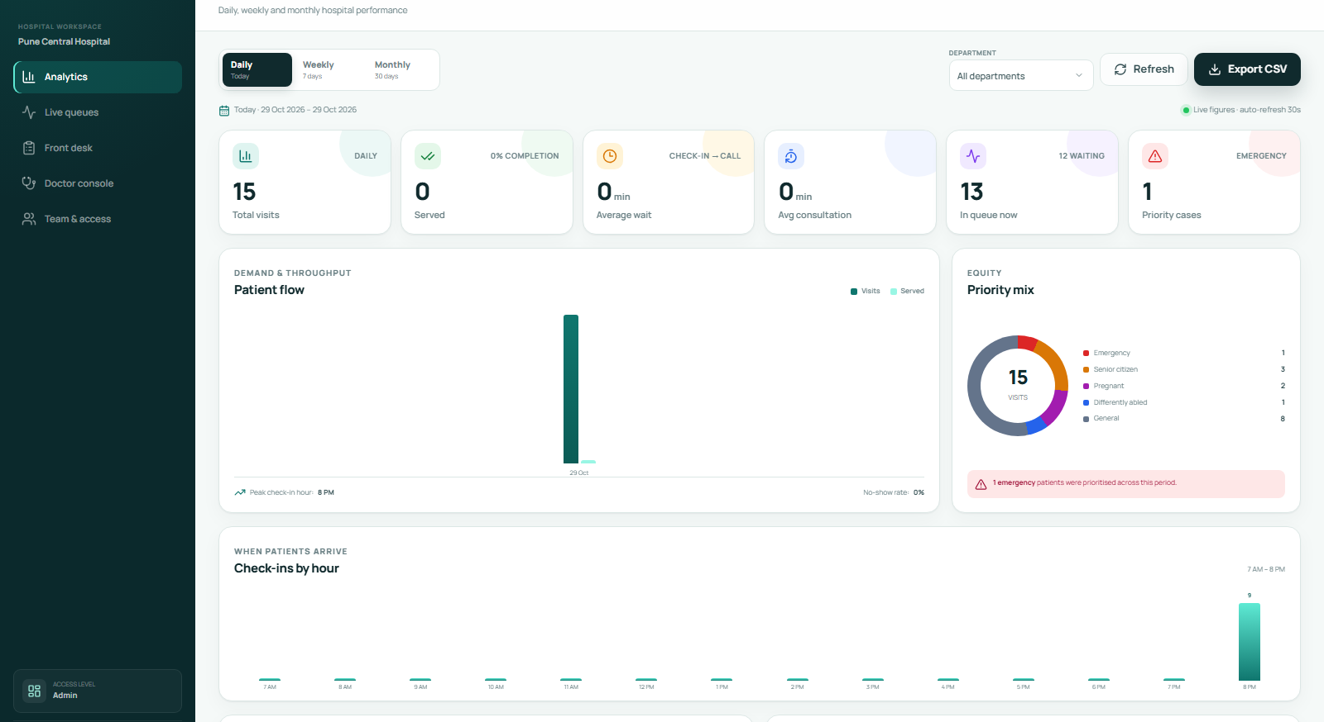
ANALYTICS
Turn daily operations into decisions.
Daily, weekly and monthly views expose demand, service performance and bottlenecks.
sqms.health / staff / analytics
Daily
Today's flow, peak hours and priority mix
Weekly
Seven-day demand and service trend
Monthly
Department and doctor performance
ALSO INCLUDED
Department filters · CSV export
Audit log · notification outbox
SQMS / Smart Queue Time Management
11
Notes:
Show how the analytics surface moves from a daily operational check to a weekly and monthly management review. Mention CSV export for reporting and the notification outbox for communication audits.

Slide 12
COMMUNICATION
Alerts that reach people in their language.
Templates are generated from the same live queue state and delivered through multiple channels.
ENGLISH
MARATHI
HINDI
Turn alert
Turn alert
Turn alert
1
1
1
Token GEN-006, please proceed to Room 101.
टोकन GEN-006, कृपया खोली 101 मध्ये या.
टोकन GEN-006, कृपया कमरा 101 में आएं.
DELIVERY CHANNELS
SMS
IN-APP
VOICE
Twilio when configured; simulated and logged otherwise.
Persistent notification history inside the tracking page.
Browser speech synthesis for waiting-room and device alerts.
Templates: booked · checked in · your turn · delay · skipped · resumed · cancelled
SQMS / Smart Queue Time Management
12
Notes:
Describe language as part of access, not decoration. The same event produces an English, Marathi or Hindi message, and the delivery layer can use SMS, in-app and voice channels.

Slide 13
ARCHITECTURE
A compact stack built for live state.
React handles the experience. Express owns the rules. Socket.IO keeps every screen in sync.
REACT SPA
EXPRESS API
SQLITE
Patient portal
Display board
Staff workspaces
Auth + roles
Queue rules
Analytics + alerts
Appointments
Doctors + state
Audit + notifications
Socket.IO / REST / JWT
LIVE SYNC
queue:changed · board:changed · alert:voice
DELIVERY
SMS via Twilio · In-app outbox · Speech synthesis
TRUST
bcrypt passwords · Role guards · Audit log
SQMS / Smart Queue Time Management
13
Notes:
Keep the architecture explanation compact. The key design choice is that all queue rules live in the API, while React and the display board are clients of the same state.

Slide 14
TRUST & QUALITY
Small stack, serious safeguards.
The demo is not just visually complete: authentication, authorization, data integrity and runtime flows were validated.
JWT SESSIONS
ROLE ENFORCEMENT
VALIDATED DELIVERY
Signed tokens with role and doctor scope; expired sessions are rejected.
The same guards protect routes, queue actions and analytics endpoints.
Ready to demo.
29/29
21/21
0
AUDIT TRAIL
DATA INTEGRITY
API checks
Browser checks
Audit vulnerabilities
Booking, priority, call, skip, pause, alert and staff actions are recorded.
Foreign keys, WAL mode, transaction-safe state changes and validations.
Build passes, production server serves the SPA, and public + staff flows were exercised in headless Chrome.
Deployment note: replace demo credentials, set a strong JWT secret, use HTTPS and configure Twilio for real SMS delivery.
SQMS / Smart Queue Time Management
14
Notes:
Use this slide to build confidence in the implementation. Mention that the automated checks were run against the real API and the built UI, not just a static mockup.

Slide 15
RUN THE DEMO
One command to start. Four roles to explore.
The database resets to a clean, seeded demo with live queues and 45 days of history.
TERMINAL
PUBLIC URLS
$ npm install
$ npm run dev
Patient portal
/
Web http://localhost:5173
API http://localhost:4000
Token tracking
/track/:code
PRODUCTION
$ npm run build && npm start
Display board
/display
Reset demo data
npm run reset-db --workspace=@sqms/api
Staff login
/staff/login
DEMO ACCOUNTS
SOURCE
Admin
admin@sqms.health
admin123
Doctor
cardio@sqms.health
doctor123
github.com/202501110031-cmd/sqms
Nurse
nurse@sqms.health
nurse123
Reception
reception@sqms.health
reception123
SQMS / Smart Queue Time Management
15
Notes:
Use this slide as the handoff. The audience can start the app, sign in with different roles and reset the database without manual setup.

Slide 16
WHAT'S NEXT
A platform, not just a queue.
SQMS IN ONE LINE
A live, fair and multilingual queue that gives patients certainty and gives staff control.
NOW
Live queue, booking, alerts, analytics and role controls
NEXT
Postgres/cloud deployment, reminders, kiosk mode and multi-hospital tenancy
LATER
ML-based wait prediction, EHR integration and patient feedback loops
Patient portal · staff workflows
analytics · alerts
Better queues. Better care.
Thank you / Questions
SQMS / Smart Queue Time Management
16
Notes:
Close with the product vision: SQMS starts with queue transparency, then becomes an operational platform. Invite questions and offer the demo URL.

