Slide 1


WSSOA (IT644) Project Presentation I · Autumn 2026
Dhirubhai Ambani University, Gandhinagar
SHE SHIELD
Cyber-Integrated Safety Platform for Women
A Proactive, Multi-Modal Emergency Dispatch and Cryptographic Forensic Ecosystem
Sr. No. | Team Member | Specific Engineering Role
1 | Krisha Doshi | Mobile UI Engineering (Flutter / Material 3)
2 | Priya Shah | Navigation & User Flow (Routing & State)
3 | Jainam Shah | Backend APIs (Flask REST Microservices)
4 | Maahir Shah | Database (PostgreSQL / Redis / Firestore)
5 | Hitarth Shah | AI Threat Models (PyTorch & NLP Classifier)
6 | Jay Shah | DevOps & Integration (Docker, CI/CD & Gateways)
7 | Nirmal Patel | Auth / RBAC (JWT & Role Permissions)
8 | Jenil Shah | Cybersecurity (SHA-256 Vault & AES Encryption)

Slide 2
PROBLEM DEFINITION & MARKET GAPS
Critical Limitations in Existing Personal Safety Solutions
1. Single-Vector Focus (Physical vs Cyber)
• Current safety apps only handle physical panic buttons and completely ignore cyber harassment.
• Digital stalking, image morphing, doxxing, sextortion, and extortion affect millions of women daily.
• Zero integration exists between physical transit monitors and cyber incident reporting desks.
2. Acute Stress & Panic Latency
• Victims under acute physical or psychological stress cannot unlock phones or navigate complex apps.
• Requiring a user to illuminate a screen, input PIN/biometrics, and dial numbers alerts assailants.
• Lack of stealth triggers (BLE pendants, secret voice phrases, tactile hardware buttons) causes fatal delays.
3. Digital Evidence Destruction
• Digital evidence (threats, blackmail, stalking chats) is easily deleted before police reporting.
• Attackers force victims to wipe devices or utilize disappearing message features on social platforms.
• Smartphone screenshots lack cryptographic timestamps, metadata, and hash proofs for Section 65B compliance.
Market Gap Summary : Modern safety necessitates a unified platform bridging immediate physical stealth triggers, proactive transit geofencing, and forensically sound cyber evidence preservation.

Slide 3
PROPOSED SOLUTION — THE SHE SHIELD ECOSYSTEM
Tri-Pillar Cyber-Physical Protection Architecture
Pillar 1: Physical Emergency SOS + Real-Time Transit Tracking
• Multi-modal stealth triggers: Bluetooth LE wearable panic pendant, secret phrase ('capcap'), power/volume click.
• Sub-2-second emergency dispatch broadcasting GPS breadcrumbs to guardians & police consoles simultaneously.
• 'Cab Guardian' & 'Walk Guardian' modules actively monitoring route deviations (>30m offset) and nocturnal hotspots.
Pillar 2: AI-Powered Cybercrime Desk with OCR Screenshot Scanning
• Built-in OCR ingestion pipeline parsing screenshots of blackmail, extortion, doxxing, and cyber harassment chats.
• PyTorch NLP threat model evaluating harassment severity and classifying incident danger (e.g. 92% Critical Risk).
• Automated generation of standardized police complaint dossiers with extracted timestamps, sender handles, and evidence URLs.
Pillar 3: Tamper-Proof Cryptographic Evidence Vault
• Continuous background blackbox audio/video recording initiated upon travel or emergency trigger.
• Client-side SHA-256 cryptographic hashing executed prior to cloud upload, creating an immutable custody ledger.
• AES-256-GCM encryption at rest and in transit, establishing legally incontrovertible proof for judicial court admissibility.
Ecosystem Outcome : Unifies personal physical transit security with digital cyber defense into a single, high-availability mobile and cloud architecture.

Slide 4
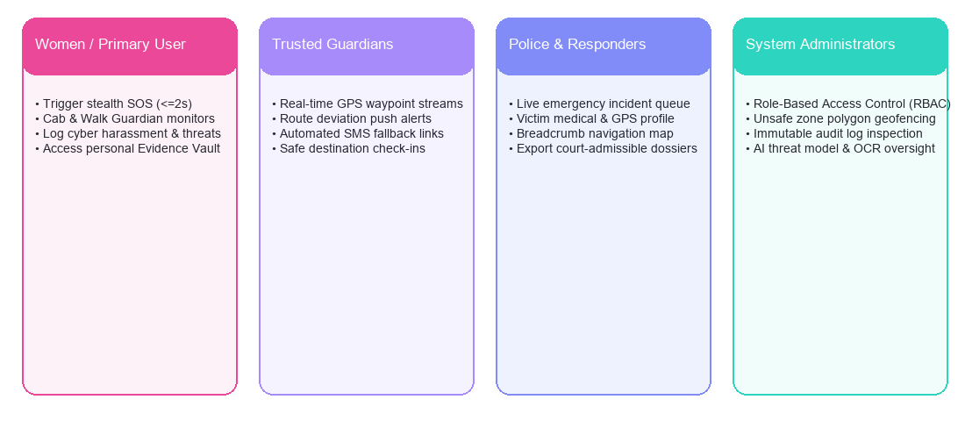
STAKEHOLDERS & USER ROLES (RBAC)
Role-Based Access Control and Persona Matrix
Role Persona | Primary System Privileges | Security & Access Scope
Women / Primary User | Stealth SOS dispatch, Cab & Walk Guardian, Cybercrime reporting, Personal Vault access. | Full read/write of own telemetry, contacts, and personal cryptographic evidence.
Trusted Guardians | Receive real-time waypoint streams, route deviation push alerts, automated SMS links. | Scoped read-only access to linked user's active SOS sessions and live transit breadcrumbs.
Police / Emergency Responders | View live emergency case map, prioritize incidents, inspect victim profile & court dossier. | Authorized access to active emergency distress sessions within geographic jurisdiction.
System Administrators | Manage RBAC roles, audit log viewer, unsafe zone polygons, AI threat model parameters. | Administrative system control, platform compliance, security monitoring, and server health.

Slide 5
CORE FUNCTIONAL REQUIREMENTS (BRD / SRS)
Engineered Capabilities for Life-Safety Operations
Requirement ID | Functional Feature | Engineering Specification | Verification Criteria
FR-01 | Instant SOS Dispatch | Emergency signal processing from trigger to server acknowledgment in <= 2 seconds. | Sub-2s benchmark under 4G/LTE & BLE relay triggers.
FR-02 | Live GPS Waypoint Streams | Continuous waypoint capture at 3–5s intervals with speed, heading, and Kalman smoothing. | Live breadcrumbs rendered on guardian/responder maps without lag.
FR-03 | Route Deviation Alerts | Heuristic Haversine algorithm flagging transit offsets >30m from planned route vector. | Automated alert push to guardians when cab veers off polyline path.
FR-04 | Cyber Incident Logging | Tesseract/EasyOCR parsing of screenshots and NLP threat severity score calculation. | Accurate text extraction and risk score assignment in <3 seconds.
FR-05 | Automated Evidence Hashing | Client-side SHA-256 fingerprinting stamped on all video/audio assets prior to upload. | Cryptographic hash match verification between client and vault record.

Slide 6
NON-FUNCTIONAL REQUIREMENTS & SECURITY MANDATES
Reliability, Privacy, Fault-Tolerance & Integrity Standards
NFR-01: High Availability (99.9% Uptime SLA)
• Critical emergency endpoints hosted on auto-scaling WSGI workers with Redis queueing.
• Zero single-point-of-failure: Health check monitoring with automatic pod failovers.
• Rapid recovery objective (RTO < 30s) ensuring continuous 24/7 emergency dispatch availability.
NFR-02: Location Privacy & Data Minimization
• Strict adherence to DPDP Act (India) & GDPR guidelines governing sensitive personal telemetry.
• Automated 30-day scheduled purging of regular transit breadcrumbs for non-emergency sessions.
• Geolocation coordinates encrypted in transit (TLS 1.3) and restricted strictly to linked guardians.
NFR-03: Offline SMS Fallback Queue
• Automatic detection of cellular data packet loss or server unreachability on client devices.
• Local SQLite coordinate queueing paired with automated SMS fallback gateway dispatch.
• Direct SMS contains timestamp, device battery health, and live Google Maps coordinate hyperlink.
NFR-04: SHA-256 Evidence Integrity
• Tamper-proof digital fingerprinting guaranteeing legal admissibility under Section 65B of Evidence Act.
• Media digests calculated locally prior to transmission; any bit modification invalidates integrity.
• Immutable database audit trail logging asset hash, file size, timestamp, and uploading UID.
Security Mandate : Security by design enforces zero-trust token authentication, ephemeral location retention, and immutable evidence notarization.

Slide 7
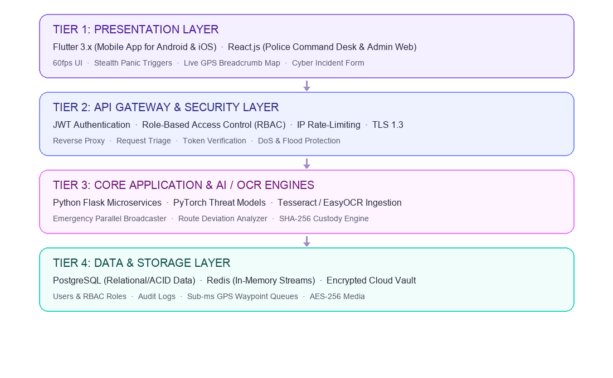
HIGH-LEVEL SYSTEM ARCHITECTURE (4-TIER DESIGN)
Decoupled Service-Oriented Framework for Scalable Emergency Operations
Tier 1: Presentation Layer
Flutter cross-platform client for Android/iOS with 60fps UI, stealth triggers, and sensors, coupled with React.js police command desk.
Tier 2: API Gateway & Security
JWT authentication filter, RBAC role-enforcement, IP rate limiting, TLS 1.3 encryption, and reverse-proxy routing.
Tier 3: Core Application & AI/OCR
Python Flask microservices handling parallel SOS dispatch, Haversine route deviation, PyTorch NLP threat classifier, and OCR screenshot pipeline.
Tier 4: Data & Storage Layer
PostgreSQL for ACID relational records (users, RBAC, complaints, audit logs), Redis for sub-ms GPS telemetry streams, and AES-256 cloud media vault.

Slide 8
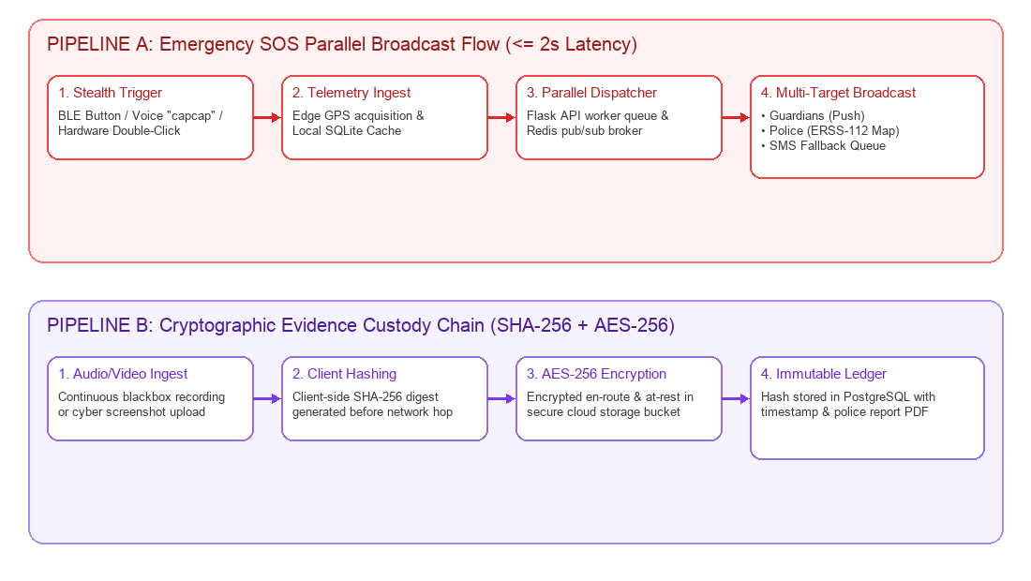
ARCHITECTURAL DIAGRAMS & DATA PIPELINES
Emergency Parallel Broadcast & Cryptographic Evidence Custody Chain

Slide 9
TECHNOLOGY STACK JUSTIFICATION
Engineering Rationale for Architectural Choices
Technology Component | Category | Selected Technology | Engineering Justification in SheShield
Mobile Client | Presentation | Flutter (Dart 3.x) | Native 60fps performance on Android & iOS, unified single codebase, low-latency BLE sensor access.
Command Portal | Presentation | React.js + Tailwind | High-density responsive web console for emergency police dispatchers with real-time WebSocket state.
Backend Services | Application APIs | Python Flask Microservices | Lightweight WSGI services, native integration with PyTorch/OpenCV AI models, asynchronous worker queues.
Relational Storage | Database | PostgreSQL | Strict ACID compliance, relational integrity for RBAC roles, audit trails, and structured police complaints.
In-Memory Telemetry | Cache & Streams | Redis Pub/Sub | Sub-millisecond latency for live GPS waypoint broadcasting, temporary session caching, and rate limiting.

Slide 10
SECURITY ARCHITECTURE & CRYPTOGRAPHIC INTEGRITY
Multi-Layered Cyber Defense and Chain-of-Custody Assurance
1. Role-Based Access Control (RBAC) via JWT
• Cryptographically signed JSON Web Tokens (JWT) enforcing granular endpoint permissions.
• Strict role boundaries: Primary Users cannot modify admin zones; Guardians cannot view unlinked telemetry.
• Short-lived access tokens (15 mins) paired with secure refresh tokens to prevent credential hijacking.
2. AES-256-GCM Vault Encryption
• Authenticated AES-256 Galois/Counter Mode (GCM) encrypting all vaulted audio, video, and screenshot assets.
• Unique cryptographic initialization vectors (IVs) generated per asset to prevent replay and leakage attacks.
• Decryption keys restricted strictly to authorized forensic responders and subpoena-validated officials.
3. IP-Level & Token-Level Rate Limiting
• Sliding-window rate limiters protecting emergency dispatch endpoints against Distributed Denial of Service (DDoS).
• Redis-backed request tracking throttling unauthorized endpoint flooding while prioritizing active SOS signals.
• Enforces IP reputation filtering and brute-force mitigation on authentication endpoints.
4. Cryptographic Hash Admissibility (Sec 65B)
• SHA-256 digital fingerprint calculated client-side before media bytes leave user hardware.
• Hash recorded in immutable ledger alongside UTC timestamp and device ID; bit-for-bit court proof.
• Eliminates forensic defense challenges regarding evidence tampering in criminal proceedings.
Cryptographic Assurance : SheShield delivers military-grade confidentiality, tamper-evident forensic validity, and zero-trust authorization.

Slide 11
CURRENT IMPLEMENTATION PROGRESS (WEEKS 1–11)
Sprint Deliverables and GitHub Repository Status
Sprint Milestone | Delivered Features & Modules | Repository Artifacts (GitHub) | Current Status
Milestone 1: Foundations | System architecture, UI wireframes, theme setup, Provider state framework. | lib/main.dart, lib/theme/app_theme.dart | 100% Completed
Milestone 2: Auth & RBAC | User, Guardian, Responder, Admin registration and role-based route guard. | lib/screens/auth_screens.dart, police_admin_screens.dart | 100% Completed
Milestone 3: SOS Center | Multi-modal trigger engine, 5s cancellable timer, volume button trigger, BLE sync. | lib/screens/sos_screens.dart, lib/services/sos_service.dart | 100% Completed
Milestone 4: Travel Monitor | Cab Guardian & Walk Guardian with 30m route offset deviation calculation. | lib/screens/travel_monitor_screen.dart, database_service.dart | 100% Completed
Milestone 5: Cybercrime Desk | Cyber complaint intake, OCR screenshot scan, PyTorch threat score, PDF export. | lib/screens/cyber_screens.dart, pdf_report_service.dart | 100% Completed
Milestone 6: Command Hub | Admin Command Center, Responder live radar, and Evidence Locker vault. | lib/screens/admin_command_center_screen.dart, vault_screens.dart | 100% Completed

Slide 12
NEXT STEPS (WEEKS 12–16) & CONCLUSION
Project Roadmap, Engineering Milestones & Q&A Floor
Weeks 12–13: End-to-End Integration
• Full integration testing between Flutter mobile client, Flask microservices, and React admin desk.
• WebSocket live synchronization hardening across simulated multi-node responder environments.
• Edge-case verification for offline network reconnects and SQLite synchronization queues.
Week 14: GPS Geofencing Benchmarks
• Field trials evaluating Haversine route deviation accuracy across dense urban corridors.
• Kalman filter calibration to eliminate multipath GPS jitter around high-rise infrastructure.
• Latency benchmarking for automated deviation alerts dispatched to guardian devices.
Week 15: High-Concurrency Load Testing
• Locust and JMeter load testing simulating 5,000+ simultaneous emergency SOS trigger bursts.
• Security penetration testing, API vulnerability scanning, and token lifecycle audits.
• Performance optimization of PostgreSQL query indices and Redis pub/sub memory allocation.
Week 16: Release & Viva Evaluation
• Production Docker containerization, staging deployment, and signed APK release.
• Community pilot testing with feedback collection and final documentation synthesis.
• Project Viva Voce defense for IT644 (WSSOA) Autumn 2026 evaluation.
THANK YOU · QUESTIONS & ANSWERS
SHE SHIELD — Cyber-Integrated Safety Platform for Women | Dhirubhai Ambani University, Gandhinagar

