Slide 1
WSSOA (IT644) · PROJECT PRESENTATION I · AUTUMN 2026
SHE SHIELD
Design Document & Architecture Presentation
Cyber-Integrated Safety Platform for Women · Dhirubhai Ambani University
Sr. No. | Team Member | Student ID | Specific Project Engineering Role
1 | Jainam Shah | 202512012 | Backend APIs (Flask REST Services, Dispatches & Hooks)
2 | Maahir Shah | 202512022 | Database Architecture (PostgreSQL Schema & Redis Streaming)
3 | Hitarth Shah | 202512042 | AI Threat Models (PyTorch NLP Classifier & Risk Scoring)
4 | Jay Shah | 202512059 | DevOps & Integration (Docker, CI/CD & Gateway Telemetry)
5 | Nirmal Patel | 202512102 | Authentication & RBAC (JWT Security & Access Control)
6 | Priya Shah | 202512105 | Navigation & User Flow (Routing, State & Mobile UI Experience)
7 | Jenil Shah | 202512110 | Cybersecurity (Evidence Vault, SHA-256 Hashing & Encryption)
8 | Krisha Doshi | 202512112 | Mobile UI Engineering (Flutter, Material 3 & Responsive Screens)

Slide 2
2. PROBLEM ANALYSIS
Problem Definition & Market Gaps
Gap 1: Single-Vector Focus (Physical vs Cyber)
• Current apps only offer physical panic buttons.
• Completely ignore online blackmail, doxxing & cyberstalking.
• Zero unified link between physical transit & cyber defense.
Gap 2: Acute Stress & Panic Latency
• Victims under attack cannot unlock phones or tap menus.
• Illuminating a screen or speaking aloud alerts assailants.
• Lack of stealth hardware & offline secret voice triggers.
Gap 3: Digital Evidence Destruction
• Abusers delete chats or use disappearing message features.
• Screenshots lack cryptographic metadata & timestamps.
• Evidence is rejected in court under Section 65B requirements.
Key Takeaway: Women need a proactive platform integrating instant stealth triggers with tamper-proof evidence preservation.

Slide 3
3. SOLUTION ARCHITECTURE
Proposed Solution — The SHE SHIELD Ecosystem
Pillar 1: Physical SOS & Transit Tracking
• Stealth Triggers: BLE pendant, voice 'capcap', power clicks.
• Sub-2s dispatch broadcasting GPS to Guardians & Police 112.
• Cab Guardian: Real-time route deviation alerts (>30m offset).
Pillar 2: AI Cybercrime & OCR Ingestion
• Screenshot Scanning: OCR extracts text, handles & timestamps.
• AI Threat Model: PyTorch NLP evaluates danger severity (92%).
• Auto-Police Dossier: Generates structured complaint reports.
Pillar 3: Cryptographic Evidence Vault
• Blackbox Capture: Continuous audio/video during active trips.
• Client SHA-256 Digest: Hashed locally before leaving device.
• AES-256 Encryption: Legally tamper-proof for court admissibility.
Core Flow: Stealth Trigger → Instant Multi-Target Alert → Continuous Route Tracking → Forensic Evidence Notarization

Slide 4
4. ACCESS CONTROL & PERSONAS
Stakeholders & User Roles (RBAC)
1. Women / Primary User
• Trigger stealth SOS (<= 2s).
• Activate Cab & Walk Guardian.
• Report cyber harassment & chats.
• Access personal Evidence Vault.
2. Trusted Guardians
• Receive live GPS waypoint stream.
• Instant route deviation push alerts.
• Automated offline SMS fallback links.
• Confirm safe trip arrivals.
3. Police & Responders
• Live emergency incident radar map.
• Prioritized dispatch queue & triage.
• Access victim profile & GPS history.
• Download court-admissible dossiers.
4. System Administrators
• Manage RBAC role permissions.
• Configure unsafe zone polygons.
• Inspect immutable audit logs.
• Oversee AI models & server health.
RBAC Security: Strict separation of privileges enforced via cryptographically signed JWT tokens on every API request.

Slide 5
5. REQUIREMENTS SPECIFICATION
Core Functional Requirements (BRD / SRS)
Req ID | Core Function | Engineering Target & Logic | Verification Criteria
FR-01 | Instant SOS Dispatch | Emergency signal latency <= 2 seconds from trigger to server ack. | Sub-2s benchmark under LTE & BLE triggers
FR-02 | Live GPS Stream | Waypoint stream every 3–5 seconds with Kalman filtering. | Smooth breadcrumb path on responder map
FR-03 | Route Deviation Alerts | Haversine offset detection flagging route detours >30 meters. | Auto-notification to guardians upon detour
FR-04 | Cyber Incident Logging | OCR text parsing from screenshots + NLP threat risk scoring. | Extracted text & score generated in <3s
FR-05 | Evidence Hashing | Client-side SHA-256 fingerprinting before file upload. | Hash match check ensures zero file tampering

Slide 6
6. QUALITY & SECURITY STANDARDS
Non-Functional Requirements & Security Mandates
1. High Availability (99.9% Uptime)
• Zero single-point-of-failure for emergency dispatch.
• Auto-scaling WSGI workers & Redis pub/sub queue.
• Health check monitoring with sub-30s pod recovery.
2. Location Privacy & Minimization
• Strict adherence to DPDP Act (India) & GDPR principles.
• Automated 30-day scheduled purging of transit logs.
• End-to-end TLS 1.3 transit encryption for all telemetry.
3. Offline SMS Fallback Queue
• Client detects cellular data loss automatically.
• Local SQLite queue caches GPS coordinates.
• Auto-dispatches SMS with live Google Maps link.
4. SHA-256 Evidence Integrity
• Client-side hashing proves media was never altered.
• Guarantees legal admissibility under Evidence Act Sec 65B.
• Immutable audit log records hash, size & timestamp.

Slide 7
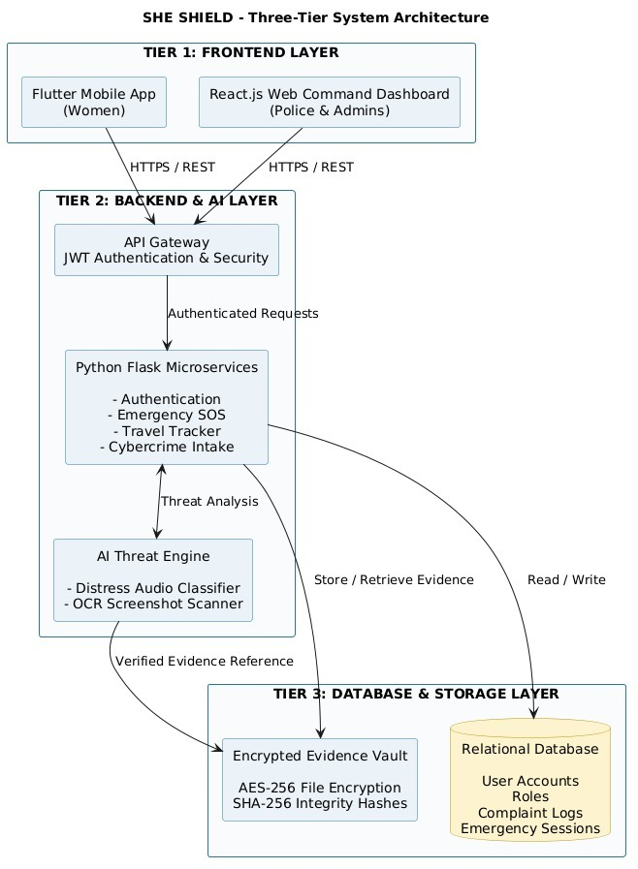
DESIGN COMPONENTS : THREE-TIER SYSTEM ARCHITECTURE
Design Components
Tier 1: Frontend Layer (Mobile & Web)
• Flutter Mobile App (Women): 60fps UI, stealth triggers, background sensors.
• React.js Web Command Dashboard: High-density radar for Police & Admins.
• Protocol: Secure HTTPS / RESTful communication.
Tier 2: Backend & AI Layer (Microservices & Threat Engine)
• API Gateway: Centralized JWT Authentication, RBAC & Request Routing.
• Python Flask Microservices: Authentication, Emergency SOS, Travel Tracker, Cybercrime Intake.
• AI Threat Engine: Real-time Distress Audio Classifier & OCR Screenshot Scanner.
Tier 3: Database & Storage Layer (ACID & Cryptographic Vault)
• Relational Database: Stores User Accounts, Roles, Complaint Logs & Emergency Sessions.
• Encrypted Evidence Vault: AES-256 File Encryption & SHA-256 Integrity Hashes.

Slide 8
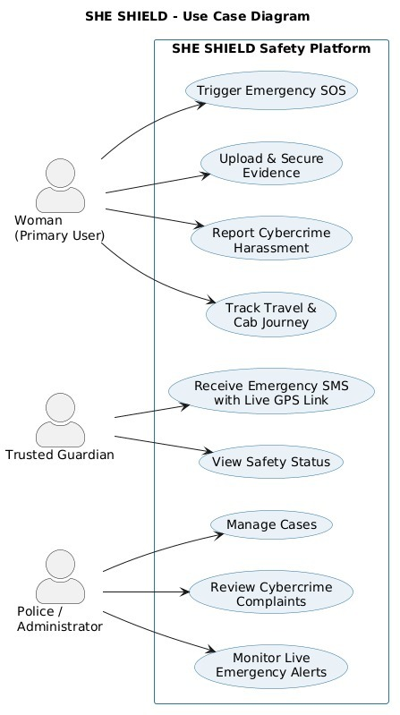
DESIGN COMPONENTS : USE CASE MODEL & SYSTEM BOUNDARY
Design Components
Actor 1: Woman (Primary User)
• Trigger Emergency SOS: Initiates instant distress broadcast via stealth or button.
• Upload & Secure Evidence: Stores incident files in AES-256 Cryptographic Vault.
• Report Cybercrime Harassment: Submits screenshots and chat logs for AI evaluation.
• Track Travel & Cab Journey: Real-time route deviation & safe arrival monitoring.
Actor 2: Trusted Guardian
• Receive Emergency SMS with Live GPS Link: Immediate offline/cellular coordinate alert.
• View Safety Status: Live breadcrumb tracking during active transit trips.
Actor 3: Police / Administrator
• Manage Cases: Coordinate emergency dispatches and assign response units.
• Review Cybercrime Complaints: Access AI threat-scored dossiers and parsed OCR evidence.
• Monitor Live Emergency Alerts: Real-time geographic radar of active SOS sessions.

Slide 9
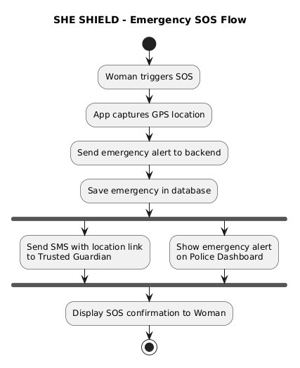
DESIGN COMPONENTS : EMERGENCY SOS EXECUTION FLOW
Design Components
Phase 1: Distress Trigger & Telemetry Acquisition
• Woman triggers SOS via physical button, BLE pendant, or voice phrase.
• Mobile app immediately captures high-precision GPS coordinates & device state.
Phase 2: Backend Ingestion & Persistent Storage
• App sends emergency payload to Flask API gateway via secure REST endpoint.
• Emergency record is instantly committed to PostgreSQL database with UTC timestamp.
Phase 3: Parallel Broadcast (Fork Execution)
• Branch A (Guardians): Automated SMS dispatched with live Google Maps coordinate link.
• Branch B (Police): Real-time emergency alert pushed onto Police Command Dashboard radar.
Phase 4: Confirmation & Safe Resolution (Join)
• System renders visual SOS confirmation & haptic feedback to user.
• Live location tracking loop continues until the emergency session is safely resolved.

Slide 10
9. ENGINEERING STACK RATIONALE
Technology Stack Justification
Technology | Layer | Selection | Why It Was Chosen for SHE SHIELD
Mobile Client | Presentation | Flutter 3.x (Dart) | Single codebase for Android/iOS, 60fps UI, low-latency BLE sensor bindings.
Command Portal | Presentation | React.js + Tailwind | High-density real-time radar for police dispatchers with WebSocket updates.
Backend Services | Application APIs | Python (Flask) | Lightweight WSGI routing, native PyTorch/OpenCV AI integration, fast boot time.
Relational Store | Database | PostgreSQL | Strict ACID compliance for user accounts, RBAC roles, audit logs & complaints.
Telemetry Stream | Cache & Pub/Sub | Redis | Sub-millisecond latency for live GPS waypoint distribution and session queues.

Slide 11
10. DEFENSE-IN-DEPTH & LEGAL INTEGRITY
Security Architecture & Cryptographic Integrity
1. Role-Based Access (JWT)
• Cryptographically signed stateless tokens.
• Short-lived 15-minute access expiration.
• Granular permission scopes by user role.
2. AES-256-GCM Encryption
• Authenticated Galois/Counter Mode cipher.
• Unique Initialization Vector (IV) per asset.
• Applied to evidence at rest and in transit.
3. Sliding-Window Rate Limiting
• Redis-backed token bucket request tracking.
• Defends emergency APIs against DDoS floods.
• Prioritizes active emergency SOS traffic.
4. Section 65B Legal Admissibility
• Client SHA-256 digest created at recording.
• Immutable ledger stores hash with timestamp.
• Provides bit-for-bit proof of non-tampering.

Slide 12
11. SPRINT DELIVERABLES (GITHUB STATUS)
Current Implementation Progress (Weeks 1–11)
Milestone | Delivered Feature & Module | GitHub Repository Artifact | Status
M1: Foundations | System architecture, UI design system, Provider state framework. | lib/main.dart, lib/theme/app_theme.dart | 100% Live
M2: Auth & RBAC | User, Guardian, Responder, Admin registration and login guards. | lib/screens/auth_screens.dart | 100% Live
M3: SOS Center | Multi-modal trigger engine, 5s countdown timer, volume double-click. | lib/screens/sos_screens.dart | 100% Live
M4: Travel Monitor | Cab Guardian & Walk Guardian with 30m route offset deviation check. | lib/screens/travel_monitor_screen.dart | 100% Live
M5: Cybercrime Desk | Cyber complaint intake, OCR screenshot scan, PyTorch threat score. | lib/screens/cyber_screens.dart | 100% Live
M6: Command Hub | Admin Command Center, Responder live radar, and Evidence Locker. | lib/screens/admin_command_center_screen.dart | 100% Live

Slide 13
12. PROJECT ROADMAP & Q&A
Next Steps (Weeks 12–16) & Conclusion
Weeks 12–13: End-to-End Integration
• Connect Flutter mobile client, Flask microservices, and React admin desk.
• Harden WebSocket real-time synchronization under simulated network loss.
Week 14: GPS Geofencing Field Benchmarks
• Test Haversine route deviation accuracy in dense urban multi-path corridors.
• Calibrate Kalman filter to eliminate GPS drift around high-rise buildings.
Week 15: High-Concurrency Load Testing
• Simulate 5,000+ simultaneous emergency SOS trigger bursts using Locust.
• Conduct penetration testing and token vulnerability audits.
Week 16: Final Release & Viva Defense
• Final production Docker containerization and signed APK release.
• Community pilot trial testing and Course Viva Voce evaluation.

