Slide 1


WSSOA (IT644) Project Presentation I
Autumn 2026 · Dhirubhai Ambani University
Project Title : SHE SHIELD
Proactive AI-Powered Women Safety & Emergency Response Ecosystem
A cross-platform smart safety, real-time geo-tracking, and cryptographic evidence platform
Sr. No. | Student Name | Student ID
1 | Diya Jain | 202512014
2 | Piyush Tanwani | 202512021
3 | Divyesh Dandwani | 202512043
4 | Harshil Dodwani | 202512044
5 | Vivek Dhanwani | 202512045
6 | Yash Gangwani | 202512048
7 | Aman Rohera | 202512049
8 | Priya Shah | 202512100

Slide 2
PROBLEM DEFINITION
The Traditional Women's Safety Journey
Problems Faced During This Process
1. Commuting or Traveling Alone
Navigating poorly lit roads, isolated transit routes, or suspicious cab rides late at night.
1. High Panic Latency & Delayed Alerts
Under physical duress, unlocking a phone or dialing emergency numbers is nearly impossible.
2. Encountering Distress or Threat
Sensing imminent physical stalking, harassment, or unauthorized route diversions.
2. Route Deviation & Stalking Blindspots
Traditional navigation apps do not monitor driver detours or notify guardians automatically.
3. Attempting Emergency Actions
Frantically unlocking a smartphone, dialing 112, or sending messages under intense panic.
3. Fragile & Tamperable Evidence
Audio/video recordings stored on phones can be erased or challenged for lack of cryptographic proof.
4. Response Delays & Uncertainty
Guardians and emergency services receive late alerts lacking precise GPS or live audio context.
4. Fragmented Responder Silos
Guardians, nearby citizens, and civic ERSS-112 operate without a unified situational map.
5. Post-Incident Forensic Hurdles
Evidence is erased, tampered with, or rejected in court due to broken chain-of-custody.
5. Unchecked Cyber Stalking & Abuse
Online harassment, blackmail, and extortion spread unchecked without rapid AI threat triage.

Slide 3
PROPOSED SOLUTION
SheShield - Proactive AI-Powered Women Safety & Emergency Response Ecosystem
SheShield is an integrated, cross-platform safety ecosystem engineered to proactively prevent distress, dispatch multi-modal stealth SOS alerts in real time, monitor journeys with intelligent geofencing, and capture tamper-proof digital evidence.
1. Multi-Modal Emergency SOS & Stealth Triggers
• Trigger alerts via discreet BLE wearable button, secret voice phrase ('capcap'), or power/volume key double clicks.
• Silent SOS mode dispatches alerts with zero screen illumination.
• Offline coordinate caching with automated SMS fallback queue.
2. Real-Time Travel & Geo-Fencing Guardian
• 'Cab Guardian' & 'Walk Guardian' monitor dynamic routes and GPS breadcrumbs.
• Automated route deviation alerts when driver detours exceed threshold offsets.
• AI Unsafe Zone Engine alerts users near high-risk nocturnal crime clusters.
3. Tamper-Proof Digital Evidence Vault
• Automatic background audio/video recording upon travel start or SOS trigger.
• Instant cryptographic SHA-256 digital fingerprinting of evidence assets.
• Tamper-verification pass ensuring forensic chain-of-custody admissible in court.
4. Unified Multi-Role Command Network
• Dedicated real-time dashboards for At-Risk Users, Linked Family Guardians, ERSS-112 Emergency Responders, and Police Administrators.
• Live WebSocket coordinate streaming and automated incident dossier export.
• Cyber Crime reporting suite with automated threat risk assessment.
Expected Outcome : SheShield compresses emergency response latency from minutes to seconds, prevents route deviations proactively, empowers women with stealth triggers, and provides incontrovertible legal evidence for swift justice.

Slide 4
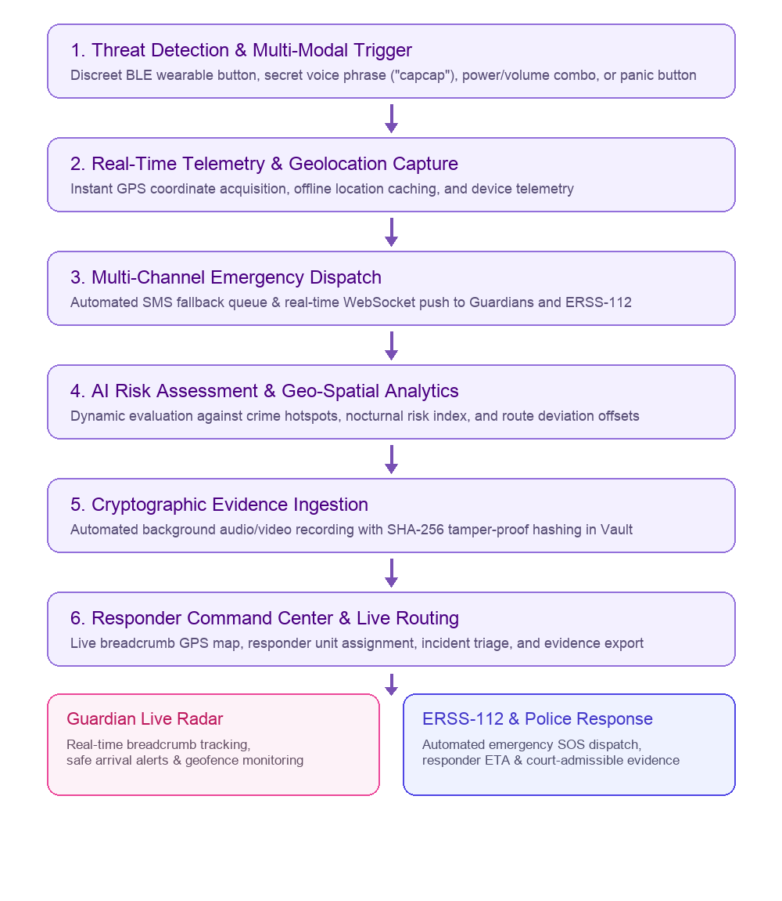
SYSTEM WORKFLOW
Data Integration & Telemetry Ingestion:
Collects multi-modal inputs from BLE wearable panic buttons, secret voice phrase detection, volume/power hardware keys, and GPS sensors into a unified telemetry stream.
Autonomous Edge Telemetry & Offline Caching:
Caches high-frequency GPS breadcrumbs locally during cellular drops and queues automated SMS fallback alerts with Google Maps coordinates.
Geo-Spatial Anomaly & Deviation Engine:
Continuously evaluates live transit coordinates against planned route vectors; flags unauthorized route offsets exceeding threshold limits (e.g. 30m+).
AI Unsafe Zone Intelligence:
Assesses real-time user location against nocturnal risk factors, street illumination, and historical crime complaints to recommend safe corridors.
Cryptographic Forensic Preservation:
Streams background audio/video into the Evidence Vault, calculating SHA-256 cryptographic digests immediately to guarantee court-admissible chain of custody.
Unified Command & Multi-Role Dispatch:
Dispatches real-time incident notifications to linked family guardians and provides ERSS-112 police dispatchers with live tracking and incident dossiers.

Slide 5
PROJECT SCOPE
In Scope :
• Multi-modal emergency SOS triggering (BLE wearable button, secret voice phrase 'capcap', power/volume double click, UI button).
• Real-time GPS tracking, breadcrumb history, and offline location caching with automated SMS fallback queue.
• Cab Guardian & Walk Guardian modules with automated route deviation alerts and distance-offset detection.
• AI Unsafe Zone Intelligence calculating localized risk scores based on time, lighting, and historical crime clusters.
• Cryptographic Evidence Locker with SHA-256 digital fingerprinting for tamper-proof audio/video blackbox files.
• Role-based portals: User Dashboard, Family Guardian Portal, Emergency Responder Hub, and Police Admin Command Center.
• Cyber Crime Reporting suite with AI threat severity scoring, screenshot upload, and official complaint tracking.
• Architecture-level integration hooks for ERSS-112, CCTNS police records, and CERT-In cyber threat databases.
Out of Scope :
• Physical deployment or tactical command of on-ground armed police personnel.
• Proprietary semiconductor or custom IoT hardware chip fabrication (utilizes standard Bluetooth LE and Android/iOS standards).
• Direct courtroom litigation, judicial prosecution, or formal legal sentencing.
• Guaranteed 100% real-time tracking in deep subterranean basements without GNSS, cellular GSM/SMS, or BLE relay connectivity.
• Automated facial recognition matching on low-resolution or heavily occluded third-party CCTV streams.
Project Boundary : SheShield focuses on rapid threat detection, automated alerting, geo-spatial intelligence, and tamper-proof evidence preservation; physical rescue and law enforcement remain under authorized civic agencies.

Slide 6
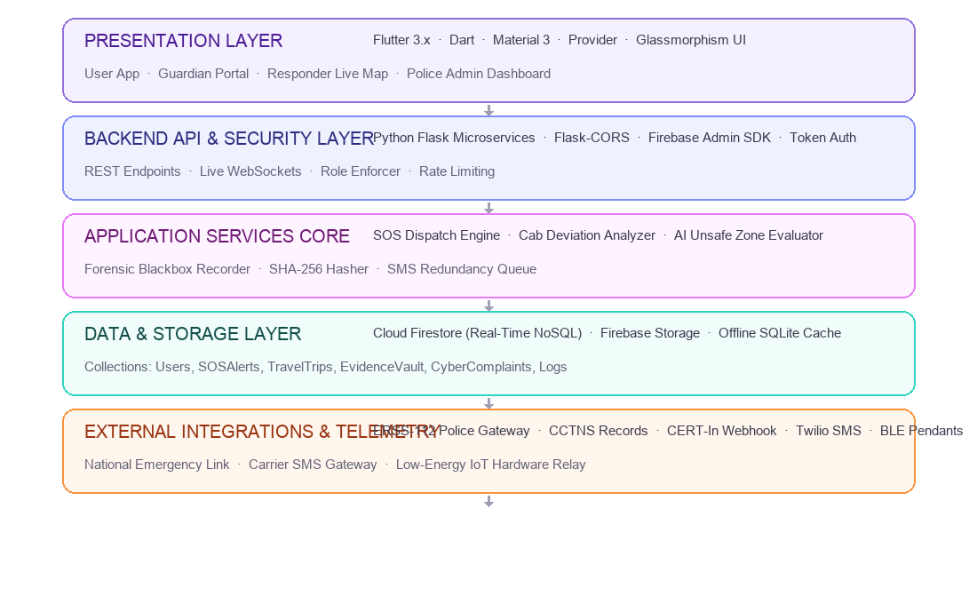
SYSTEM ARCHITECTURE
Presentation Layer:
Flutter 3.x with Dart delivers 60fps responsive interfaces across mobile and web with Material 3 theming and modern glassmorphism.
Backend API Layer:
Python Flask microservices orchestrate RESTful endpoints, token authentication, and Firebase Admin SDK services.
Application Services:
Core micro-engines power Cab Deviation Detection, AI Unsafe Zone Scoring, Forensic Evidence Streaming, and SMS fallback queues.
Data Layer:
Cloud Firestore provides real-time reactive NoSQL collections for live telemetry, paired with encrypted Firebase Storage.
Integration Layer:
Future-ready integration hooks interface with ERSS-112 (National Emergency), CCTNS (Police records), CERT-In (Cyber Defense), and Twilio SMS.

Slide 7
FRONTEND AND BACKEND TECHNOLOGIES
FRONTEND TECHNOLOGIES
BACKEND & AI TECHNOLOGIES
Technology | Why It Is Used in SheShield
Flutter | Builds high-performance native user interfaces for Android and iOS using a single unified codebase.
Dart | Provides sound type safety and asynchronous event streams essential for emergency telemetry.
Provider | Manages reactive state cleanly across SOS countdowns, travel monitoring, and live location updates.
Material 3 | Creates accessible, high-contrast UI components with responsive glassmorphic cards and buttons.
Flutter BLE | Enables low-latency communication with Bluetooth LE panic buttons and wearable smart pendants.
Geolocator | Captures high-precision GPS coordinates, breadcrumb paths, and speed telemetry in real time.
Technology | Why It Is Used in SheShield
Python Flask | Runs lightweight, scalable REST microservices handling emergency routing and alert dispatch.
Flask-CORS | Secures cross-origin API communication between mobile clients, responder maps, and admin consoles.
Firebase Admin SDK | Provides privileged server-side access to Cloud Firestore collections and user security rules.
PyTorch & Transformers | Powers NLP models to classify cyber harassment severity and assess digital blackmail threats.
OpenCV | Processes uploaded forensic evidence screenshots and inspects visual file authenticity.
hashlib (SHA-256) | Computes immutable cryptographic digests of recorded evidence to guarantee court admissibility.

Slide 8
DATABASE, AI, DATA PROCESSING & INTEGRATION
Technology / Component | Category | Why It Is Used in SheShield
Cloud Firestore | Data Storage & Real-Time Sync | Stores user profiles, SOS alerts, travel sessions, and syncs live telemetry across all roles.
Firebase Auth | Authentication & Identity | Secures multi-role authentication (User, Guardian, Responder, Admin) with biometric support.
Python (Flask) | Backend Microservices | Coordinates emergency dispatch, evidence hashing verification, and external API gateways.
PyTorch & Transformers | AI Threat Intelligence | Evaluates cyber crime complaints using NLP to calculate threat scores (e.g. 92% blackmail).
AI Unsafe Zone Service | Geo-Spatial AI Analytics | Computes dynamic composite risk scores using time of night, illumination, and crime records.
Cab Deviation Engine | Heuristic Route Analytics | Calculates vehicle route offsets from expected polyline and triggers deviation alerts.
SHA-256 Crypto Engine | Evidence Integrity & Forensics | Generates cryptographic fingerprints for captured audio/video to ensure court admissibility.
ERSS-112 Integration Hook | National Emergency Integration | Connects SheShield alert payloads with India's Emergency Response Support System (112).
CCTNS Sync Hook | Law Enforcement Integration | Prepares crime dossiers and incident records for Crime and Criminal Tracking Network & Systems.
CERT-In Webhook Hook | Cyber Threat Intelligence | Automates escalation of severe online blackmail, doxxing, and cyber harassment cases.
Twilio SMS Fallback | Redundant Emergency Alerting | Dispatches instant SMS with live Google Maps coordinates when mobile data is offline.
Docker Compose | Service Management | Packages and runs application microservices, databases, and mock government gateways.

Slide 9
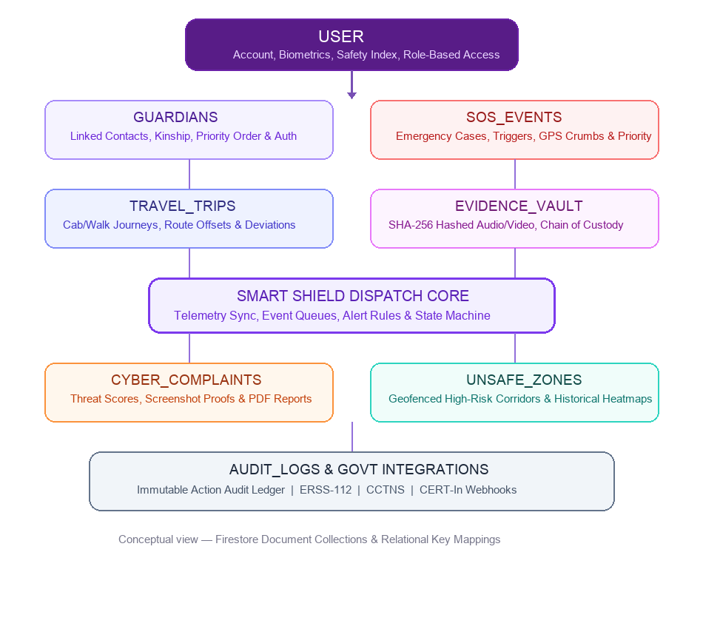
DATABASE DESIGN AND DATA MANAGEMENT
Table / Collection Name | Purpose in SheShield
User | Stores user account details, Aadhaar/face verification status, and safety preferences.
Guardians | Maintains linked emergency contacts, kinship relations, and notification priority order.
SOSEvents | Logs emergency alerts, trigger mechanisms (voice/BLE/button), live GPS, and status.
TravelTrips | Records Cab Guardian & Walk Guardian trips, vehicle plates, route offsets, and risk scores.
EvidenceVault | Catalogs encrypted audio/video assets alongside SHA-256 hashes for legal chain of custody.
CyberComplaints | Archives cyber abuse reports, screenshots, AI threat severity scores, and police status.
UnsafeZones | Defines geofenced high-risk corridors, historical incident density, and advisory rules.
AuditLogs | Preserves an immutable chronological ledger of administrative actions and SOS events.

Slide 10
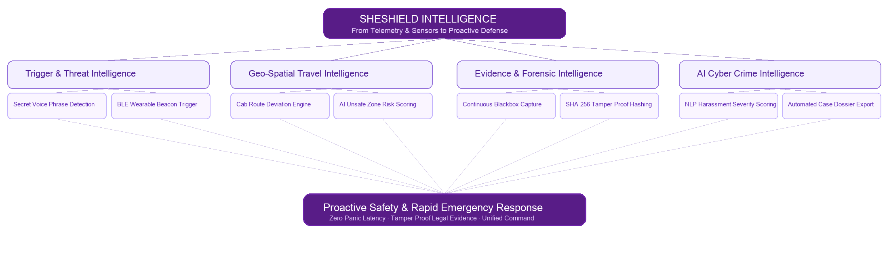
SMART SAFETY INTELLIGENCE AND AI CAPABILITIES
SheShield unifies multi-modal sensor intelligence, predictive geo-spatial analytics, NLP threat scoring, and cryptographic evidence preservation to build a proactive safety net. It eliminates panic latency through stealth triggers, proactively detects travel anomalies before danger strikes, and guarantees uncompromised digital evidence for swift law enforcement and court action.
Key Intelligence Pillars: Multi-Modal Stealth Triggers (BLE & Voice 'capcap') · Cab Deviation Analytics · AI Unsafe Zone Scoring · Forensic SHA-256 Evidence Vault · Automated Cyber Threat Assessment.

Slide 11
CHALLENGES AND LIMITATIONS
Challenges Faced :
System Limitations :
Challenge | Description
Low / Intermittent Connectivity | Emergency situations often occur in low-signal areas; mitigated via offline coordinate caching and automated SMS fallback queue.
Accidental / False Triggers | Pocket presses could overburden responders; handled using 5-second cancellable audio-haptic countdown timers.
Urban GPS Signal Drift | Multipath reflections cause coordinate jumping; stabilized using Kalman filtering and route offset tolerance thresholds.
Mobile OS Background Throttling | Operating systems suspend background apps; resolved via Android foreground services and travel wake-locks.
Evidence Cryptographic Integrity | Audio/video evidence must be court-admissible; solved by generating client-side SHA-256 hashes prior to cloud sync.
Multi-Stakeholder Dispatch Latency | Synchronizing guardians, nearby responders, and police without confusion requires strict role-based state machines.
• Hardware Dependency:
Stealth BLE wearable triggers depend on Bluetooth peripheral battery level and active pairing range.
• Cellular SMS Network Latency:
Delivery speed of emergency SMS alerts depends on telecom carrier traffic and congestion.
• Govt Emergency Gateway Readiness:
Direct dispatch into civic ERSS-112 and CCTNS relies on government API availability and authorization.
• Ambient Acoustic Noise:
Extreme environmental noise (e.g. industrial areas) can occasionally impede whisper-level voice recognition.
• Polyline Granularity:
Route deviation alerts require baseline map routing data and destination accuracy.

Slide 12
THANK YOU
SHE SHIELD — Proactive AI-Powered Women Safety & Emergency Response Ecosystem
WSSOA (IT644) · Autumn 2026
Dhirubhai Ambani University, Gandhinagar, Gujarat
Questions & Answers

