Slide 1

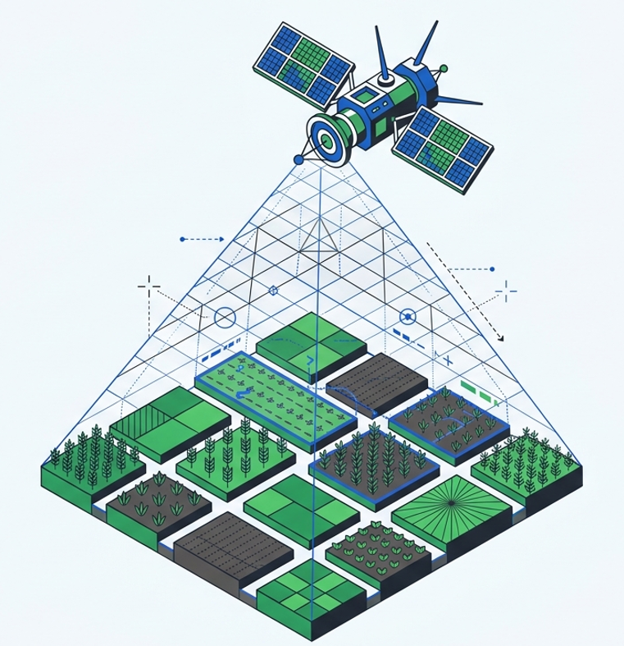

Multi-Sensor Satellite Data Fusion and
Machine Learning-Based Crop Discrimination
in Jhansi District, Uttar Pradesh, India
Submitted by: -
Mehul B Chaudhary Dhruv S Soni
Under the guidance of: - Dr. Abhishek Dhanodia

Slide 2
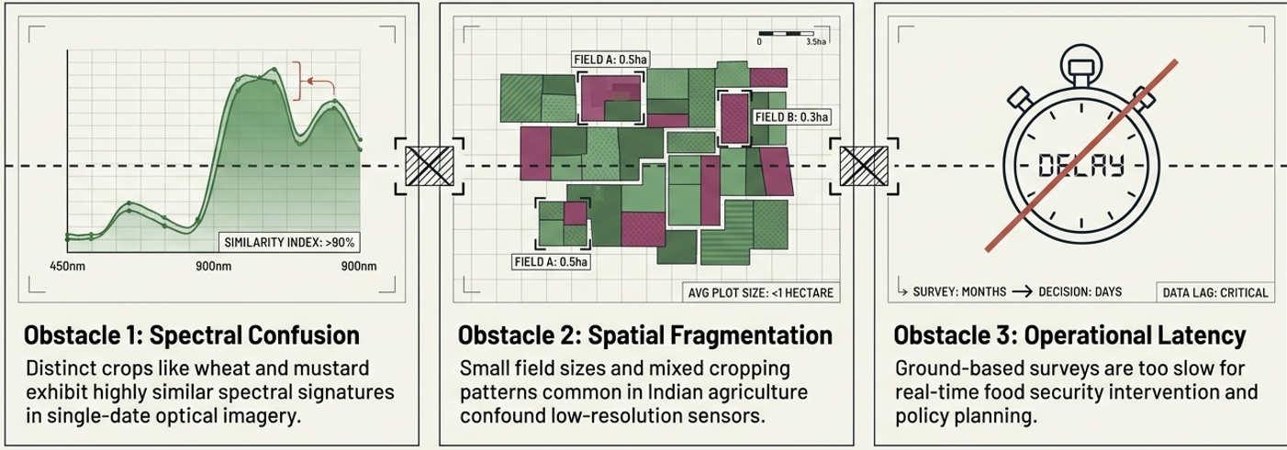
The Research Problem
Crop types are incredibly difficult to distinguish due to:
Resolving this barriers requires multi – sensor fusion and continuous temporal analysis

Slide 3
Study Objectives
Compare Performance: Evaluate the capabilities of different satellite sensors.
Evaluate Modalities: Compare single-date versus temporal (time-series) data.
Compare ML Algorithms: Assess Random Forest, CART, GTB, and SVM.
Identify Best Model: Find the most robust model for crop classification.
Generate Accurate Maps: Produce reliable spatial crop distribution maps.

Slide 4
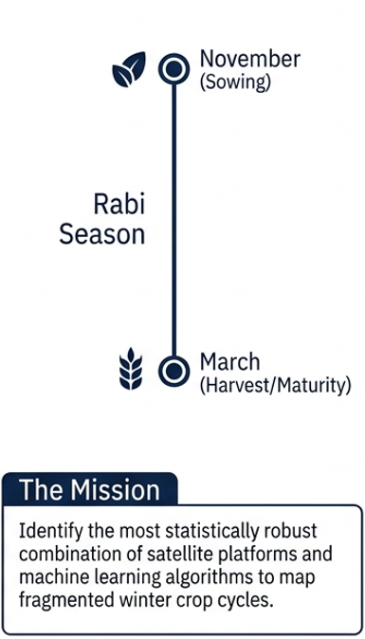
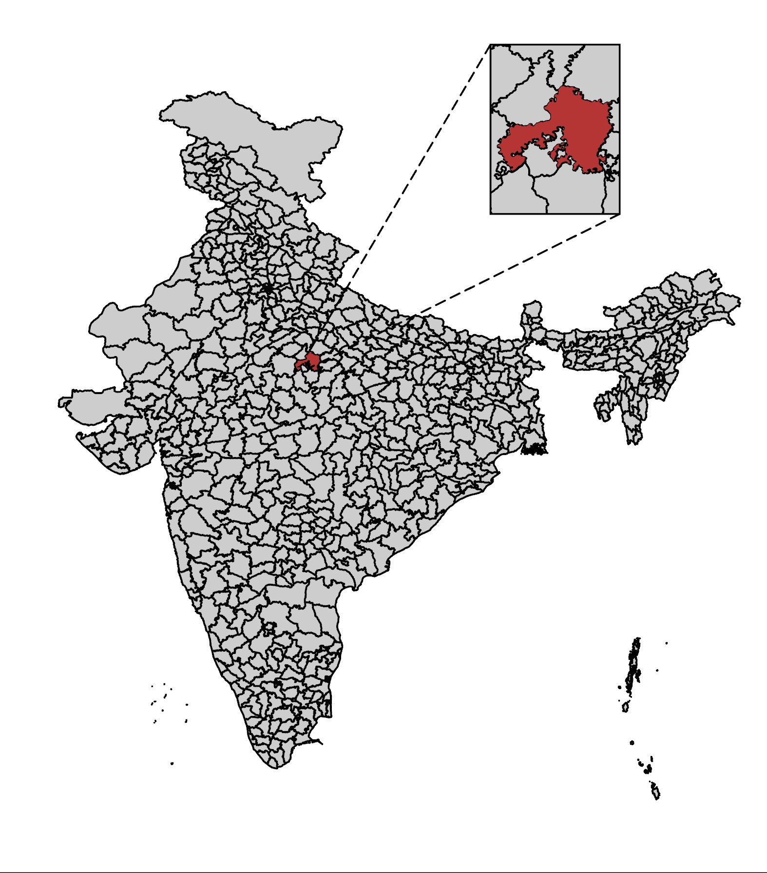
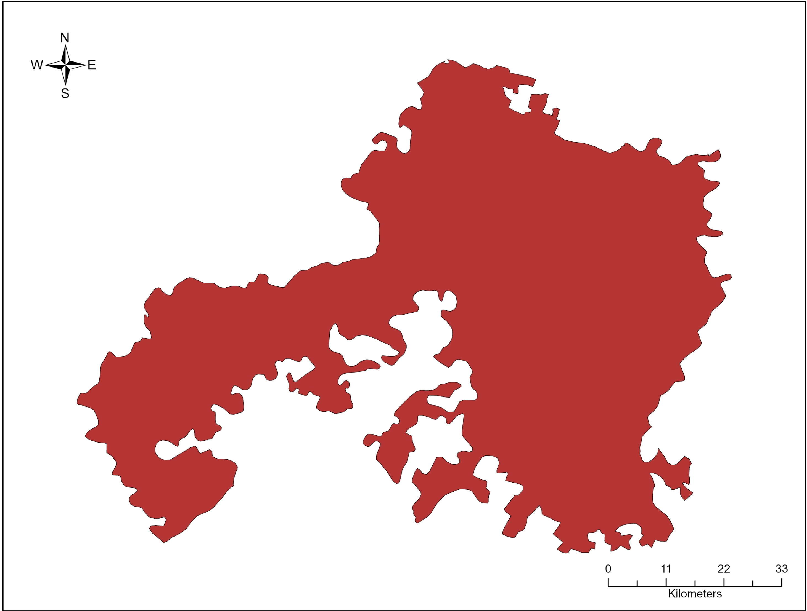
Area of Study
Location: Jhansi District, Uttar Pradesh
Coordinates: ~25.45°N, 78.57°E
🌾 Crops Evaluated:
Wheat, Mustard, Gram, Field Pea
🌳 Other Classes:
Forest, Water, Settlement, Barren

Slide 5
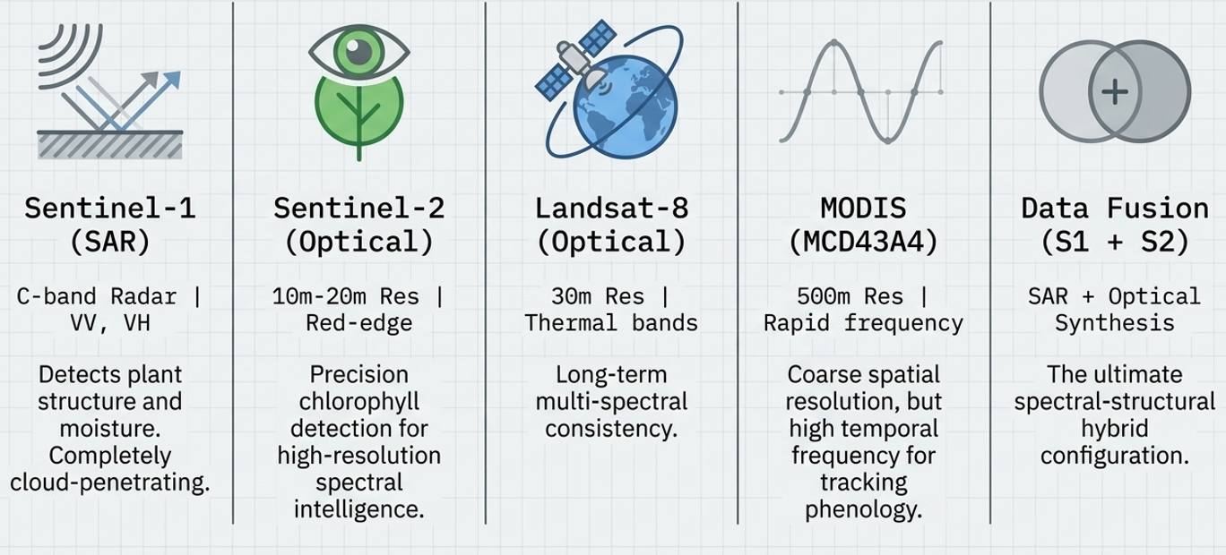
Satellites used
Sentinel – 1 (SAR) Detects plant structure and moisture. Completely cloud - penetrating
Sentinel – 2 (Optical) Precision chlorophyll detection for high – resolution spectral intelligence.
Landsat – 8 (Optical) Long term multi – spectral consistency.
MODIS (MCD43A4) Coarse spatial resolution, but high temporal frequency for tracking phenology.
Data Fusion (S1 + S2) The ultimate spectral – structure hybrid configuration.

Slide 6
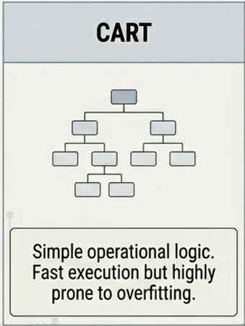
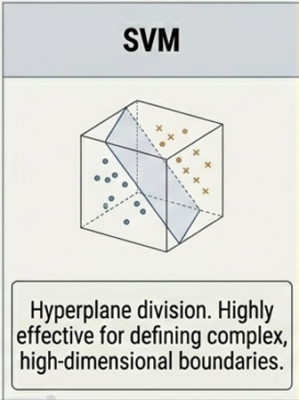
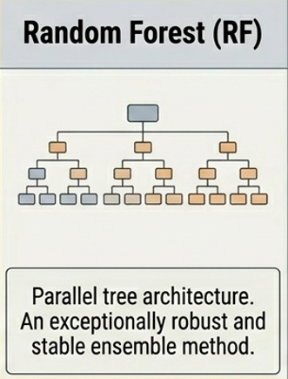
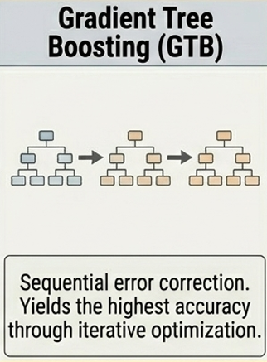
ML Algorithms used
Ensemble methods performs better in this case

Slide 7
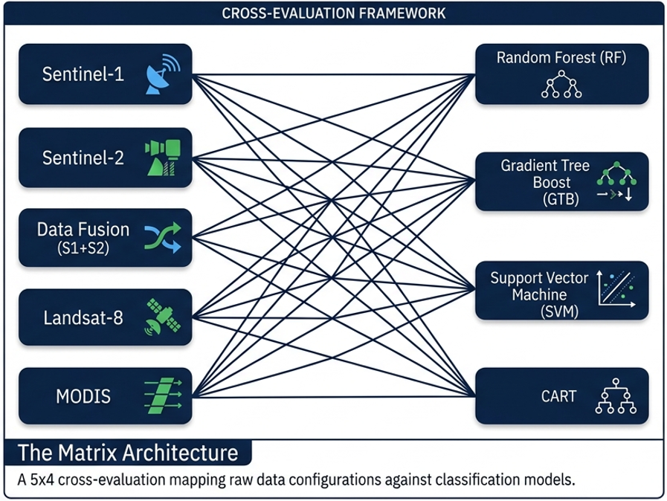
Main Idea

Slide 8
Features and Accuracy Metrics used
Spectral Bands
Standard raw reflectance data across multiple wavelengths.
Vegetation Indices
NDVI, EVI, NDWI, SAVI, LSWI used to track health and moisture.
SAR Features
Structural and backscatter metrics: VV, VH, and the VV/VH ratio.
Accuracy Metrics
Overall Accuracy
Kappa Coefficient

Slide 9
Methodology
Preprocessing: -
Cloud masking and atmospheric correction
Feature Extraction: - Extraction of targeted spectral, index, and SAR backscatter features.
Ground Truth Split: - 70% designated for training, 30% for independent testing.
ML Classification:- Model deployment and training
Accuracy Assessment: - Validation against Ground Truth

Slide 10
💡 Important Findings
Temporal Performance
⏳ Temporal > Single date
Multi-date observations provide superior insights compared to single-day snapshots.
Data Synergy
🔗 Data fusion improves accuracy
Integrating Optical and SAR data sources leads to more robust and accurate classifications.
Model Selection
🌲 Tree-based models (RF, GTB)
Random Forest and Gradient Tree Boosting consistently outperform other algorithmic approaches.
Spatial Precision
📏 Spatial resolution is critical
10m > 30m > 250m

Slide 11
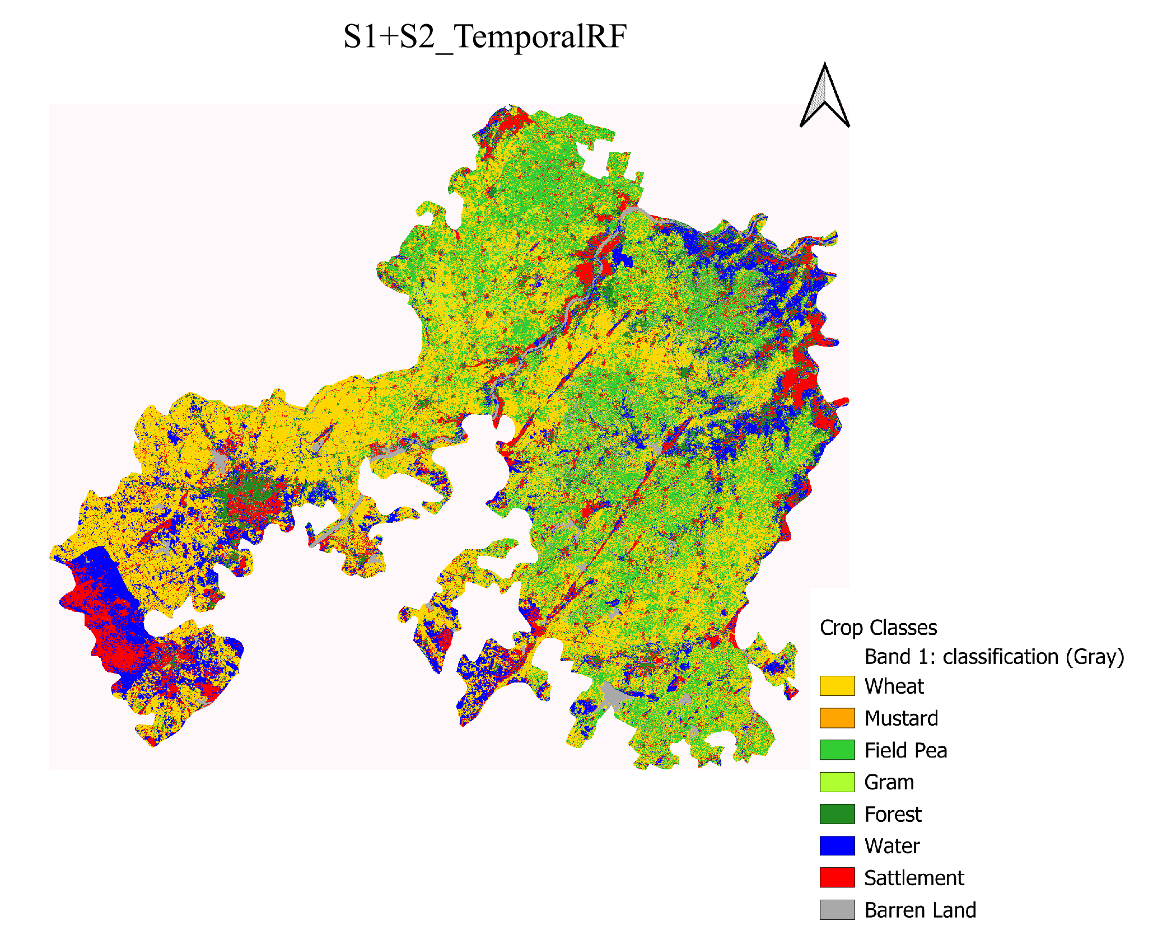
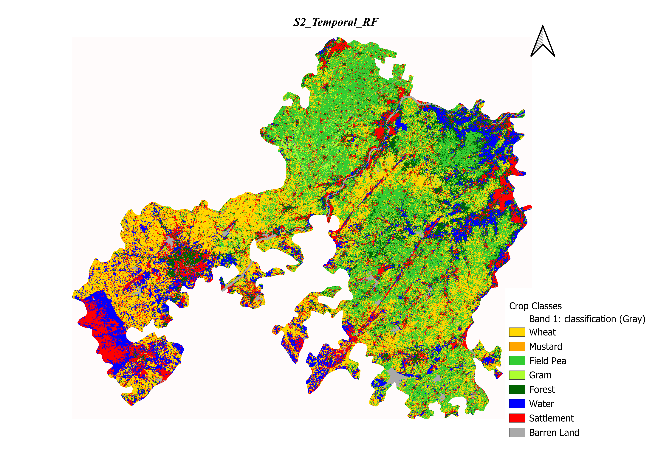
Results

Slide 12
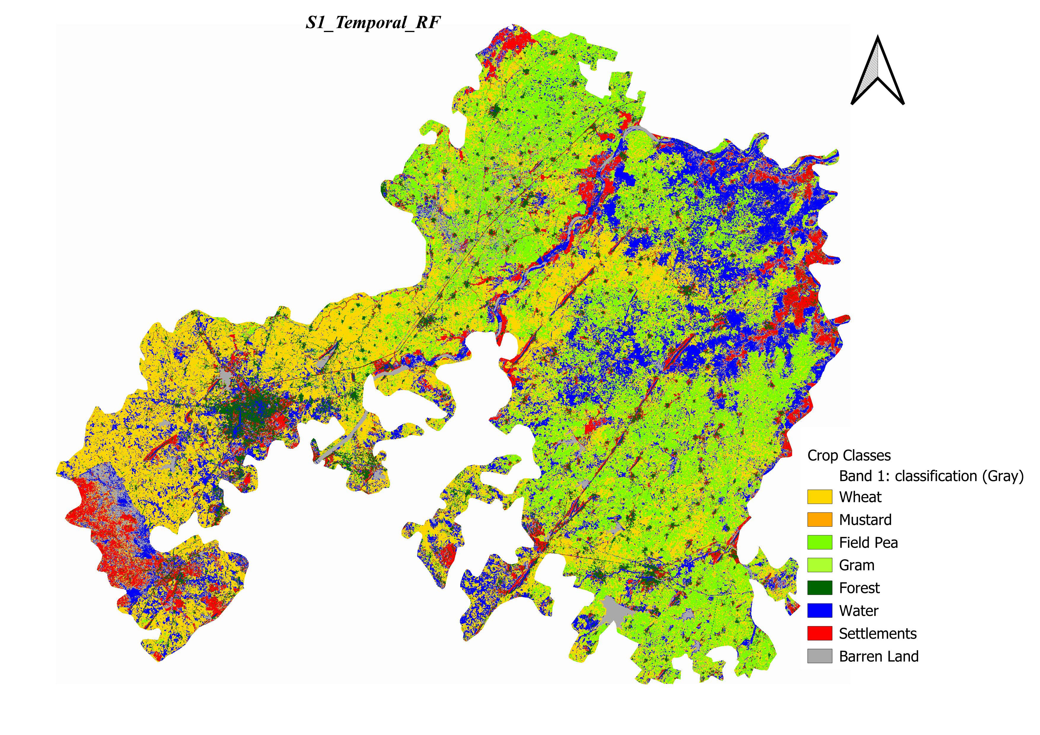
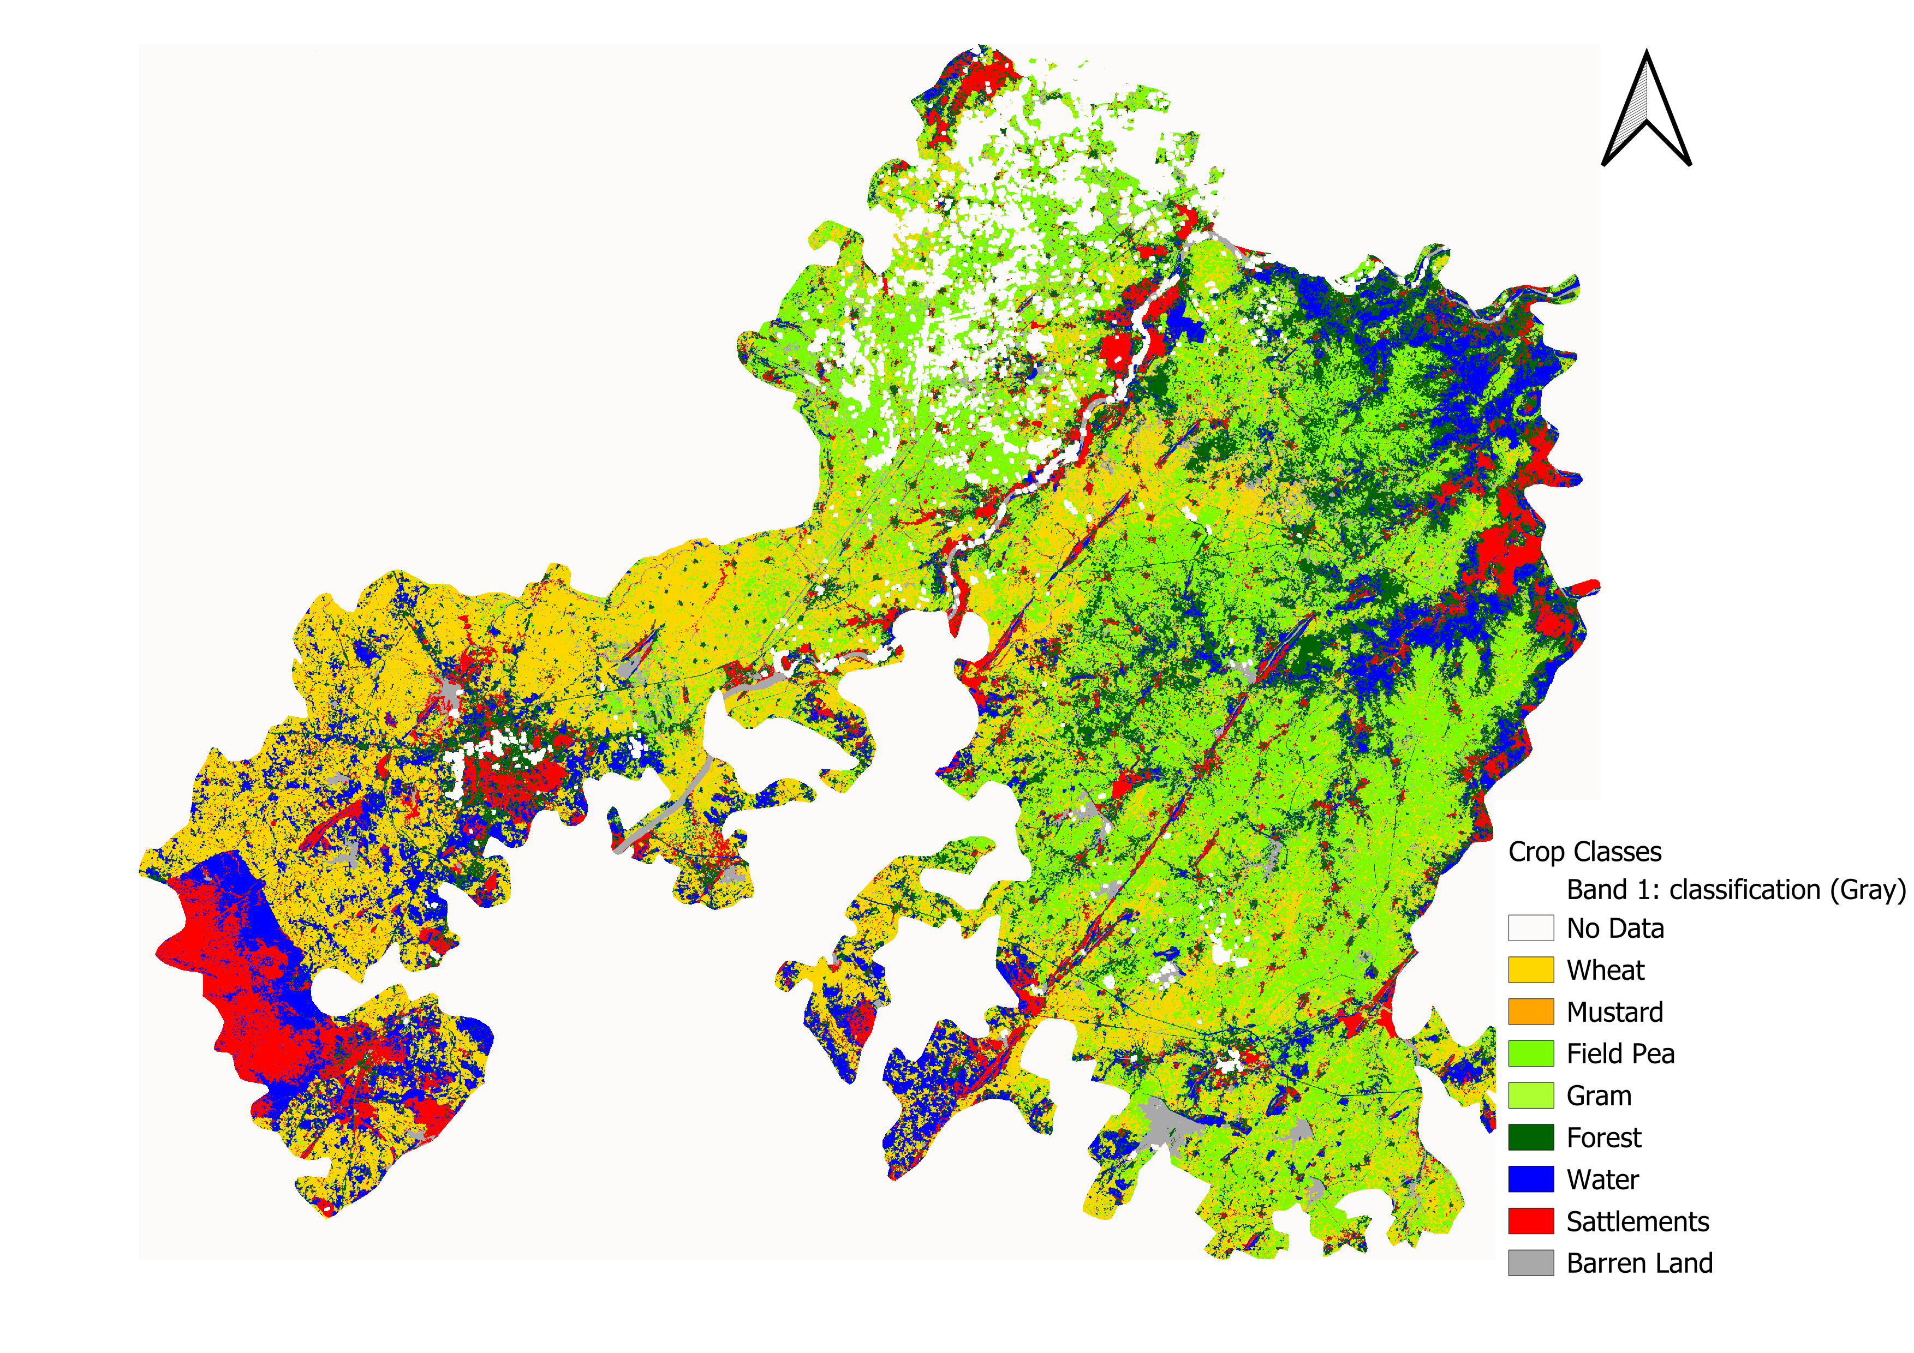
Results

Slide 13
Accuracy Matrix
Satellite / Sensor | Data Type | Algorithm | Overall Accuracy (%) | Kappa's Coefficient | Best Algorithm
Sentinel-1 | Single Date | RF | 57.56 | 48.54 | SVM
 |  | GTB | 56.48 | 47.71
 |  | CART | 50.75 | 40.86
 |  | SVM | 62.81 | 53.52
 | Temporal | RF | 77.52 | 72.46 | RF
 |  | GTB | 73.92 | 68.52
 |  | CART | 63.28 | 55.91
 |  | SVM | 68.91 | 62.63
Sentinel-2 | Single Date | RF | 81.07 | 76.87 | GTB
 |  | GTB | 81.78 | 77.78
 |  | CART | 78.21 | 73.35
 |  | SVM | 80.00 | 75.44
 | Temporal | RF | 85.00 | 81.70 | RF
 |  | GTB | 83.92 | 80.52
 |  | CART | 79.6 | 75.4
 |  | SVM | 79.28 | 75.17
MODIS | Single Date | RF | 63.11 | 53.57 | RF
 |  | GTB | 60.00 | 49.97
 |  | CART | 54.66 | 43.83
 |  | SVM | 48.88 | 35.52
 | Temporal | RF | 59.45 | 50.06 | GTB
 |  | GTB | 61.71 | 52.20
 |  | CART | 54.50 | 44.62
 |  | SVM | 51.35 | 39.93

Slide 14
Satellite / Sensor | Data Type | Algorithm | Overall Accuracy (%) | Kappa's Coefficient | Best Algorithm
Landsat-8 | Single Date | RF | 78.92 | 74.43 | RF
 |  | GTB | 73.92 | 68.75
 |  | CART | 75.00 | 69.65
 |  | SVM | 78.21 | 73.41
 | Temporal | RF | 87.17 | 73.68 | SVM
 |  | GTB | 84.61 | 68.42
 |  | CART | 79.74 | 70.92
 |  | SVM | 89.74 | 79.06
Sentinel-1 + Sentinel-2 | Single Date | RF | 82.11 | 78.22 | GTB
 |  | GTB | 83.21 | 79.54
 |  | CART | 78.83 | 74.24
 |  | SVM | 80.29 | 76.04
 | Temporal | RF | 86.49 | 83.51 | GTB
 |  | GTB | 87.22 | 84.43
 |  | CART | 80.65 | 76.76
 |  | SVM | 81.38 | 77.50
Accuracy Matrix

Slide 15


🏁 Conclusion
📌 Key Takeaways
🌍 Useful For:
✅ Multi-sensor + temporal approach is highly effective
🌾 Crop monitoring
📜 Policy planning
✅ Sentinel-2 is best single sensor
🔐 Food security
✅ Fusion gives highest accuracy
✅ GTB is most powerful algorithm

Slide 16
References
Soni- multisatellite.pdf Song, X.-P., Huang, W., Hansen, M. C., & Potapov, P. (2021). An evaluation of Landsat, Sentinel-2, Sentinel-1 and MODIS data for crop type mapping. Science of Remote Sensing, 3, 100018. https://doi.org/10.1016/j.srs.2021.100018
Cross-Regional Crop Classification Based on Sentinel-2.pdf He, J., Zeng, W., Ao, C., Xing, W., Gaiser, T., & Srivastava, A. K. (2024).
Cross-regional crop classification based on Sentinel-2. Agronomy, 14, 1084. https://doi.org/10.3390/agronomy14051084
Crop Type Identification and Spatial Mapping Using Sentinel-2.pdf Gumma, M. K., Tummala, K., Dixit, S., Collivignarelli, F., Holecz, F., Kolli, R. N., & Whitbread, A. M. (2020). Crop type identification and spatial mapping using Sentinel-2 satellite data with focus on field-level information. Geocarto International. https://doi.org/10.1080/10106049.2020.1805029
Crop Classification Using Random Forest & SVM on Sentinel-2.pdf Saini, R., & Ghosh, S. K. (2018). Crop classification on single date Sentinel-2 imagery using random forest and suppor vector machine. The International Archives of the Photogrammetry, Remote Sensing and Spatial Information Sciences, XLII-5, 683-688. https://doi.org/10.5194/isprs-archives-XLII-5-683-2018
Crop classification using spectral indices derived from Sentinel-2A imagery.pdf Kobayashi, N., Tani, H., Wang, X., & Sonobe, R. (2020). Crop classification using spectral indices derived from Sentinel-2A imagery. Journal of Information and Telecommunication, 4(1), 67-90. https://doi.org/10.1080/24751839.2019.1694765

Slide 17
THANK YOU

