Slide 1

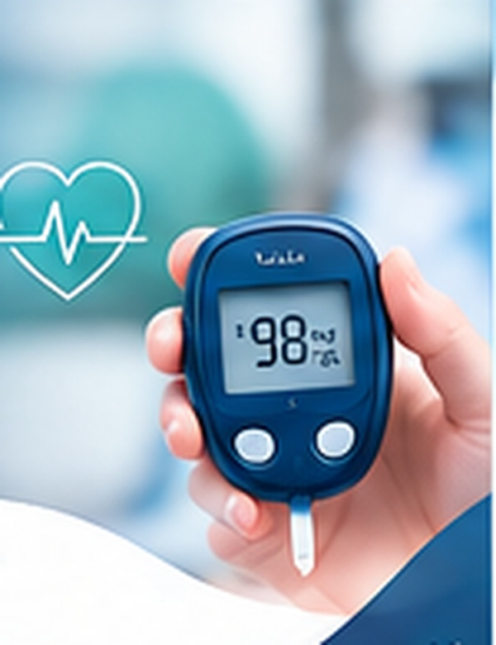

COMPUTER SCIENCE RESEARCH & DEVELOPMENT PROJECT
Diabetes Risk Scoring &
Predictive Analytics
A Polyglot Hybrid Architecture for Rapid Healthcare Screening
AUTHORS
SECTION
Saiyam Gupta • Gurpreet Singh • Tanvi Kohli
Computer Science (A4)
1

Slide 2

02 AGENDA
Table of Contents
A quick guide to the project
01
Introduction
08
Tools and Technologies Used
02
Problem Statement
09
Implementation
03
Objectives
10
Results and Discussion
04
Existing System
11
Limitations and Future Scope
05
Proposed System
12
Conclusion
06
Methodology
13
References
07
System Design / Architecture
14
Thank You
MODEL INSTITUTE OF ENGINEERING & TECHNOLOGY • JAMMU
MIET • Diabetes Risk Scoring & Predictive Analytics 2

Slide 3

03 INTRODUCTION
Fast, Reliable Diabetes Screening for Every Clinic
A hybrid C + Python workflow turns four clinical inputs into an explainable risk score.
1
The Context
2
The Approach
3
The Outcome
Around 40% of diabetes cases worldwide go undiagnosed, delaying preventive care.
Low-level C input validation paired with a Python machine-learning pipeline.
A local, transparent risk score that can help flag higher-risk patients for clinical review.
Screening support — not a medical diagnosis.
MODEL INSTITUTE OF ENGINEERING & TECHNOLOGY • JAMMU
MIET • Diabetes Risk Scoring & Predictive Analytics 3

Slide 4
04 PROBLEM STATEMENT
The Healthcare Challenge: Unmanaged Diabetes
Why timely, consistent screening matters
!
Real-World Impact
⚙
Diagnostic Bottlenecks
• Many people with diabetes remain undiagnosed.
• Delayed detection can increase the risk of serious complications.
• Late intervention can raise the burden on patients and healthcare systems.
• Manual data entry can slow patient intake.
• High patient volumes may lead to missed early checks.
• Clinics need a simple way to validate Age, Glucose, BMI and Blood Pressure inputs.
MODEL INSTITUTE OF ENGINEERING & TECHNOLOGY • JAMMU
MIET • Diabetes Risk Scoring & Predictive Analytics 4

Slide 5
05 OBJECTIVES
What the Project Sets Out to Achieve
Four stages from patient input to a screening-support output
1
Capture
2
Validate
3
Predict
4
Deploy
Collect Age, Glucose, BMI and Blood Pressure through a lightweight CLI.
Reject invalid or out-of-range values with ISO C boundary checks.
Estimate diabetes risk using Logistic Regression and k-NN similarity.
Run locally without requiring a cloud connection.
Early detection support. Better-informed decisions. Healthier lives.
MODEL INSTITUTE OF ENGINEERING & TECHNOLOGY • JAMMU
MIET • Diabetes Risk Scoring & Predictive Analytics 5

Slide 6
06 EXISTING SYSTEM
Where Current Screening Falls Short
Challenges that motivate a lightweight and consistent workflow
1
Manual Intake
2
Inconsistent Screening
3
Resource-Heavy Models
• Paper and form-based entry can delay patient processing.
• Repeated manual entry may introduce errors.
• High patient volumes can make routine checks harder to complete.
• Some opportunities for early screening may be missed.
• Some deep-learning approaches require substantial compute resources.
• Complex models can be harder to interpret.
MODEL INSTITUTE OF ENGINEERING & TECHNOLOGY • JAMMU
MIET • Diabetes Risk Scoring & Predictive Analytics 6

Slide 7
07 PROPOSED SYSTEM
Polyglot Risk Scoring Architecture
Three coordinated layers, each with a clear responsibility
C
Layer 01 • C Input
Py
Layer 02 • Python
ML
Layer 03 • Scikit-Learn
• Captures Age, Glucose, BMI and Blood Pressure.
• ISO C checks validate input boundaries and reject invalid values.
• Pandas pipeline handles missing clinical values.
• Feature scaling prepares consistent model inputs.
• Logistic Regression estimates probability.
• k-NN identifies similar records for additional context.
MODEL INSTITUTE OF ENGINEERING & TECHNOLOGY • JAMMU
MIET • Diabetes Risk Scoring & Predictive Analytics 7

Slide 8

08 METHODOLOGY
From Benchmark Data to Risk Score
A structured pipeline from dataset preparation to evaluation
1
Dataset
2
Preprocessing
3
Dual Models
4
Evaluation
PIMA Indians Diabetes Database
768 records
Pandas handles missing values
and feature scaling
Logistic Regression probability
+ k-NN similarity
Precision and recall assessed
against the benchmark
➜
➜
➜
MODEL INSTITUTE OF ENGINEERING & TECHNOLOGY • JAMMU
MIET • Diabetes Risk Scoring & Predictive Analytics 8

Slide 9
09 SYSTEM DESIGN / ARCHITECTURE
End-to-End Workflow & Pipeline
How data moves through the hybrid screening workflow
1
CLI Entry
2
C Pre-Check
3
Preprocessing
4
Dual ML Model
5
Clinical Output
Age • Glucose
BMI • BP
Boundary and
sanity validation
Missing values
and scaling
Logistic Regression
+ k-NN
Risk score for
clinical review
→
→
→
→
HIGH-RELIABILITY SCREENING SUPPORT
Fast-tracks higher-risk cases for clinician review; it does not replace diagnosis.
MODEL INSTITUTE OF ENGINEERING & TECHNOLOGY • JAMMU
MIET • Diabetes Risk Scoring & Predictive Analytics 9

Slide 10
10 TOOLS & TECHNOLOGIES
The Technology Stack
Each tool supports one part of the workflow
TOOL
ROLE IN THE SYSTEM
ISO C
CLI data entry, boundary and sanity validation
Python
Pipeline orchestration between layers
Pandas
Missing-value handling and feature scaling
Scikit-Learn
Logistic Regression and k-NN models
PIMA Dataset
768-record benchmark for training and validation
MODEL INSTITUTE OF ENGINEERING & TECHNOLOGY • JAMMU
MIET • Diabetes Risk Scoring & Predictive Analytics 10

Slide 11
11 IMPLEMENTATION
How the Layers Come Together
A modular implementation keeps validation, preparation and prediction separate
1
1 C Input Module
2
2 Python Pipeline
3
3 ML Risk Scoring
• Prompts for Age, Glucose, BMI and BP.
• Applies range and sanity checks.
• Rejects invalid values before model processing.
• Loads and cleans PIMA data with Pandas.
• Handles missing clinical values.
• Standardizes feature distributions.
• Logistic Regression returns a probability estimate.
• k-NN finds similar records.
• Combined output supports triage decisions.
MODEL INSTITUTE OF ENGINEERING & TECHNOLOGY • JAMMU
MIET • Diabetes Risk Scoring & Predictive Analytics 11

Slide 12
12 RESULTS & DISCUSSION
Why the Polyglot Approach Is Practical
A qualitative comparison of implementation characteristics
METRIC
DEEP NEURAL NETWORKS
POLYGLOT ML APPROACH
Compute footprint
May require GPU / cloud resources
Designed for a low CPU footprint
Explainability
Can be difficult to interpret
Probability + similar-record context
Data efficiency
Often benefits from larger datasets
Benchmark uses 768 PIMA records
Input validation
Depends on input pipeline
C layer checks input boundaries
Accuracy, Precision and Recall: add measured values after model evaluation.
MODEL INSTITUTE OF ENGINEERING & TECHNOLOGY • JAMMU
MIET • Diabetes Risk Scoring & Predictive Analytics 12

Slide 13
13 LIMITATIONS & FUTURE SCOPE
Current Boundaries and Next Steps
Important constraints and realistic directions for further development
!
Current Limitations
↗
Future Scope
• Small benchmark dataset (768 records).
• Limited feature set: four clinical parameters.
• Screening support only; not a diagnosis.
• CLI may not suit every clinical workflow.
• Use larger and more diverse datasets.
• Explore additional clinical parameters.
• Develop a simple GUI or web interface.
• Investigate health-record integration and prospective validation.
MODEL INSTITUTE OF ENGINEERING & TECHNOLOGY • JAMMU
MIET • Diabetes Risk Scoring & Predictive Analytics 13

Slide 14

14 CONCLUSION
A Smarter, More Explainable
Screening Approach
A hybrid C + Python workflow supports efficient, local and transparent diabetes risk screening.
Fast, validated data entry
Transparent dual-model scoring
Instant risk estimate for clinical review
Thank you
Designed for resource-constrained settings
15

Slide 15
15 REFERENCES
Research Literature & Standards
Key datasets, documentation and standards referenced in the project
PIMA Benchmark Dataset
Kaggle: PIMA Indians Diabetes Database; originally associated with NIDDK (768 records).
1
IEEE Access Publication
Predictive Modeling of Diabetes Risk. DOI: 10.1109/ACCESS.2019.2923707
2
Global Standards
WHO Diabetes Fact Sheet; IDF Diabetes Atlas; ISO C Standard Library (cppreference).
3
Technical Documentation
Scikit-Learn documentation and Pandas documentation.
4
MODEL INSTITUTE OF ENGINEERING & TECHNOLOGY • JAMMU
MIET • Diabetes Risk Scoring & Predictive Analytics 15

Slide 16
THANK YOU!
Questions & Discussion
Diabetes Risk Scoring & Predictive Analytics
Saiyam Gupta • Gurpreet Singh • Tanvi Kohli | Computer Science (A4)
16

