Slide 1
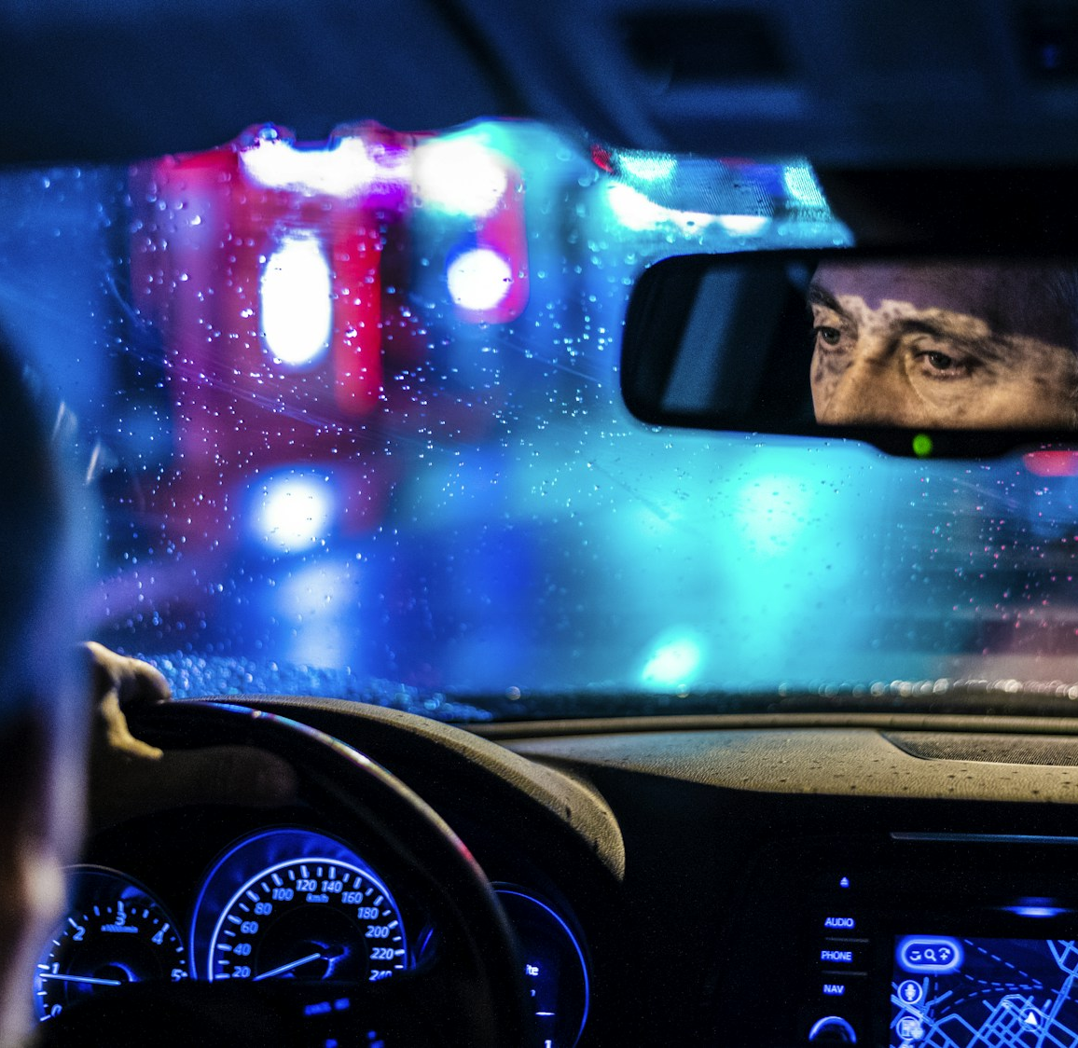
PROJECT EVALUATION
Driver Drowsiness
Detection
Alert after 1.5 s of sustained closure
It reads facial landmarks frame by frame and times continuous eye closure before presenting a warning.
PYTHON
MEDIAPIPE
OPENCV
Webcam input processed locally, with a sustained-closure alert
Illustrative driving photo
DRIVER DROWSINESS DETECTION / PROJECT EVALUATION
01
Notes:
Opening: This project uses a webcam and eye landmarks to identify sustained eye closure. The deck describes the code as it exists and proposes how to evaluate it.
Photo credit: Barna Bartis, Unsplash, https://unsplash.com/photos/reflective-photo-of-man-in-rearview-mirror-MbBpj-A-yns . The image is illustrative and is not a project test frame.
Project sources: outputs/driver_drowsiness_detection/README.md and outputs/driver_drowsiness_detection/driver_drowsiness_detection.py.

Slide 2
TABLE OF CONTENTS
Project overview and evaluation
From the detection problem through implementation, results, and references.
01
Title Slide
09
System Design / Architecture
02
Table of Contents
10
Tools and Technologies Used
03
Introduction
11
Implementation
04
Problem Statement
12
Results and Discussion
05
Objectives
13
Limitations and Future Scope
06
Existing System
14
Conclusion
07
Proposed System
15
References
08
Methodology
16
Thank You
DRIVER DROWSINESS DETECTION / PROJECT EVALUATION
02

Slide 3
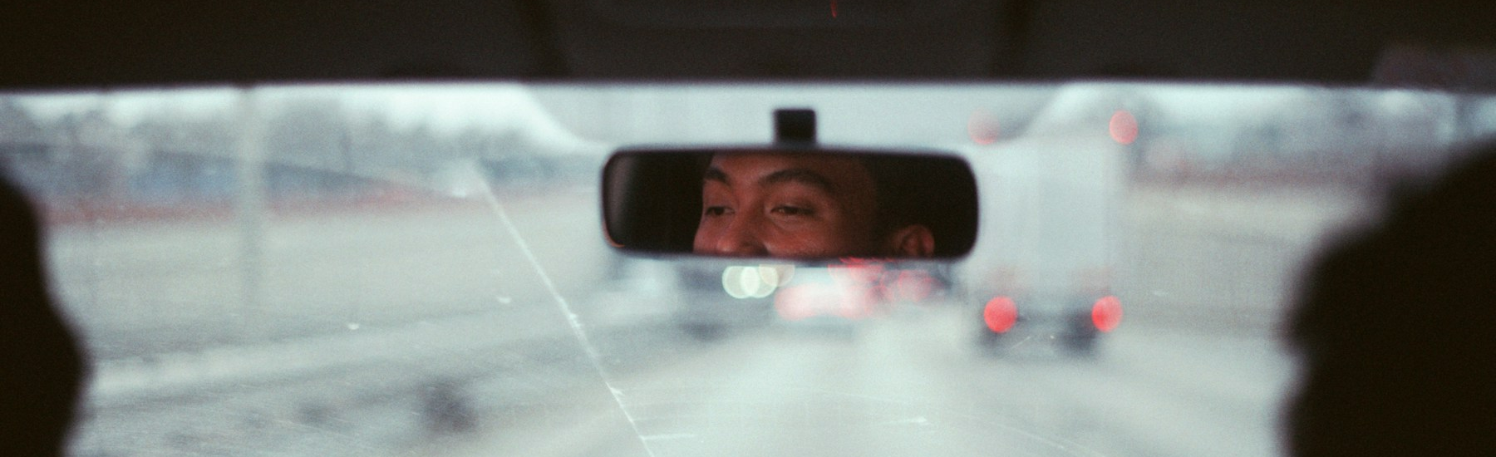
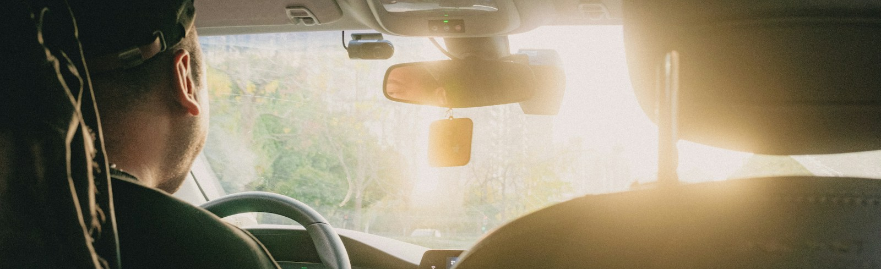
INTRODUCTION
A webcam prototype for sustained eye closure
The program tracks eye openness and warns when closure lasts beyond a configurable delay.
WHY THIS CUE
The duration of eye closure is easy to explain.
The demo estimates eye openness from face landmarks and times continuous closure. Brief blinks stay green; a sustained closure triggers a warning.
WEBCAM
Illustrative driving photos, not detector footage
Not a diagnosis or a complete driver-monitoring system
DRIVER DROWSINESS DETECTION / PROJECT EVALUATION
03
Notes:
Explain the chosen scope: webcam-based eye closure duration. This implementation does not estimate lane position, yawning, head pose, or a medical diagnosis.
Photo credit: Hakam Magdea Fardana Ansie, Unsplash, https://unsplash.com/photos/a-persons-eyes-are-visible-in-the-rearview-mirror-osAsmAd33Vw . This is an illustrative stock image.
Additional photo credit: Xingchen Yan, Unsplash, https://unsplash.com/photos/a-man-driving-a-car-with-the-sun-shining-through-the-windshield-nwxLVN69wFU . This image shows a daytime drive and is not a project test frame.
Project source: outputs/driver_drowsiness_detection/README.md.

Slide 4
PROBLEM STATEMENT
A blink should not trigger a sustained-closure warning
The detector needs to ignore normal blinks and respond when closure persists.
FRAME VARIATION
Short blinks are normal. Sustained eye closure is a cue to warn.
Landmark ratios can shift with motion, lighting, and camera position.
FALSE ALERTS
A brief blink should not trigger the same response as sustained closure.
This prototype estimates closure duration; it does not diagnose fatigue.
THRESHOLD CHOICE
A time gate must be adjustable and evaluated on the target setup.
DRIVER DROWSINESS DETECTION / PROJECT EVALUATION
04
Notes:
The project addresses one narrow interaction: distinguish a short eye blink from eye closure that persists past the configured time. The app uses a fixed EAR cutoff and a timer; camera conditions and driver variation can affect the signal. This is a software demonstration, not a diagnosis or a certified safety intervention.
Project source: outputs/driver_drowsiness_detection/README.md and driver_drowsiness_detection.py.

Slide 5
OBJECTIVES
Build an explainable, local webcam prototype
The goal is a clear baseline that can be evaluated before it is extended.
01
DETECT
Find one face and obtain eye landmarks from each webcam frame.
02
ESTIMATE
Calculate left and right EAR, then smooth their mean across five frames.
03
TIME
Measure continuous closure and reset when the eyes reopen or face is lost.
04
ALERT
Keep brief blinks green; show a warning and sound after the configured delay.
05
PROCESS LOCALLY
Analyze frames in memory without saving or transmitting video.
DRIVER DROWSINESS DETECTION / PROJECT EVALUATION
05
Notes:
The objective is not to build a complete driver-monitoring system. It is to implement a local, understandable eye-closure baseline with a timer and configurable alert, then evaluate it with labeled data. The code uses a five-sample median and resets the timer when the face is not visible or the eyes reopen.
Project source: outputs/driver_drowsiness_detection/driver_drowsiness_detection.py.

Slide 6
EXISTING SYSTEM
Drowsiness approaches use different signals
Published methods include eye closure, vehicle behavior, and combinations of cues.
EYE MEASURES
Use eye closure or blink behavior as a visual signal.
VEHICLE BEHAVIOR
Use steering or lane information to observe driving performance.
COMBINED CUES
Fuse eye and vehicle measures to represent more than one signal.
PROJECT BASELINE
One webcam cue: eye landmarks and closure duration; no vehicle sensors or sensor fusion.
DRIVER DROWSINESS DETECTION / PROJECT EVALUATION
06
Notes:
The NHTSA review describes a range of vehicle-based drowsy-driving algorithms using eye closure, steering, lane position, and combinations of driver-performance measures. This project is narrower: it uses eye landmarks from one webcam and does not include vehicle sensors or sensor fusion.
Source: NHTSA, Assessment of Vehicle-Based Sensors for Drowsy Driving Detection, DOT HS 811 886, https://www.nhtsa.gov/sites/nhtsa.gov/files/811886-assess_veh-based_sensors_4_drowsy-driving_detection.pdf.
Project source: outputs/driver_drowsiness_detection/driver_drowsiness_detection.py.

Slide 7
PROPOSED SYSTEM
Brief blinks stay green; prolonged closure triggers an alert
Configurable timing defaults in the current code
0.0 s
<1.5 s
1.5 s
+1.5 s
Closure starts
Blink remains green
Alert starts
Alert repeats
Smoothed EAR < 0.21
No visual warning
Continuous closure
While closure continues
At 1.5 seconds, the outline turns red and the sound alert starts.
Eyes reopen or the face disappears: the closure timer resets.
DRIVER DROWSINESS DETECTION / PROJECT EVALUATION
07
Notes:
The current program uses the configured EAR threshold (0.21 by default) and a continuous-closure gate (1.5 seconds by default). Eye outlines remain green for brief closure. At the gate, the warning and sound alert begin; the sound repeats every 1.5 seconds by default while closure continues. The timer resets when eyes reopen or the face is not detected. These are demo defaults, not safety-validated thresholds.
Project source: outputs/driver_drowsiness_detection/driver_drowsiness_detection.py, --ear-threshold, --closed-seconds, and --alarm-interval.

Slide 8
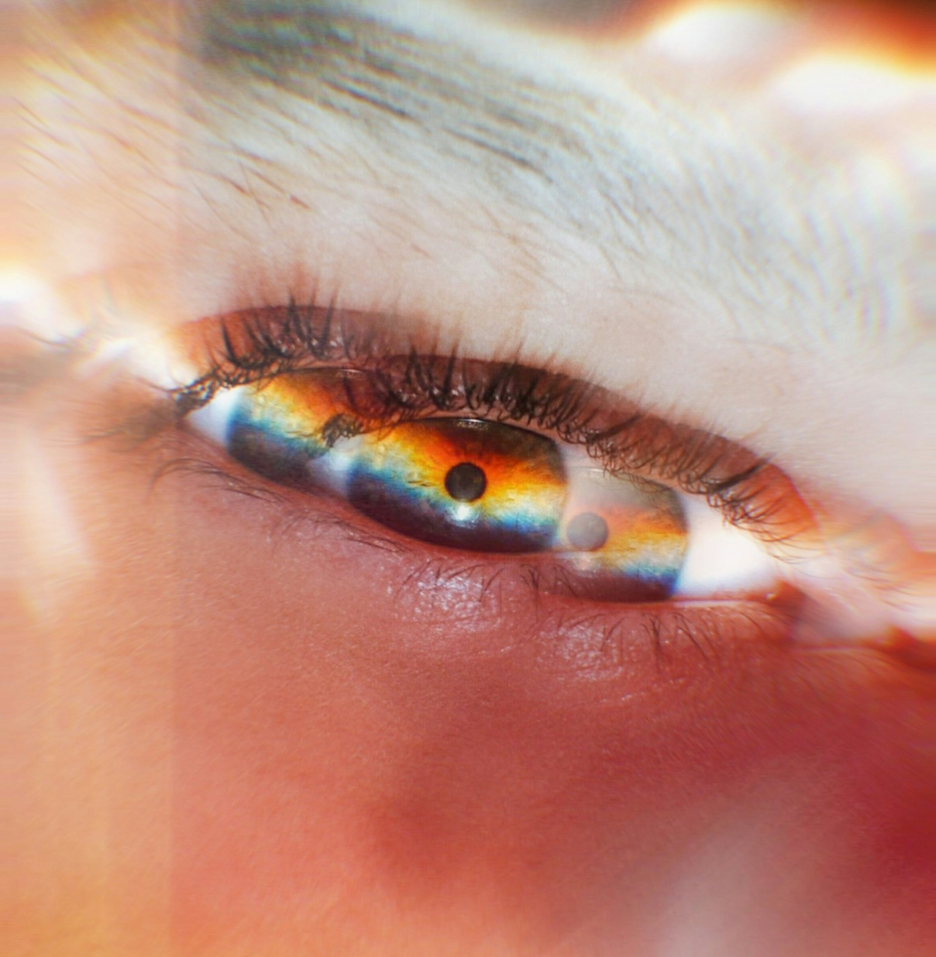
METHODOLOGY
Eye Aspect Ratio (EAR)
The ratio falls as the eye opening narrows relative to its width.
IN THE CODE
EAR = (V₁ + V₂) / (2 × H)
Read six landmarks
01
For each eye, use a fixed six-point contour from the face mesh.
Two vertical distances
Eye width
Calculate each EAR
02
Measure left and right eye ratios, then take their mean.
Lower EAR means a narrower opening
03
Smooth the signal
Use the median of the latest five mean-EAR samples.
Illustrative eye photo
DRIVER DROWSINESS DETECTION / PROJECT EVALUATION
08
Notes:
Walk through the formula. V1 and V2 are vertical landmark distances; H is the horizontal distance between the eye corners. The implementation computes each eye's EAR, averages left and right, and applies a five-sample median.
This diagram is a conceptual explanation, not a measured eye image or model output.
Photo credit: Eugene Golovesov, Unsplash, https://unsplash.com/photos/close-up-of-a-persons-eye-VPHYZUOI278 . The photograph illustrates the eye region only; the detector uses MediaPipe landmarks rather than this image.
Project source: outputs/driver_drowsiness_detection/driver_drowsiness_detection.py, eye_aspect_ratio, LEFT_EYE, RIGHT_EYE, and the mean/median calculation in main.

Slide 9
SYSTEM DESIGN / ARCHITECTURE
From webcam frame to warning
Each frame is processed locally before the closure timer is updated.
01
02
03
04
05
06
Webcam
Face Landmarker
Mean EAR
5-frame median
Closure timer
Alert
Read a live frame
from the selected camera
Find one face and
its eye landmarks
Calculate each eye,
then average them
Reduce brief
frame-to-frame changes
Measure time below
the EAR threshold
Show a warning
and play a sound
LOCAL BY DESIGN
Camera frames stay on the device. The code does not save or transmit them.
If no face is detected, the closure timer and recent EAR samples reset.
DRIVER DROWSINESS DETECTION / PROJECT EVALUATION
09
Notes:
Explain the frame-by-frame flow. The Python loop converts each webcam frame to RGB, runs MediaPipe Face Landmarker in VIDEO mode, calculates and smooths EAR, and checks the timer.
If no face is detected, the implementation clears the closure timer and EAR samples. The webcam feed is processed locally and no frames are saved or transmitted.
Project source: outputs/driver_drowsiness_detection/driver_drowsiness_detection.py and README.md.

Slide 10
TOOLS AND TECHNOLOGIES USED
A lightweight local Python stack
One local processing path handles capture, landmarks, and eye-closure timing.
OpenCV
MediaPipe Tasks
NumPy
Capture webcam frames
Convert frames for the model
Draw contours and labels
Track one face in VIDEO mode
Return face mesh landmarks
Supply eye points each frame
Map points into pixel space
Calculate landmark distances
Smooth values with a median
CAPTURE + DISPLAY
LANDMARKS
SIGNAL MATH
The face-landmarker task file is stored locally and downloaded on first run only when it is missing.
Privacy boundary
Frames are analyzed in memory and discarded. This prototype does not record or upload video.
DRIVER DROWSINESS DETECTION / PROJECT EVALUATION
10
Notes:
The code uses Python, OpenCV, MediaPipe Tasks, and NumPy. The Face Landmarker task asset sits beside the Python script. The model is downloaded on first run only if missing.
The live frame loop does not save or transmit camera frames. This prototype has no backend, database, or web interface.
Project sources: outputs/driver_drowsiness_detection/requirements.txt, README.md, and driver_drowsiness_detection.py.

Slide 11
IMPLEMENTATION
The live view exposes detector state and alert timing
This is a schematic of the Python interface, not a captured detector run.
CAMERA PREVIEW
GREEN OUTLINES
EAR: live value
FPS: live estimate
On a brief blink:
Illustrative face landmark path
EYE COLOR STAYS GREEN
At 1.5 s: RED WARNING
+ SOUND ALERT
Run: python driver_drowsiness_detection.py · Default alert delay: 1.5 s
DRIVER DROWSINESS DETECTION / PROJECT EVALUATION
11
Notes:
The interface schematic reflects the actual program labels and behavior; it is not a camera capture. Brief blinks keep the eye outlines green. At the configured closure duration (1.5 seconds by default), the eyes and warning turn red and the app plays an alert sound. On macOS it plays the Glass system sound; the alarm repeats at the configured interval.
Run from the project directory with: python driver_drowsiness_detection.py. The local camera feed is processed in memory and is not saved or transmitted.
Project source: outputs/driver_drowsiness_detection/README.md and driver_drowsiness_detection.py.

Slide 12
RESULTS AND DISCUSSION
The prototype runs; performance remains unmeasured
No labeled evaluation set or benchmark results are included with the project.
Protocol: label eye-closure events, tune settings on training clips, then test on held-out clips.
FEATURE
CURRENT IMPLEMENTATION
EVIDENCE
Live input
Webcam frames and one-face landmarks
Implemented
Blink behavior
Five-sample median; green outlines below 1.5 s
Implemented
Alert
Red warning and sound after 1.5 s by default
Implemented
Repeat
Sound repeats every 1.5 s while closed
Implemented
Accuracy
No labeled evaluation set in the project
Not measured
PROPOSED TESTS
The code demonstrates the workflow; accuracy and robustness still need measurement.
DRIVER DROWSINESS DETECTION / PROJECT EVALUATION
12
Notes:
The project files show an implementation that captures webcam frames, calculates and smooths EAR, and triggers a visual and sound alert after the configured continuous-closure delay. The project contains no labeled test set, benchmark, or measured accuracy results, so this slide reports implemented behavior rather than quantitative performance.
Project source: outputs/driver_drowsiness_detection/README.md and driver_drowsiness_detection.py.

Slide 13
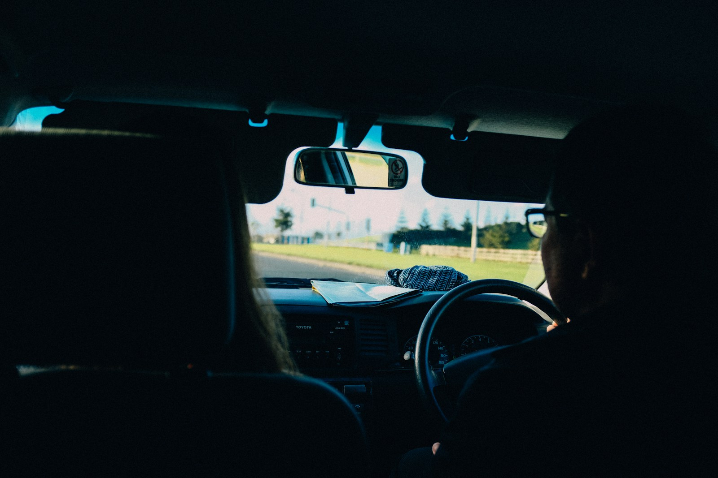
LIMITATIONS AND FUTURE SCOPE
One webcam cue leaves important gaps
Camera conditions and individual differences can affect eye landmarks.
Single eye cue
The code does not combine gaze, head pose, lane position, or steering behavior.
01
Camera conditions
Lighting, glasses, camera placement, and face angle can change detection quality.
02
Evidence and next steps
No labeled clips yet. Collect consented data; measure false alerts, recall, latency, and FPS.
03
Illustrative driving photo, not detector footage
Do not rely on this demo as the sole safety measure while driving.
DRIVER DROWSINESS DETECTION / PROJECT EVALUATION
13
Notes:
The prototype uses one eye-closure signal and does not combine gaze, head pose, lane position, or steering behavior. Lighting, eyewear, camera placement, and face angle may change detection quality. No labeled evaluation set or safety certification is included. Future work should collect consented labeled clips, measure false alerts, recall, alert latency, and runtime, then compare any additional signals against this baseline.
Photo credit: Adrien Olichon, Unsplash, https://unsplash.com/photos/person-driving-car-during-daytime-mOAQM3nkJE8 . The image is illustrative, not detector footage.
Project source: outputs/driver_drowsiness_detection/README.md and driver_drowsiness_detection.py.

Slide 14
CONCLUSION
A focused baseline that can now be evaluated
The project demonstrates a local alert workflow; it does not establish accuracy or safety.
01
Local
Webcam frames are processed on the device and discarded.
02
Explainable
Five-sample median EAR feeds a continuous-closure timer.
03
Responsive
Brief blinks stay green; after 1.5 seconds, a red warning and sound alert begin.
04
Validate
Test on consented, labeled clips before considering broader features.
A learning prototype, not a certified driver-safety system.
DRIVER DROWSINESS DETECTION / PROJECT EVALUATION
14
Notes:
The current MVP demonstrates a local webcam, face landmarks, five-sample EAR smoothing, a continuous-closure timer, and a visual and audio alert. Its behavior is not evidence of detection accuracy or driving safety. Evaluate with consented, labeled clips before expanding the system.
Project source: outputs/driver_drowsiness_detection/README.md and driver_drowsiness_detection.py. No performance results are claimed.

Slide 15
REFERENCES
Project files and technical documentation
Sources used for the implementation description and background context.
Project source
README.md and driver_drowsiness_detection.py · local workspace
MediaPipe Face Landmarker
Google AI Edge · developers.google.com/edge/mediapipe/solutions/vision/face_landmarker
MediaPipe Python API
FaceLandmarker detect_for_video · ai.google.dev/edge/api/mediapipe/python/mp/tasks/vision/FaceLandmarker
Drowsiness detection methods
NHTSA, Assessment of Vehicle-Based Sensors · DOT HS 811 886 (2013)
OpenCV Video I/O
OpenCV documentation · docs.opencv.org/3.4.8/d0/da7/videoio_overview.html
DRIVER DROWSINESS DETECTION / PROJECT EVALUATION
15
Notes:
Project documentation: outputs/driver_drowsiness_detection/README.md and driver_drowsiness_detection.py.
MediaPipe Face Landmarker guide: https://developers.google.com/edge/mediapipe/solutions/vision/face_landmarker
MediaPipe Python FaceLandmarker API: https://ai.google.dev/edge/api/mediapipe/python/mp/tasks/vision/FaceLandmarker
NHTSA report, Assessment of Vehicle-Based Sensors for Drowsy Driving Detection (DOT HS 811 886): https://www.nhtsa.gov/sites/nhtsa.gov/files/811886-assess_veh-based_sensors_4_drowsy-driving_detection.pdf
OpenCV Video I/O Overview: https://docs.opencv.org/3.4.8/d0/da7/videoio_overview.html

Slide 16
THANK YOU
Questions?
Driver Drowsiness Detection · local webcam prototype
A focused baseline: detect, time, warn, then validate.
Not for use as the sole safety measure while driving.
DRIVER DROWSINESS DETECTION / PROJECT EVALUATION
16
Notes:
Closing slide. The project is a learning prototype and is not a certified driver-monitoring or vehicle-safety system.

