Slide 1
DEEPFAKE VIDEO DETECTION
Video → face images → AI model → REAL / FAKE
PROJECT TEAM
Varahagiri Venkata Sri Swati • Aishwary Agrawal • Devesh Srivastava
6,529
73,429
0.9999
videos in Celeb-DF v2
face images prepared
best holdout video AUC

Slide 2
PROJECT OVERVIEW
End-to-end pipeline
The project converts each video into one final REAL / FAKE result.
Video
Take frames
Detect face
Score faces
Video result
→
→
→
→
input
selected images
RetinaFace
ConvNeXt-Tiny
REAL / FAKE
CURRENT RESULT
794 of 809 holdout videos were classified correctly.
ConvNeXt-Tiny was the best of seven models, trained and evaluated in three steps.

Slide 3
STEP 1
Data Preparation
Prepare consistent face images before model training.

Slide 4
STEP 1 — DATA PREPARATION
Dataset used
Celeb-DF v2 was downloaded directly from Kaggle.
590
300
5,639
6,529
real celebrity videos
real YouTube videos
fake videos
total videos
DATA PREPARATION FLOW
Take frames
Detect face
Align face
Resize
→
→
→
from each video
RetinaFace
same position
224 × 224
Output: consistent face images ready for training.

Slide 5
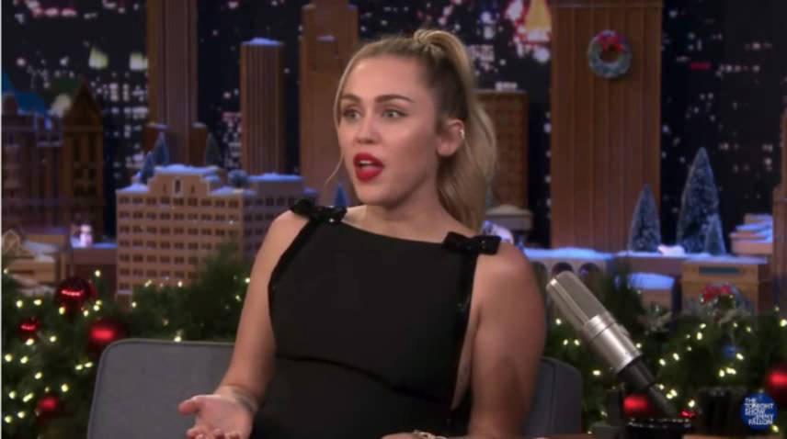
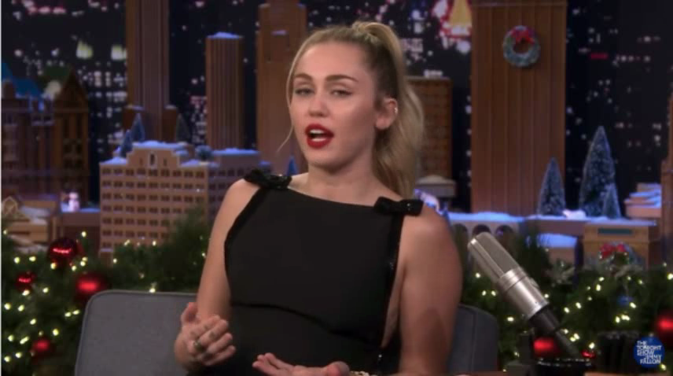
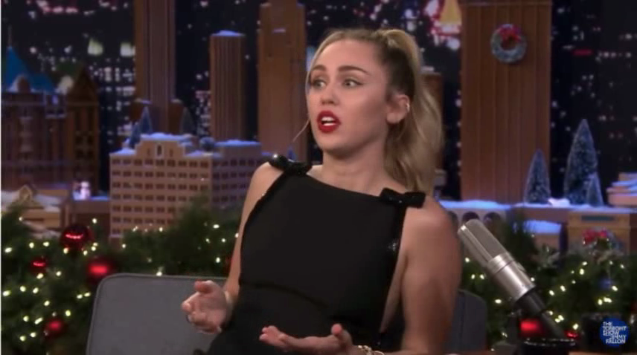
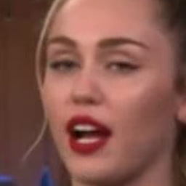
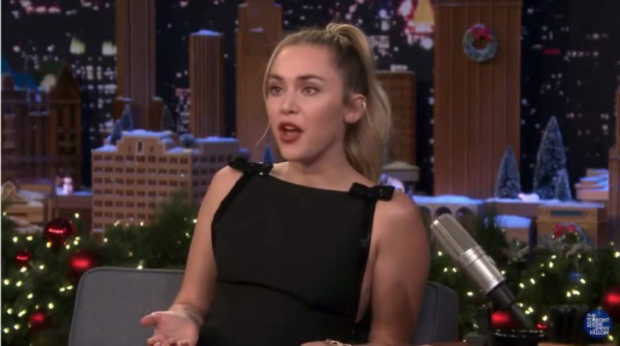


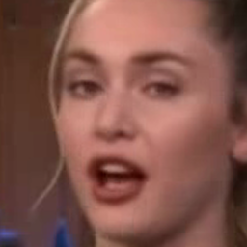
STEP 1 — DATA PREPARATION
Real and fake samples
Each fake swaps another person's face into a real video: the scene stays the same and only the face changes.
Frame at 1.5 s
Frame at 4.6 s
Frame at 7.8 s
Aligned face
REAL
id49_0000.mp4
original video
FAKE
id49_id50_0000.mp4
face from id50
WHAT THE MODEL HAS TO SPOT
Background, pose, clothes and lighting match; only the face is swapped.
So every frame is cropped to the face and aligned on the eyes before scoring. Both videos are from the holdout set, never seen in training.

Slide 6
STEP 1 — DATA PREPARATION
Face detector selected
OpenCV Haar, MTCNN, RetinaFace and YOLOv8 were compared on the same frames from 10 videos.
50.2 FPS
15.4 FPS
4.5 FPS
Retina Face speed, all faces found
MTCNN speed, all faces found
OpenCV Haar speed, 99.3% of faces found
SELECTED METHOD
RetinaFace
3× faster than MTCNN with the same face yield; it's 5 landmarks give eye-aligned face crops.
YOLOv8 was faster (76.3 FPS) but gives unaligned boxes. This comparison checks face detection only.

Slide 7
STEP 1 — DATA PREPARATION
Prepared data output
The final preprocessing run completed for all 6,529 videos.
73,429
99.95%
0
12 parts
face images prepared
face preparation yield
videos without a face
face-image cache saved to Drive
OUTPUT FOR MODEL TRAINING
73,429 prepared face images are passed to Step 2.
All seven models train on these saved face images instead of repeatedly processing the videos.

Slide 8
STEP 2
Model Training
Train seven pretrained models on the same face images and compare them.

Slide 9
STEP 2 — MODEL TRAINING
Data split
Different video groups are used for training, model selection and final testing.
4,385
817
809
518
training videos
validation videos
holdout videos
official test videos
DATA SEPARATION
The 809 holdout videos were kept outside training.
Train, validation and holdout identities were checked to avoid overlap. The 518-video official list is reported separately.

Slide 10
STEP 2 — MODEL TRAINING
Data distribution: videos
Real and fake videos in each split. Real = 590 celebrity + 300 YouTube videos; fake = 5,639 face swaps.
6.3 : 1
fake to real videos overall
7.9 : 1
fake to real in the training split
1.9 : 1
fake to real in the official test list
WHY IT MATTERS
Answering FAKE every time would already be 87% accurate on the holdout videos.
So models are compared with AUC and with errors counted separately for real and fake videos.

Slide 11
STEP 2 — MODEL TRAINING
Data distribution: face images
Face images (one per sampled frame) in each split: 73,429 in total.
2.0 : 1
fake to real faces in training (7.9 : 1 for videos)
32 · 8 · 16
frames taken per real · fake · official-test video
0.51
loss weight on fake faces, to even out the rest
BALANCING
Taking 4× more frames from real videos cuts the imbalance from 7.9 : 1 to 2.0 : 1.
Evaluation still gives each video one score, the average of its faces, so videos with more frames do not count more.

Slide 12
STEP 2 — MODEL TRAINING
Face scoring flow
Each trained model gives a fake score to each prepared face image.
Face image
ConvNeXt-Tiny
Face score
Average
Decision
→
→
→
→
input
best of 7 models
fake score
all face scores
REAL / FAKE
DECISION POINT
MODEL SELECTION
Average < 0.0233 → REAL
ConvNeXt-Tiny
Average ≥ 0.0233 → FAKE
Highest holdout AUC of the seven models; a modern CNN pretrained on ImageNet-22k.

Slide 13
STEP 2 — MODEL TRAINING
Seven models compared
Every model used the same face images, split, augmentation, 224 × 224 input and 8 training rounds.
Model | Type | Parameters | Training time
EfficientNet-B0 | Mid-term baseline, lightweight CNN | 4.0 M | 45 min
ResNet-50 | Classic CNN reference | 23.5 M | 47 min
Xception | Standard deepfake-detection baseline (FaceForensics++) | 20.8 M | 51 min
ConvNeXt-Tiny | Modern CNN pre trained on ImageNet-22k | 27.8 M | 49 min
Swin-Tiny | Vision transformer with local attention windows | 27.5 M | 50 min
EfficientNet-B4 | Larger version of EfficientNet-B0 | 17.6 M | 53 min
CLIP ViT-B/16 | Foundation model; only the last 4 of 12 blocks trained | 85.8 M | 50 min
TRAINING SETUP
Each model trained in 45–53 minutes on a Colab T4 GPU.
Progress was saved after every round, so a run could resume after a Colab disconnect.

Slide 14
STEP 2 — MODEL TRAINING
Training result
Each model's best round was selected using validation data.
Round 7
0.0233
7 saved
best round for ConvNeXt-Tiny
ConvNeXt-Tiny decision point from validation
best rounds used in Step 3
FINAL TRAINING OUTPUT
Step 3 uses each model's best round and decision point.
No retraining is done during the final evaluation.

Slide 15
STEP 3
Evaluation and Demo
Evaluate the saved models on unseen videos, test their robustness and run the complete video demo.

Slide 16
STEP 3 — EVALUATION AND DEMO
Evaluation scope
The saved models are tested after training.
Load models
Test videos
Compare labels
Stress test
Grad-CAM + demo
→
→
→
→
7 saved
809 + 518
correct / wrong
JPEG, resize, blur
attention, video → result
STEP 3 OUTPUT
Accuracy, AUC, errors, robustness, attention maps and demo.
The holdout test is the main unseen-video check; the official test provides the Celeb-DF benchmark result.

Slide 17
STEP 3 — EVALUATION AND DEMO
Model comparison
All seven models on the 809 holdout videos (main result) and the 518 official test videos.
Model | Holdout AUC (95% CI) | Holdout accuracy | Holdout EER | Official AUC | Speed (img/s)
ConvNeXt-Tiny | 0.9999 (0.9997–1.0000) | 98.15% (794) | 0.008 | 0.9998 | 575
EfficientNet-B4 | 0.9990 (0.9978–0.9999) | 97.90% (792) | 0.011 | 0.9991 | 517
Swin-Tiny | 0.9988 (0.9975–0.9997) | 98.15% (794) | 0.022 | 0.9988 | 462
Xception | 0.9986 (0.9970–0.9996) | 98.39% (796) | 0.012 | 0.9992 | 567
ResNet-50 | 0.9981 (0.9963–0.9994) | 97.78% (791) | 0.010 | 0.9969 | 841
EfficientNet-B0 | 0.9981 (0.9963–0.9993) | 97.65% (790) | 0.020 | 0.9979 | 1,440
CLIP ViT-B/16 | 0.9873 (0.9811–0.9927) | 94.31% (763) | 0.049 | 0.9955 | 318
Accuracy uses each model's own validation decision point. Speed is GPU images per second on prepared faces (T4).
KEY FINDING
ConvNeXt-Tiny separated REAL and FAKE videos best.
Its 95% interval lies above EfficientNet-B0, ResNet-50 and Xception. Accuracy differs by only a few videos among the top five.

Slide 18
STEP 3 — EVALUATION AND DEMO
Evaluation results
ConvNeXt-Tiny predictions are compared with the known REAL / FAKE label of each test video.
794 / 809
98.15%
0.9998
0.954
holdout videos correct
holdout accuracy
official video AUC
official video F1
RESULT CHECK
Holdout: 90 REAL + 704 FAKE = 794 correct | 15 + 0 = 15 wrong
Official: AUC 0.9998 and F1 0.954 at the same 0.0233 decision point
Accuracy = correct predictions ÷ total videos. No fake holdout video was missed.

Slide 19
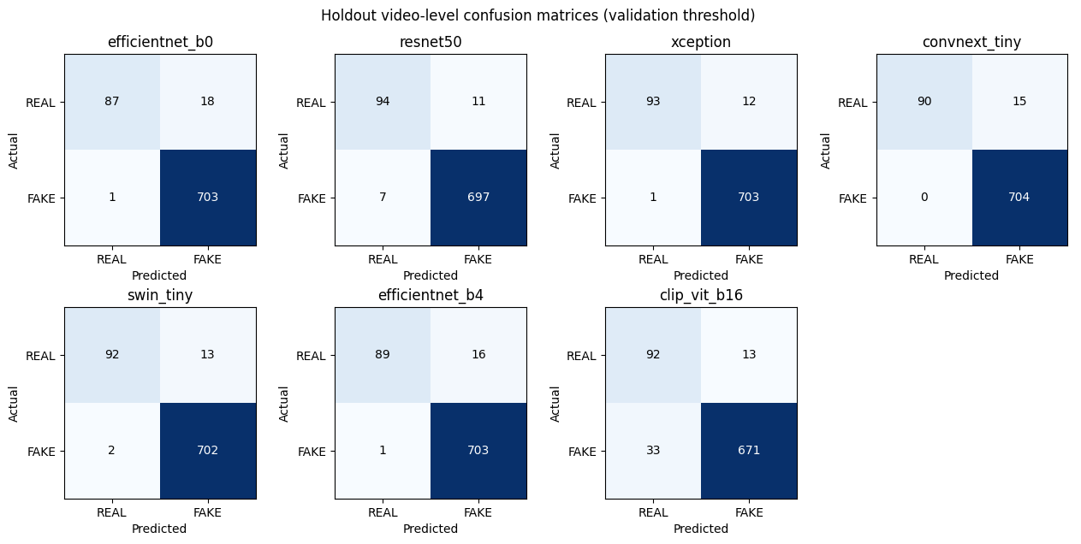
STEP 3 — EVALUATION AND DEMO
Correct and wrong predictions
Holdout confusion matrices for all seven models, each at its own validation decision point.
CONVNEXT-TINY — 809 VIDEOS
794
15
correct predictions
wrong predictions
ACROSS ALL SEVEN MODELS
13
46
fewest errors (Xception)
most errors (CLIP)
Most errors are real videos flagged as fake. ConvNeXt-Tiny missed no fake video.

Slide 20
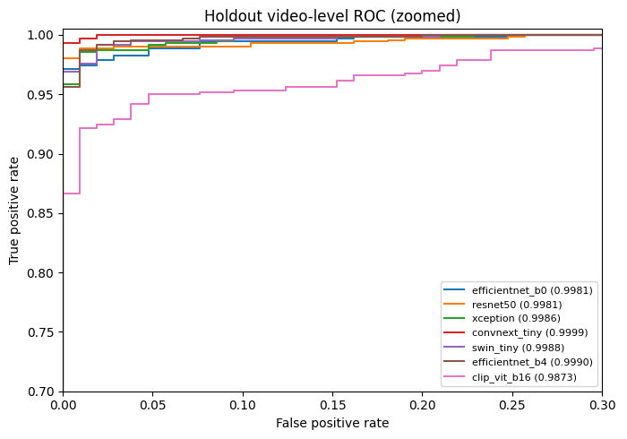
STEP 3 — EVALUATION AND DEMO
ROC / AUC result
AUC checks how well model scores separate REAL and FAKE videos.
0.9999
0.9998
ConvNeXt holdout AUC
ConvNeXt official AUC
RESULT
ConvNeXt-Tiny (red) is closest to the top-left corner; CLIP (pink) is lowest.
Zoomed view of the holdout videos. All AUC values are on the comparison slide.

Slide 21
STEP 3 — EVALUATION AND DEMO
Robustness check
Holdout faces were scored again after JPEG compression, downscaling and blur, as happens when videos are re-uploaded.
MOST ROBUST
ConvNeXt-Tiny
AUC stayed at 0.9985 or higher under every distortion (worst drop 0.0014).
LEAST ROBUST
CLIP ViT-B/16
AUC fell to 0.9718 under blur (drop 0.0192).
JPEG quality 30 and half-size downscaling are harsher than anything used in training.

Slide 22
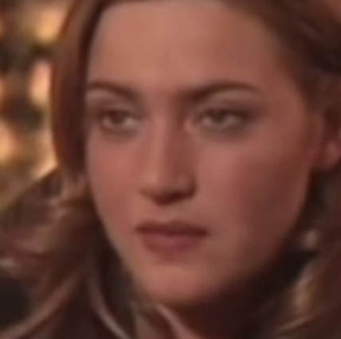
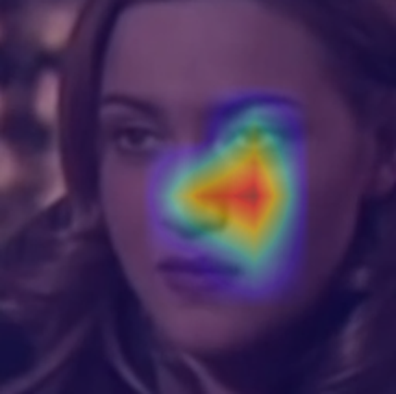
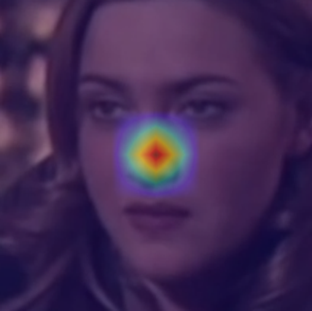
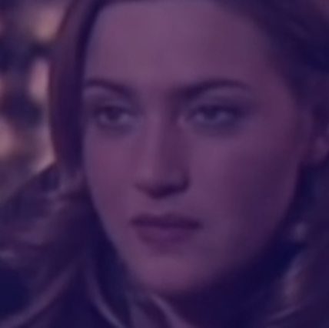
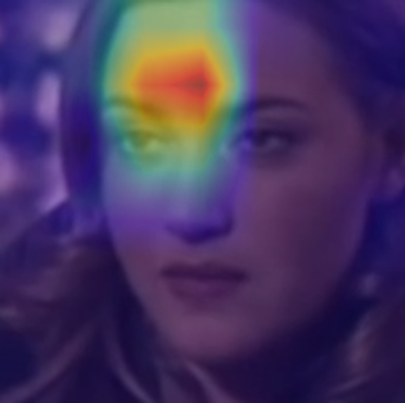
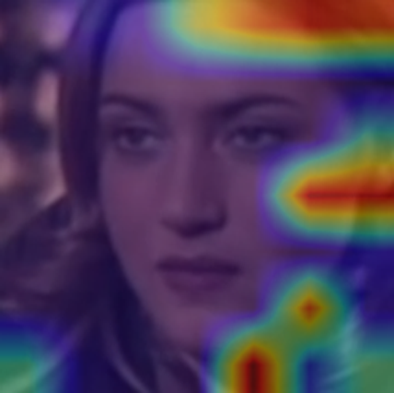
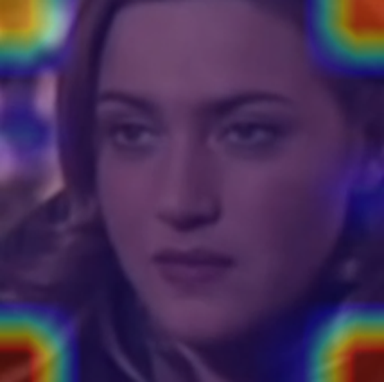
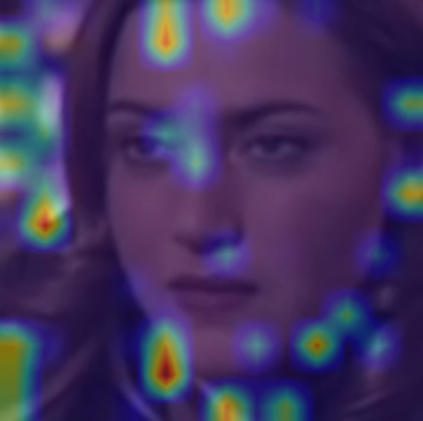
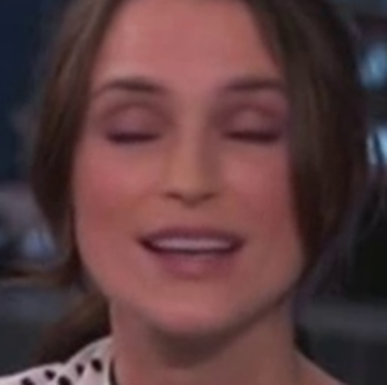
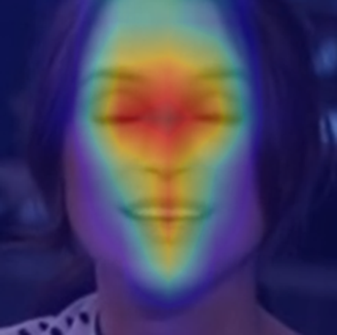
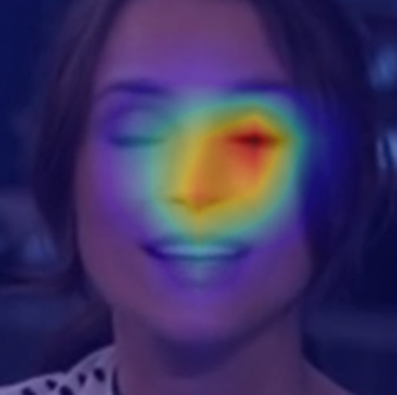
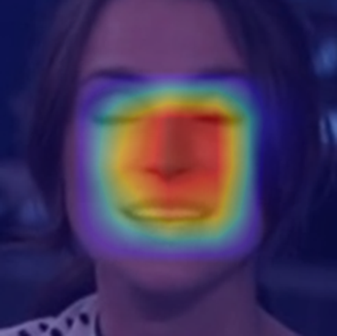
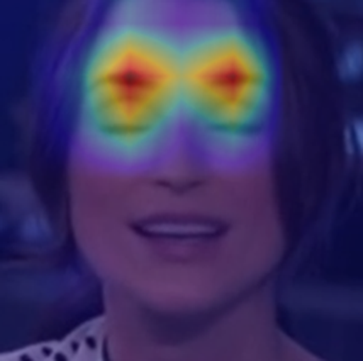
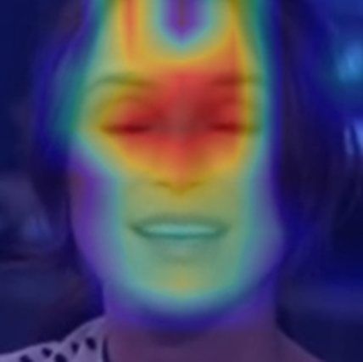
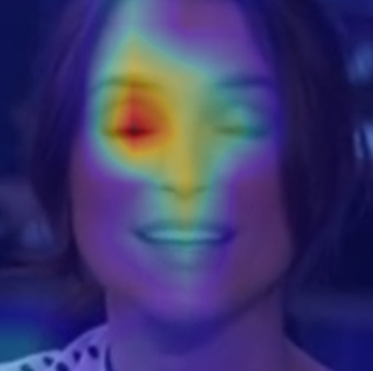
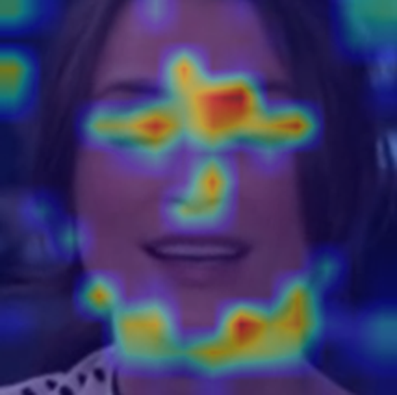
STEP 3 — EVALUATION AND DEMO
Grad-CAM output
Grad-CAM highlights the face regions that most influenced each model's score.
Input face
EfficientNet-B0
ResNet-50
Xception
ConvNeXt-Tiny
Swin-Tiny
EfficientNet-B4
CLIP ViT-B/16
REAL face
P(fake) 0.023
P(fake) 0.002
P(fake) 0.000
P(fake) 0.065
P(fake) 0.000
P(fake) 0.004
P(fake) 0.000
FAKE face
P(fake) 1.000
P(fake) 1.000
P(fake) 1.000
P(fake) 1.000
P(fake) 1.000
P(fake) 1.000
P(fake) 0.995
ATTENTION SHOWN
PURPOSE
On the fake face, most models focus on the eyes, nose and mouth, where the face swap is blended.
Scores are for single frames; the REAL / FAKE decision uses the average over the whole video.

Slide 23
STEP 3 — EVALUATION AND DEMO
Full video demo
Two complete videos were passed through the final pipeline with ConvNeXt-Tiny.
DEMO OUTPUT
REAL
FAKE
Both sample videos were predicted correctly.
demo 1 correct
demo 2 correct
Video | Truth | Faces | P(fake) | Prediction | Time
id49_0000.mp4 | REAL | 32 | 0.00003 | REAL | 18.0 s
id49_id50_0000.mp4 | FAKE | 32 | 0.8717 | FAKE | 1.6 s
32
1.6 s
frames checked per video
per video after warm-up
REAL: 0.00003 → REAL ✓
FAKE: 0.8717 → FAKE ✓
32 evenly spaced frames per video, one face from each; P(fake) is their average. The first video took 18 s because it also loaded the face detector.
PROCESSING FLOW
Video → faces → scores
→ average → REAL / FAKE

Slide 24
STEP 3 — EVALUATION AND DEMO
Speed check
Model speed and complete-video time are measured separately.
575 images/sec
~1.6 sec/video
ConvNeXt-Tiny alone on an NVIDIA T4 GPU (Colab): batches of 64 face images of 224 × 224
856 × 478 video, 9.3 s long, 32 frames scored; face detection and model on an NVIDIA T4 GPU (Colab)
RUNTIME
Python timers measure the processing duration.
Model speed excludes face detection (318 to 1,440 images/sec across the seven models). Full-video times by size, frames and hardware: next slide.

Slide 25
STEP 3 — EVALUATION AND DEMO
Speed test: video size, frames and hardware
Time to score one video end to end: read frames, find and align faces, score them, average. Models already loaded.
Hardware | Face detection on | Video size and length | Frames scored | Time per video
NVIDIA T4 GPU (Colab) | GPU | 856 × 478, 9.3 s | 32 | 1.6 s
NVIDIA T4 GPU (Kaggle) | CPU | 974 × 500, 10.3 s | 32 | 6.1 s
NVIDIA T4 GPU (Kaggle) | CPU | 286 × 300, 10.6 s | 32 | 5.9 s
Apple M2 Pro, CPU only | CPU | 856 × 478, 9.3 s | 8 / 16 / 32 / 64 | 2.3 / 2.4 / 4.4 / 8.8 s
Apple M2 Pro, CPU only | CPU | 640 × 360 → 1920 × 1080, 9.3 s | 32 | 4.3 → 4.8 s
Apple M2 Pro, CPU only | CPU | 856 × 478, 55.6 s (looped) | 32 | 4.5 s
WHAT DRIVES THE TIME
Frames scored and where face detection runs, not video size or length.
Face detection on the T4 GPU took 1.6 s instead of about 6 s on CPU. Doubling the frames doubles the time; 360p to 1080p only adds decoding; a 6× longer video takes the same time because frames are sampled.
T4 rows: timings recorded by the Colab and Kaggle training notebooks (detector on CPU in Kaggle). M2 Pro rows: median of 3 runs after a warm-up, 4 CPU threads as in the app; below 16 faces PyTorch uses a slower path on this CPU, so 8 frames take as long as 16.

Slide 26
PROJECT STATUS
Completed work
The implementation covers the full pipeline and a seven-model comparison.
1
Dataset prepared
2
Faces prepared
3
Models trained
6,529 videos checked
73,429 face images
7 models compared
4
Models evaluated
5
Results reviewed
6
Demo completed
809 + 518 videos
AUC + robustness + Grad-CAM
ConvNeXt-Tiny: video → result
CONVNEXT-TINY
0.9999 holdout AUC
98.15% holdout accuracy

Slide 27
MY UPDATE
What I changed for the low-resolution test
The goal was simple: use more frames and check whether enhancement actually improves low-quality videos.
Test area | Previous approach | Updated test
Frames checked | 32 frames | 64 frames per video
Video quality | Normal / high quality | Low-resolution videos included
Enhancement check | Limited comparison | Original vs Enhanced
Kaggle test | Single example | 3 different REAL low-resolution videos
WHY 64 FRAMES
WHY LOW RESOLUTION
WHY ENHANCE
More coverage
Harder input
Measure benefit
More moments from each video are reviewed
Checks performance on poorer video quality
Compare confidence before and after
Main question: does enhancement improve the result, or is the original low-resolution video already sufficient?

Slide 28

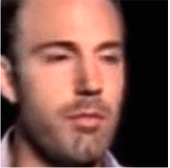



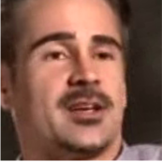
FACE OUTPUT
What the model actually saw
Example extracted face frames from each low-resolution REAL video, before and after enhancement.
REAL Low 1 • 348 × 500
REAL Low 2 • 456 × 500
REAL Low 3 • 476 × 482
ORIGINAL
ENHANCED
ORIGINAL
ENHANCED
ORIGINAL
ENHANCED
64 / 64 faces found in Original and Enhanced
64 / 64 faces found in Original and Enhanced
64 / 64 faces found in Original and Enhanced
FACE DETECTION
VISUAL CHANGE
NEXT CHECK
No issue
Faces look clearer
Compare confidence
64 / 64 faces found for all 3 videos
Enhancement changes appearance, not the label
The next slide shows whether this helped
Observation: enhancement changed the appearance of the extracted faces, but face detection was already complete before enhancement.

Slide 29
ENHANCEMENT CHECK + FINAL RESULT
REAL low-resolution: original vs enhanced
The same 3 low-resolution REAL videos were tested before and after enhancement, giving 6 outputs in total.
Video / version | Resolution | Faces | Fake score | Confidence | Prediction
REAL Low 1 — Original | 348 × 500 | 64 / 64 | 0.0000 | 100% | REAL ✓
REAL Low 1 — Enhanced | 348 × 500 | 64 / 64 | 0.0000 | 100% | REAL ✓
REAL Low 2 — Original | 456 × 500 | 64 / 64 | 0.0000 | 100% | REAL ✓
REAL Low 2 — Enhanced | 456 × 500 | 64 / 64 | 0.0000 | 100% | REAL ✓
REAL Low 3 — Original | 476 × 482 | 64 / 64 | 0.0000 | 100% | REAL ✓
REAL Low 3 — Enhanced | 476 × 482 | 64 / 64 | 0.0000 | 100% | REAL ✓
OUTPUTS SHOWN
FACE DETECTION
CONFIDENCE
FINAL RESULT
6 outputs
Same result
Same result
3 / 3 videos correct
3 Original + 3 Enhanced results
All 64 sampled faces were detected in each test
100% before and after enhancement
All 3 were correctly predicted as REAL
Conclusion: Enhancement did not improve these 3 videos. Each was already correctly predicted as REAL with a 0.0000 fake score and 100% confidence before enhancement.
Note: the 6 rows above come from 3 selected REAL videos tested twice (Original + Enhanced). Run B overall performance: Validation accuracy 98.78%, Holdout accuracy 97.28%, with AUC 0.9998 on both. Threshold = 0.4825 (selected using validation data only)..

Slide 30

THANK YOU
Try the deepfake detector live: upload a short video of a face and get a REAL / FAKE decision.
LIVE DEMO
detect-deep-fake.streamlit.app
The Streamlit app built from this project. Scan the code to open it on a phone.
PROJECT TEAM
Varahagiri Venkata Sri Swati • Aishwary Agrawal • Devesh Srivastava

