Slide 1

Motor Insurance
Database Management System
Database Systems Project
Name: AHABWE CEDRIC
RegNo: 2025/BCS/001
Group: 7
Date: 5th May 2026

Slide 2

Agenda
Project Selection
Business Case
01
02
Database Design
Implementation
03
04
Sample Queries & Results
Demonstration & Conclusion
05
06
2

Slide 3


1. Project Selection — Insurance Industry
Possible Systems
Why Motor Insurance?
Health Insurance System
1
Covers complete insurance cycle
(Customer → Vehicle → Policy → Claim → Payment)
Life Insurance System
2
High real-world application in Uganda
✓ Motor Insurance System (Chosen)
3
Suitable scope for database design & implementation
4
Clear entities and relationships
3

Slide 4





2. Business Case
Application Domain
Benefits
Manages motor insurance policies, vehicles, claims & payments for insurance companies/agents.
Faster claim processing · Better customer retention · Reduced errors on premium calculation and claims processing · Improved decision making
Costs vs Risks
Limitations
Low cost (uses free MySQL). Risks: data security & regulatory changes — all around with constraints & backups.
Designed for small to medium insurance businesses. Not enterprise-level.
Comparable System: Guidewire InsuranceSuite
4

Slide 5
3. Logical Design — Entities & Relationships
Main Entities
Key Relationships
Customer
Customer
1 : N
Policy
One customer can have many policies
Vehicle
Vehicle
1 : N
Policy
One vehicle can be covered by many policies
Policy
Policy
1 : N
Claim
One policy can have many claims
Claim
Payment
Policy
Payment
One policy can have many payments
1 : N
ER Diagram → See Next Slide
5

Slide 6
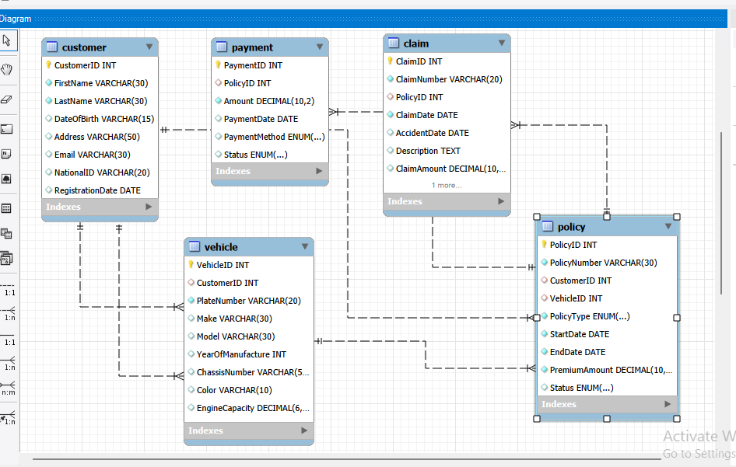
ER Diagram — Entity Relationship Diagram (EER)
[ Insert EER Diagram Screenshot Here ]
Export from MySQL Workbench → Database → Reverse Engineer
Motor Insurance Database — Entity-Relationship Diagram (EER)
6

Slide 7
Implementation — Table Creation
Database: motor_insurance
CREATE TABLE customer (...
CREATE TABLE policy (
customer_id INT PRIMARY KEY,
first_name VARCHAR(50),
last_name VARCHAR(50),
email VARCHAR(100),
phone VARCHAR(20),
...
policy_id INT PRIMARY KEY,
customer_id INT NOT NULL,
vehicle_id INT NOT NULL,
start_date DATE,
end_date DATE,
...
ALL THIS WAS USED TO CREATE THE FIVE TABLES USING MYSQL LANGUAGE.
8

Slide 8
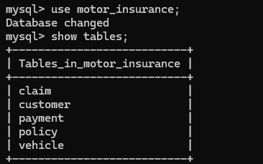
Physical Design — Table Structures
Screenshots taken from MySQL Client line
SHOW TABLES;
Shown are the tables in the motor_insurance database created using mysql
[ Screenshot Here ]
DESCRIBE Vehicle;
[ Screenshot Here ]
Note: All tables created in MySQL Command Line Client with proper Primary and Foreign Keys.
7

Slide 9
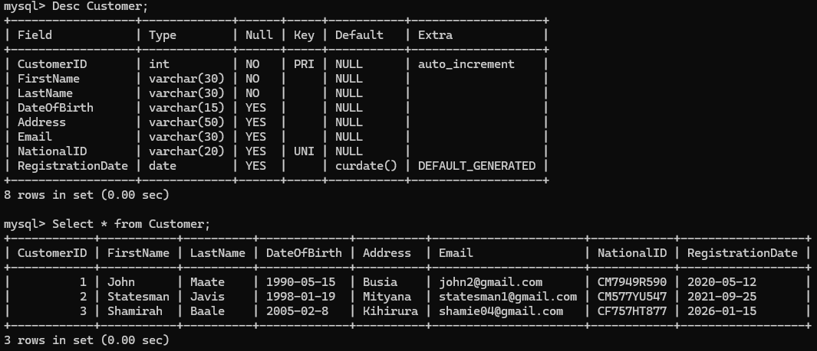
customer table:
Customer table:
[ Screenshot Here ]

Slide 10
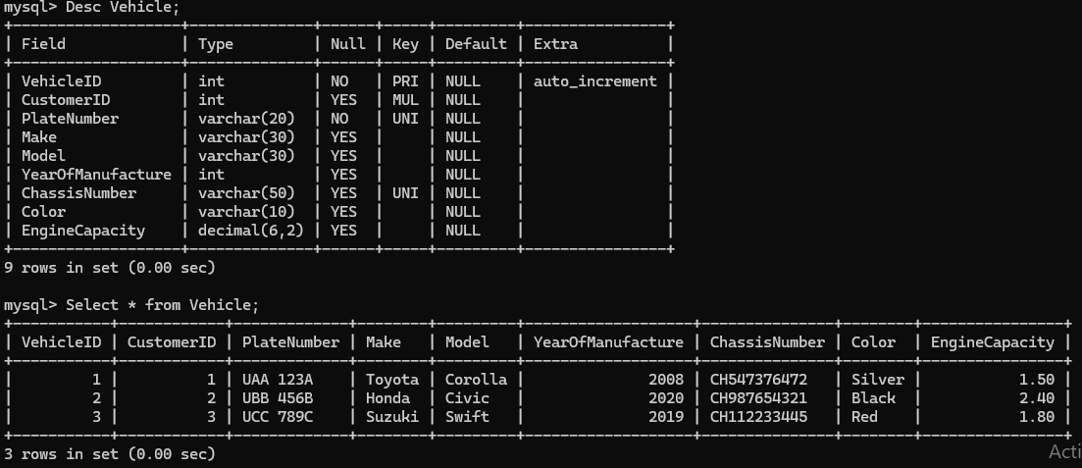
vvehicle table:

Slide 11
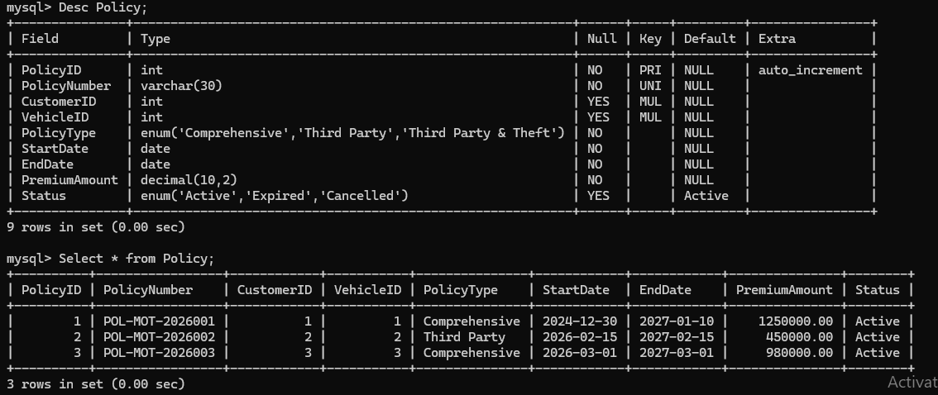
policy table:

Slide 12
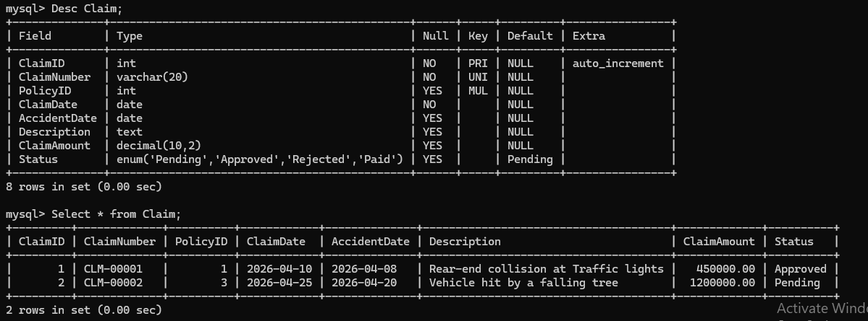
claim table:

Slide 13
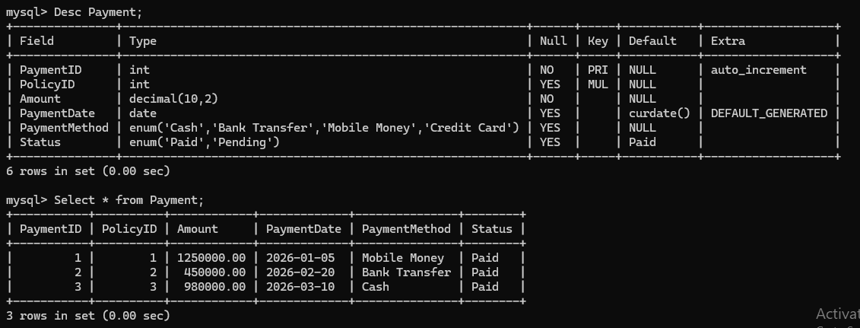
payment table:

Slide 14

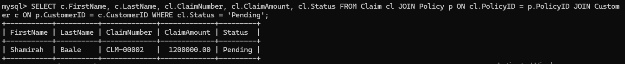
Query Results — Output Screenshots
Policies Expiring Soon
Total Claims by Customer/Policy
[ Insert Query Result Screenshot ]
This brought an Empty set as there seemed no policy to expire in the 60 day peroid.
Pending Claims Report
Premium Summary
This brought customers that had pending claims.
11

Slide 15
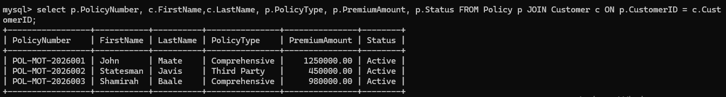
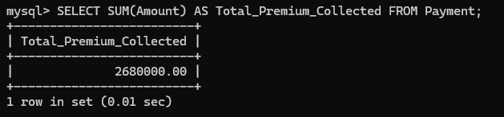
Query Results — Output Screenshots
AAll active policies with customer names:
Total premium calculated:

Slide 16
Conclusion
Successfully designed and implemented a Motor Insurance Database using MySQL
All assignment requirements completed (Phase 1 through final submission)
System is functional and ready for use by small insurance companies
Valuable learning experience in database design and SQL implementation
Future Improvements:
Reporting module · Login & role-based access system
13

Slide 17
Thank You!
Get your motor insured
https://github.com/2025bcs001-Hera/Motor_Insurance-CEDRIC
GitHub Link:
Motor Insurance Database Management System · Database Systems Project · May 2026

