Slide 1
DATABASE GROUP 3 PROJECT
By;
AKAMUMPA MARTIN
REGNO;
2025/BCS/023/PS

Slide 2
Salon Management System
As a group, we selected the Saloon Management System as our area of interest. This is because it involves multiple operations such as managing customers, appointments, services and financial transactions making it suitable for database design and implementation.

Slide 3
PAYMENT AND TRANSACTIONS DATABASE PROJECT
Personally, I focused on the Payment and Transactions Management subsystem.
The reason for choosing this subsystem is because financial management is a critical aspect of any business. A well-designed payment and transaction system ensures accuracy, reduces errors, and provides reliable records for decision-making. It also helps the organization track revenue and analyze payment trends effectively.

Slide 4
Reasons for choosing the transactions database
- Easy to use
- Open-source
- Supports relationships
- Works with XAMPP

Slide 5
Application Domain
Handles:
- Customer payments
- Payment tracking
- Receipt generation
- Daily income monitoring
Users:
Cashier, Manager, Accountant

Slide 6
Benefits
Tangible:
Accurate records
Faster work
Easy to calculate daily income
Intangible:
Better decisions
Customer trust

Slide 7
Costs
Tangible:
- Hardware
- Setup
Intangible:
- Training
- Adaptation time

Slide 8
User Challenges
Training required since some workers may not know how to use computers.
Resistance to change due to fear of new machines or technology.
Basic computer skills needed

Slide 9
Risks
Technical:
System failure/crashes.
Data loss
Hackers
Mitigation:
Backups
Training

Slide 10
Limitations
Requires electricity
Limited offline functionality
It depends on correct data entry.

Slide 11
Entities
Customer
Services
Appointments
Appointment_Services
Payments

Slide 12
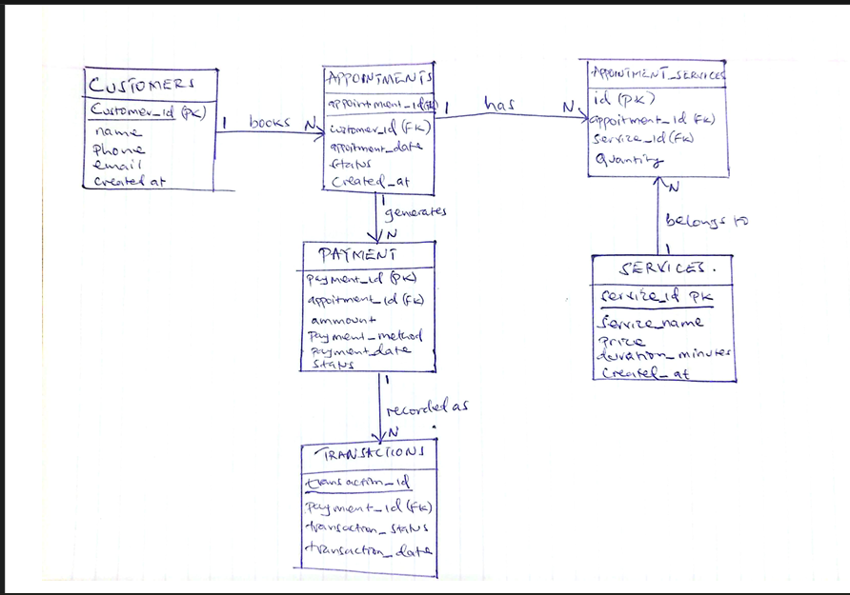
ER DIAGRAM

Slide 13
Database Tables
Customers table
Service
Appointment
Appointment_Services
Payment

Slide 14
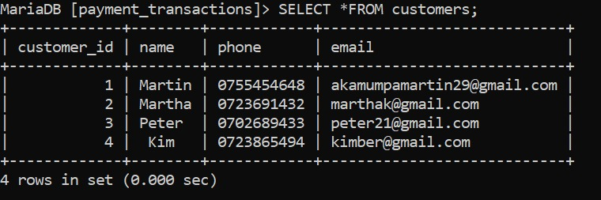
Customer table

Slide 15
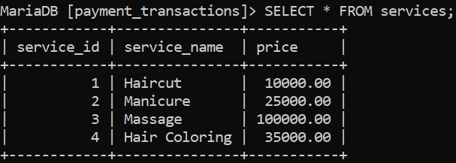
Services table

Slide 16
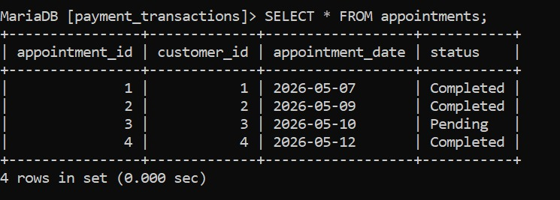
Appointments table

Slide 17
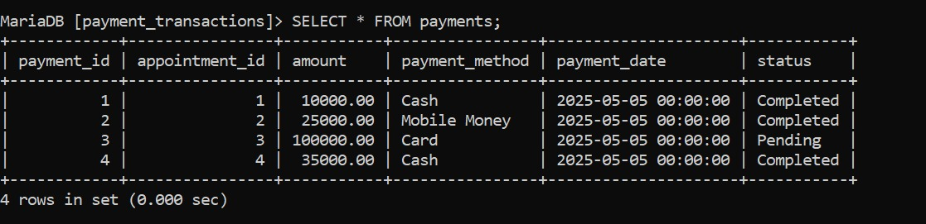
Payments Table

Slide 18
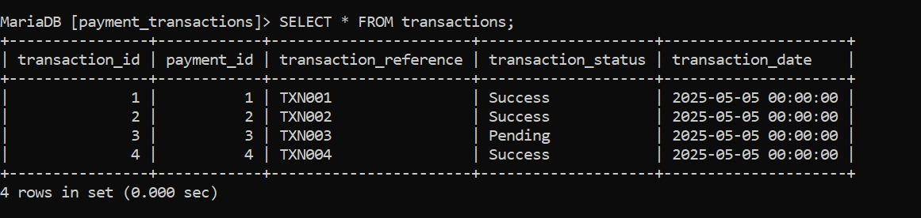
Transactions Table

Slide 19
Relationships between the tables(Queries)
All Project Queries combined(Joined)
Total daily revenue
Payments by method
Customer payment history

Slide 20
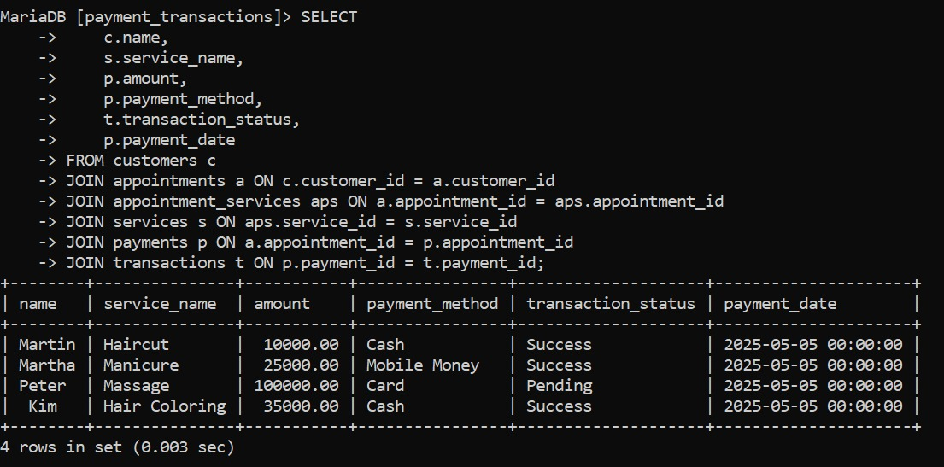
All Project Queries combined(Joined)

Slide 21
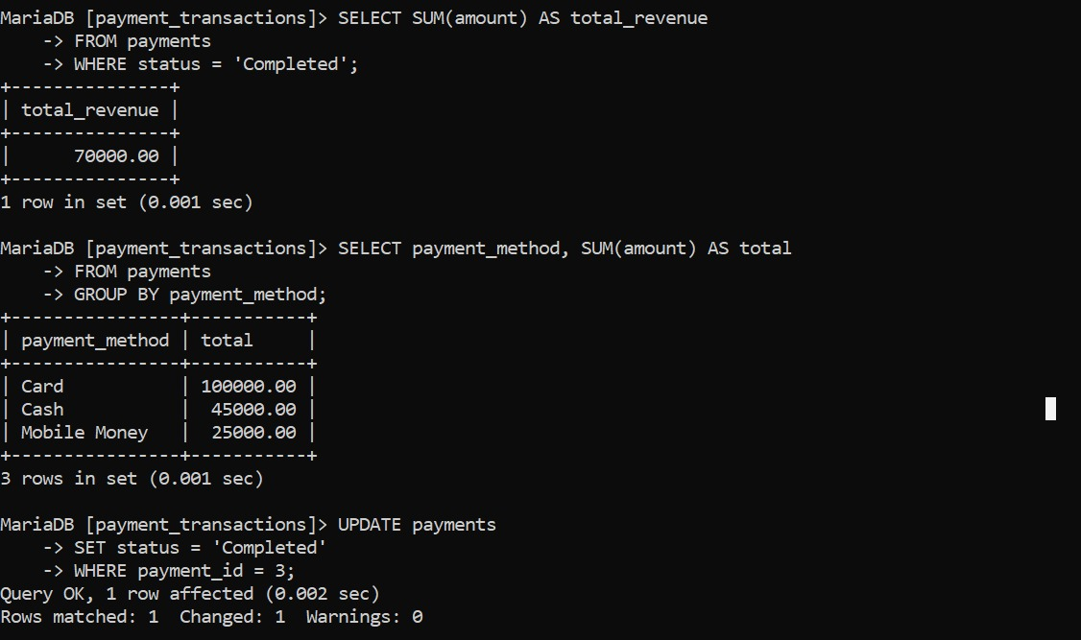
Total daily revenue and payment methods

Slide 22
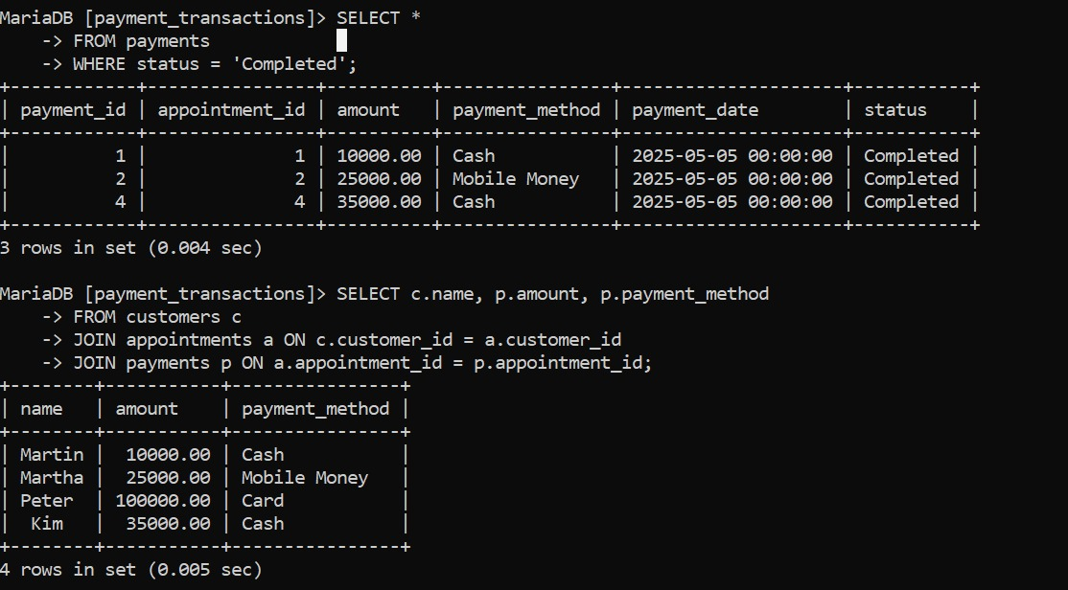
Customer payments

Slide 23
Conclusion
In conclusion, the main goal of the system is to replace manual financial record-keeping with a structured database solution that ensures accuracy, security, and easy retrieval of transaction data.

