Slide 1
Patient Database System
Database Management Systems Project
Hospital Setting
GROUP 10
NAMANYA DAVID MUGIZI 2025/BCS/140/PS

Slide 2
Introduction
The area of interest selected for this project is the Healthcare and Hospital Management sector. Hospitals generate and rely on large volumes of data daily, ranging from patient demographics and clinical notes to lab results and billing records.
A Patient Database System provides a centralized digital platform for storing, managing, and retrieving patient information efficiently. It enhances decision-making, reduces redundancy, and improves overall hospital operations.

Slide 3
objectives
Problem statement
Store patient data
Manage appointments
Track treatments
Ensure data integrity
The following are the problems the system is set to solve;
Data transparency
Slow retrieval
Duplicate data
Poor management
Data security

Slide 4
System Overview
users
Register patients
Store medical records
Schedule appointments
Track diagnoses
Doctors
Receptionists
Administrators

Slide 5
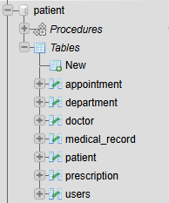
Work flow

Slide 6
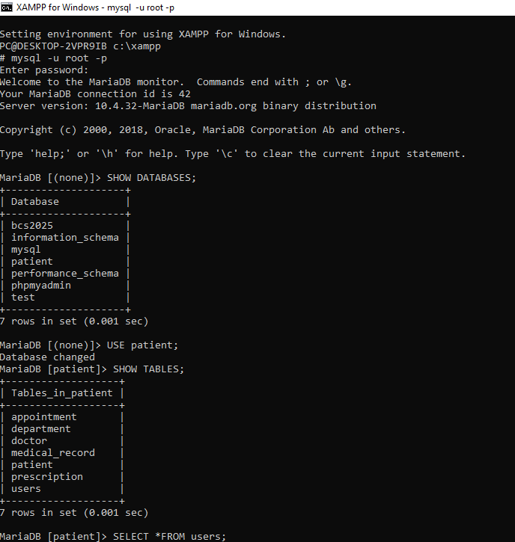


Slide 7
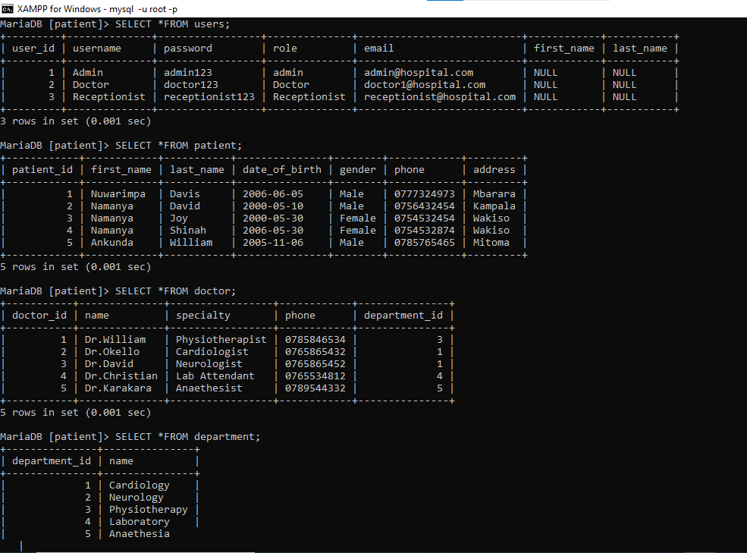

Slide 8
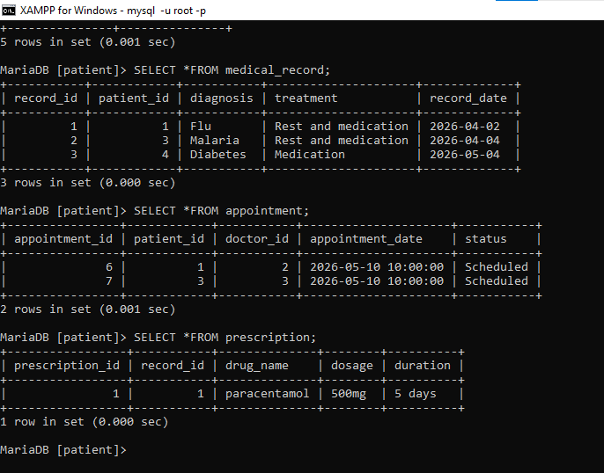

Slide 9
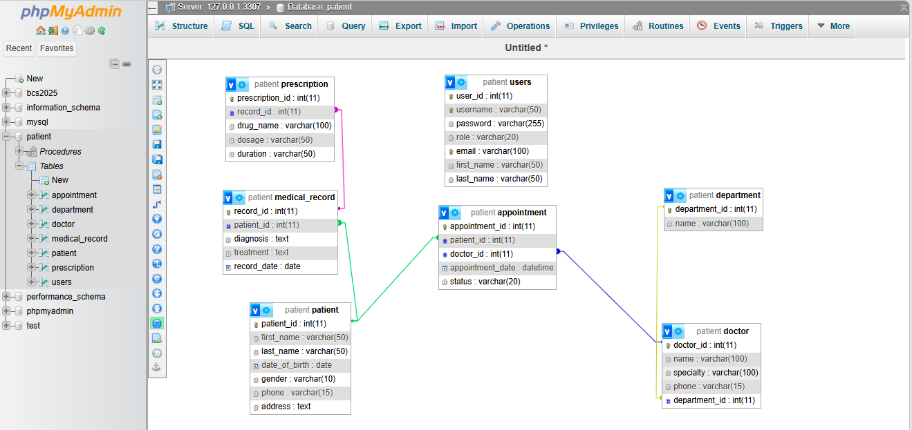

Slide 10
Relationships (Cardinality)
Patient → Appointment (1:N)
Doctor → Appointment (1:N)
Department → Doctor (1:N)
Patient → Medical Record (1:N)
Medical Record → Prescription (1:N)
Users ↔ Doctor (M:N via linking)

Slide 11
Advantages
Limitations
Fast data access
Reduced errors
Efficient management
Requires training
System dependency
Limited scope

Slide 12
Conclusion
Improves healthcare data management
Enhances efficiency
Future: mobile & AI integration

