Slide 1
FIMS PROJECT
Fire Insurance Management System
Database Design & Implementation
By TASHOBYA MARK | 2025/BCS/177/PS
Slide 1 of 15

Slide 2
1. EXECUTIVE SUMMARY
The Fire Insurance Management System (FIMS) is a relational database application designed to automate the management of fire insurance policies. This project documents the complete lifecycle of database development:
Developing a business case and identifying requirements.
Creating normalized logical and physical designs.
01
02
Implementation using MariaDB and loading sample data.
Executing queries to solve organizational problems.
03
04
Slide 2 of 15

Slide 3
2. BUSINESS CASE: APPLICATION DOMAIN
Domain Analysis
Key Users
FIMS operates within the Property Insurance sector. It tracks insured properties, the policies covering them, and manages the financial transactions associated with premiums.
The system is designed for Insurance Agents, Claims Officers, and Administrative staff to manage customer profiles and claim processing efficiently.
Slide 3 of 15

Slide 4
2. BUSINESS CASE: BENEFITS
Tangible Benefits
Intangible Benefits
Reduction in paper-based filing costs.
Improved data security and privacy.
Elimination of manual data entry errors.
Increased customer trust through faster claim settlement.
Faster retrieval of historical claim data.
Better management oversight via reporting.
Slide 4 of 15

Slide 5
2. BUSINESS CASE: COSTS & RISKS
Costs: Low implementation costs due to the use of open-source MySQL/MariaDB. Main effort involves initial system training for employees.
Risks & Limitations
Data Loss
Scope Limit
Network Dependency
Risk mitigated by automated backups.
Handles only Fire Hazards; multi-peril policies not in V1.0.
Dependency on internet/local network availability.
Slide 5 of 15

Slide 6
3. LOGICAL DESIGN: ENTITIES (1–4)
Entity | Primary Key | Attributes
Customer | customer_id | first_name, last_name, phone, email, address
Property | property_id | customer_id (FK), type, location, value
Policy | policy_id | property_id (FK), coverage, premium, status
Payment | payment_id | policy_id (FK), date, amount, method
Slide 6 of 15

Slide 7
3. LOGICAL DESIGN: ENTITIES (5–8)
Entity | Primary Key | Attributes
FireIncident | incident_id | property_id (FK), date, cause, damage_level
Claim | claim_id | policy_id (FK), incident_id (FK), date, amount
Employee | employee_id | employee_name, role, contact
Renewal | renewal_id | policy_id (FK), renewal_date, amount
Slide 7 of 15

Slide 8
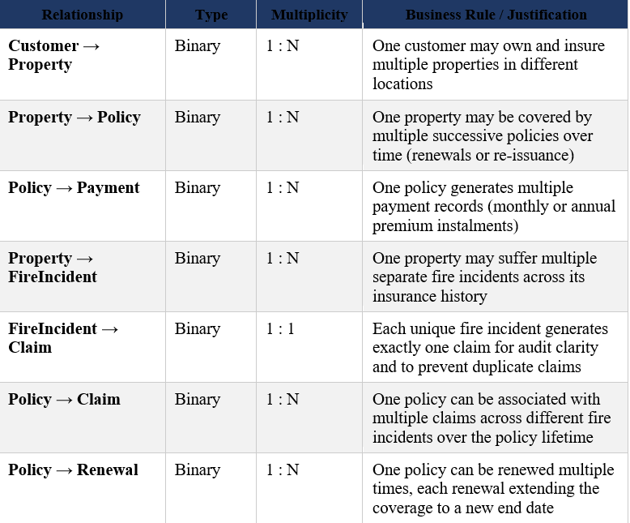
3. LOGICAL DESIGN: MULTIPLICITIES
The system uses relational logic to link entities:
Slide 8 of 15

Slide 9
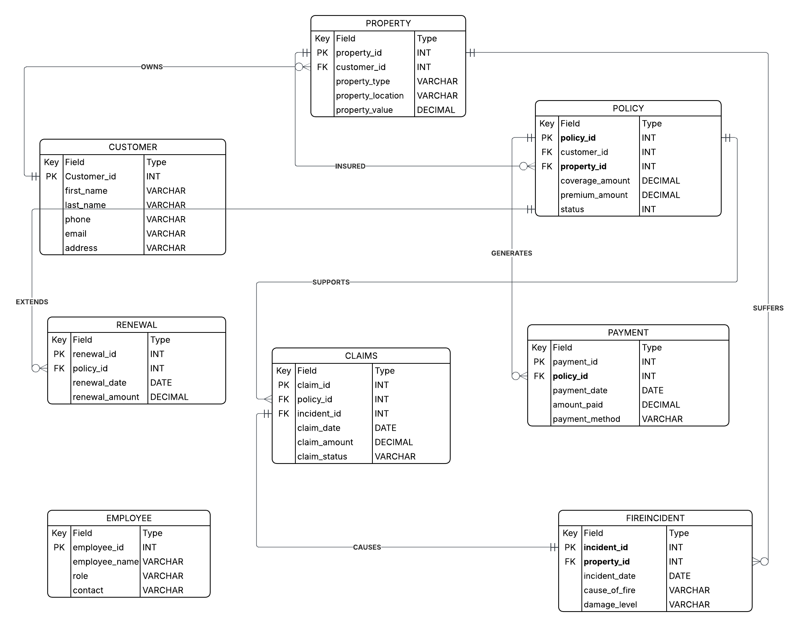
3. LOGICAL DESIGN: ER DIAGRAM
Slide 9 of 15

Slide 10
3. LOGICAL DESIGN: DIALOGUE STRUCTURE
Workflow: Issuing a New Policy
Step | Screen / Action | Description
1 | User Login | User enters username and password; system validates credentials and assigns role-based access permissions (agent, claims officer, admin, or management)
2 | Search / Add Customer | Agent searches for an existing customer by name or ID; if new, enters full customer details: first name, last name, phone number, email address, and physical address
3 | Register Property | Agent enters full property details: property type (residential/commercial/industrial), physical location, declared monetary value, year built, and size in square metres
4 | Define Policy Terms | Agent selects coverage amount, system calculates premium (based on declared value × premium rate), sets policy start and end dates, and assigns policy status as 'Active'
5 | Process Initial Payment | Finance staff records the first premium payment: amount, payment method (cash, mobile money, or bank transfer), transaction reference number, and payment date
6 | System Confirmation | System generates a unique policy number, stores all related records across Customer, Property, Policy, and Payment tables, and displays a summary confirmation to the agent
Slide 10 of 15

Slide 11
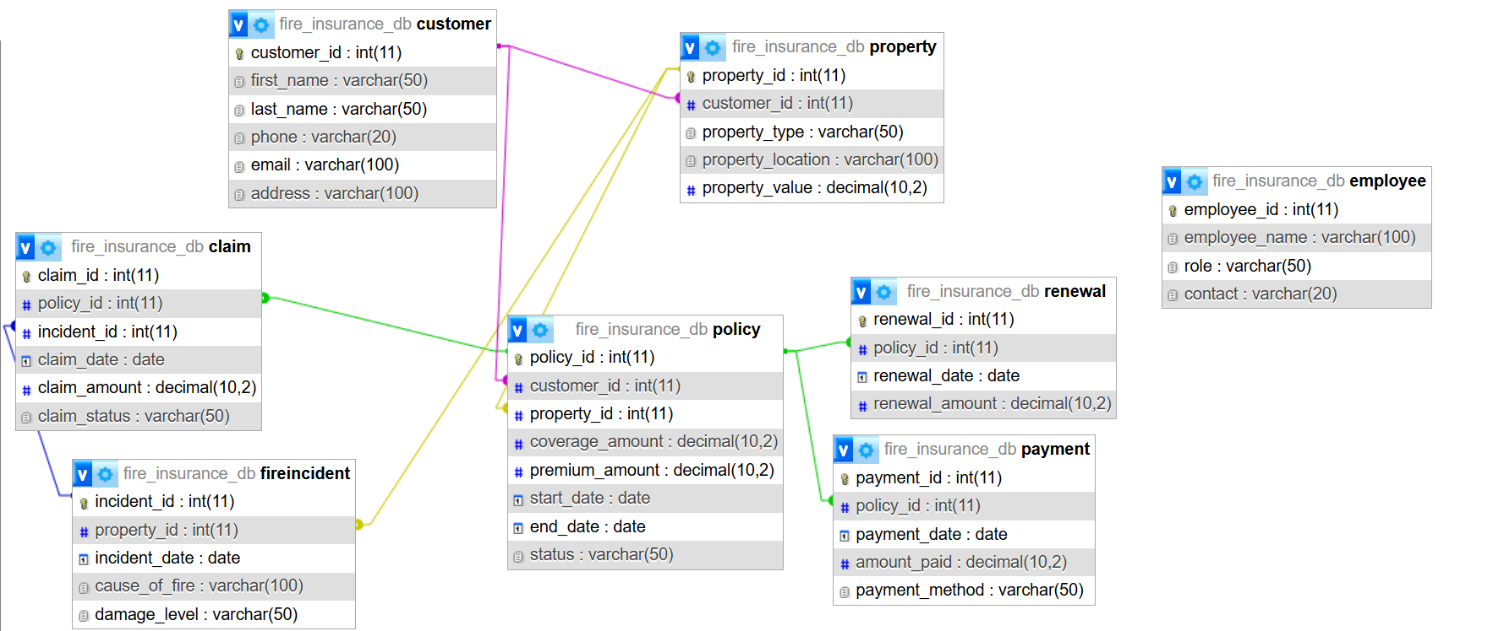
3. PHYSICAL DESIGN: MySQL SCHEMA
Slide 11 of 15

Slide 12
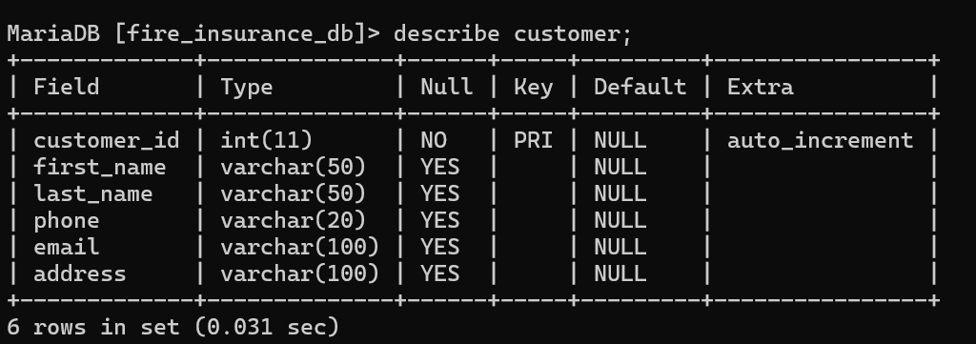
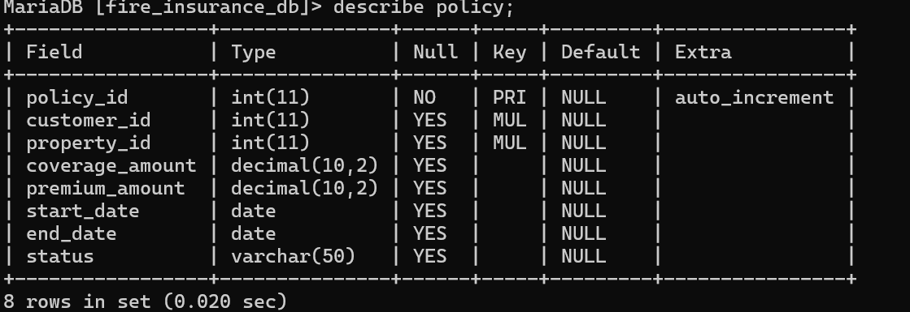
4. IMPLEMENTATION: TABLE DESCRIPTIONS
DESCRIBE CUSTOMER;
DESCRIBE POLICY;
Screenshots confirming data types and constraints.
Slide 12 of 15

Slide 13
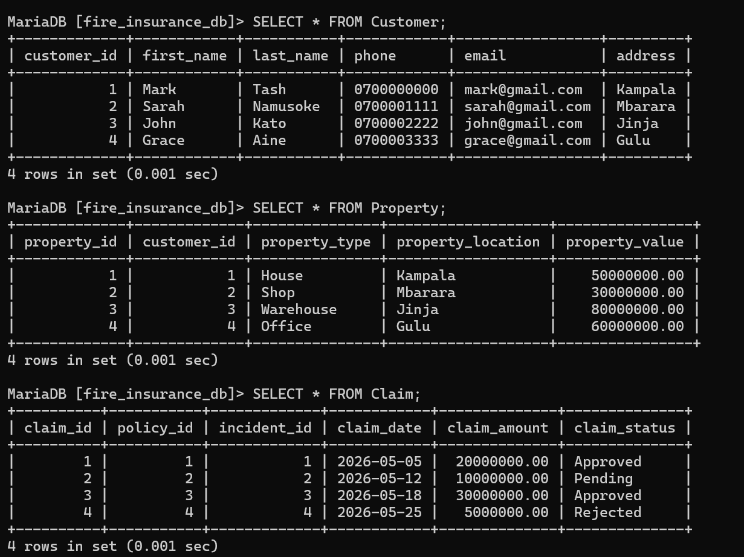
4. IMPLEMENTATION: DATA SAMPLES
Slide 13 of 15

Slide 14
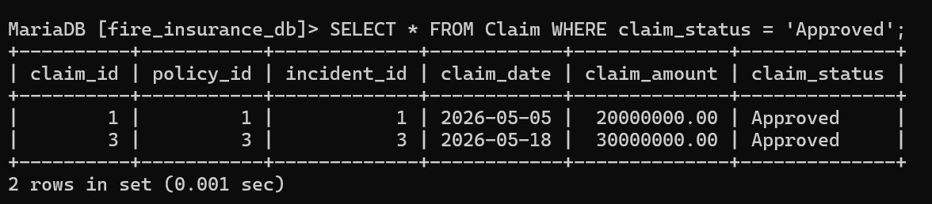
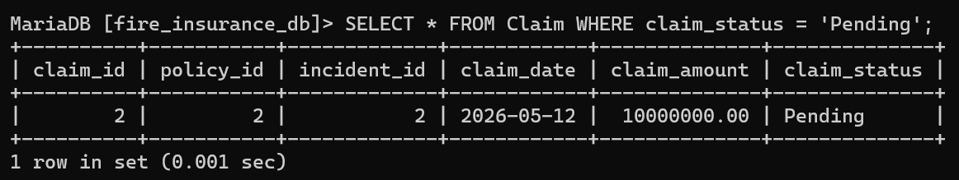
4. IMPLEMENTATION: SAMPLE QUERIES
Slide 14 of 15

Slide 15
5. BIBLIOGRAPHY
[1] MariaDB Foundation (2024). MariaDB SQL Language Reference.
[2] Lucidchart Guide to Database Design and ERDs.
[3] "Database Management Systems", Self-paced Assignment Guidelines 2026.
[4] "Modern Database Management" (12th Ed), Hoffer et al.
Thank You
Slide 15 of 15

