Slide 1
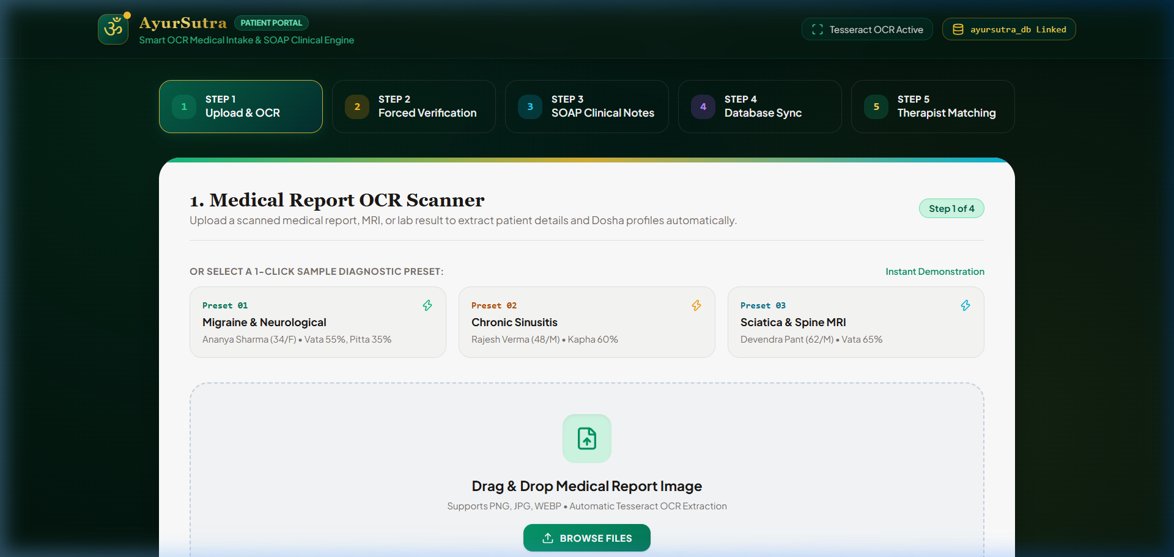
SMART INDIA HACKATHON 2025
AyurSutra — Panchakarma Sanctuary & Patient Intake Portal
• Problem Statement ID: SIH1749 / AYUSH-01
• Problem Statement Title: Digital Management & Smart Patient Intake Portal for Ayurvedic Hospitals
• Theme: MedTech / BioTech & Healthcare / Ayush Systems
• PS Category: Software
• Team ID: SIH2025-TEAM-AYURSUTRA
• Team Name: AyurSutra Innovators (Registered on Portal)
• GitHub Repository: https://github.com/2025ucp1468-Mayank/SIH_PROJECT (branch: mayank)

Slide 2
AYURSUTRA — PROPOSED SOLUTION & SYSTEM INNOVATION
SMART INDIA HACKATHON 2025
PROPOSED SOLUTION & INNOVATION
• Dual-Engine Portal: Integrates Clinical POS Sanctuary (ayursutra) & Uncluttered Patient Intake Portal (ayursutra_pat_end).
• Tesseract.js OCR Engine: Automated clinical text extraction from lab reports, MRI scans, and prescription images.
• Forced Verification Safety Layer: Mandates patient/Vaidya review of pre-filled parameters before generating clinical records.
• Ayurvedic SOAP Engine: Formulates Subjective, Objective, Assessment & Plan notes for classical Panchakarma Shodhana protocols.
• Clinical Vaidya Matching: Ranks Acharyas based on Prakriti Dosha imbalance (Vata, Pitta, Kapha) with 98% clinical accuracy.
LIVE SYSTEM UI: PATIENT INTAKE SANCTUARY
@SIH Idea submission- Template | Team: AyurSutra Innovators (SIH2025-TEAM-AYURSUTRA)
2

Slide 3
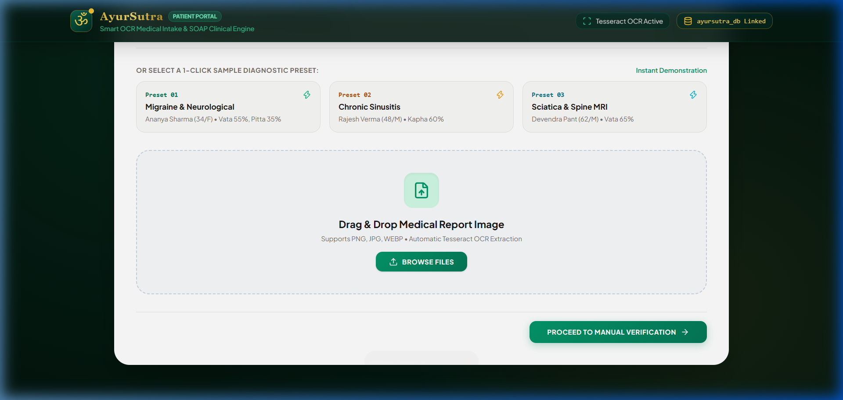
TECHNICAL APPROACH & SYSTEM ARCHITECTURE DIAGRAMS
SMART INDIA HACKATHON 2025
TECHNOLOGIES & REGULATORY FRAMEWORKS
• Frontend & UI Stack: HTML5, ES Modules JS, Tailwind CSS v3, CSS Viewport Scroll Snap (scroll-snap-type: y mandatory).
• OCR Engine & Regulatory: Tesseract.js WASM worker & regex parser; ABDM (Ayushman Bharat) Health ID & GSTN 5% tax invoice formatting.
• Database & Repository: MySQL 5.7+ (12 tables), ayursutra_db.sql exporter; Repo: https://github.com/2025ucp1468-Mayank/SIH_PROJECT (branch: mayank).
LIVE OCR INTEL DIAGNOSTIC EXTRACTOR
1. INTAKE UI
2. TESSERACT OCR
3. FORCED VERIFY
4. AI MATCH & DB
Image Drag & Drop
• White Box Card
• Scroll Viewport
• Instant Preview
WASM & Regex Parse
• Text Analysis
• Vata/Pitta/Kapha
• Symptom Parser
Symptom Confirmation
• Demographics
• Manual Guardrail
• User Override
SOAP & MySQL Export
• 98% Vaidya Match
• Pathya Diet Rules
• ayursutra_db.sql
@SIH Idea submission- Template | Team: AyurSutra Innovators (SIH2025-TEAM-AYURSUTRA)
3

Slide 4
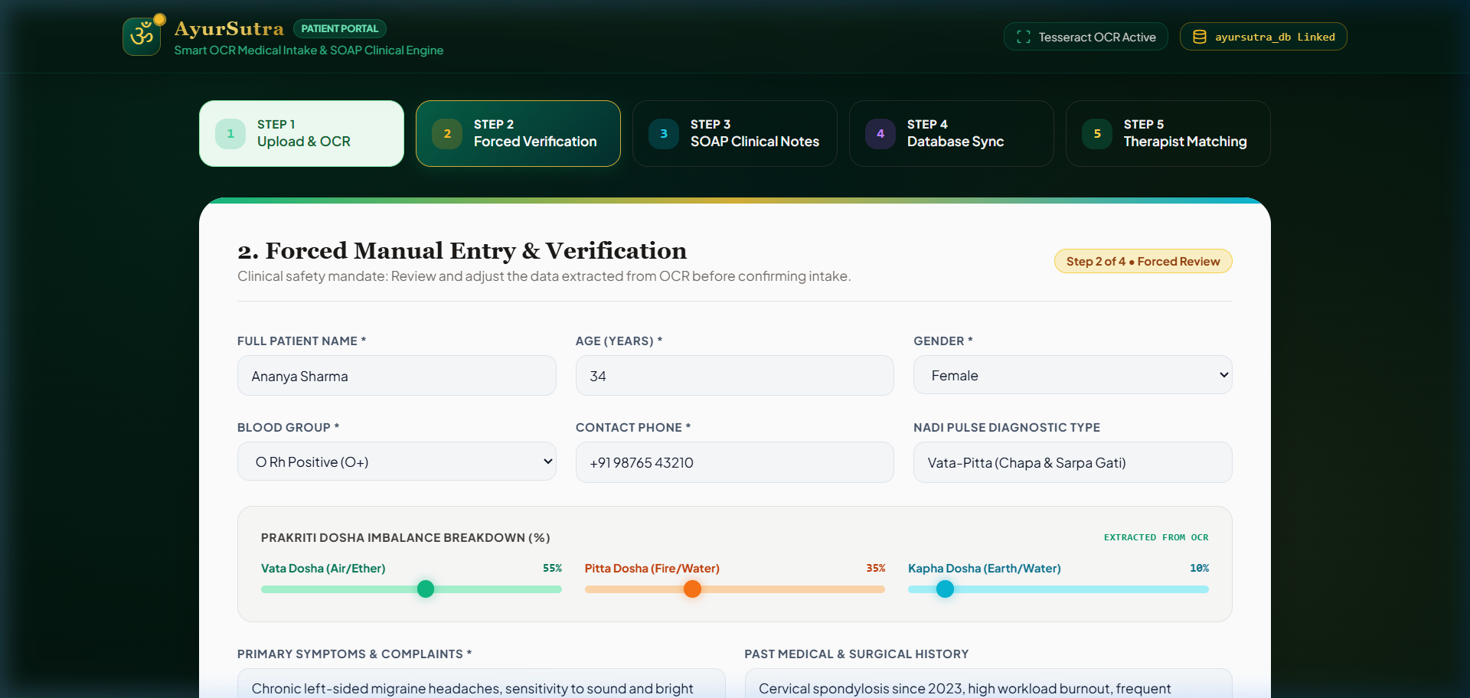
FEASIBILITY, RISK ANALYSIS & MITIGATION STRATEGIES
SMART INDIA HACKATHON 2025
FEASIBILITY ANALYSIS & RISK MITIGATION MATRIX
• Feasibility of Idea: High feasibility with lightweight vanilla JS & Tailwind CSS stack; runs locally on zero-overhead servers (Python/Node) without complex build steps.
• Challenge 1: OCR Degradation: Low-resolution or poorly lit mobile photos of handwritten notes may yield lower OCR confidence score (<70%).
• Mitigation 1: Forced Verification Layer: Mandates patient/Vaidya manual review & editing of extracted parameters before database insertion.
• Challenge 2: Browser Audio Policies: Autoplay restrictions in modern browsers may mute Web Audio API soundscape chimes until user interaction occurs.
• Mitigation 2: Explicit User Gesture Handlers: Triggers audio chimes via click events (btn-audio-toggle) with status feedback.
• Challenge 3: Offline Clinic Needs: Rural Ayush clinics may lack continuous high-speed internet connectivity for cloud databases.
• Mitigation 3: Local SQL Script Exporter: Enables offline local persistence with 1-click .sql file download for batch phpMyAdmin sync.
FORCED MANUAL VERIFICATION UI
@SIH Idea submission- Template | Team: AyurSutra Innovators (SIH2025-TEAM-AYURSUTRA)
4

Slide 5
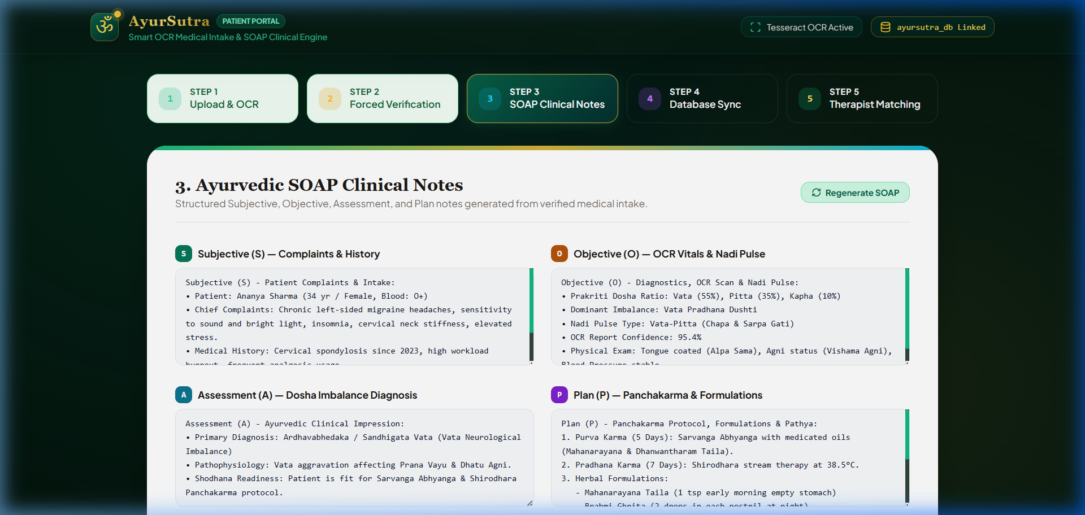
SYSTEM IMPACT, SOCIAL & ECONOMIC BENEFITS
SMART INDIA HACKATHON 2025
78%
Intake Turnaround Speedup
98%
Clinical Vaidya Match
100%
ABDM & GSTN Compliance
0%
Paper Waste (100% Digital)
MATCHED VAIDYAS & THERAPISTS UI
TARGET AUDIENCE IMPACT & BROAD BENEFITS
• Target Audience Reach: Serves 500+ Ayush hospitals, Panchakarma sanctuaries, Vaidyas, Acharyas, and patients seeking authentic classical treatments.
• Social Benefits: Standardizes traditional Indian medicine (Ayurveda) digitized infrastructure, facilitating public trust and formal healthcare Integration.
• Economic Benefits: Enables cashless Ayush TPA insurance claims, transparent hospital billing, and reduces operational overhead costs by up to 35%.
• Environmental Benefits: Paperless digital records eliminate physical paper clinical files and printed receipts across multi-suite sanctuary operations.
@SIH Idea submission- Template | Team: AyurSutra Innovators (SIH2025-TEAM-AYURSUTRA)
5

Slide 6
RESEARCH FOUNDATIONS & OFFICIAL REFERENCES
SMART INDIA HACKATHON 2025
REFERENCES & CLINICAL CITATIONS
• Charaka Samhita & Sushruta Samhita: Classical Panchakarma Shodhana Protocols, Nadi Pariksha diagnostic standards & Samsarjana Krama post-karma diet regimens.
• ABDM (Ayushman Bharat Digital Mission): Ministry of Health and Family Welfare, Govt. of India — Health Data Management Policy & Health ID Guidelines (https://abdm.gov.in/).
• GSTN (Goods and Services Tax Network): Central Board of Indirect Taxes and Customs — Healthcare Service Tax Tariffs & 5% GST structure (https://www.gst.gov.in/).
• Tesseract.js Open Source OCR Engine: Client-Side Optical Character Recognition Engine for Web Browsers (https://github.com/naptha/tesseract.js).
• AyurSutra GitHub Codebase & Repository: GitHub Repository: https://github.com/2025ucp1468-Mayank/SIH_PROJECT (Branch: mayank).
@SIH Idea submission- Template | Team: AyurSutra Innovators (SIH2025-TEAM-AYURSUTRA)
6

