Slide 1
CASE STUDY 117
Vellum Antiquarian Bookstore & Rare Books Chain
Campus LAN Segmentation, Trunking & Spanning Tree
Yatharth Dharmesh Mishra · B.Tech CSE 2025–29 · ITM Skills University
Computer Networking & Cyber Security
Notes:
Introduce Vellum as a three-location rare-books chain whose network must protect provenance data, point-of-sale systems, staff operations, and guests while remaining resilient and manageable.

Slide 2




THE RISK
A flat network is putting three rare-book locations at risk
Three sites
Flat traffic
Main Street, Harborfront, and Auction Annex.
One flat broadcast domain creates unnecessary traffic and storm risk.
Guest exposure
Required shift
Guest users can reach sensitive staff, POS, and provenance resources.
The chain needs segmentation, controlled access, and resilient links.
Notes:
Frame the problem as both a performance and security issue. The same flat design that allows traffic to travel widely also makes failures harder to contain and troubleshoot.

Slide 3
THE DESIGN BRIEF
The design objectives turn risk into control
1
Segment users and systems with VLANs
2
Secure inter-switch trunks and isolate guests
3
Enable controlled inter-VLAN communication
4
Prevent loops with STP and add resilience with EtherChannel
5
Harden access ports with port security
Five control moves
Notes:
These objectives become the evaluation criteria for the design. VLANs address segmentation, trunks and ACLs address control, STP addresses loop safety, EtherChannel addresses link resilience, and port security hardens the edge.

Slide 4
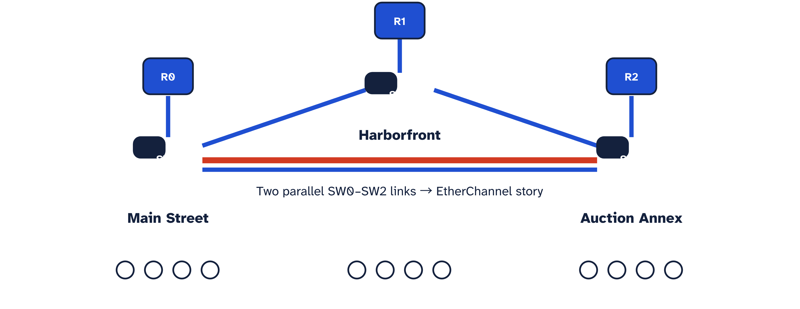
PHYSICAL TOPOLOGY
Three switches form a resilient triangle across the chain
Notes:
Walk the audience through the three locations. Each site has a router, a local switch, and four PCs. The switches form a triangle, while the two parallel SW0–SW2 links establish the physical basis for EtherChannel.

Slide 5
LOGICAL SEGMENTATION
Six VLANs separate business roles from guest traffic
VLAN | Name | Purpose
13 | Provenance-Systems | Rare-book provenance, catalog, and archive systems
23 | Staff-POS | Staff workstations and point-of-sale systems
33 | Admin | Administration and business operations
43 | IT-Mgmt | Network and infrastructure management
915 | Guest | Internet-only guest access
999 | Native | Unused native VLAN for trunk hardening
Smaller broadcast domains
Improve performance, security, and troubleshooting by giving each role a deliberate boundary.
VLAN 915 is isolated from sensitive internal resources. VLAN 999 carries no user traffic.
Notes:
Emphasize that VLAN IDs are purposeful, not arbitrary labels. VLAN 915 is the guest boundary, while VLAN 999 is reserved and unused for user traffic, strengthening trunk hygiene.

Slide 6
SITE ASSIGNMENT
VLANs follow the needs of each location
Site | Active VLANs | Primary users and systems
Main Street | 13, 23 | Provenance systems, staff, POS
Harborfront | 23, 33, 43, 915 | Staff, administration, IT management, guests
Auction Annex | 13, 23 | Provenance systems, staff, POS
Common core
Local need
VLAN 23 supports staff and POS at every location.
Guest access exists only at Harborfront, where it is required.
Notes:
Use the matrix to show that segmentation follows actual site requirements. Main Street and Auction Annex need provenance and staff/POS access. Harborfront adds administration, IT management, and guest access, but only where needed.

Slide 7
TRUNKING
802.1Q trunks carry the right VLANs between switches
SW0
802.1Q trunk
SW1
VLAN 13 · Provenance-Systems
VLAN 23 · Staff-POS
VLAN 33 · Admin
VLAN 43 · IT-Mgmt
VLAN 915 · Guest
VLAN 999 · Native, unused
Allowed VLANs only
Tagging preserves VLAN identity while frames cross a shared inter-switch path.
Notes:
Explain that 802.1Q adds VLAN identity to frames on the trunk. The design permits only the required VLANs and reserves VLAN 999 as an unused native VLAN, reducing accidental exposure.

Slide 8
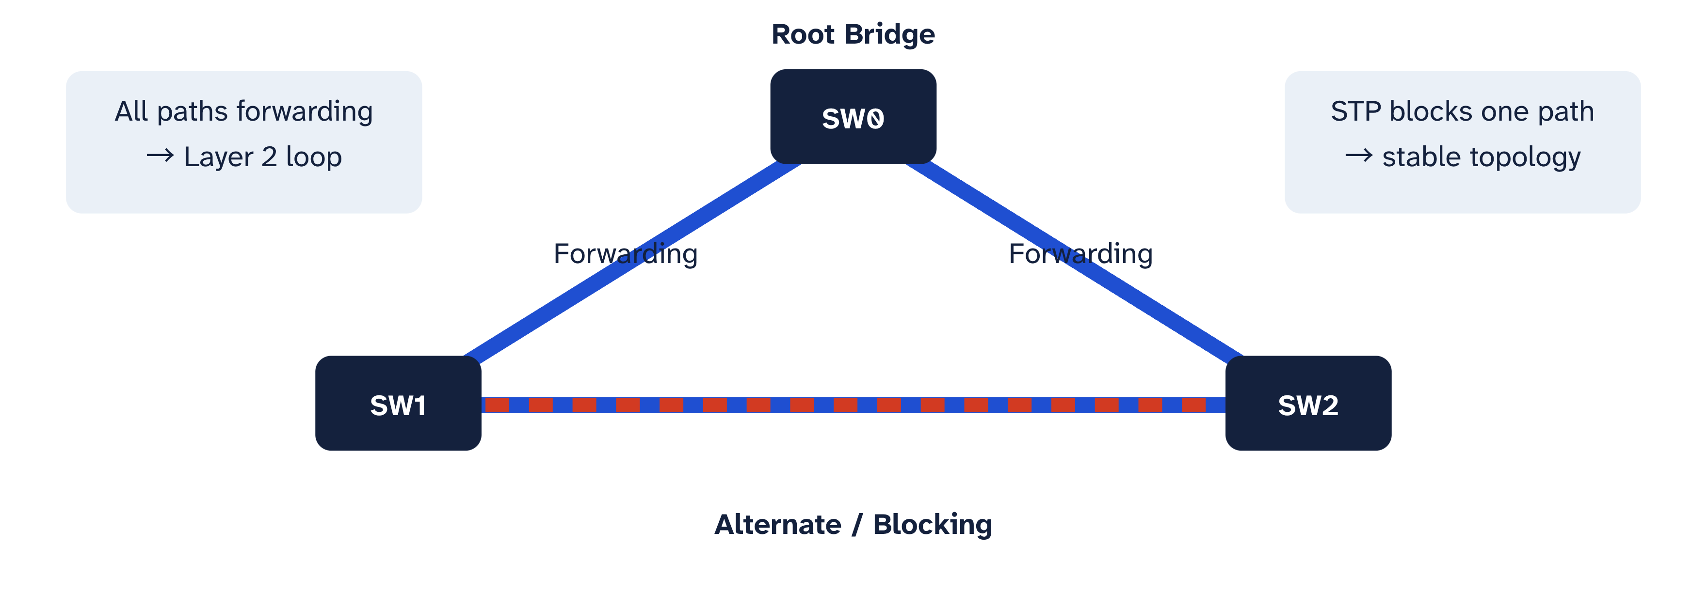
LOOP PREVENTION
STP blocks loops before they become broadcast storms
Notes:
Redundant links are valuable only when loop behavior is controlled. STP elects SW0 as the planned root bridge, keeps the two direct paths forwarding, and blocks the SW1–SW2 path until it is needed.

Slide 9
LINK RESILIENCE
EtherChannel makes two physical links act as one logical path
BEFORE
AFTER
LOOP RISK
One Port-Channel
Two separate links
SW0
Po1 · LACP
SW2
SW0
Separate paths
SW2
Two member links
LACP bundles parallel links into one Port-Channel. Traffic distributes across members, increasing bandwidth without changing the logical topology. One member failure can be absorbed without losing the bundle.
Independent paths can complicate topology and loop control.
Notes:
EtherChannel changes the logical view of the two SW0–SW2 links. LACP bundles them into one Port-Channel, allowing load distribution and preserving the bundle when one physical member fails.

Slide 10

CONTROLLED ROUTING
Router-on-a-Stick enables controlled inter-VLAN routing
Router
802.1Q trunk
Switch
Router subinterfaces map to VLANs
Router subinterface | VLAN
Gi0/0.13 | 13
Gi0/0.23 | 23
Gi0/0.33 | 33
Gi0/0.43 | 43
Gi0/0.915 | Guest (915)
ACL control · Guest → Internet; internal systems blocked from guest access.
One trunk, multiple subinterfaces, explicit policy.
Notes:
Close the architecture by connecting VLANs to routing policy. Each VLAN maps to a router subinterface and default gateway. ACLs decide what may communicate, sending guest traffic toward the internet while blocking access to sensitive internal systems.

