Slide 1


PROBLEM & OPPORTUNITY
Reliable light should be available before ownership becomes a burden.
For rural households and farm workers, lighting needs can appear suddenly and disappear just as quickly.
Sudden need
Buying creates burden
Rent from the kiosk
Portable lighting is needed now.
Occasional use still brings ownership and maintenance.
Immediate access to reliable lighting without ownership.
Value proposition: “Reliable portable lighting when you need it, without having to purchase and maintain it.”

Slide 2





TARGET CUSTOMER & VALUE PROPOSITION
Temporary need, simple access, easy return.
Primary users
Customer value flow
NEED → ACCESS → USE → RETURN
Rural households
Farm workers
Benefits: low upfront cost · reliable charged lantern · no ownership or maintenance burden · easy return
Frequent users who need lanterns several times every week are not the main target; frequent rental can become less attractive than buying.
Temporary needs
Outage-affected users
People with failed lanterns
Temporary/event users

Slide 3
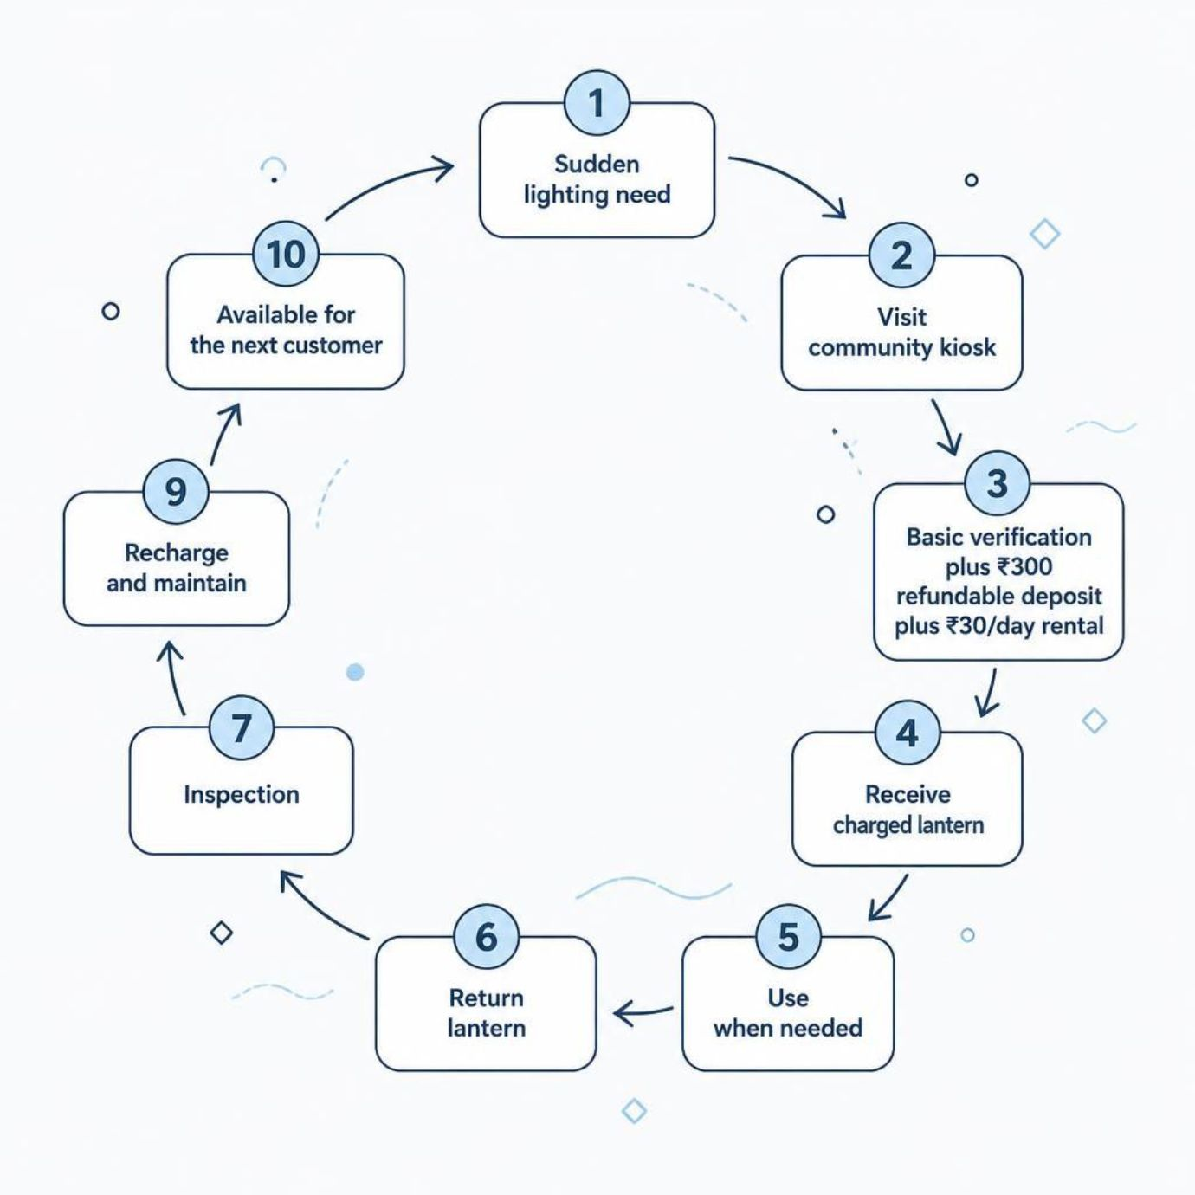
Customer Journey & Product-as-a-Service
PAAS
Access over ownership
The kiosk owns the physical lanterns. Customers pay for temporary access as a service.
₹300 deposit is refundable. ₹30/day is the rental.

Slide 4
BUSINESS MODEL & OPERATING FLOW
Nine connected blocks make the kiosk operational.
CUSTOMER SEGMENTS
RELATIONSHIPS
ACTIVITIES
Emergency and occasional rural users
Simple rental · repeat-user and loyalty benefits
Rent · charge · inspect · maintain
PARTNERS
VALUE PROPOSITION
Suppliers and local community partners
Reliable lighting without ownership
REVENUE
₹30 per rental day
COSTS
CHANNELS
Lanterns · maintenance · charging/electricity · kiosk/staffing · loss/damage provision
Community kiosk · local shops · WhatsApp/community communication
RESOURCES
20 lanterns · charging setup · kiosk · rental records

Slide 5
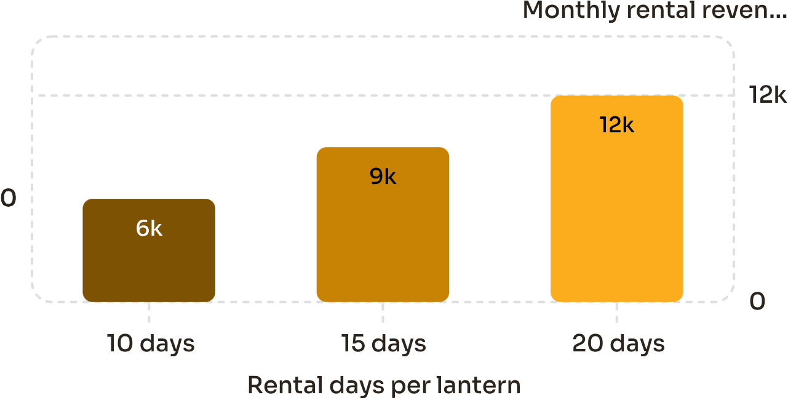
Financial Snapshot, SWOT & Risk Control
Monthly rental revenue by rental days per lantern
SWOT
Strengths: Affordable access and reusable inventory
Weaknesses: Limited inventory and charging needs
Opportunities: More kiosks and partnerships
Threats: Theft, damage, low utilization and cheap alternatives
RISK CONTROL
₹18,000
₹2,000
Deposit + ID/phone verification
Inspection and damage policy
Late fee
Small pilot
Solar + grid charging
Backup lanterns
Initial investment
20 × ₹900
Annual maintenance
20 × ₹100
₹300 deposits are refundable and are not revenue.

Slide 6
90-DAY PILOT → MEASURE → SCALE
90-Day Pilot → Measure → Scale
Days 1–30 | Launch
Days 61–90 | Evaluate & scale
Acquire 20 lanterns; set up kiosk and charging; define deposit, rental, return and damage policies; start with local emergency and occasional users.
Measure utilization and repeat usage; review losses, maintenance and operating contribution; identify peak demand; expand only if demand justifies it.
Days 31–60 | Test & improve
Success measures
Track rental frequency and utilization; monitor returns, damage and charging issues; collect feedback; improve the process.
Utilization | Repeat usage | Low loss/damage | Reliable returns | Positive operating contribution
Yatharth Dharmesh Mishra · Roll No. 150096725055 · ITM Skills University

