Slide 1

Hangman Multiplayer Word Guessing Platform
By
YATHARTH DHARMESH MISHRA
150096725055

Slide 2
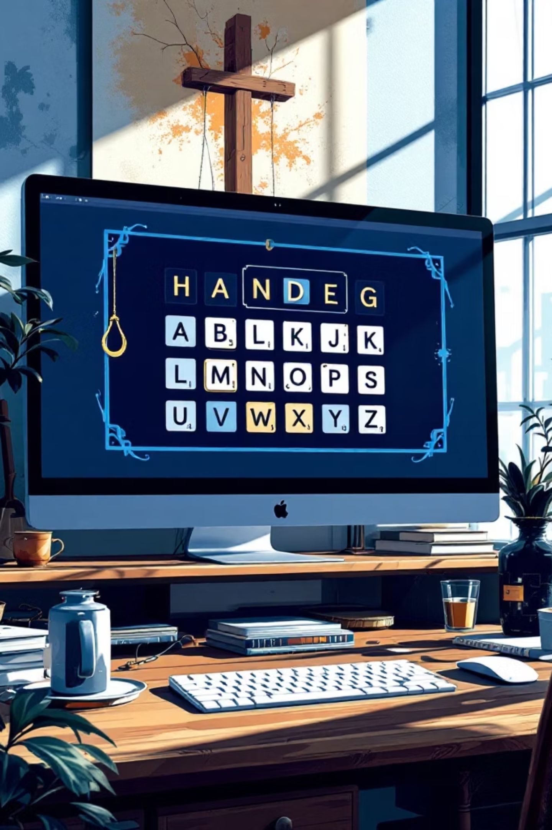
Hangman Multiplayer Word Guessing Platform
Problem Statement
Traditional Hangman games are mostly limited to single player gameplay and do not include features that encourage long term engagement. Players cannot track their performance, compete with others, or interact with a community of players. Most versions of the game lack a leaderboard system and do not provide multiplayer functionality. As a result, users often lose interest after playing a few rounds. There is also no platform for players to discuss difficult words, share strategies, or learn from each other. The objective of this project is to develop a responsive Hangman web application that introduces multiplayer gameplay, leaderboard tracking, and a discussion forum to make the game more interactive and engaging.

Slide 3
Your Solution
To solve this problem, a web based Hangman Multiplayer platform was developed using HTML, CSS, and JavaScript. The system allows users to guess letters of a hidden word within a limited number of attempts. When a player selects an incorrect letter, a hangman figure is drawn step by step. The platform includes several additional features to improve the traditional game experience.
Single player and local multiplayer gameplay
Interactive alphabet button grid for guessing letters
Automatic win and loss detection
Leaderboard system for tracking player scores
Forum section where users can post comments and discuss strategies
The application runs completely on the frontend and stores scores and comments using browser local storage

Slide 4
Working (Method / Mind Map)
The working process of the Hangman game follows a simple sequence of steps.
01
02
03
The system randomly selects a word from a predefined word list.
The selected word is displayed as hidden letters on the screen.
The player guesses letters using alphabet buttons.
04
05
06
If the guessed letter is correct, the letter appears in the correct position in the word.
If the guessed letter is incorrect, part of the hangman figure is drawn.
The system continues checking guesses until the player either completes the word or reaches the maximum number of incorrect attempts.
07
The game then displays a win or loss message and updates the leaderboard.
This process ensures smooth gameplay and interactive user participation.

Slide 5
Conclusion
The Hangman Multiplayer Word Guessing Platform successfully enhances the traditional Hangman game by adding modern features such as multiplayer gameplay, leaderboard tracking, and a discussion forum. The project demonstrates how web technologies such as HTML, CSS, and JavaScript can be used to create interactive and engaging browser based applications. The system encourages friendly competition among players while also promoting vocabulary learning and problem solving skills. Overall, the platform provides a fun and educational gaming experience while showcasing the practical implementation of frontend web development technologies.

Slide 6
Thank You

