Slide 1

Hangman Multiplayer
(Word Guessing Platform)
By
YATHARTH DHARMESH MISHRA
150096725055

Slide 2
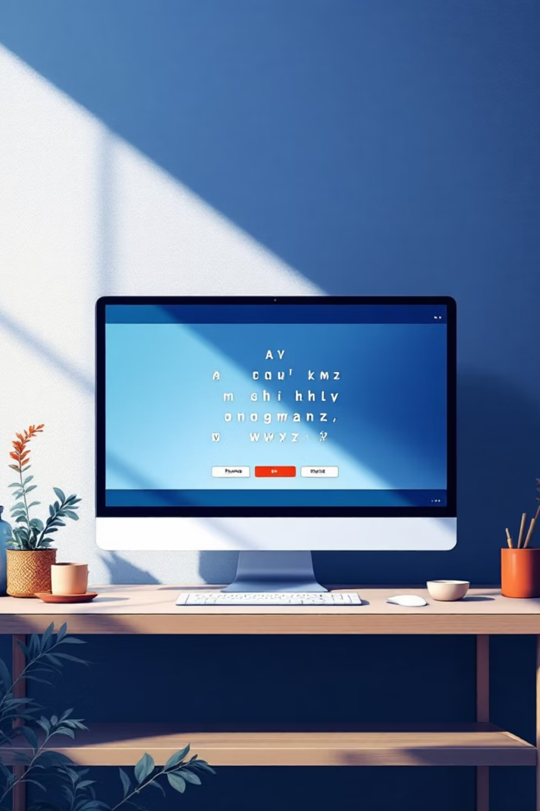
Hangman Multiplayer
Problem Statement
The traditional Hangman game is usually played using paper and pen or through simple digital versions with limited functionality. These versions often lack interactive features such as multiplayer gameplay, score tracking, and visual user interfaces.
There is a need for a modern digital version of the Hangman game that provides an engaging and interactive experience for users.
This project focuses on developing a web-based Hangman game that allows players to guess hidden words, track their progress, and enjoy both solo and multiplayer gameplay.

Slide 3
Your Solution
The proposed solution is a Hangman Web Application developed using modern web technologies.
The system is built using:
HTML
CSS
JavaScript
to create the structure of the game interface
to design the layout, themes, and animations
to implement the game logic and user interaction
Key features of the system include:
Solo and Multiplayer game modes
Word categories and difficulty levels
Interactive on-screen keyboard
Score tracking and leaderboard system
Light and dark theme support

Slide 4
Working (Method / Mind Map)
The Hangman game follows a simple step-by-step process.
01
02
First, the player selects the game mode such as Solo Mode or Multiplayer Mode.
In Solo Mode, the system randomly selects a word from a category. In Multiplayer Mode, one player sets the word while the other player guesses it.
03
04
The player guesses letters using the on-screen keyboard.
If the guessed letter is correct, it appears in the correct position in the word.
05
06
If the guess is incorrect, a part of the hangman figure is drawn and the number of remaining attempts decreases.
The player wins by guessing the word before all attempts are used.

Slide 5
Conclusion
The Hangman Multiplayer successfully recreates the classic word guessing game in a modern digital format.
The system provides an engaging and interactive user experience through multiple game modes, score tracking, and leaderboard features.
The project demonstrates the practical use of HTML, CSS, and JavaScript for developing interactive web applications and highlights how modern web technologies can be used to create fun and educational games.

Slide 6
Thank You

