Slide 1
JAVA PROGRAMMING · CASE STUDY 37
Inventory Management System
for a Retail Store
Yatharth Dharmesh Mishra
Roll No: 150096725055
B.Tech Computer Science and Engineering · ITM Skills University

Slide 2



PROJECT OVERVIEW
A Java desktop app for controlling retail inventory
Java Swing app manages retail inventory: products, suppliers, purchases, sales, bills, and transaction history.
Stock control
Billing
Storage
Tracks stock and flags low-stock products.
Calculates 18% GST and generates sales bills.
In-memory data keeps the app lightweight, but not persistent.

Slide 3
ONE CONTROLLED FLOW
The project turns daily store tasks into one controlled flow
Each action updates the same operational picture.
Manage
Record
Update
Products and supplier information.
Purchases and sales.
Stock changes automatically.
Bill
Review
Alert
Sales bills include 18% GST.
Search, sort, and inspect history.
Low-stock products are detected.

Slide 4
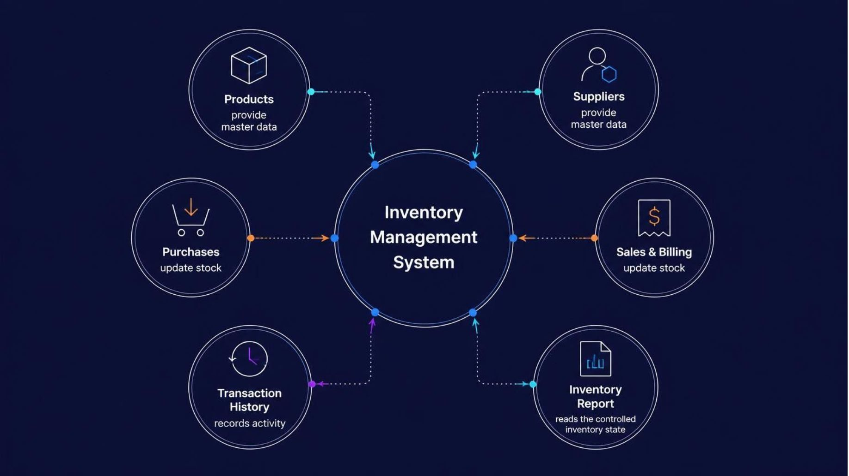
SYSTEM MAP
Six modules connect through the inventory service
Each module contributes data or an action to the central inventory flow.

Slide 5
APPLICATION FOUNDATION
Java provides the application layer and its core building blocks
Platform | Java · Java Swing · JDK 8+
Collections | ArrayList · LinkedList · HashMap · TreeMap · Arrays
Programming | classes and objects · constructors · CRUD · searching and sorting
Reliability | exception handling · input validation
Storage | in-memory data only

Slide 6
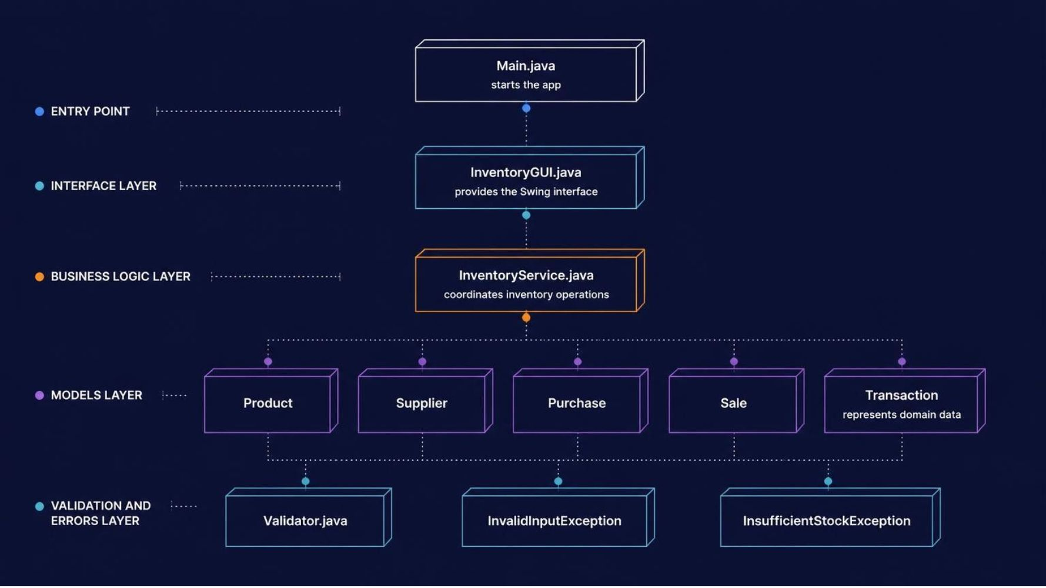
CODE ORGANIZATION
The class structure separates interface, logic, models, and errors
The interface starts the work; the service coordinates it; domain classes carry the data.

Slide 7
DATA STRUCTURES
Each data structure has a focused job
Structure | Role and fit
ArrayList | Suppliers, Purchases, Sales — simple ordered collections
LinkedList | Inventory transaction history — efficient sequential history
HashMap | Product ID → Product lookup — fast keyed access
TreeMap | Sorted products and category totals — maintains sorted keys
Arrays | Categories and low-stock thresholds — fixed-size reference values

Slide 8
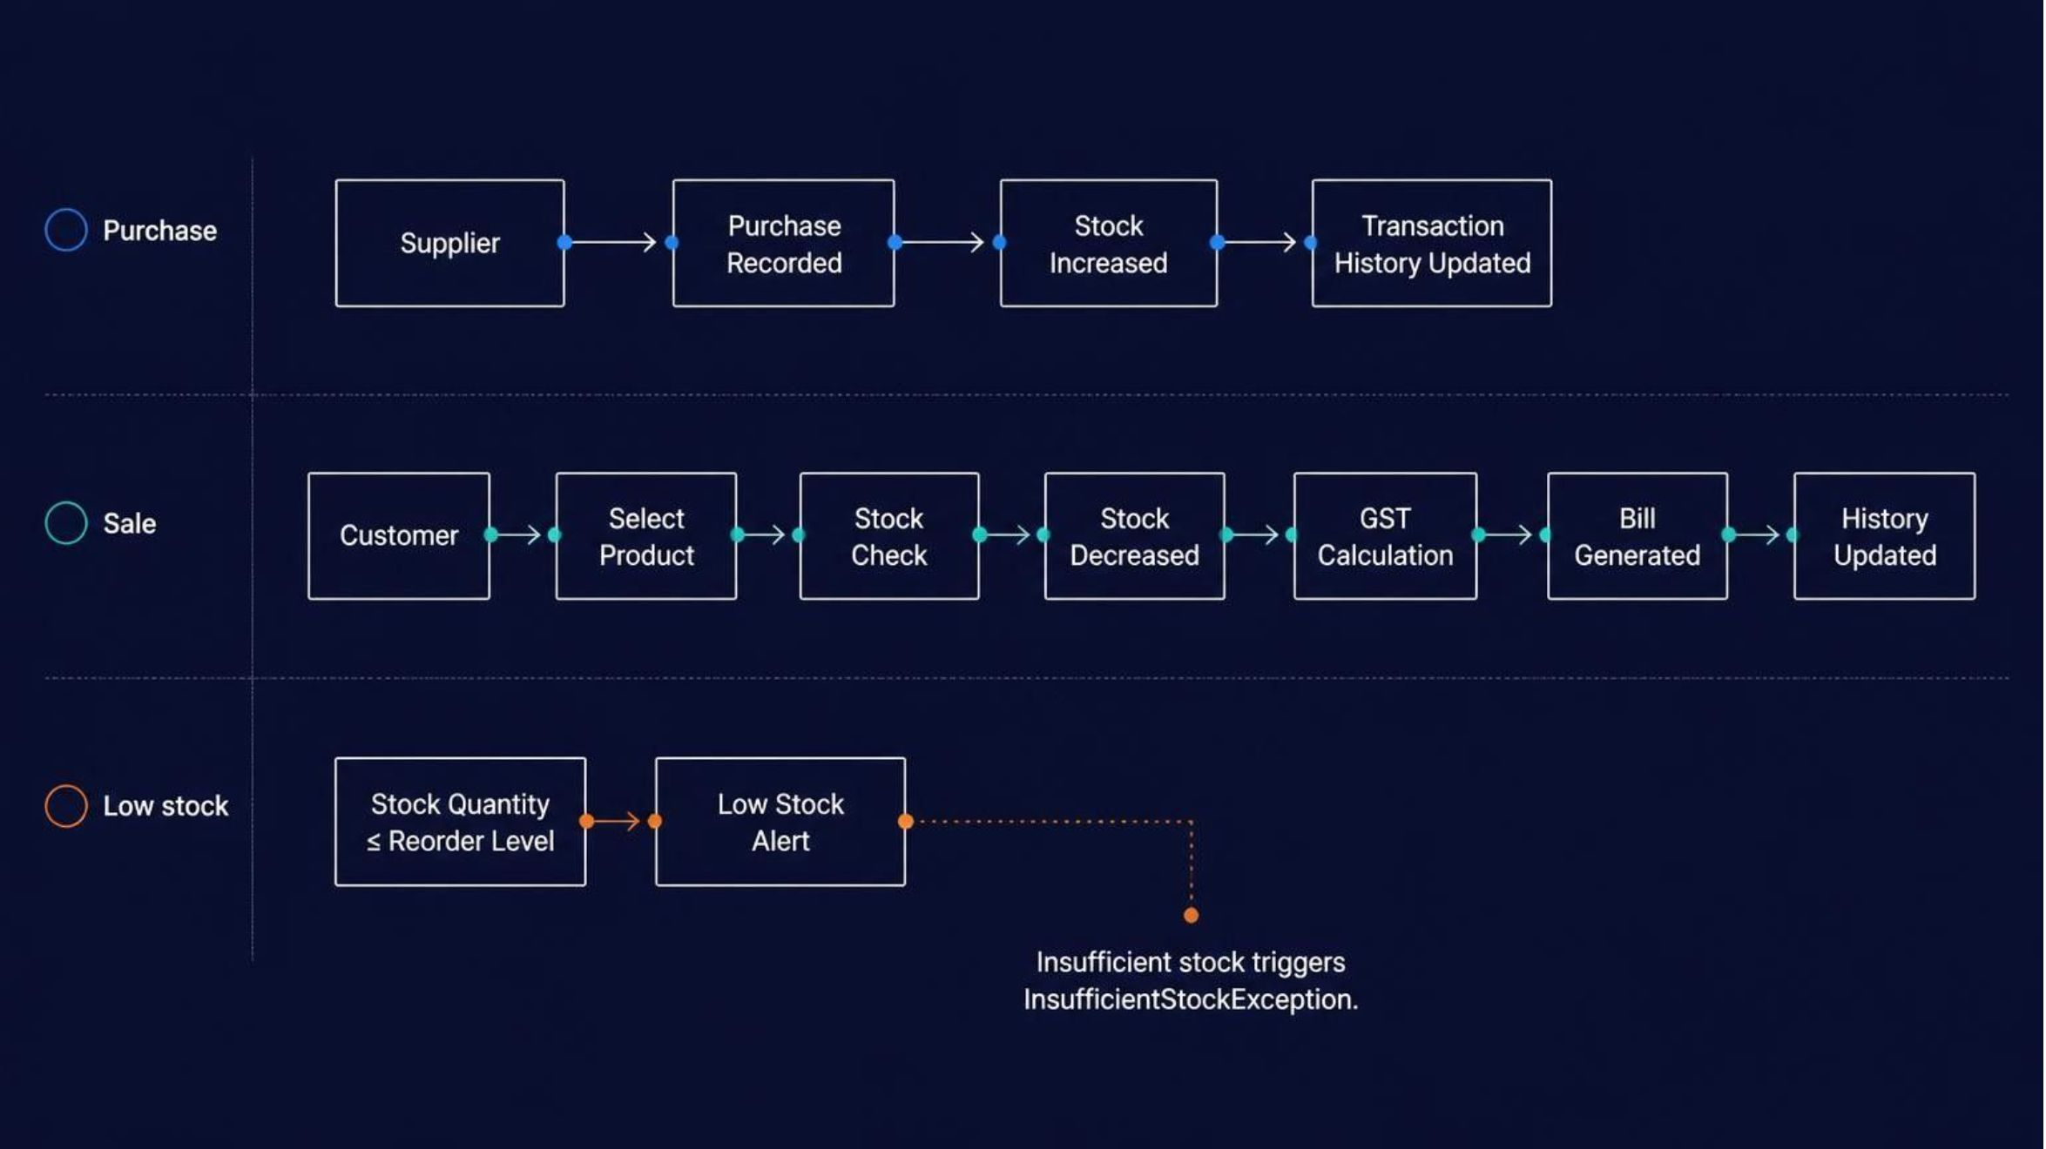
EVENT FLOW
Purchase, sale, and low-stock events update the same inventory flow

Slide 9




VALIDATION BY DESIGN
Features are backed by explicit validation rules
Operations
Automation
Add · update · delete; search by ID, name, category; sort by ID, name, price, quantity.
Stock tracking · 18% GST billing · low-stock alerts · reports · transaction history.
Identifiers
Checks
Product ID: P + 3–6 digits; Supplier ID: S + 3–6 digits.
Price > 0 · valid quantity · 10-digit phone · valid email format.

