Slide 1

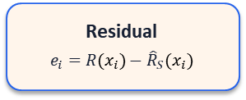


1. Inputs
2. Prediction & Correction
3. Outputs
Scene Construction
COLMAP, PGSR, Proxy Mesh
Renderer
3DGS Scene
3D RF Volume
Estimators
Uncorrected
Plain IDW
Residual IDW
Global bias
Handheld
Device
Sionna RT
$${\hat{R}}_{S}(x)$$
Calibration RSSI
$$R(x_{i})$$
$${\hat{R}}_{S}(x_{i})$$
Evaluation
MAE / RMSE
LoS / NLoS bias
Residual
$$e_{i}=R(x_{i})−{\hat{R}}_{S}(x_{i})$$
Test RSSI

