Slide 1
Housing Rental Policies & Rent Growth Trends
Chicago Metropolitan Area
YC Zhang, Ke Gao · Data Visualization · Final Project
Notes:
Good Morning everyone.
Today we will present our project on housing rental policies and rent growth trends in the Chicago metropolitan area.

Slide 2
Motivation
• Rents rose +21.9% from 2015 to 2024
• Post-pandemic surge: +12.1% in just 4 years (2019–2023)
• 83% of Cook County census tracts have majority cost-burdened renters
• Cost burden = spending >30% of income on rent (HUD threshold)
"A majority of Chicago renters spend more than 30% of their income on housing, but the crisis is not spread evenly across the city."
Notes:
In recent years, housing affordability has become one of the most pressing urban policy issues in Chicago.
From 2015-2024, rents have risen significantly, it increased 12.1% in just 4 years especially after the COVID-19 pandemic. We want to investigate about the relationship between residents' income median and their house rent proportion. Because some of the residents cost burden spending over 30% of income on rent.

Slide 3
Research Questions
01
02
03
Temporal Dynamics
Spatial Inequality
Policy Relevance
How have rents evolved across Chicago ZIP codes from 2015 to 2026, and how did COVID-19 policy shape that trajectory?
Which census tracts bear the highest rent burdens, and is geographic clustering visible?
Do rent trends and burden concentrations align with key Chicago housing policy events?
Notes:
Therefore, we addresses three main questions on this project.
First, how have rents evolved across Chicago zipcodes from 2015 to 2024? Did COVID-related policies change the circumstance?
Second, which census tracts experience the highest rent burdens, and is there clear geographic clustering?
Third, do rent trends and burden concentrations align with major housing policy events in Chicago?

Slide 4
Data Sources
Two independent datasets merged by geography
Dataset
Source
Unit
Coverage
ACS B25064 – Median Gross Rent
U.S. Census Bureau
Census tract
1,254 Cook County tracts
ACS B19013 – Median Household Income
U.S. Census Bureau
Census tract
1,254 Cook County tracts
ACS B25070 – Rent Burden Bins
U.S. Census Bureau
Census tract
1,254 Cook County tracts
Zillow ZORI – Monthly Rent Index
Zillow Research
ZIP code
206 Chicago metro ZIPs · 2015–2026
Notes:
According to these question, we use U.S. Census Bureau to know the median gross rent, rent burden bins and median household income. Second, we use Zillow’s ZORI monthly rent index at the ZIP code level. This dataset captures short-term rent dynamics and allows me to analyze changes around policy events. By combining tract-level structural data with ZIP-level time-series data, we can study both spatial inequality and temporal change.

Slide 5
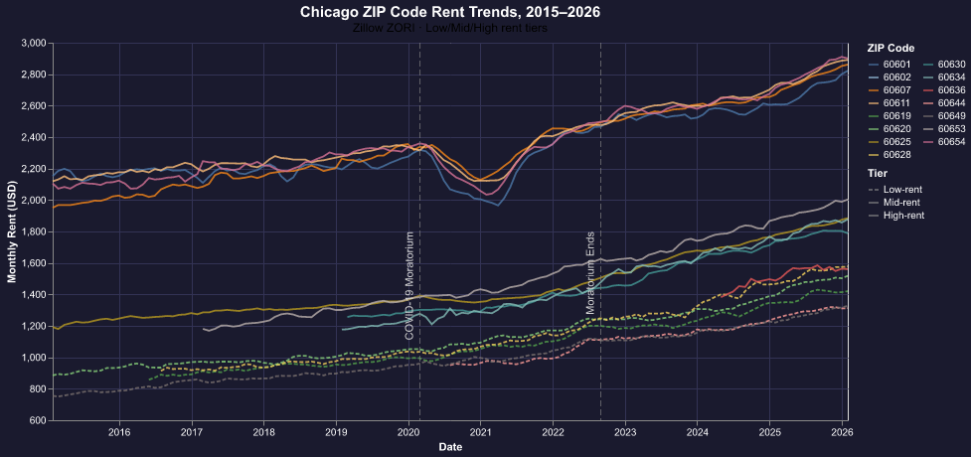
Finding 1: Rent Trends Over Time (2015–2026)
Zillow ZORI · 15 Chicago ZIP codes across Low / Mid / High rent tiers
Notes:
After integrated all the data we have our first figure, this shows monthly rent trends for selected ZIP codes across low-, mid-, and high-rent tiers from 2015 to 2026
Before COVID, rent growth was relatively modest and stable. During 2020 and 2021, rents slightly declined because the start of COVID-19 and the eviction moratorium. Once the eviction moratorium ended, rents accelerated sharply. By 2024, the average climbed to approximately $1,820 — a cumulative 21.9 percent increase since 2015. This post-moratorium surge is the steepest increase in the entire dataset.
Another important pattern is tier divergence.
High-rent ZIP codes mostly located in the North Side and central areas recovered faster and increased more in absolute dollar terms.
Low-rent ZIP codes, often in the South and West sides, showed smaller absolute rent increases, but because incomes in those areas are lower, even moderate rent growth can create larger affordability stress.
This bring up to our next question:
If rents diverged across ZIP codes, what does that mean for affordability at the census tract level?

Slide 6
Finding 1: Key Takeaways
Before COVID (2015–2019)
COVID Period (2020–2021)
Post-Moratorium Surge (2022–2024)
• Modest growth: +3.2% over 4 years
• Market broadly stable across tiers
• Rents dipped: $1,532 → $1,521
• Eviction moratorium suppressed re-pricing
• 2023 average: $1,728 (+12.1% vs 2019)
• 2024 average: $1,820 (+21.9% vs 2015)
• High-rent ZIPs recovered faster
• Intra-city rent gap widened
Notes:
So what do we really learn from this time-series analysis?
There are three key takeaways.
First, the overall rent increase since 2015 is not just gradual growth, it is highly concentrated in the post-moratorium period. The sharp acceleration after 2022 suggests that pandemic-era protections may have temporarily delayed market adjustments rather than prevented them.
Second, the recovery was uneven across ZIP codes. High-rent neighborhoods recovered faster and experienced stronger absolute growth. This widened the rent gap within the city.
Third, even though lower-rent ZIP codes saw smaller dollar increases, the affordability impact there may be more severe. In areas where household income is already low, even moderate rent growth can significantly raise the rent-to-income ratio.
At this point, the question shifts.
We now understand how rents changed over time.
But rent growth alone does not tell us who is struggling the most.

Slide 7
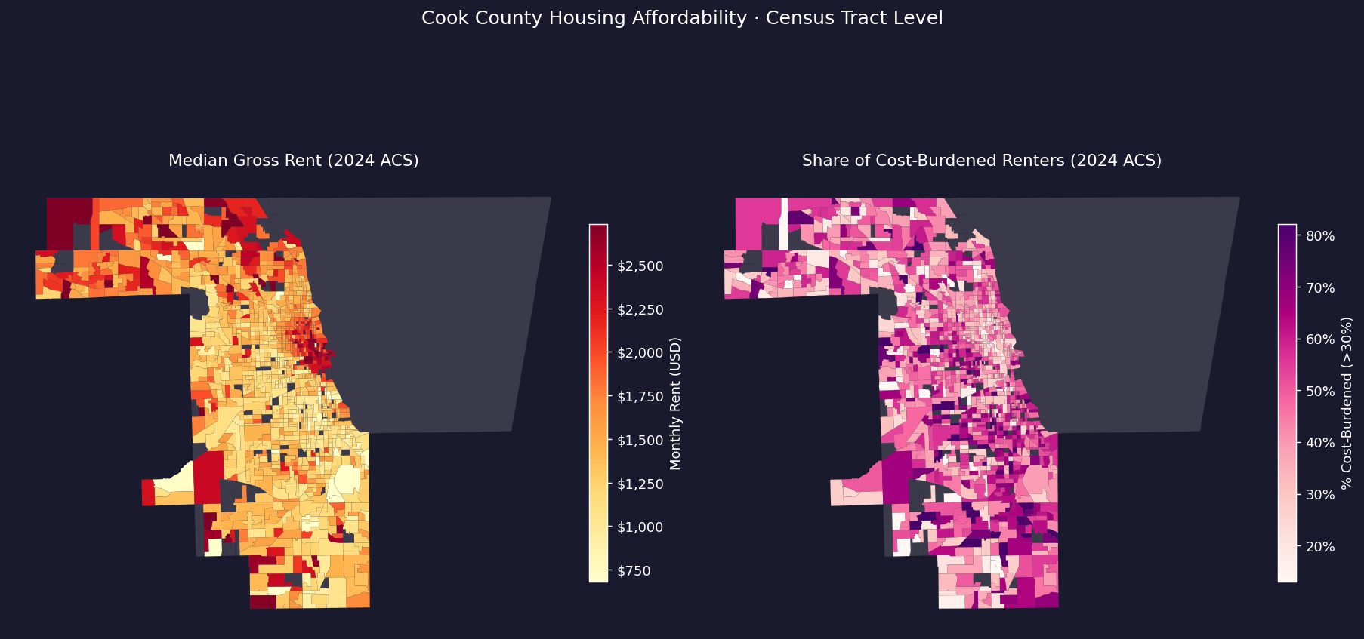
Finding 2: Geographic Inequality
Cook County census tracts · 2024 ACS · Left: median rent | Right: % cost-burdened

Slide 8
Finding 2: Key Takeaways
Rent Level (left map)
Cost Burden (right map)
• High rents cluster in Near North Side, Lincoln Park, Lakeview (>$2,000/mo)
• South & West Side tracts often below $900/mo
• Clear North–South gradient
• Severe burden ≠ highest-rent areas
• Concentrated in South/West Side (Englewood, Austin, Garfield Park)
• 40.7% of tracts: majority of renters are cost-burdened
• Driven by income inadequacy, not just high rents
83.4%
40.7%
$1,100+
of tracts exceed HUD 30% threshold
of tracts have >50% renters burdened
median rent gap North vs South Side

Slide 9
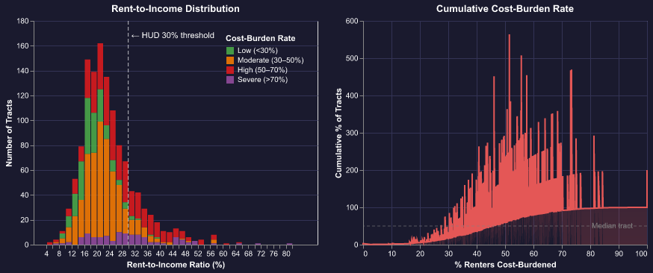
Finding 3: Affordability Distribution
Cook County census tracts · 2024 ACS · Left: RTI histogram | Right: cumulative burden rate

Slide 10
Finding 3: Key Takeaways
• Median rent-to-income ratio across Cook County: 21.9% — looks OK at the aggregate...
• But 83.4% of tracts have >30% of their renters cost-burdened
• 40.7% of tracts exceed the 50% threshold — the majority of renters in those tracts
• "Severe" tracts (>70% burdened) appear across the full RTI range: burden is driven by low income, not just high rent
• Only ~17% of tracts fall below the HUD affordability threshold

Slide 11
Interactive Dashboard
Live Streamlit App — link TBD
Tab 1 Rent Trends
Tab 2 Choropleth Map
Tab 3 Distribution
• Multi-select ZIP codes & cities
• Year range slider
• Policy event overlay toggle
• Summary stats table
• Switch: rent / RTI / burden rate
• Adjustable color scheme
• Top 10 burdened tracts table
• RTI histogram (interactive)
• Cumulative burden ECDF
• Rent vs. burden scatter plot
⚠ Remember to wake up the app the night before the presentation.

Slide 12
Policy Implications
Finding
Policy Recommendation
+12% rent surge after moratorium ends
Stronger tenant relocation assistance & just-cause eviction protections
Severe burden in South/West corridors
Target vouchers & affordable unit production to high-burden areas
83% of tracts exceed HUD threshold
Expand rental assistance eligibility — current scale is insufficient
North Side rent appreciation gap
Anti-displacement zoning overlays in rapidly appreciating neighborhoods
Chicago's Affordable Requirements Ordinance (ARO) needs stronger income targeting and enforcement.

Slide 13
Conclusion
1
Rents rose 21.9% from 2015–2024, with the sharpest acceleration post-moratorium (2022–2024).
2
Geographic inequality is severe: high rents in the North, but the worst burden is concentrated in South/West Side neighborhoods due to low incomes.
3
Cost burden is the norm: 83% of Cook County tracts fail the HUD affordability standard — a systemic failure, not an isolated problem.
4
Both supply and income policies are needed: market-rate construction alone won't reach the communities that need help most.

Slide 14
Thank You
Data: ACS 2024 · Zillow ZORI 2015–2026 · Census TIGER/Line 2024
GitHub Repo: [link TBD] | Streamlit Dashboard: [link TBD]

