Slide 1
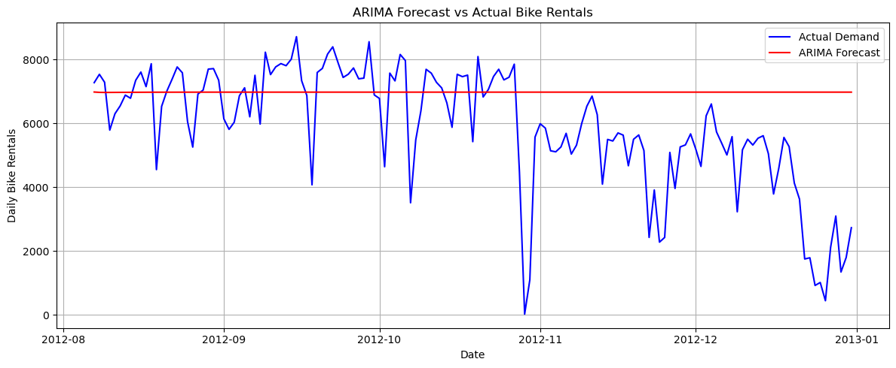
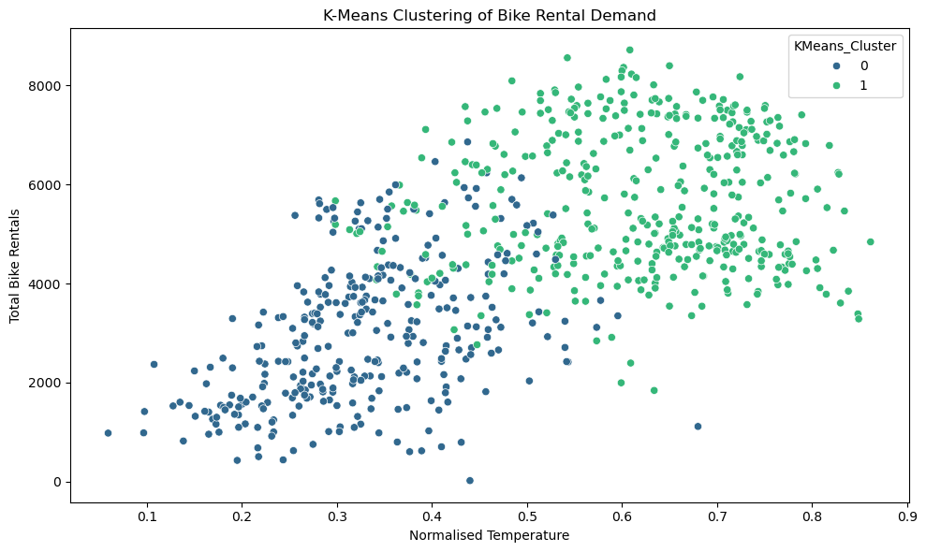
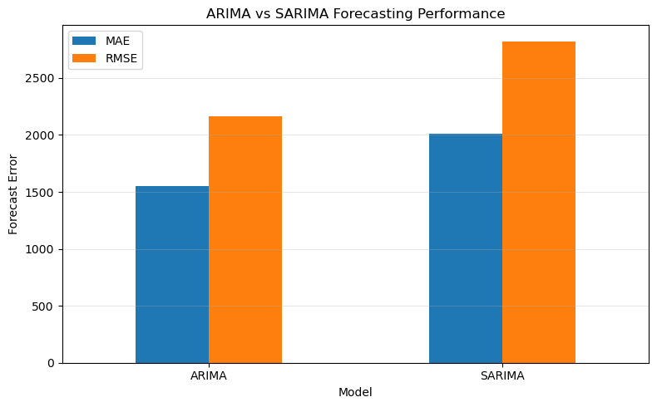
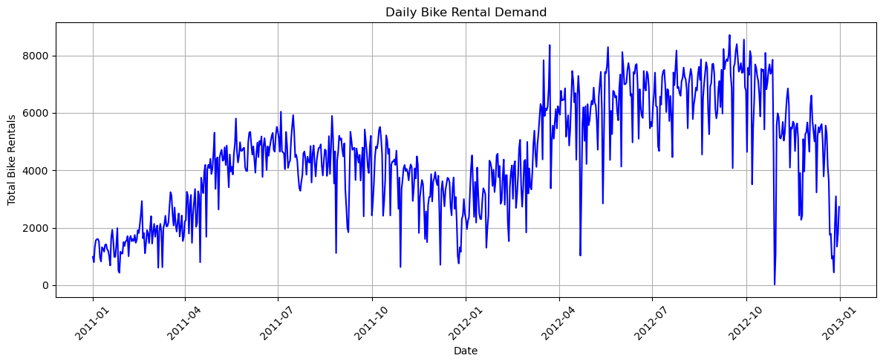
BIKE SHARING DEMAND ANALYSIS
Clustering and Time Series Forecasting | Machine Learning for Business — CA1
Student: Khishigjargal Burmaa • Student Number: 2026059 • CCT College Dublin • October 2026
INTRODUCTION & OBJECTIVES
CLUSTERING RESULTS
FORECAST RESULTS
This study examines daily bicycle rental demand to identify patterns and compare clustering and forecasting methods. Objectives include exploratory analysis, grouping similar days, and assessing the accuracy of ARIMA and SARIMA models.
K-Means: silhouette 0.3017; Davies–Bouldin 1.3592. Agglomerative: silhouette 0.2478; Davies–Bouldin 1.4384. K-Means performed better on both measures, although cluster separation was modest.
ARIMA: MAE 1,550.72; RMSE 2,162.51; MAPE 272.56%. SARIMA: MAE 2,007.49; RMSE 2,822.66; MAPE 308.95%. ARIMA performed better on the held-out test period.
DATASET & METHODS
UCI Bike Sharing Dataset: 731 daily observations and 16 variables (2011–2012). Weather and rental features were explored. Standardised temp, hum, windspeed and cnt were clustered using K-Means and Agglomerative Clustering. Forecasting used an 80/20 chronological split.
LOW- VS HIGH-DEMAND DAYS
K-Means identified 313 lower-demand days (mean 2,966.57 rentals) and 418 higher-demand days (mean 5,655.84 rentals).
DAILY DEMAND OVER TIME
Daily rental demand changes across the two years, with pronounced variation over time.
ARIMA forecast compared with observed rentals
FORECASTING METHODS
ARIMA(2,1,2) and SARIMA(2,1,2)(0,1,1,7) were fitted to the training data. ADF tests indicated non-stationarity before differencing. Models were evaluated against the final 147 days.
CONCLUSION
BUSINESS IMPLICATIONS
K-Means gave the stronger clustering metrics; ARIMA had lower test errors than SARIMA. Nevertheless, the results highlight important limits of these models for long-range forecasting.
Demand grouping may help plan bicycle availability and staffing. Forecast errors are too large for dependable operational decisions without further validation and improved models.
LIMITATIONS
Historical data may not reflect present demand. The test horizon is long, and both forecasts miss major demand changes. SARIMA also produced parameter-uncertainty warnings.
REFERENCES
Fanaee-T, H. & Gama, J. (2014), Progress in Artificial Intelligence, 2, 113–127. | UCI Machine Learning Repository, Bike Sharing Dataset (2013). | Hyndman, R.J. & Athanasopoulos, G. (2021), Forecasting: Principles and Practice, 3rd ed.

