Slide 1
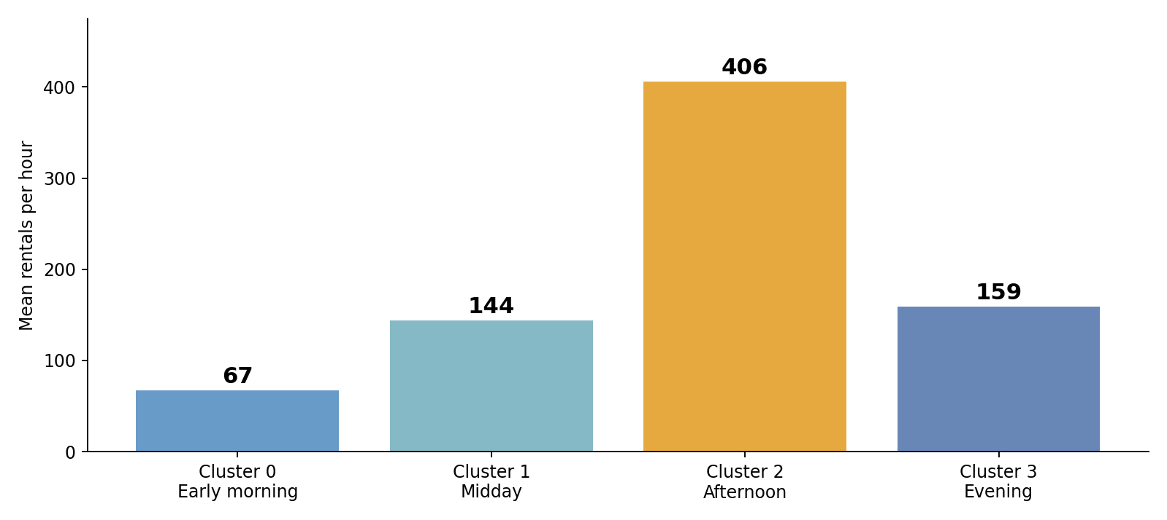
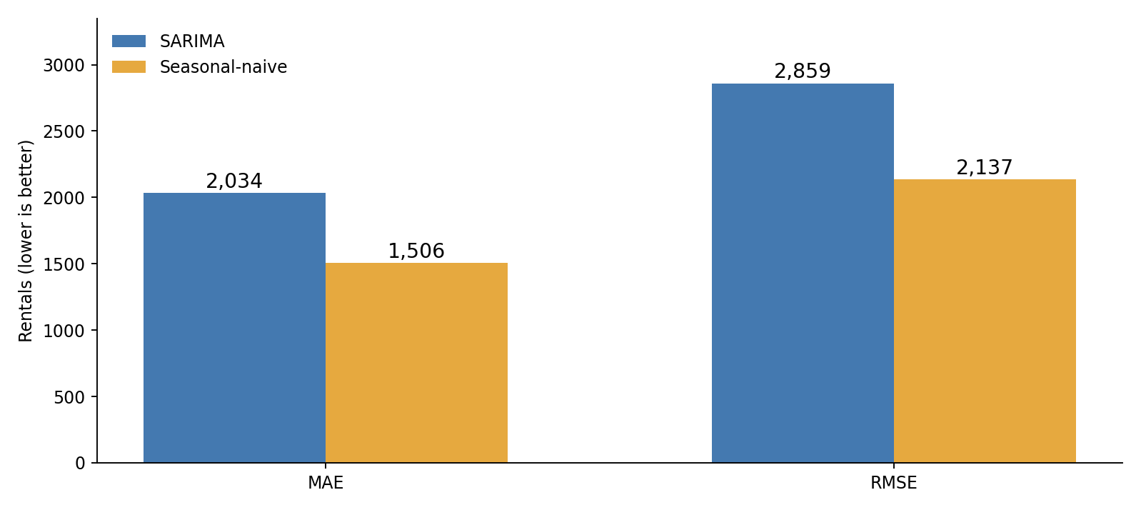
UNDERSTANDING BIKE-SHARING DEMAND
Pedro Netto (2026083) | Machine Learning for Business | CCT College Dublin, October 2026
ABSTRACT & RESEARCH QUESTION
METHODS — CLUSTERING
METHODS — FORECASTING
CONCLUSIONS
This project explores bike-sharing demand using clustering and time-series forecasting. The aim is to understand how rentals change across time and conditions, and how accurately daily demand can be forecast.
Research question: What demand patterns can be identified, and which forecasting approach performs better?
Five standardised variables: hour, temperature, humidity, wind speed and rental count.
K-Means and Agglomerative Clustering were compared at k = 4 using Silhouette and Davies–Bouldin metrics. k = 4 was chosen for interpretable demand profiles, despite k = 2 having the highest Silhouette.
Hourly rentals were aggregated into daily totals. The chronological split used 584 days for training and 147 days for testing.
Four SARIMA candidates were assessed on validation RMSE. SARIMA(1,1,1) × (1,1,1,7) was selected and compared with a seasonal-naive benchmark.
The clustering analysis identified four useful demand profiles. K-Means had stronger metrics, although separation was modest.
The SARIMA model did not outperform the seasonal-naive forecast on the final test period. More complex models are not always more accurate.
A business should test these insights using newer and station-level data before making operational decisions.
CLUSTER PROFILES
FORECAST ERROR COMPARISON
DATASET & OBJECTIVES
UCI Bike Sharing Dataset: 17,379 hourly observations from 2011–2012. No missing or duplicate records; 731 daily totals.
Objectives: explore demand, compare two clustering methods, evaluate a SARIMA forecast against a seasonal-naive baseline.
LIMITATIONS
Rental count was included in clustering, so the profiles describe demand rather than predict it independently.
The forecast covered 147 days without updating the model. The dataset is historical (2011–2012), and unusual low-demand days can affect percentage errors.
The Sandy event is a possible explanation for 29 Oct 2012, not proven causation.
CLUSTERING RESULTS
FORECAST FINDINGS
BUSINESS APPLICATION
K-Means (k = 4):
Silhouette = 0.239
Davies–Bouldin = 1.372
Agglomerative (k = 4):
Silhouette = 0.157
Davies–Bouldin = 1.766
K-Means performed better, but the groups were not strongly separated.
SARIMA test errors:
MAE = 2,034 | RMSE = 2,859
Seasonal-naive test errors:
MAE = 1,506 | RMSE = 2,137
The simple baseline was more accurate. SARIMA over-forecast on average (residual ≈ −1,849). A day with only 22 rentals made MAPE sensitive to low values.
Cluster 0: ~67 rentals/hour, mainly early morning. Consider this quieter window for maintenance and redistribution.
Cluster 2: ~406 rentals/hour, mainly afternoon. Prioritise bike availability during busy periods.
These are planning suggestions, not station-level recommendations.
REFERENCES
Fanaee-T, H. and Gama, J. (2014) “Event labeling combining ensemble detectors and background knowledge”. Progress in Artificial Intelligence.
UCI Machine Learning Repository (n.d.) Bike Sharing Dataset.
National Hurricane Center (2012) Post-Tropical Cyclone Sandy: Tropical Cyclone Update.

