Slide 1


1
Replicating the paper: ?
NAME?
†
‡
†
Department of Information Management and Finance, National Yang Ming Chao Tung University
Institute of Business and Management, National Yang Ming Chao Tung University
‡

Slide 2
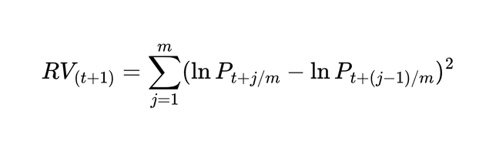
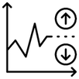
R1
2
Motivation and Why this topic interests you
Volatility
Notes:
真正的波動度其實是一個不可觀測的潛在變數，為了更精確地衡量實際市場波動，Andersen & Bollerslev提出了 Realized Volatility 的概念
一段期間內的「真實波動度」可以表示為瞬時波動度的積分，稱之為Integrated Volatility
利用quadratic variation 理論來估計實際波動度。根據 quadratic variation 的性質，如果價格資料的取樣頻率足夠高，則高頻報酬率平方的加總會收斂到真實的 integrated volatility，用於近似真實波動度。

Slide 3
R2
3
Data
Volatility
Notes:
真正的波動度其實是一個不可觀測的潛在變數，為了更精確地衡量實際市場波動，Andersen & Bollerslev提出了 Realized Volatility 的概念
一段期間內的「真實波動度」可以表示為瞬時波動度的積分，稱之為Integrated Volatility
利用quadratic variation 理論來估計實際波動度。根據 quadratic variation 的性質，如果價格資料的取樣頻率足夠高，則高頻報酬率平方的加總會收斂到真實的 integrated volatility，用於近似真實波動度。

Slide 4

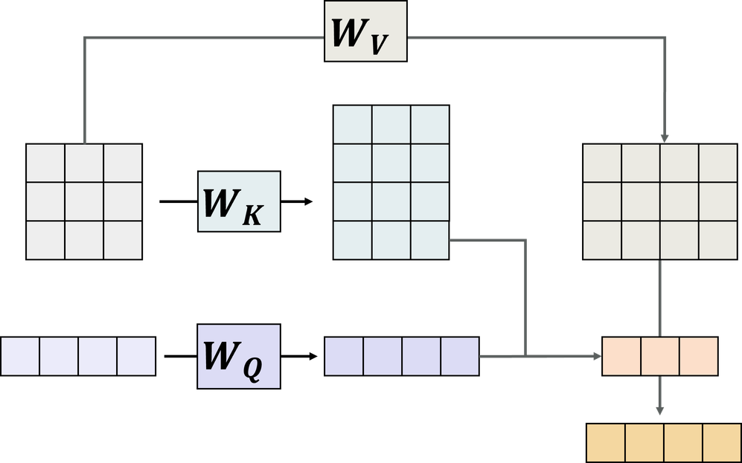


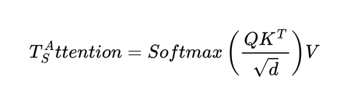
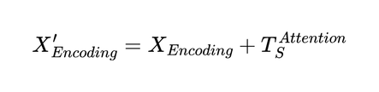
R3
4
Benchmark and the experimental design
      Market indicators encode the current market state and form the query vector
      News embeddings are projected to keys and values
      The weighted news representation is added to
Volatility

Slide 5
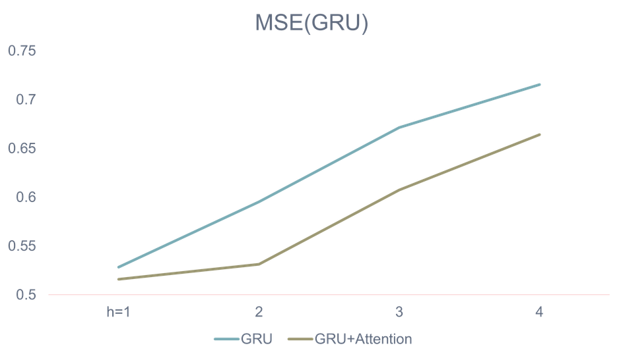
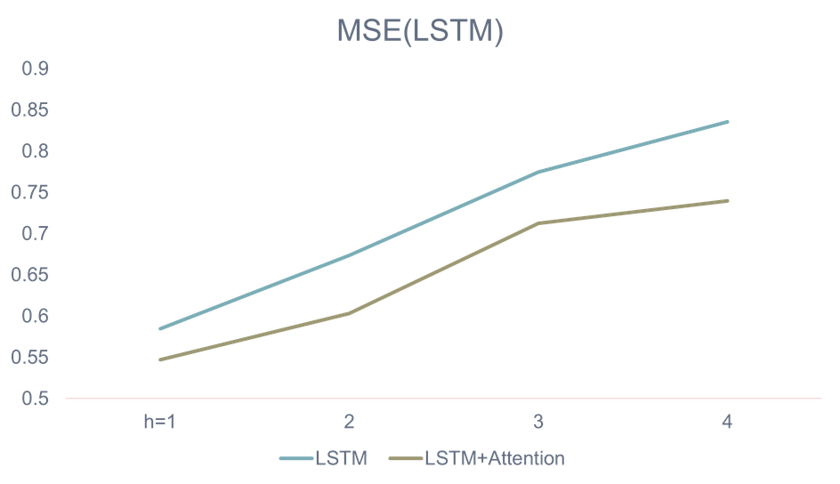
R4
5
Empirical results and conclusion
      Numerical market features provide the strongest signals for RV forecasting
      Naively aggregated news embeddings add little value to conventional ML models
      Cross-attention enables RNNs to extract useful information from news and improve forecasting accuracy
Volatility

Slide 6
6
Replicating the paper: ?
NAME?
†
‡
†
Department of Information Management and Finance, National Yang Ming Chao Tung University
Institute of Business and Management, National Yang Ming Chao Tung University
‡

