Slide 1

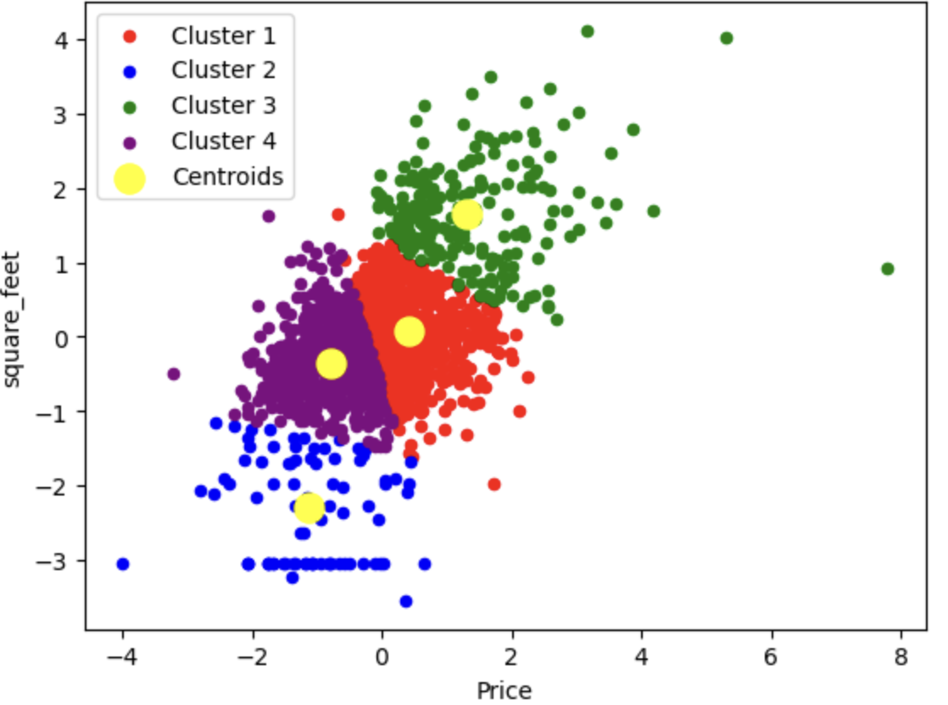
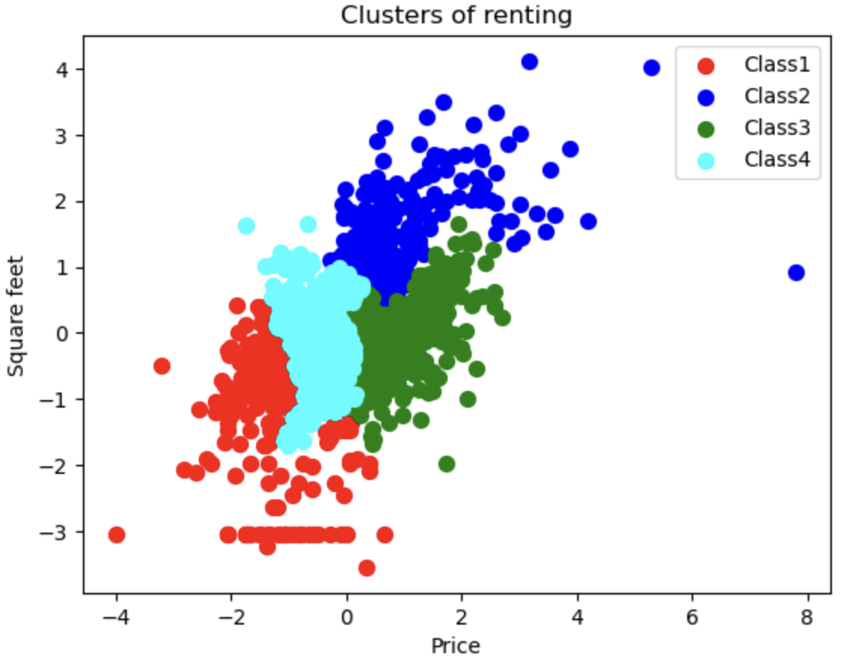
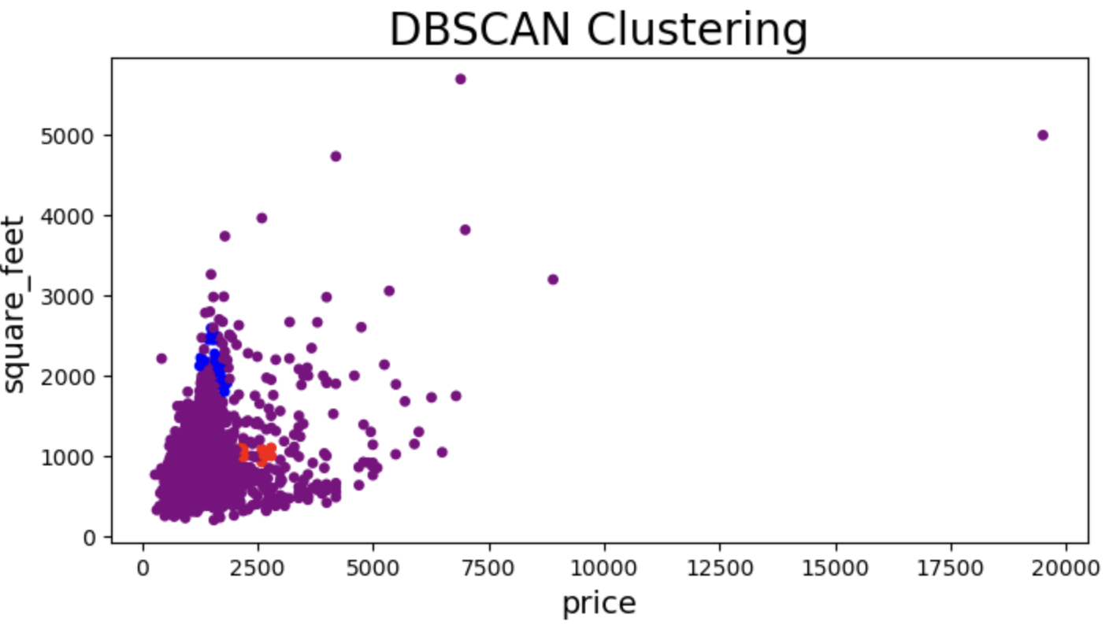
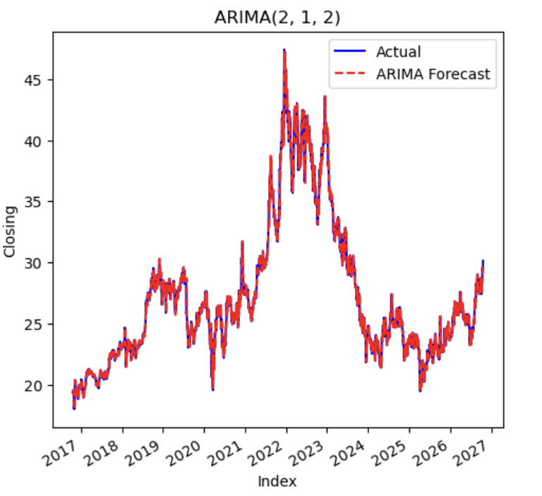
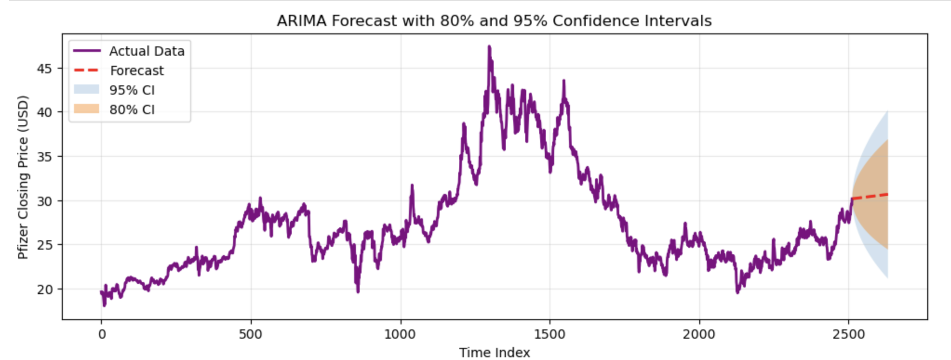
‘Segmenting the US Rental Market: Clustering Listings by Price and Size’
‘ Forecasting Pfizer Stock Price with ARIMA’
Erdene-Undrakh Batjargal, Data Analytics For Business 2026
Introduction
Results
Objectives
If we cluster using price/ square feet, would groups like ‘expensive’, ‘cheap’ and ‘price does not match its size’ merge. For instance, a listing of $1560 for 200 square feet might be far from most listings. Regarding renting ads in USA.
Stock prices are noisy and non-stationary. This part of analysis dedicates how ARIMA model can describe the daily closing price of Pfizer and what uncertainty surrounds its short =term forecasts.
Clustering
ARIMA(2, 1, 2) follows the overall movement of the price closely (Fig. 1).
The 80% and 95% confidence intervals widen as the forecast horizon increases, showing growing uncertainty (Fig. 2).
Test-set performance: On the test set, the model achieved an R² score of 0.9943, indicating that it explains approximately 99.4% of the variance in the observed prices. Because R² computed on price levels tends to be high for trending series.
The RMSE is 0.43 and the MAE is 0.30 (in price units), meaning that forecasts deviate from the actual prices by about 0.30 on average, with larger errors penalized more heavily in the RMSE.
K-Means the elbow curve drops sharply up to k=3, k=4 then flattens, so in terms of that k=4 is a simplicity and fitted. Four clusters separate listings mainly along price and size. ‘A small low-size’, ‘a low- price mid-size’ , ‘a mid –market group’ , and ‘a high-price large-size group’. Centroids show a clear progression from compact, affordable units to large, expensive ones.
Figure1. K-Means (k = 4) clusters of listings by price and square footage (standardized). Yellow dots mark centroids.
Methods and Materials
Ward-linkage produced four clusters ordered along a clear price-size gradient: ‘red- a small low-price’ , ‘cyan- a compact mid-low group’, ‘ green a mid-high group’, ‘blue- a large-high price’ groups. The Clusters are similar to former model (K-Means) which suggests the structure is stable among methods. Some boundary overlap between cyan. Green and blue shows that segments are gradual rather than sharply separated.
Clustering
10000 rental listings (id, category, title, body, amenities, bathrooms, bedrooms, fee, has photo, pets allowed, price, price display, price type, square, city name, state, latitude, longitude, source, time). Dataset is cleaned and most necessary features are selected (e.g. bathrooms, bedrooms, square feet, price, city name) for clustering.
Prices were converted to numeric values, restricted to monthly rents, log-transformed and standardized both square meter and price are before clustering.
K-Means number of clusters chosen with The Elbow method. Agglomerative ward linkage with Euclidean distance on standardized price and square footage, the Dendrogram is used to choose of the number of clusters. DBSCAN density based clustering used as a comparison for outlier detection.
Time Series
Dataset contains last 10 years stock market record which is total 2523 rows and 5 columns daily closing prices Pfizer (Yahoo Finance).
Checked stationarity. ‘Augmented Dickie-Fuller’ test on closing price (statistic result: adf= -2.03 , p-value=0.275) and first-order differencing (d=1) applied. Selected ARIMA (2,1,2 min=2922.66). Measured accuracy with ‘R2 score’(result= 0.9943). Produced forecasts with 80% and 95% confidence intervals.
QQ plot of the closing price shows a slight S shape deviation from the normal line, indicating heavy tails and non-normal distribution.
Conclusion
Rental listings form a continuous spectrum rather than sharply separated groups, so K-Means and Hierarchy Agglomerative which partitions the whole space, suits this data better than DBSCAN, which looks for density gaps that barely exist.
Four market segments were identified and can support pricing and search tools.
There is only two main variables drive the clusters; listing prices are asking prices; location was not used in clustering.
Figure2. Hierarchical clustering (Ward, k = 4) of listings by standardized price and square footage.
DBSCAN grouped most listings into one dense region and flogged the rest as a noise, so it did not meaningful segments here.
It was still useful for spotting extreme listings for example rents near $19.500 or units of about 5000 square feet.
ARIMA captures short-term dynamics but cannot anticipate sudden events (e.g. the 2021-2022 peak and fall), because it only uses past prices. Forecasts beyond a few steps revert towards a trend and have wide intervals. ARIMA is a simple, interpretable baseline for short-term forecasting.
Limitations: no external variables (news, market indices, volume), assumes constant variance, results depend on the test period.
Figure3. DBSCAN on price and square footage: most points form one dense group or noise; useful mainly for outliers.
Time-Series
References
Lecture 1, Clustering Introduction, Muhammad Iqbal, 2026,
Lecture 2,3 ,4 Clustering Model, “DBCAN”, “KMeans”, “Hierarchy ” Muhammad Iqbal, 2026,
Lecture 6, Time Series Analysis Muhammad Iqbal, 2026,
Tutorial 1,2,3 Clustering Model, “DBCAN”, “KMeans”, “Hierarchy ” Muhammad Iqbal, 2026,
https://scikit-learn.org/stable/modules/clustering.html
Apartment for Rent Classified [Dataset]. (2019). UCI Machine Learning Repository. https://doi.org/10.24432/C5X623.
https://finance.yahoo.com/quote/%5EPFE/history/
https://www.geeksforgeeks.org/machine-learning/regression-metrics/
Figure 1. ARIMA(2, 1, 2) fitted values versus actual Pfizer closing price.
Figure 2. ARIMA forecast with 80% and 95% confidence intervals.

