Slide 1
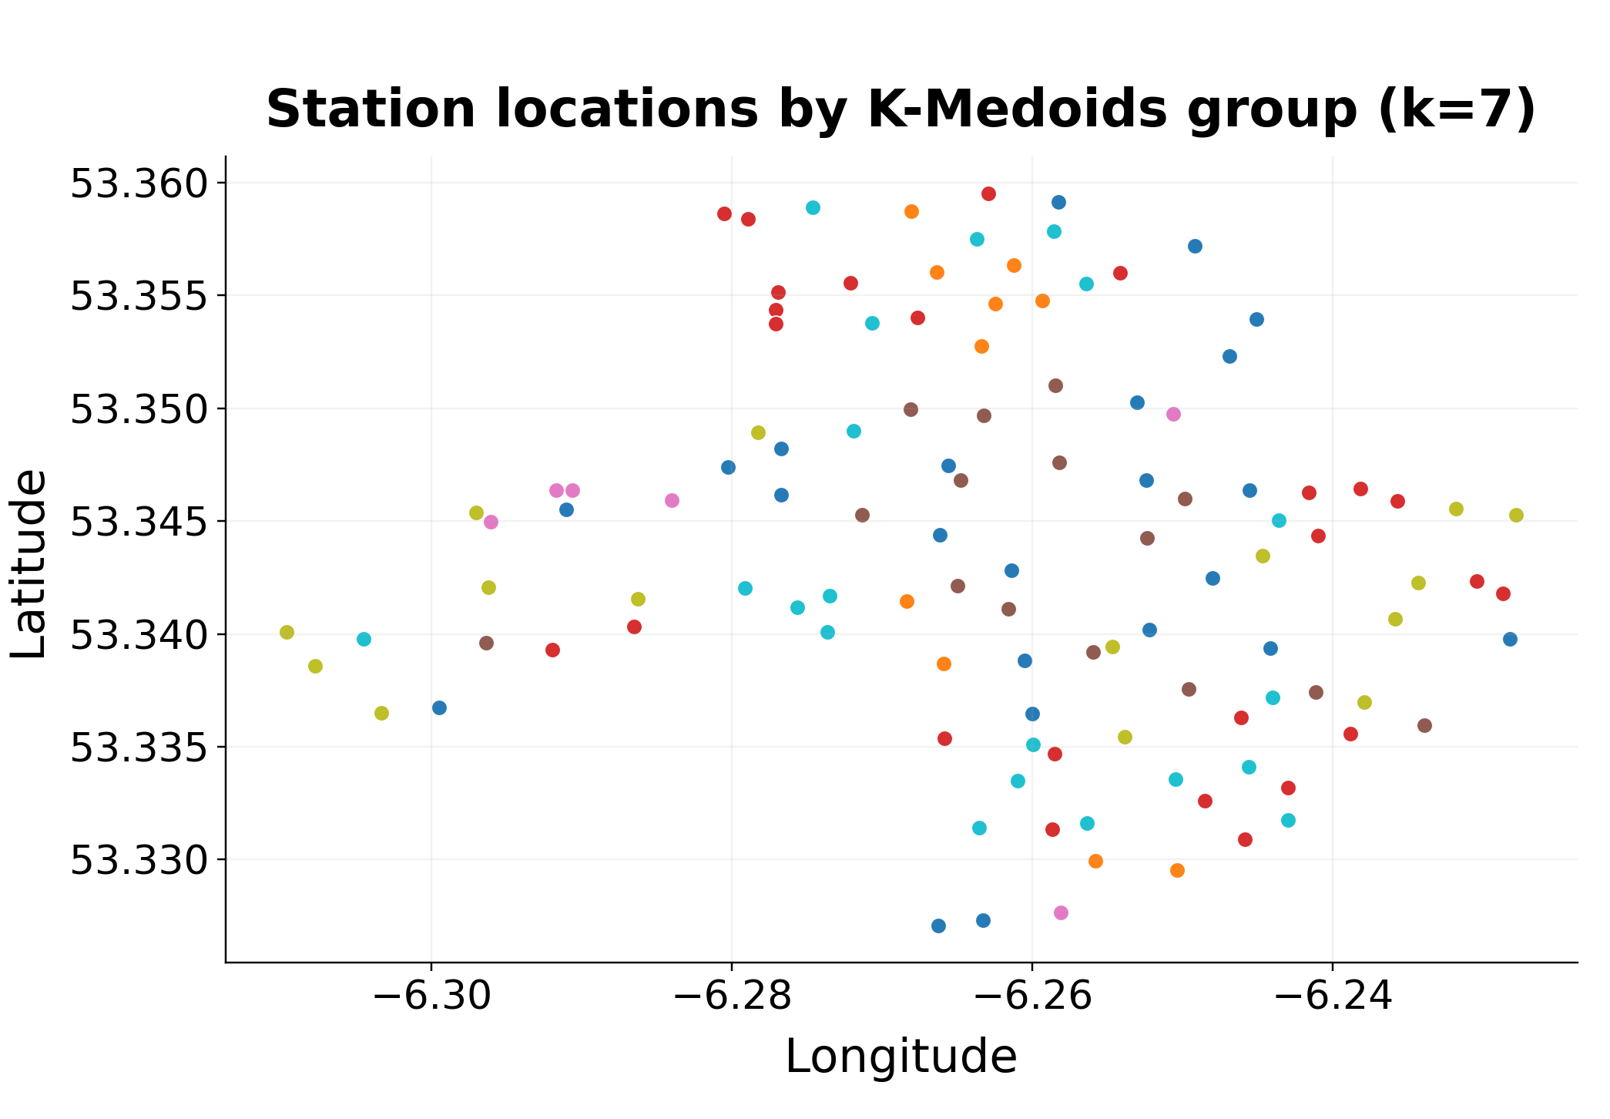
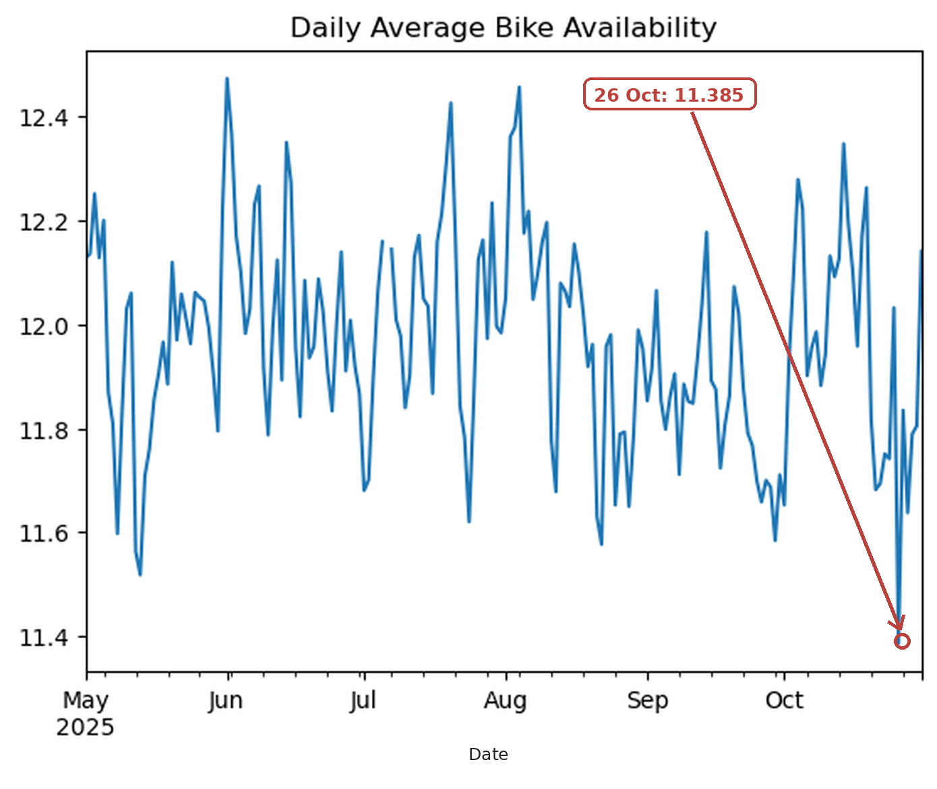
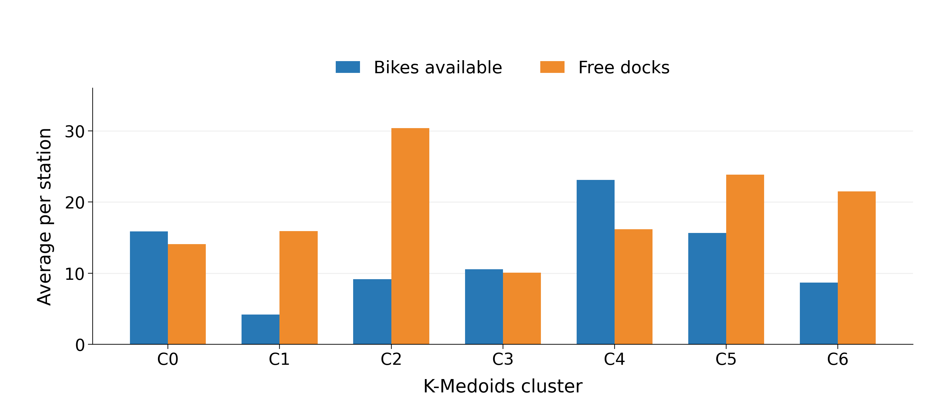
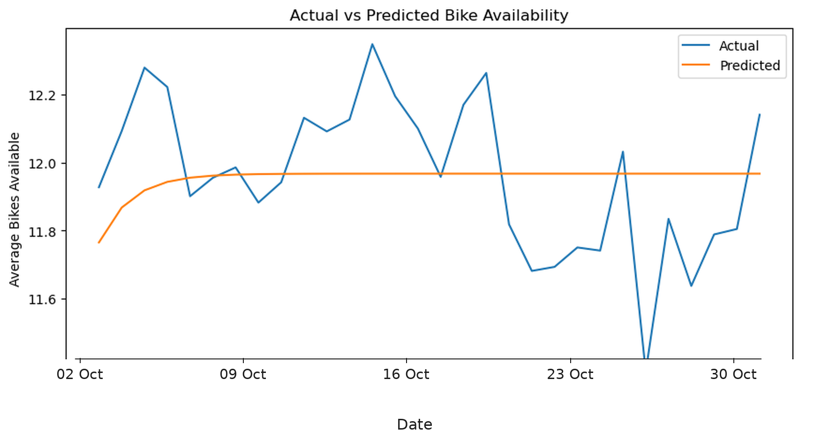
Dublin Bikes: Station Profiles and Daily Availability
Clustering and Time Series Forecasting | CA1 — Machine Learning for Business
Gleiciane Rocha | Student number: 2026248 | CCT College Dublin | May–October 2025
Main finding: K-Medoids with 7 clusters gave useful station profiles, while the simple mean baseline gave the best forecasts.
WHY I CHOSE THIS TOPIC
THE SEVEN STATION GROUPS
DAILY PATTERN AND POSSIBLE ANOMALY
WHAT I FOUND, WHAT IS MISSING, AND WHAT I WOULD TRY NEXT
I chose Dublin Bikes, an urban transport service, because availability matters at both ends of a trip: riders need a bike to start and a free dock to finish. Stations with very few bikes or free docks may need attention.
The seven groups describe stations with different levels of bike availability, free docks and capacity.
Daily average availability stayed around 11.4–12.5, without a clear long-term rise or fall. Weekend averages were a little higher, but lag-7 autocorrelation was only 0.20, so the weekly relationship looked weak.
Main takeaway
K-Medoids with k=7 gave every station a profile. For forecasting, the mean baseline beat all four time-series models.
This project has two aims:
On 26 October 2025, the mean fell to 11.385 and the decomposition residual was −0.481. Clocks went back that day in Ireland, but the data cannot show that this caused the drop (Citizens Information, 2025).
1. Group stations by availability and capacity.
Limitations
2. Test whether daily average availability can be forecast.
Bikes, free docks and capacity overlap. Daily means hide busy hours, and availability is not trip demand. The data covers six months, and the 0/0 records and the 26 October drop are unclear.
Availability does not show how many trips people made.
26 October 2025: a possible anomaly; the cause is unknown.
DATA AND PREPARATION
What I would try next
I combined six monthly CSV files for May–October 2025 from Dublin City Council / Smart Dublin (Dublin City Council, n.d.; pandas, 2026), under a CC BY 4.0 licence.
Hourly data, Holt-Winters or Prophet, and weather, events or trip counts. Staff could review stations with few bikes or many free docks before rebalancing.
I removed four constant columns and added total availability, leaving 12 columns. Station 51 was removed because it kept reporting 0 bikes and 0 docks despite a capacity of 40. Other 0/0 records were treated as offline or missing.
REFERENCES
CLUSTERING: METHODS AND SCORES
Fig. 1. Station locations by K-Medoids group (k=7). Colours match the cluster key.
Citizens Information (2025) When do clocks change in Ireland? Available at: https://www.citizensinformation.ie/en/government-in-ireland/how-government-works/government-records-and-statistics/when-do-clocks-change/ (Accessed: 13 October 2026).
DBSCAN groups stations by density and can label some as noise (scikit-learn developers, n.d.a). I tested two settings of eps and min_samples (Table 1).
Cluster key
Dublin City Council (n.d.) Dublinbikes API DCC. Smart Dublin Open Data Portal. Available at: https://data.smartdublin.ie/dataset/dublinbikes-api (Accessed: 25 October 2026).
● C0 — Medium capacity; moderate availability (23 stations)
● C1 — Low capacity; very few bikes (10 stations)
● C2 — High capacity; many free docks (25 stations)
● C3 — Low capacity; fewer free docks (15 stations)
● C4 — High capacity; many bikes available (6 stations)
● C5 — High capacity; moderate bike availability (15 stations)
● C6 — Medium capacity; more free docks (20 stations)
Fig. 3. Daily average bike availability, with 26 October marked.
K-Medoids builds a fixed number of groups around real stations, the medoids (Iqbal, 2026c; Novikov, 2019).
FORECASTING: THE SIMPLE BASELINE WON
Iqbal, M. (2026a) ‘ARIMA and SARIMA Time Series Models’, Machine Learning for Business, HDip in Science in Data Analytics for Business, CCT College Dublin. Lecture slides.
Silhouette Score and Davies–Bouldin Index
The ADF test on the training series gave p = 0.215. After first differencing, the p-value was 0.000247, so I also tested d = 1.
Silhouette shows how well a station fits its own cluster versus the nearest other one (higher is better). Davies–Bouldin compares spread within clusters with distance between them (lower is better) (scikit-learn developers, n.d.b, n.d.c).
The PACF suggested trying p = 1 and the ACF suggested q = 1, although neither plot had a clear cut-off. All five methods used the same 30-day test set.
Iqbal, M. (2026b) ‘ARMA Time Series Model’, Machine Learning for Business, HDip in Science in Data Analytics for Business, CCT College Dublin. Lecture slides.
The mean baseline had the lowest errors. The Ljung–Box test for ARIMA(1, 0, 1) gave p = 0.0025, so autocorrelation remained (Iqbal, 2026a, 2026b; statsmodels developers, n.d.a).
Iqbal, M. (2026c) ‘Introduction to Clustering’, Machine Learning for Business, HDip in Science in Data Analytics for Business, CCT College Dublin. Lecture slides.
K-Medoids k=7 beat k=3 on both measures (Table 1). DBSCAN with eps=0.2 scored better, but only on its own subset, with 22 noise stations, so the scores are not directly comparable.
Novikov, A. (2019) ‘PyClustering: Data Mining Library’, Journal of Open Source Software, 4(36), p. 1230.
Table 2. MAE and RMSE for the five methods on the 30-day test set.
pandas (2026) pandas.to_datetime. Available at: https://pandas.pydata.org/pandas-docs/stable/reference/api/pandas.to_datetime.html (Accessed: 21 October 2026).
Why I chose K-Medoids with k=7
Model | MAE | RMSE
Mean baseline | 0.1804 | 0.2189
ARIMA (1, 0, 1) | 0.1896 | 0.2267
ARIMA (1, 0, 0) | 0.1922 | 0.2307
ARIMA (1, 1, 1) | 0.2168 | 0.2606
SARIMA (period 7) | 0.3106 | 0.3497
scikit-learn developers (n.d.a) Clustering. scikit-learn documentation. Available at: https://scikit-learn.org/stable/modules/clustering.html (Accessed: 24 October 2026).
All 114 stations received a label and the groups were easier to describe, although the result changed with the starting medoids.
scikit-learn developers (n.d.b) davies_bouldin_score. scikit-learn documentation. Available at: https://scikit-learn.org/stable/modules/generated/sklearn.metrics.davies_bouldin_score.html (Accessed: 24 October 2026).
Fig. 2. Average bikes and free docks for each K-Medoids group.
Table 1. Clustering results by method (K-Medoids k=7 highlighted).
A few examples from the groups
Method / settings | Clusters | Noise | Silhouette | Davies–Bouldin
DBSCAN 0.2 / 2 | 18 | 22 | 0.569 | 0.417
DBSCAN 0.5 / 5 | 3 | 17 | 0.495 | 0.857
K-Medoids k=3 | 3 | 0 | 0.431 | 0.862
K-Medoids k=7 | 7 | 0 | 0.541 | 0.543
• C1 averaged 4.18 bikes available.
scikit-learn developers (n.d.c) silhouette_score. scikit-learn documentation. Available at: https://scikit-learn.org/stable/modules/generated/sklearn.metrics.silhouette_score.html (Accessed: 24 October 2026).
• C4 averaged 23.09 bikes available.
• C2 averaged 30.38 free docks, with a capacity of around 40.
statsmodels developers (n.d.a) statsmodels.stats.diagnostic.acorr_ljungbox. statsmodels documentation. Available at: https://www.statsmodels.org/stable/generated/statsmodels.stats.diagnostic.acorr_ljungbox.html (Accessed: 25 October 2026).
Fig. 4. Actual daily average bike availability compared with forecasts from the ARIMA(1, 0, 1) model over the 30-day test period.
Lower MAE and RMSE mean smaller forecast errors. The mean baseline beat all four more complex models.

