Slide 1

The cost of
procrastination
Short-term relief.
More pressure later.
Near the end of the semester:
More reported stress
More reported illness
Lower grades
Example: a group presentation
left until the night before
Tice & Baumeister (1997). Observed associations.
5
Notes:
PART 5 — APPROXIMATELY 45 SECONDS
So, what does procrastination actually cost us? A 1997 study by Tice and Baumeister followed university students across a semester. Students who procrastinated reported more stress and illness near the end, and received lower grades. The short-term relief came with a longer-term cost. For example, imagine leaving a group presentation until the night before. There is less time to check sources, practise speaking, or help your teammates. Even when the deadline is met, the group may have little time left to improve the work. So, what can we do?
RESEARCH SOURCES
Tice, D. M., & Baumeister, R. F. (1997). Longitudinal study of procrastination, performance, stress, and health: The costs and benefits of dawdling. Psychological Science, 8(6), 454–458. Abstract consulted.
https://doi.org/10.1111/j.1467-9280.1997.tb00460.x
Jaffe, E. (2013). Why Wait? The Science Behind Procrastination. Association for Psychological Science.
https://www.psychologicalscience.org/observer/why-wait-the-science-behind-procrastination
IMAGE SOURCE
Illustrative stock photograph, as published by Earth.com. It does not depict the research participants.
https://www.earth.com/news/night-owls-are-mentally-sharper-than-morning-larks/
https://cff2.earth.com/uploads/2024/07/15074125/Night-owls-cognitive-performance.jpg

Slide 2
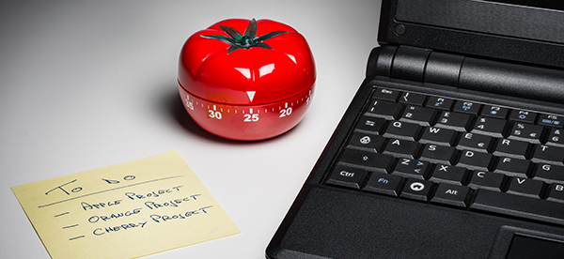
Two tools for getting started
Two-Minute Rule
Pomodoro Technique
A first step under 2 minutes
25
5
Open the document.
Write one slide title.
minutes of focus
minute break
One task at a time
After four focus periods:
15–30 minute break
James Clear, Two-Minute Rule. Francesco Cirillo, The Pomodoro Technique (2007).
6
Notes:
PART 6 — APPROXIMATELY 75 SECONDS
00:45–01:15 — TWO-MINUTE RULE
One approach is James Clear’s Two-Minute Rule: make the first step small enough to take less than two minutes. Instead of thinking, “I need to finish my whole presentation,” start by opening the document and writing one slide title. You have a clear first action, instead of facing the entire project at once. The aim is to make starting easier.
01:15–01:50 — POMODORO
Then try the Pomodoro Technique. Choose one task, focus for twenty-five minutes, and take a five-minute break. After four focus periods, take a longer break of fifteen to thirty minutes. For our presentation, one focus period could be used to prepare three key points, followed by a short break. The timer gives you a clear stopping point and a planned moment to rest. Then stand up and get some water.
01:50–02:00 — HANDOFF
Start with one small action, then focus. Next, we’ll look at turning our intentions into specific plans.
METHOD SOURCES
Clear, J. (n.d.). How to Stop Procrastinating by Using the “2-Minute Rule”.
https://jamesclear.com/how-to-stop-procrastinating
Cirillo, F. (2007). The Pomodoro Technique. Version 1.3. Section 2.1 and Appendix 1.
https://www.faasafety.gov/files/events/SO/SO15/2024/SO15134204/Cirillo_--_Pomodoro_Technique.pdf
IMAGE SOURCE
South West TAFE. How to study effectively. Illustrative photograph of a tomato timer beside a laptop.
https://www.swtafe.edu.au/about-us/news-events/how-to-study-effectively/
https://swtafe-prod-cdn.azureedge.net/media/3412/kitchen-timer-for-cooking-and-working-productively-600x400.jpg

