Slide 1

Indian Institute of Technology Ropar · Student Project Evaluation · AI101
Used Car Resale Price Prediction
End-to-End Supervised Learning Pipeline using Multiple Linear Regression
Group 8
PROJECT TEAM & ROLES
Team Member | Project Role
Siddharth Kumar | Execution Lead
Divyaans Agarwal | Video Lead
A Damaruk Vajra Tej | PPT Lead
Nihal Ahirwar | Documentation Lead
AI101 MINI-PROJECT · FINAL EVALUATION
Supervised regression evaluation on structured automotive market data using Scikit-Learn Pipeline, ColumnTransformer, and empirical diagnostic analysis.
PROJECT REPOSITORY & CODEBASE
GitHub: https://github.com/2026aib1001-AI/ai101-mini-project
Notes:
Good morning evaluators. We are Group 8 presenting our AI101 Mini-Project: 'Used Car Resale Price Prediction using Multiple Linear Regression'. Our team comprises Siddharth Kumar as Execution Lead, Divyaans Agarwal as Video Lead, A Damaruk Vajra Tej as PPT Lead, and Nihal Ahirwar as Documentation Lead. Our objective is to build an end-to-end, reproducible machine learning pipeline that models used car market selling prices from vehicle age, mileage, brand equity, and specifications.

Slide 2

Predicting Used-Car Resale Prices from Multidimensional Vehicle Attributes
PROBLEM & RELEVANCE
DATASET SPECIFICATION
Problem Statement
Second-hand vehicle markets suffer from significant valuation opacity, non-linear depreciation dynamics, and severe price dispersion. Estimating fair resale values requires objectively modeling associations across mechanical usage (odometer mileage), vehicle age, mechanical specifications, and manufacturer brand equity.
Market Relevance
Provides prospective car buyers, private sellers, and digital resale platforms with an empirical, data-driven pricing benchmark grounded in verified transaction records rather than arbitrary dealer markups.
CarDekho Vehicle Dataset
Dataset Source: CAR DETAILS FROM CAR DEKHO.csv via Kaggle (nehalbirla/vehicle-dataset-from-cardekho)
Component | Attribute Details & Statistics
Dataset Volume | 4,340 raw listings → 3,577 clean unique records (763 duplicates removed, 17.6%)
Target Variable (y) | selling_price (Continuous, Range: ₹20,000 to ₹89,00,000; Mean: ₹5.04 Lakhs)
Input Predictors (X) | 7 features: age (fixed 2020 vintage: 2020-yr), km_driven, fuel, seller, trans, owner, brand (43 encoded)
Supervised Learning Target: Continuous price prediction (selling_price in ₹) modeled as a multivariate linear function of vehicle usage, aging (fixed 2020 vintage), mechanical specifications, and manufacturer brand equity.
Data Quality & Vintage: Vehicle age is derived using the fixed 2020 dataset collection year (range 0–28 yrs). High-cardinality vehicle 'name' (1,491 titles) was dropped to prevent overfitting, retaining brand equity across 27 distinct marques.
Notes:
Turning to our problem statement and dataset: used car pricing is heavily impacted by information asymmetry. To build an objective pricing benchmark, we utilized the Kaggle CarDekho dataset comprising 4,340 historical records. We executed deduplication, removing 763 duplicate rows to ensure 3,577 clean unique instances. Our continuous target is selling_price in Rupees, which ranges from ₹20,000 to ₹89 Lakhs. Vehicle age is calculated relative to the fixed dataset collection year 2020. Our implementation leverages seven rich attributes: vehicle age, mileage, fuel type, seller type, transmission, ownership history, and manufacturer brand equity.

Slide 3






Methodology: End-to-End Modular Machine Learning Pipeline
1. Data Ingestion
2. Data Cleaning
3. Feature Engineering
Load 4,340 CarDekho records from CSV with 8 initial attributes.
Deduplication: removed 763 duplicate rows (17.6%) → 3,577 clean unique cars.
Derived car age using fixed ref year (2020 - year) & extracted brand token.
4. Train-Test Split
5. ColumnTransformer
6. Model Pipeline
80% Training (2,861 cars) / 20% Held-Out Testing (716 cars), seed=42.
Median + StandardScaler (num); Mode + OneHotEncoder (cat; 43 dims).
OLS LinearRegression() fitted strictly on train fold; evaluated on held-out test.
FEATURE FORMULATION & PREPROCESSING
PIPELINE SPECIFICATIONS & MODEL ARCHITECTURE
Vehicle Age = 2020 - year (fixed ref year) | Brand = name.split()[0]
Input Features (X): 7 raw predictor columns expanding into 43 learned encoded dimensions.
Target Variable (y): selling_price (evaluated in Indian Rupees ₹).
Estimator: Scikit-Learn Pipeline bundling ColumnTransformer and LinearRegression().
Objective Function: Ordinary Least Squares (OLS) minimizing Residual Sum of Squares: RSS = Σ (y_i - ŷ_i)².
High-Cardinality Pruning: Dropped vehicle 'name' (1,491 titles) to avoid extreme parameter explosion.
Fixed Reference Year: 2020 (dataset collection vintage; derived age ranges from 0 to 28 years).
Numeric Pipeline: SimpleImputer(median) + StandardScaler() applied to ['age', 'km_driven'].
Categorical Pipeline: SimpleImputer(most_frequent) + OneHotEncoder(ignore) on ['fuel', 'seller_type', 'transmission', 'owner', 'brand'].
Leakage Prevention: Transformers fitted strictly on X_train (2,861); transformed X_test (716) without lookahead.
Notes:
Walking through our methodology: we engineered a modular 6-stage machine learning pipeline. To strictly avoid data leakage, we split the 3,577 records into 80% training (2,861) and 20% test (716) folds before fitting any transformations. Vehicle age is computed relative to the fixed 2020 dataset year. Using Scikit-Learn's ColumnTransformer, continuous age and kilometers driven were standardized to zero mean and unit variance. The 5 categorical attributes were one-hot encoded into 43 features. The preprocessing and Linear Regression estimator were combined inside a single Scikit-Learn Pipeline.

Slide 4
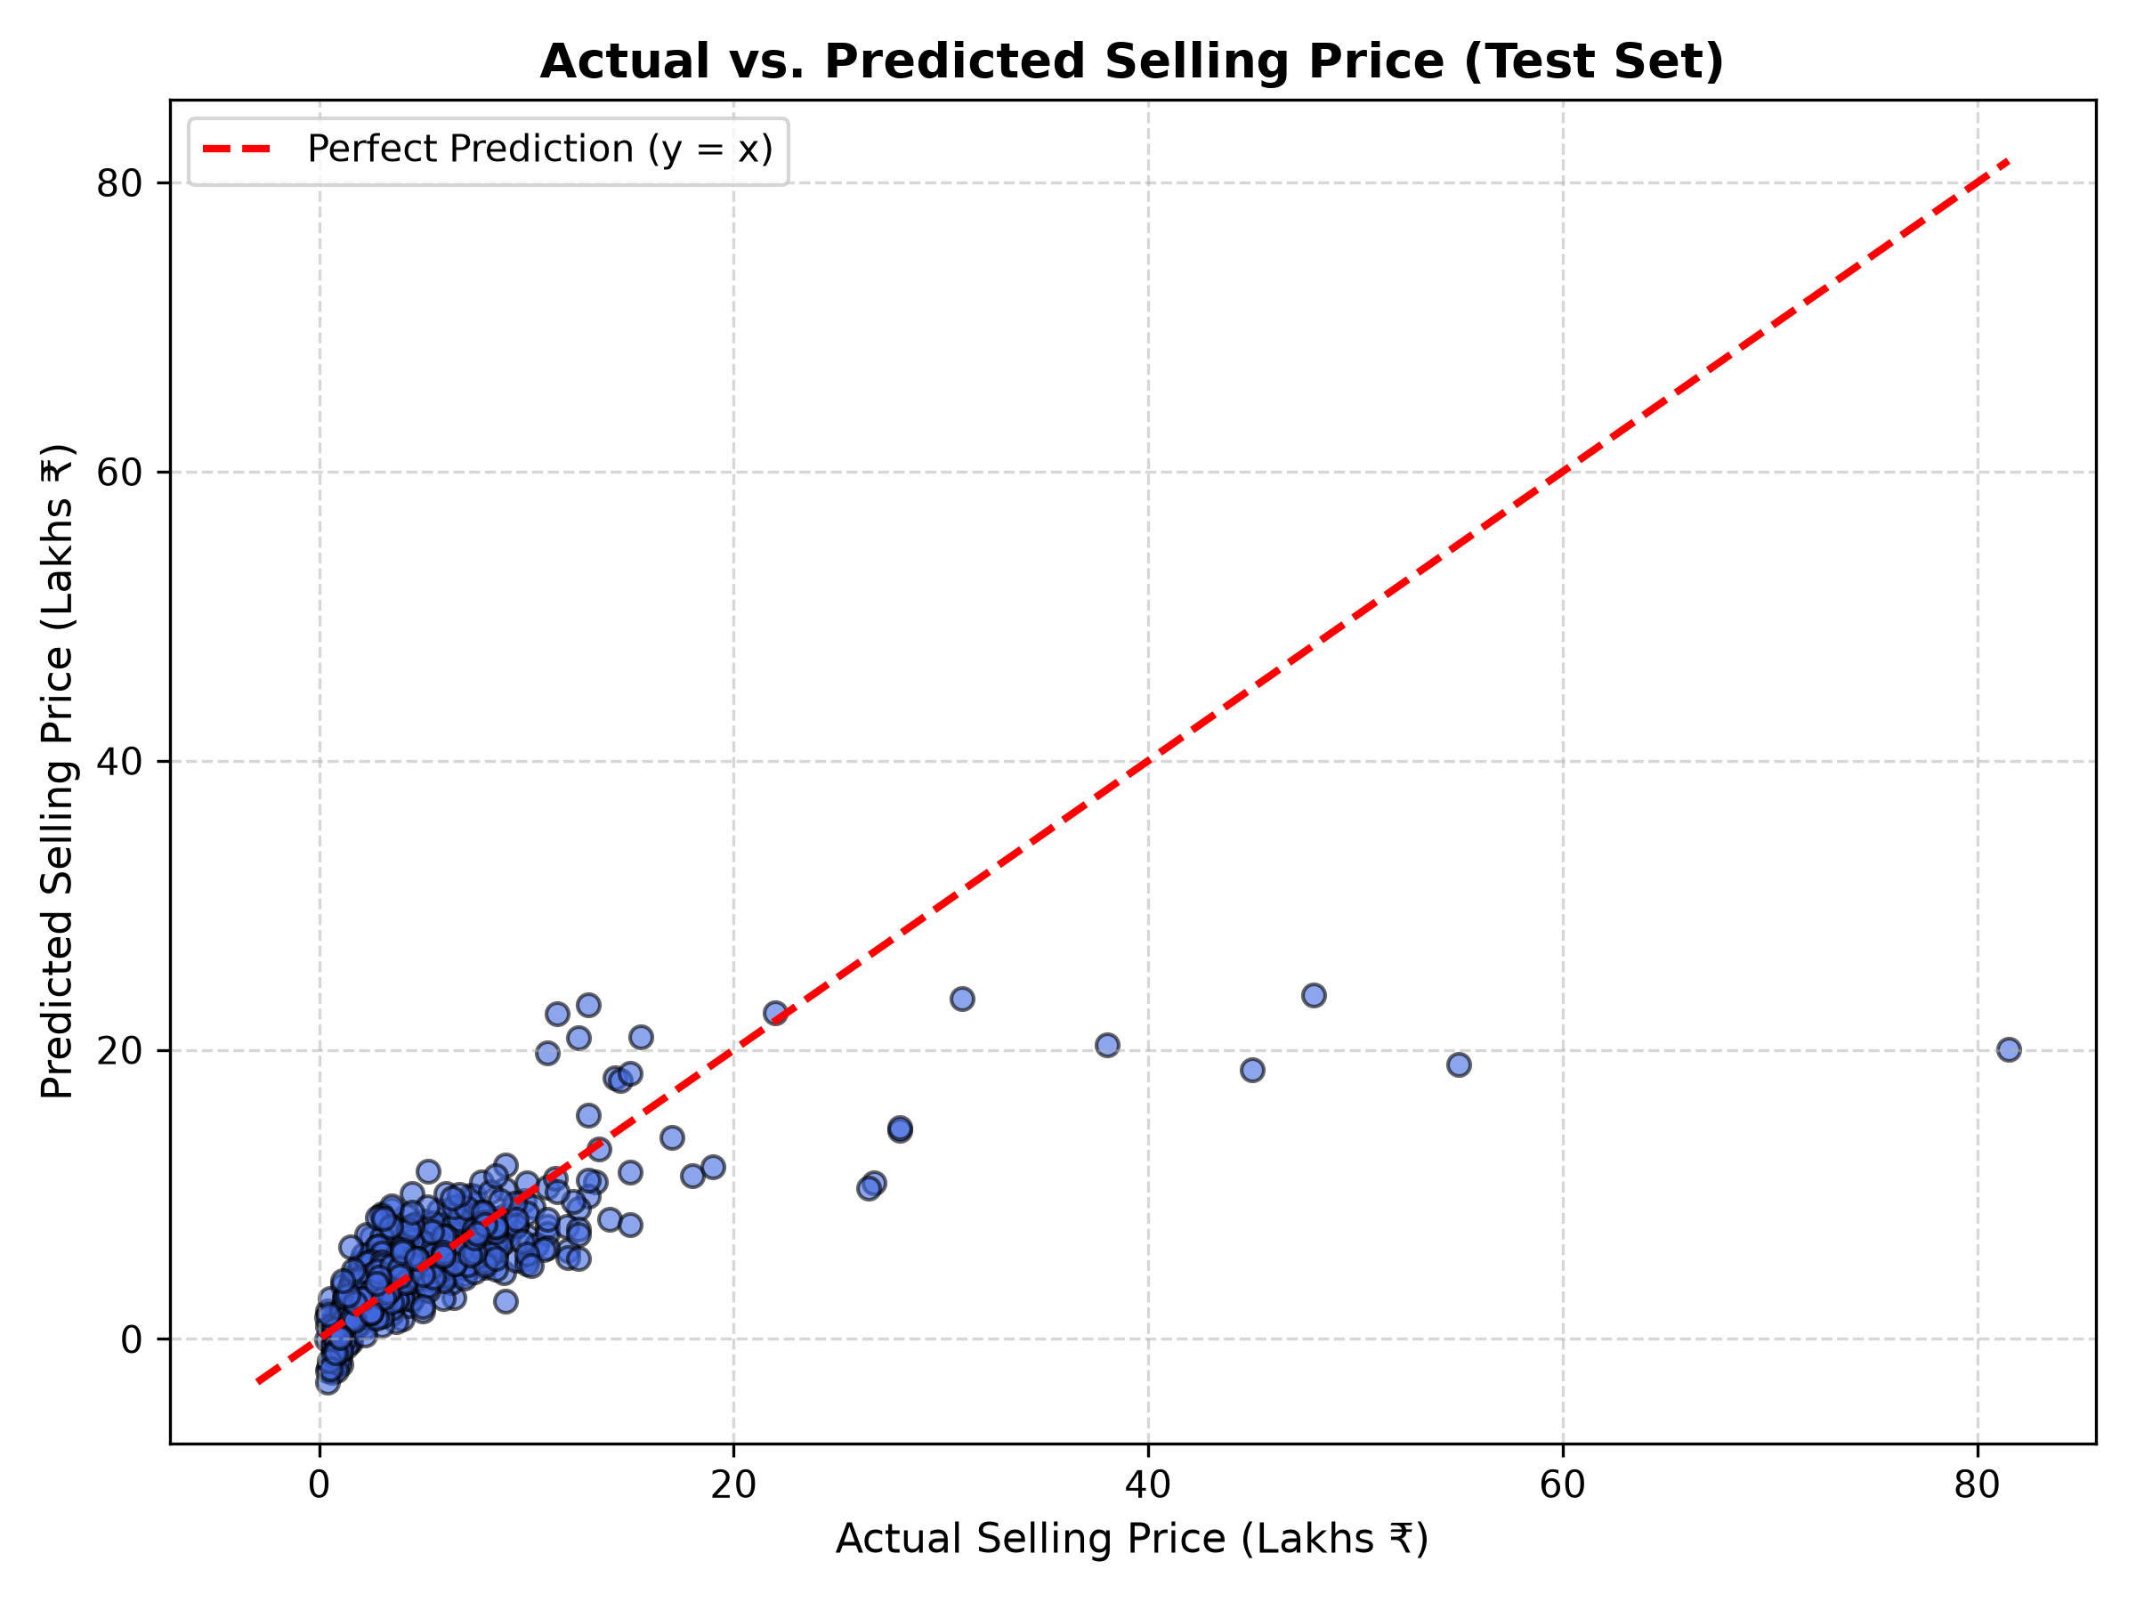
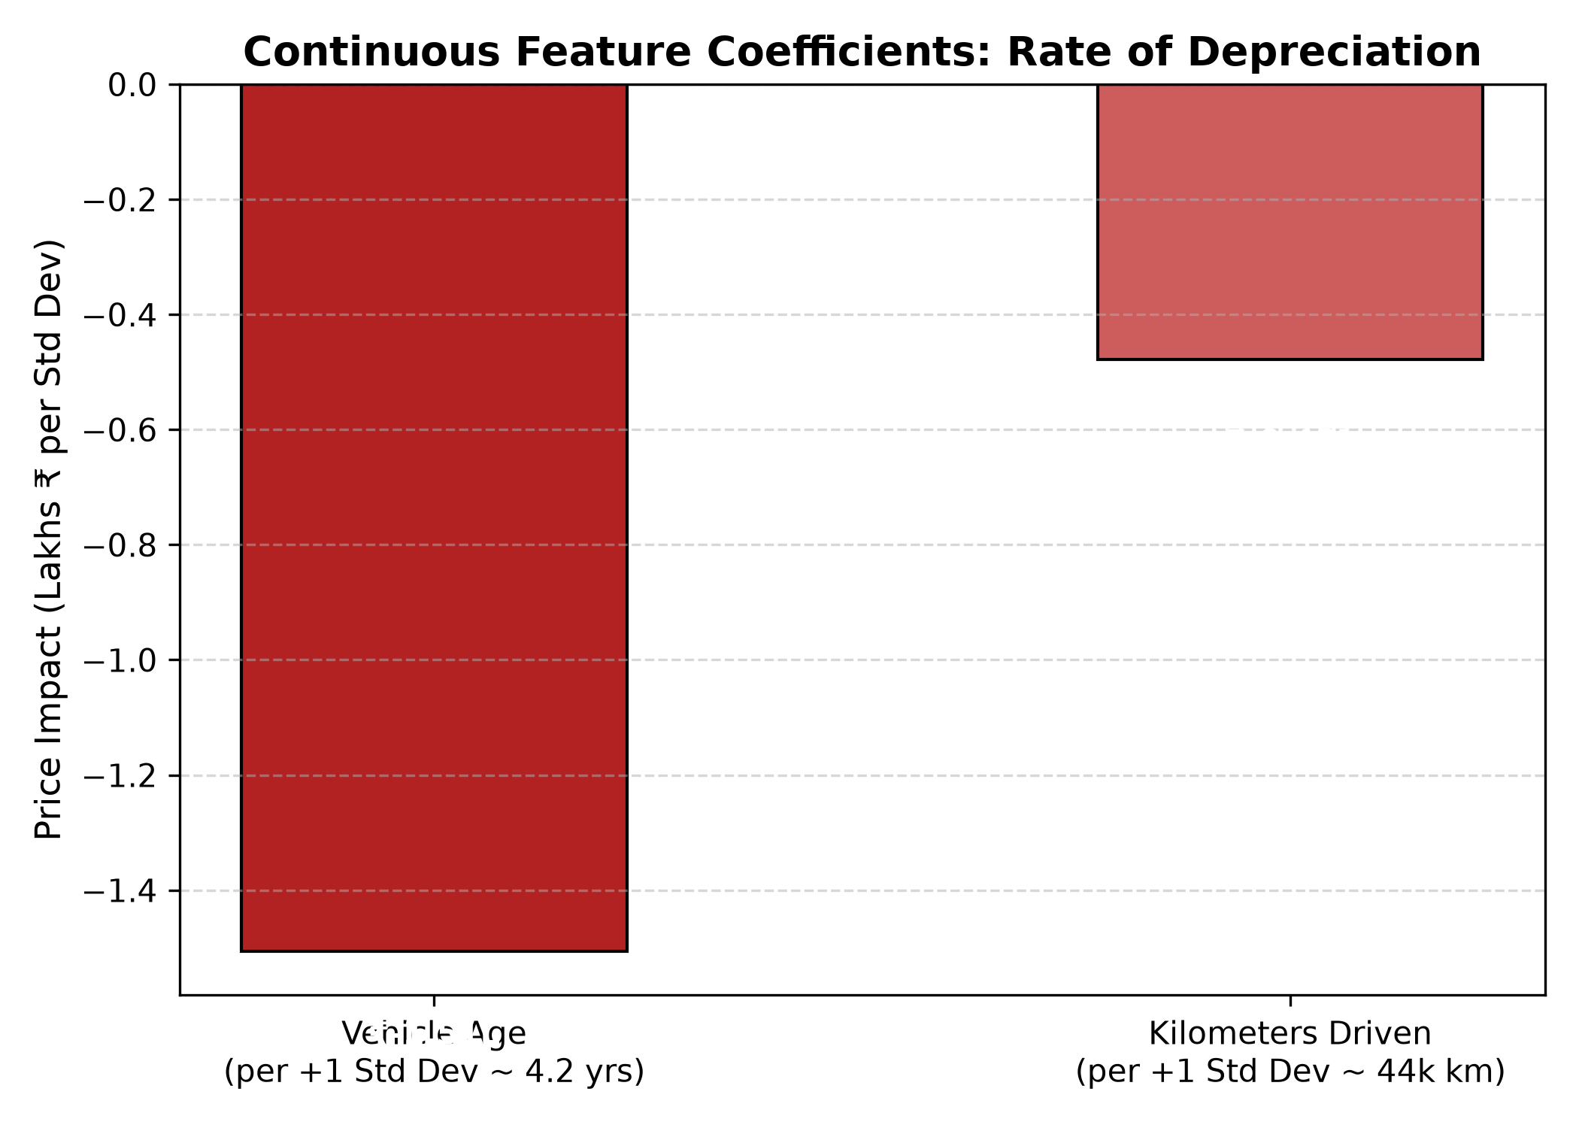
Model Evaluation: Quantitative Metrics and Diagnostic Visualizations
Evaluated on held-out test partition of 716 unseen cars (80/20 train-test split, random_state=42).
MEAN ABSOLUTE ERROR (MAE)
ROOT MEAN SQUARED ERROR (RMSE)
COEFFICIENT OF DETERMINATION (R²)
₹1,79,642
₹3,84,723
0.5405
Test split MAE · Train: ₹1,62,856 (Gap: +₹16,786)
Test RMSE · Train: ₹2,87,437 (Gap: +₹97,286)
Test R² · Train R²: 0.6608 (Gap: -0.1203)
Actual vs. Predicted Price (Test Set)
Depreciation Rate: Vehicle Age vs. Mileage
Model Interpretation & Diagnostics
Noticeable Generalisation Gap: R² drops from 0.6608 (train) to 0.5405 (test, Δ=-0.1203) and RMSE widens from ₹2.87L to ₹3.85L (+₹97.3k), indicating noticeable performance drop on unseen data.
Base Intercept: ₹10,42,435.48 (model-estimated reference price at standardized mean predictor values).
Luxury Outlier Sensitivity: Squared errors heavily penalize multi-million rupee luxury car residuals, elevating test RMSE.
Residual Distribution: Residuals are centred approximately around zero overall, with a right-skewed tail indicating larger errors for some high-priced vehicles.
Scatter aligns with red dashed line (y = x); error dispersion widens for luxury vehicles (> ₹25 Lakhs).
Standardised comparison: age penalises price 3.15× more per std dev (-₹1.51L / 4.2y) than mileage (-₹0.48L / 44k km).
Notes:
Examining our evaluation metrics on the held-out test set: the model achieved an R-squared of 0.5405, explaining over 54% of market price variation on completely unseen vehicles. Importantly, we observe a noticeable generalization gap between train and test splits: R-squared drops from 0.6608 on training to 0.5405 on test, and RMSE increases from ₹2,87,437 to ₹3,84,723, largely driven by high variance and quadratic penalties on luxury vehicle outliers. Test MAE is ₹1,79,642 versus ₹1,62,856 on training. In our coefficient analysis, comparing standardized predictors reveals that vehicle age has a 3.15 times greater penalty per standard deviation than mileage. Residuals are centred approximately around zero overall, with a right-skewed tail indicating larger errors for some high-priced vehicles.

Slide 5
Conclusion, Limitations, Contributions & AI Disclosure
KEY EMPIRICAL FINDINGS
GENUINE TECHNICAL LIMITATIONS
TEAM CONTRIBUTIONS & ROLES
Age vs. Mileage (Standardised): Per standard deviation of variation, vehicle age carries a 3.15× larger price penalty (-₹1,50,691 / 4.2 yrs) than odometer mileage (-₹47,754 / 44k km), reflecting normalized dataset variance rather than raw per-year vs. per-km rates.
Brand Equity Associations: Relative to baseline brands, luxury European marques exhibit strong positive model associations (e.g. Land Rover +⁠₹23.35L, Volvo +⁠₹12.37L, Audi +⁠₹10.28L), whereas budget marques exhibit negative relative offsets.
Specification Associations: Controlling for other factors, automatic transmission (+⁠₹3.34L over manual) and diesel fuel (+⁠₹2.79L over petrol) are positively associated with price. These represent linear conditional associations, not guaranteed market premiums or causal effects.
Noticeable Generalisation Gap: While data leakage was eliminated, evaluation reveals a noticeable performance drop on unseen test data (R²: 0.6608 → 0.5405; RMSE: ₹2.87L → ₹3.85L), driven by luxury car dispersion.
Linear Depreciation Assumption: Ordinary Least Squares assumes constant annual depreciation, whereas real automobile valuation decays exponentially (steepest in early years 1–3).
Luxury Outlier Sensitivity: Squared-error loss disproportionately penalizes multi-million rupee luxury vehicles, inflating test RMSE (₹3.85L) well above test MAE (₹1.80L).
Unconstrained Linear Predictions: Standard Linear Regression does not enforce non-negativity constraints; for extreme combinations of advanced age and high mileage, the unconstrained linear hyperplane can extrapolate to unphysical negative selling prices (ŷ < 0).
Omitted Confounders & Non-Causality: The dataset lacks vehicle cosmetic condition, accident history, maintenance logs, and registration city tier, precluding causal interpretations.
Siddharth Kumar (Execution Lead): ML pipeline architecture, ColumnTransformer integration, model training & plotting scripts.
Divyaans Agarwal (Video Lead): Project video walkthrough recording, presentation timing & submission media.
A Damaruk Vajra Tej (PPT Lead): Slide architecture, narrative structure, technical synthesis, metric validation & design.
Nihal Ahirwar (Documentation Lead): Comprehensive README writeup, repository structure & experimental results cataloging.
AI-Use Disclosure
Gamma: Used to create and design the presentation.
ChatGPT: Used for project-related guidance, analysis assistance and presentation review.
Claude: Used for reviewing and refining the final presentation.
Gemini 3.8 Flash: Used for formatting the initial README.md and creating the ASCII representation in main.py.
The team reviewed and verified AI-assisted content against the actual project code, dataset and model results.
Empirical statistical associations derived from 43 learned OLS regression coefficients.
Highlights structural boundary constraints of linear regression on secondary automotive data.
Notes:
In conclusion: our empirical evaluation reveals key associations in used car valuation. Comparing standardized predictors, vehicle age carries a 3.15 times larger penalty per standard deviation than mileage. Brand equity and specifications show strong positive conditional associations with price, notably for European luxury marques, automatic gearboxes, and diesel powertrains, though these are statistical associations rather than causal guarantees. Key limitations include a noticeable generalization gap, quadratic outlier sensitivity, the linear assumption over exponential curves, and unconstrained linear predictions that can output negative values for extreme cases without post-hoc clipping. Each team member held clear ownership across execution, video, presentation, and documentation. In accordance with course guidelines, our AI tool usage disclosure is pending team confirmation before submission. Thank you.

