Slide 1
AI101 MINI-PROJECT · IIT ROPAR · GROUP 1
IPL Match Winner Prediction
At the innings break, can a model tell who will win?
Logistic Regression on 1,218 IPL matches (2008–2026), predicting whether the team batting first wins from its score, wickets, the teams and the venue.
Mannat
Execution Lead
2026AIB1055
Yatharth Garg
Documentation Lead
2026ESB1501
Ankit Bassi
Documentation Lead
2026EEB1320
Yash Meena
PPT Lead
2026EEB1426
Alankrit Tripathi
Video Lead
2026MCB1508
GitHub repository github.com/2026aib1055/ipl-match-winner-prediction

Slide 2
Who wins, judged at the innings break?
SLIDE 2 · PROBLEM AND DATA
What we predict
Feature | Meaning
target_runs | Runs scored by the team batting first
target_wkts | Wickets it lost
runs_vs_avg | Score minus average of previous 60 matches
bat_first, chase | The two teams (one-hot encoded)
venue | Stadium (one-hot encoded)
bat_first_won | Target: 1 = batting-first team won
Does the team batting first win? A yes/no (binary classification) problem, answered using only what is known when the first innings ends.
Why it matters
Shows how much the first innings decides a T20 match, and gives fans and broadcasters a win-probability estimate at the break.
Dataset
IPL 2008–2026 Matches Dataset (Kaggle)
1,243 matches × 31 columns → 1,218 after removing no-result matches. Included in the repo as data/matches.csv.
Not used: second-innings score, win margin and player of the match. They are only known after the match, so using them would give the answer away.

Slide 3
From raw matches to a win probability
SLIDE 3 · APPROACH
1
2
3
4
5
Clean
Build features
Split by time
Scale + select
Train model
›
›
›
›
Merge renamed franchises, drop no-result matches, sort by date
Find who batted first from the toss; runs, wickets, runs vs recent average
Oldest 80% (974) to train, newest 20% (244) to test
StandardScaler and SelectKBest (k = 15), fitted on training data only
Logistic Regression (C = 0.1) → probability the batting side wins
Libraries
Why split by time?
Python 3.10+ · pandas (data) · scikit-learn (scaling, feature selection, model, metrics) · Matplotlib and Seaborn (charts) · Jupyter
The model is tested only on newer matches, just like predicting a real future game.

Slide 4
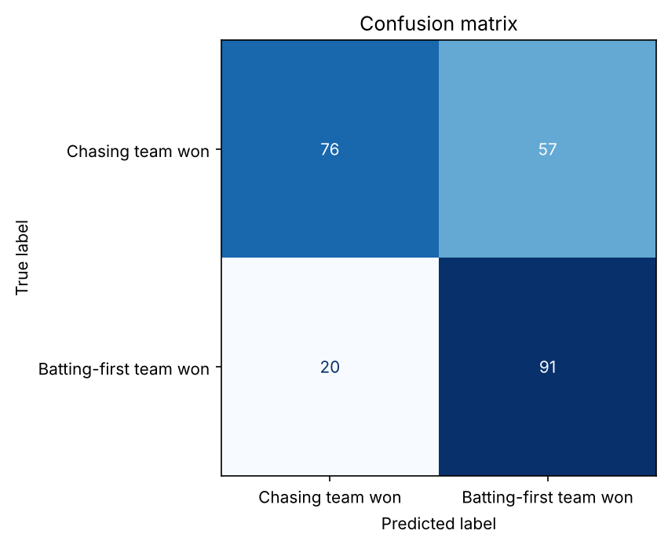
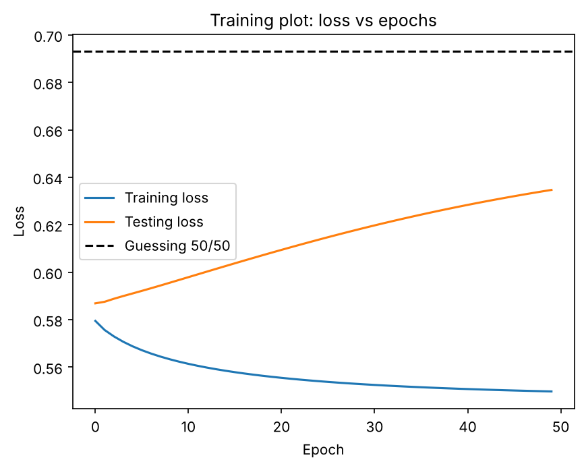
68% accurate: about 14 points better than guessing
SLIDE 4 · RESULTS AND DEMO
68.4%
test accuracy (244 newest matches)
Baseline | 54.5%
Precision | 0.62
Recall | 0.82
F1 score | 0.70
ROC-AUC | 0.77
MSE / MAE / RMSE | 0.21 / 0.39 / 0.46
Demo: CSK bat first vs MI at Wankhede → CSK win chance
140/8 → 20% 185/6 → 56% 220/4 → 82%
Most errors are chasing wins predicted as batting-first wins. Mild overfitting: test loss rises slightly but stays below the 50/50 line.

Slide 5
What we learned and who did what
SLIDE 5 · LEARNINGS, CONTRIBUTIONS, AI USE
What worked
What didn't
Next steps
Contributions
A simple, explainable model beats the baseline by ~14 points. First-innings runs and runs-vs-average are the strongest signals.
A bug trained the model on unscaled data, so the demo gave nonsense; fixing it gave sensible predictions. Chasing wins are still hard to predict.
Add player stats, recent team form and mid-chase data; compare with Random Forest or XGBoost.
Mannat: code pipeline, cleaning, execution
Yatharth & Ankit: README, setup steps, docs
Yash: presentation slides
Alankrit: video script and editing, scaling-bug fix, README updates
AI-use disclosure
Claude: coding help, and finding and fixing the scaling bug (we re-ran the notebook and checked the results). ChatGPT: README drafting. Gemini: slide templates. No AI was used to generate the data or the results; the team reviewed everything and can explain every part.

