Slide 1
AI101 MINI PROJECT • GROUP 74
Loan Eligibility
Prediction
Predicting whether a loan application is likely to be approved
using a Logistic Regression classification model.
TEAM MEMBERS
Tanush Metla • Neil Patil • Abhinav Karoli • Devnandan Menon
GitHub: https://github.com/2026aib1062-creator/loan-eligibility-prediction-project-grp74.git
AI101 Mini-Project

Slide 2
Problem & dataset
What the project predicts and the data used
THE PROBLEM
DATASET SNAPSHOT
To predict loan approval eligibility based on applicant financial and demographic profile
614
13
original records
columns
The model learns patterns from previous loan applications and classifies an application as approved (Y) or not approved (N) using logistic regression
502
11
rows after cleaning
model input features
Goal: support a consistent, data-driven first-pass assessment.
Source: Kaggle – Eligibility Prediction for Loan
https://www.kaggle.com/datasets/devzohaib/eligibility-prediction-for-loan
02

Slide 3
Approach & model pipeline
From raw application data to a loan-status prediction
01
02
03
04
05
CLEAN DATA
PREPARE FEATURES
SPLIT DATA
SCALE + TRAIN
PREDICT
Drop ID/Gender; remove rows
missing selected fields;
convert Dependents
One-hot encode
categorical columns using the get_dummies() function;
separate X and y
Stratified split:
67% train / 33% test
(random_state = 100)
StandardScaler;
Logistic Regression
(max_iter = 100)
Predict test labels;
calculate precision,
recall and F1-score
LIBRARIES
Pandas • NumPy • Matplotlib • Scikit-learn
Output: predicted loan status (Y / N) for each record in the test set.
03

Slide 4
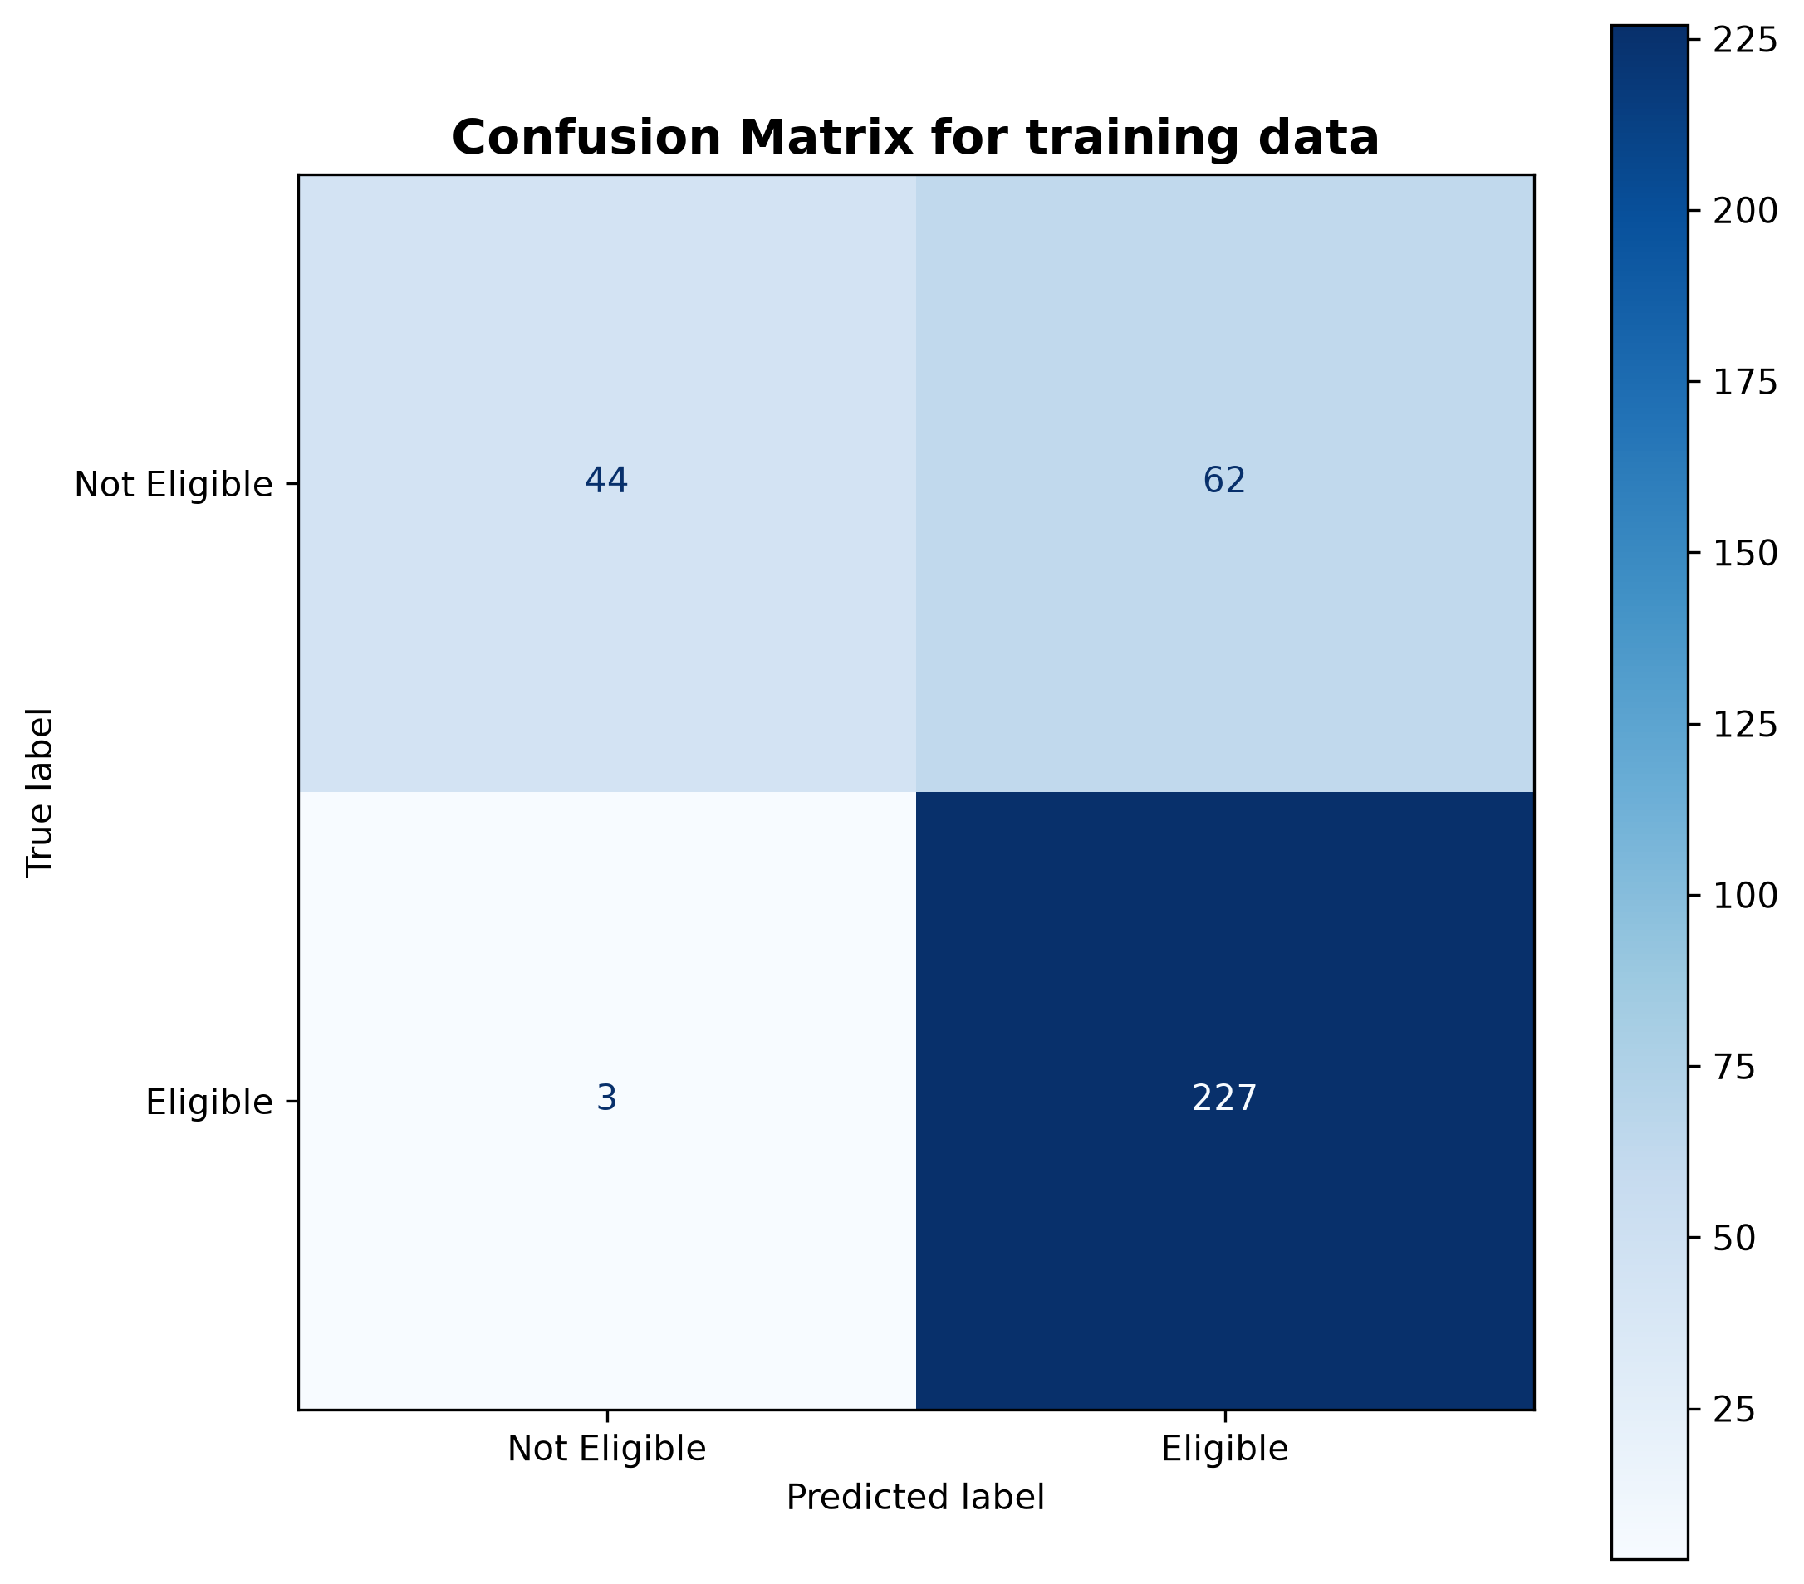
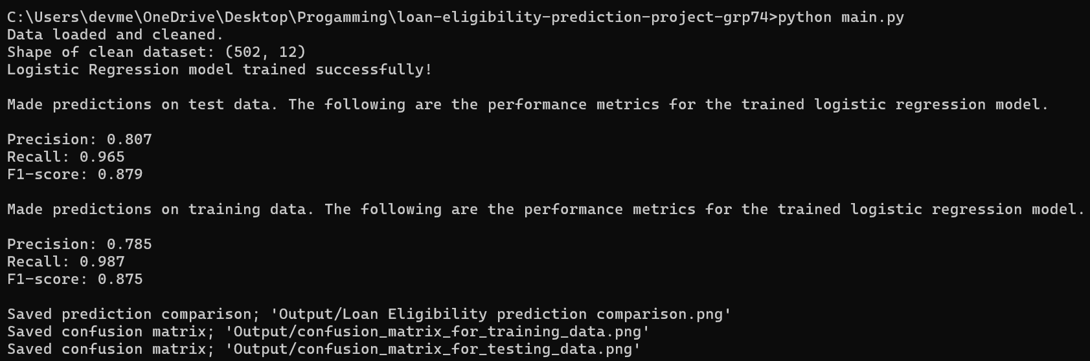
Results
The Confusion Matrix of the model performance on testing data
The Model Performance Metrics on the training data
Precision: 0.785
Recall: 0.987
F1-score: 0.875
The Model Performance Metrics on the testing data
Precision: 0.807
Recall: 0.965
F1-score: 0.879
Screenshot of the output:

Slide 5
Learnings & team contributions
What the team practiced while building the classifier
WHAT WE LEARNED
WHO DID WHAT
Tanush Metla
• Data cleaning is essential before model training.
• Categorical variables must be encoded for the model.
• A stratified train/test split helps preserve class proportions.
• Scaling and Logistic Regression form the core modelling pipeline.
• Precision, recall and F1-score provide different views of model performance.
PPT lead; assigned comparison/bar-graph code
Neil Patil
Documentation lead; assigned data cleaning and model training/prediction. Created the README.md file
Abhinav Karoli
Video lead; assigned train/test split and model analysis
Devnandan Menon
Execution lead; Created the requirements.txt file. Plotted the confusion matrix. Cleared the bugs in the program
AI-use disclosure
AI was used for graphing the performance metrics,to create organised slide and taken reference for making REAME.md file
05

