Slide 1
GROUP 76 | AI101 MINI-PROJECT
Predicting Product Sales via Multi-Channel Advertising Spend
TV, Radio and Newspaper channels: a Machine Learning approach
Vedansh Singla
Kallem Srivarsha
Jatin
Deepanshu Chahal
2026AIB1092
2026AIB1046
2026EEB1359
2026MCB1524
PPT Lead
Video Lead
Documentation Lead
Execution Lead
Repo: https://github.com/2026aib1092-hash/Mini-Project-Group-76.git
School of AI and Data Engineering, IIT Ropar

Slide 2
2
Problem and Data
What and why
Dataset
Predict product sales from the advertising budget spent on TV, Radio and Newspaper.
Helps decide how to split a marketing budget across channels.
Shows which channel actually drives sales, so spend is not wasted.
Task type: supervised regression (numeric target).
Kaggle: Advertising Sales Dataset (yasserh)
Size: 200 rows, 4 numeric columns
Budgets in thousands of dollars
Columns
TV
Radio
Newspaper
Sales
Input
Input
Input
Target
Split: 80% train / 20% test (random_state = 42)
School of AI and Data Engineering, IIT Ropar | AI101 Mini-Project | Group 76
2

Slide 3
3
Approach
DATA
MODEL
OUTPUT
Load CSV (200 rows)
Drop index column
0 missing values
X: TV, Radio, Newspaper
y: Sales
80/20 split (160 / 40)
Median imputer
SelectKBest (k = 3)
StandardScaler (fit on train)
Multiple Linear Regression
Trained on 160 rows
Predicted sales
R², MSE, RMSE, MAE
Confusion matrix, precision, recall, F1 score
Plots + demo prediction
Libraries used
pandas
NumPy
scikit-learn
matplotlib
os
load & clean data
arrays, median
model & metrics
scatter plots
CSV file path
sklearn modules: LinearRegression · train_test_split · SimpleImputer · SelectKBest · StandardScaler · metrics
School of AI and Data Engineering, IIT Ropar | AI101 Mini-Project | Group 76
3

Slide 4
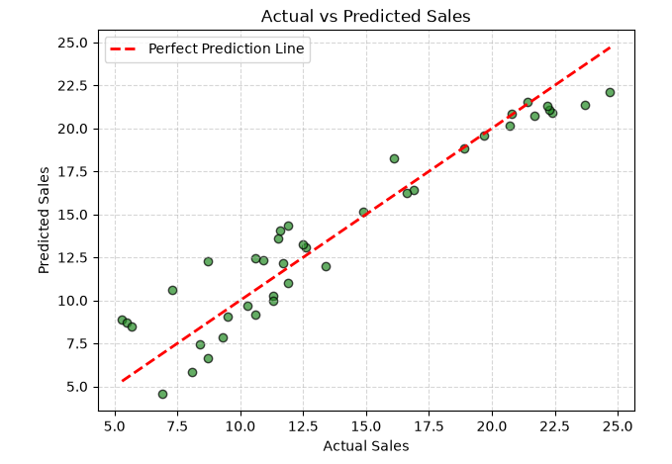
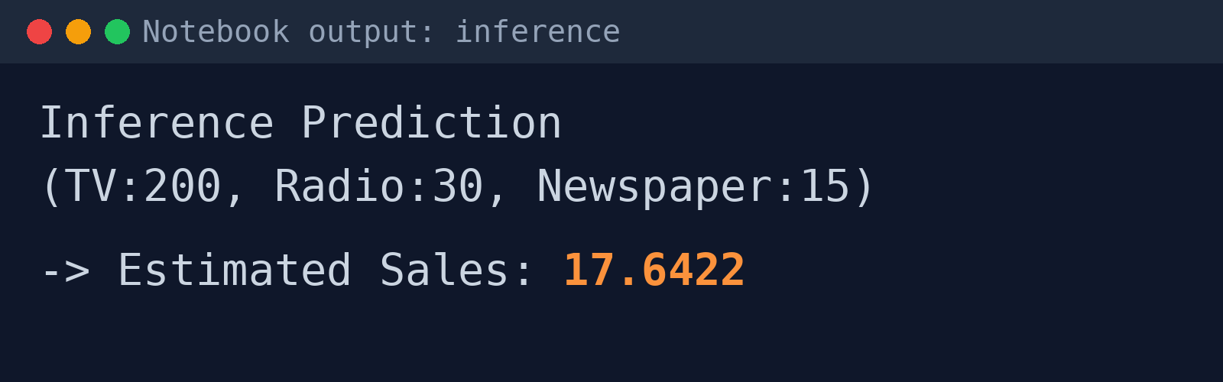
4
Results
Confusion matrix
0.8994
High vs low sales, median cut-off
Pred. low
Pred. high
Actual low
14
TN
6
FP
R² score (test set)
Regression error
Actual high
1
FN
19
TP
MSE
RMSE
MAE
3.1741
1.7816
1.4608
Demo prediction
Classification metrics
Learned coefficients
0.8250
Accuracy
0.7600
Precision
Intercept
TV
Radio
Newspaper
14.1000
3.7642
2.7923
0.0560
0.9500
Recall
0.8444
F1 score
Predicted sales for TV 200, Radio 30, Newspaper 15
on standardised inputs
n = 40 test rows. High/Low split at the test median (positive = high). Run on the Kaggle Advertising Sales dataset.
School of AI and Data Engineering, IIT Ropar | AI101 Mini-Project | Group 76
4
Notes:
All numbers are copied from the latest notebook run (200 rows, 160 train / 40 test, random_state = 42), which loaded the real Kaggle Advertising Budget and Sales CSV. Regression: R2 0.8994, MSE 3.1741, RMSE 1.7816, MAE 1.4608. Coefficients are on standardised inputs (intercept 14.1000; TV 3.7642, Radio 2.7923, Newspaper 0.0560). Demo prediction for TV 200, Radio 30, Newspaper 15 = 17.6422. Classification metrics come from converting sales to High/Low at the test-set median (positive = high sales): confusion matrix [[14, 6], [1, 19]], accuracy 0.8250, precision 0.7600, recall 0.9500, F1 0.8444. Correlation with Sales: TV 0.7822, Radio 0.5762, Newspaper 0.2283. The demo panel is a rendering of the notebook output.

Slide 5
5
Learnings
What worked
What didn't
AI-use disclosure
R² = 0.90: the model explains ~90% of the variation in sales
High/low accuracy 0.825, F1 0.84
TV is the strongest driver (corr. 0.78), then Radio (0.58)
Newspaper adds very little (corr. 0.23, coef. 0.06)
Precision 0.76: 6 of 25 high-sales calls were wrong
Imputer and feature selection changed nothing: no NaNs, all 3 features kept
AI tools were used for code assistance and to prepare these slides.
Slides were then edited by Vedansh.
Results were updated from the final notebook run.
Who did what
Vedansh Singla
Kallem Srivarsha
Jatin
Deepanshu Chahal
PPT Lead: built the presentation and coordinated
Video Lead: demo video
Documentation Lead: README and report
Execution Lead: ran the code and results
School of AI and Data Engineering, IIT Ropar | AI101 Mini-Project | Group 76
5

