Slide 1
STARTUP PREDICTION
Predicting whether a Startup will be acquired or shut down
Team Number: 14
Team members: Prameya Krishn - Documentation Lead
Veronica Silvery - PPT Lead
Meesala Jyothi Prakash - Video Lead
Rohit Raj - Executive Lead
GitHub Repository: https://github.com/2026dab1301-pKrishn/AI_101_Final_Project_Group-14

Slide 2
PROBLEM STATEMENT & DATASET
THE PROBLEM:
Startups face uncertainty about their future outcomes. Some startups are acquired by other companies, while others shut down.
OUR OBJECTIVE:
To develop a machine learning model that predicts whether a startup will be acquired or closed using historical investment information.
.
DATASET INFORMATION:
Dataset: Startup Investments Analysis
Source: Hugging Face
Original source: Crunchbase (via Kaggle)
Records: 4,757
Total columns: 23
Target variable: status
1 = Acquired
0 = Closed

Slide 3
PROJECT APPROACH
01
DATASET
Startup data
02
INSPECTION
Explore data
03
ANALYSIS
Visualise patterns
04
MODEL
Logistic
Regression
05
OUTPUT
Predicted Status
DATA → INSPECTION → ANALYSIS → MODEL → OUTPUT
TECHNOLOGIES USED:
Python - Pandas - Numpy - Matplotlib - Seaborn - Scikit-Learn

Slide 4
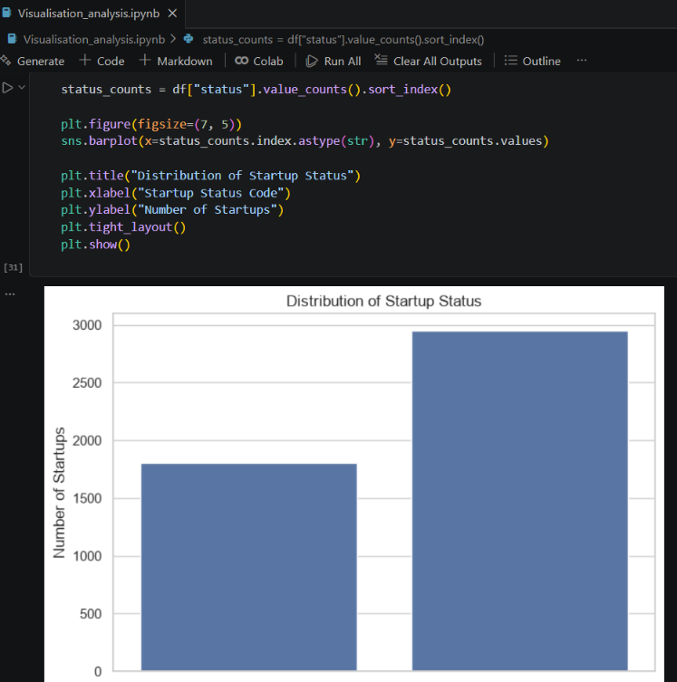
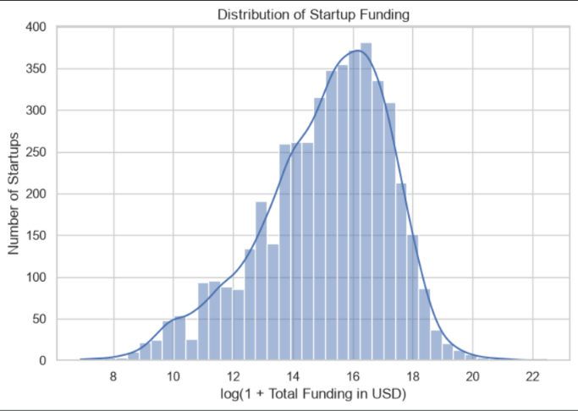
RESULTS & ANALYSIS
MODEL PERFORMANCE:
Training accuracy: 61.97%
Testing accuracy: 61.97%
Precision: 38.41%
F1-score: 47.43%

Slide 5
LEARNINGS & CONCLUSION
WHAT WE LEARNED:
Data visualisation helps us understand patterns in startup data.
Funding distribution is uneven across startups.
Logistic Regression gave us a baseline for predicting startup outcomes
WHAT WORKED:
Pandas helped us inspect and organise the dataset.
Visualisations helped us explore startup status and funding patterns
WHAT DIDN’T:
The Logistic Regression model struggled to identify startups in status class 0.
The model's F1-score was 47.43%, showing that its predictions had limitations.
AI USE DISCLOSURE : AI tools were used for guidance, code assistance, and presentation preparation. The team reviewed and adapted the outputs for the project.

