Slide 1
Movie Recommender
AI101 MINI-PROJECT | TEAM NO. 44
MEMBERS & ROLES
Aadarsh Kumar
1
Entry No: 2026EEB1309
EXECUTION LEAD
Ankush Chaudhary
2
Entry No: 2026AIB1017
A genre-based movie recommender using Logistic Regression and Jaccard similarity on Netflix titles.
DOCUMENTATION LEAD
Aryan Rahul Bachchhav
3
Entry No: 2026MCB1517
VIDEO LEAD
GITHUB REPO
Abhinav Mishra
https://github.com/2026eeb1309/AI101-Mini-project.git
4
Entry No: 2026DAB1289
PPT LEAD

Slide 2
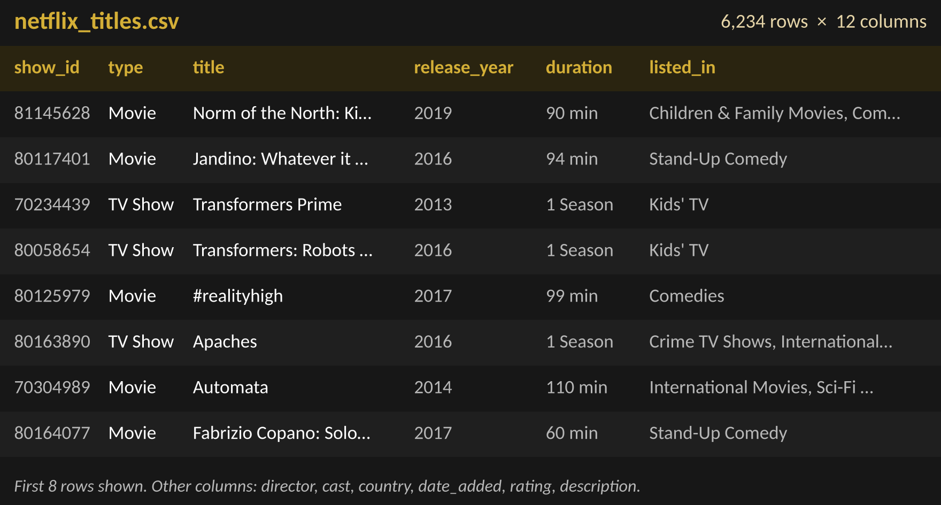
Problem & Data
What we are solving, why it matters, and the dataset behind it
THE PROBLEM: WHAT AND WHY
FIRST ROWS OF THE DATASET
What: given one movie a user likes, suggest 5 other movies they may enjoy.
Why: Netflix has thousands of titles, so finding similar ones by scrolling is slow. Genre is the clearest signal in the data, so we use it to match movies.
Task: Logistic Regression learns Movie vs TV Show from genres (binary classification); Jaccard genre similarity then ranks the closest movies.
DATASET
SOURCE
Kaggle: Netflix titles (netflix_titles.csv)
kaggle.com/code/abhichoudhury/a-simple-movie-recommender
SIZE
6,234 titles: 4,265 Movies and 1,969 TV Shows, released 1925 to 2020.
6,234
12
1925-2020
COLUMNS
12 columns: show_id, type, title, director, cast, country, date_added, release_year, rating, duration, listed_in, description.
TITLES
COLUMNS
RELEASE YEARS

Slide 3
Approach
Pipeline: data → model → output, and the libraries we used
1
DATA
2
MODEL
3
OUTPUT
Netflix titles dataset from Kaggle: 6,234 rows.
Clean it: remove duplicates, drop missing values, fix types.
Turn genres into 0/1 columns with MultiLabelBinarizer: 42 genres + release_year = 43 features.
Split 80% train / 20% test (stratified).
SelectKBest (chi-square) keeps the best 15 genres.
StandardScaler, then Logistic Regression (balanced classes, max_iter = 1000).
Movie / TV Show label with a probability: 99.04% accuracy.
Jaccard genre similarity, movies only.
Top 5 similar movies for the chosen movie.
LIBRARIES USED
pandas
numpy
matplotlib
seaborn
scikit-learn
load and clean the data
numbers and RMSE
charts and curves
heatmaps and bar plots
split, select, scale, model, metrics

Slide 4
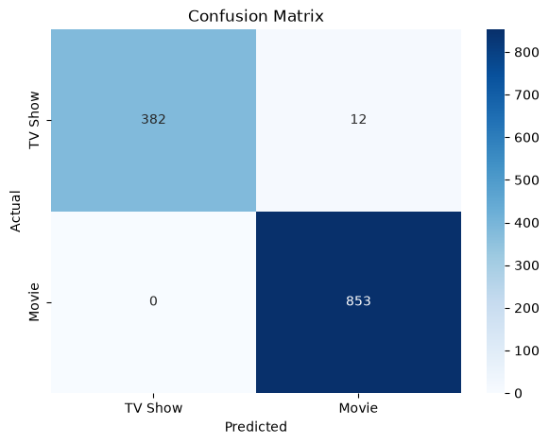
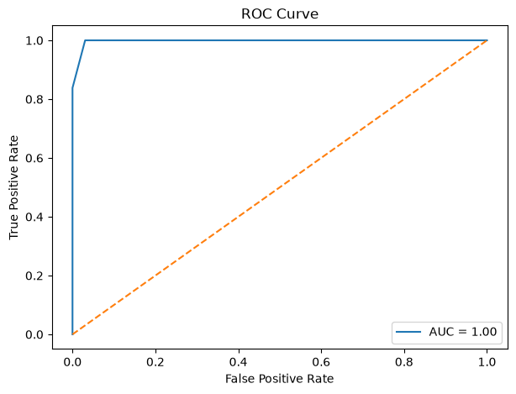

Results
Key charts, key numbers and a demo of the recommender
CONFUSION MATRIX
ROC CURVE
KEY NUMBERS (TEST SET)
99.04%
98.61%
Accuracy
Precision
100%
99.30%
Recall
F1 score
DEMO: recommend_movies("The Conjuring", 5)
0.9975
0.096
ROC AUC
RMSE
Only 12 of 1,247 test titles were misclassified, and no Movie was missed.

Slide 5
Learnings
What worked, what didn’t, who did what, and our AI-use disclosure
WHAT WORKED
WHO DID WHAT
Genres alone separate Movies from TV Shows: 99.04% accuracy, AUC 0.9975.
Fitting feature selection and scaling on training data only avoided data leakage.
Balanced class weights handled 4,265 Movies vs 1,969 TV Shows.
Jaccard similarity gave sensible picks (The Conjuring → Gothika, Cabin Fever).
Aadarsh Kumar
EXECUTION LEAD
Code execution and results
Ankush Chaudhary
DOCUMENTATION LEAD
README and documentation
Aryan Rahul Bachchhav
VIDEO LEAD
Project demo video
Abhinav Mishra
PPT LEAD
This presentation
WHAT DIDN’T
Logistic Regression only predicts Movie vs TV Show; the recommendations come from the Jaccard step.
Many movies tie at similarity 1.0, so the top 5 are not truly ranked.
Only genres are used (no ratings or user history), so it is not personalised.
release_year did not make the top 15 features, and the title must be typed in full.
AI-USE DISCLOSURE
Some parts of the notebook were written with the help of AI, as they were beyond our current level. The statistics part and the Logistic Regression part were written by us. This PPT was made with AI, but the prompt for the theme and content came from Group-44.

