Slide 1
Engineering Student Placement Analysis
How CGPA, internships, stream and backlog history relate to placement
2,966
55.3%
6
students in dataset
placed overall
engineering streams
Dataset: Engineering Placements Prediction (placements.csv) | Source: Kaggle
Team: Tashvi Garg, Rishabh Rajput, Arjun Solanki, Shreyansh
Notes:
Introduce the question and the dataset (Engineering Placements Prediction, from Kaggle).

Slide 2
CGPA and internships track with placement
Every student with CGPA 8 or 9 is placed; at 7 or below it is under a third. Two internships lift placement to about 81%, up from 49% with none. Data check: no missing values, but 1,829 rows are repeats.
Notes:
Member 1. CGPA 8+ shows 100% placement, a very sharp cut-off. Mention duplicates.

Slide 3
Stream matters more than backlog history
55.8%
No backlog history
2,396 students, 1,337 placed
53.0%
Has backlog history
570 students, 302 placed
Electronics, IT and CS lead (58 to 59%); Civil and Mechanical trail by about 12 points. Backlog history costs only about 3 points.
Notes:
Member 2 (Rishabh). Stream gap is about 13 points between best and worst; backlog gap is under 3. Same pattern holds after removing repeated rows.

Slide 4
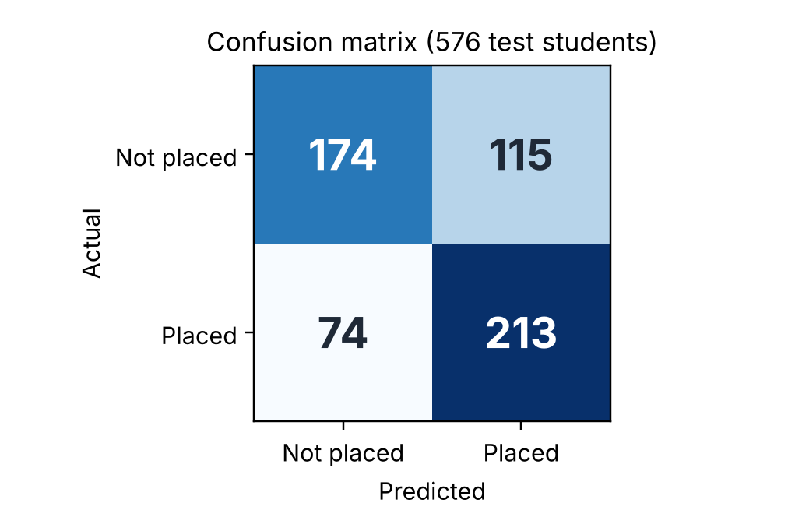
Logistic regression: method and results
How we built it
Results
1
Inputs: Age, gender, stream, internships, CGPA, hostel, backlog history
Metric | Model | Always guess most common
Accuracy | 67.2% | 50.2%
Precision | 64.9% | 0.0%
Recall | 74.2% | 0.0%
F1-score | 69.3% | 0.0%
2
Preparation: Gender and stream turned into yes/no columns; numbers put on a similar scale
3
Split: 2,390 records to train, 576 to test; matching profiles kept together
115 wrongly predicted placed; 74 placed students missed
4
Output: Predicts placed (1) or not placed (0), checked by Member 4
Beats always guessing by 17 points of accuracy (67.2% vs 50.2%).
Notes:
Members 3 and 4. Results from Member 4 notebook (columns corrected). Baseline accuracy is the share of real not-placed students, 289 of 576.

Slide 5
What we found and what to keep in mind
Findings
Limitations
CGPA 8+ is linked to 100% placement
2 internships: about 81% placed
Stream gap: up to 13 points
Backlog history: only about 3 points
Patterns, not proof: no factor guarantees placement
62% of rows are repeats; unique-row results agree
Data is one source, with few columns
AI use: Member 1 ChatGPT (README structure, code, debugging). Member 2 Claude (analysis code, graphs, slide building). Member 3 ChatGPT (code, explanations, debugging). Member 4 AI for syntax only.
Notes:
Wrap up. Disclose AI assistance as required.

