Slide 1

MOBILE PRICE CLASSIFICATION USING
MULTICLASS LOGISTIC REGRESSION
AI-101 MACHINE LEARNING MINI PROJECT | GROUP-71
MEMBER | ENTRY.NO | NAME | ROLE
1 | 2026EEB1328 | ASHISH KUMAR | Executive Lead
2 | 2026AIB1038 | GAVINI JITESH YADAV | PPT Lead
3 | 2026EEB1381 | MRINALIKA SINGH | Video Lead
4 | 2026MCB1547 | MEENAKSHI | Documentation Lead
REPOSITORY LINK
https://github.com/2026eeb1328-rgb/AI101-Mini-Project-Group-71.git

Slide 2

Problem and why
WHY THIS PROBLEM
Estimate a phone’s price tier from its hardware and connectivity specifications, giving buyers and sellers a consistent way to compare devices.
DATASET SOURCE & SIZE
GitHub · Mobile-Price-Classification | https://github.com/arpita-maji/Mobile-Price-Classification/blob/master/mobile_price_range_data.csv
2,000 phones · 21 columns (20 inputs + price_range) · 5 missing feature values · 0 duplicate rows
DATASET COLUMNS
battery_power · blue · clock_speed · dual_sim · fc · four_g · int_memory · m_dep
mobile_wt · n_cores · pc · px_height · px_width · ram · sc_h
sc_w · talk_time · three_g · touch_screen · wifi
Target: price_range | 0 Low · 1 Medium · 2 High · 3 Very High
02 | GROUP 71
Notes:
Sources: supplied README.md and notebooks for project details. Dataset source: GitHub repository file provided by the user (https://github.com/2026eeb1328-rgb/mini-project/blob/main/data%2FMobile_Price_Data.csv).

Slide 3
Approach
MODEL PIPELINE
1 DATA
2 SPLIT
3 IMPUTE
4 SCALE
5 TRAIN
6 EVALUATE
→
→
→
→
→
CSV · 2,000 × 21
80 / 20 · stratified
Training medians
StandardScaler
Multiclass logistic regression
400 test phones
TOOLS
Pandas · NumPy · scikit-learn · Matplotlib · Seaborn
PREPROCESSING RULE
Missing-value medians and the scaler were fitted on the 1,600 training rows only; the same fitted steps transformed the 400 test rows.
03 | GROUP 71
Notes:
Sources: supplied data_preprocessing_training_evaluation.ipynb and README.md. Pipeline details follow the executed notebook: stratified 80/20 split with random_state=42, train-set median imputation, StandardScaler, LogisticRegression(max_iter=1000), prediction and evaluation.

Slide 4
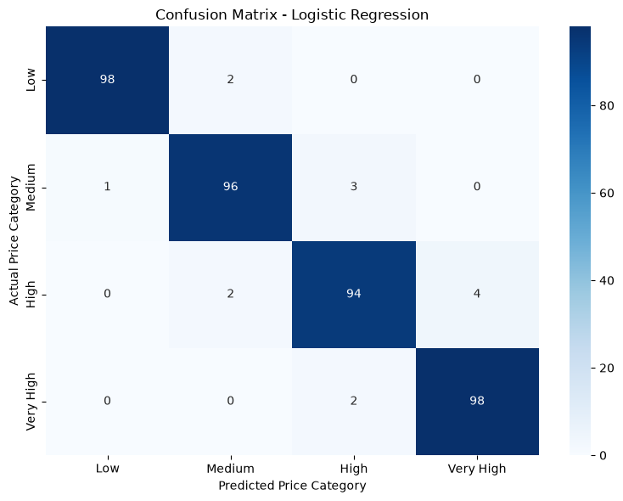
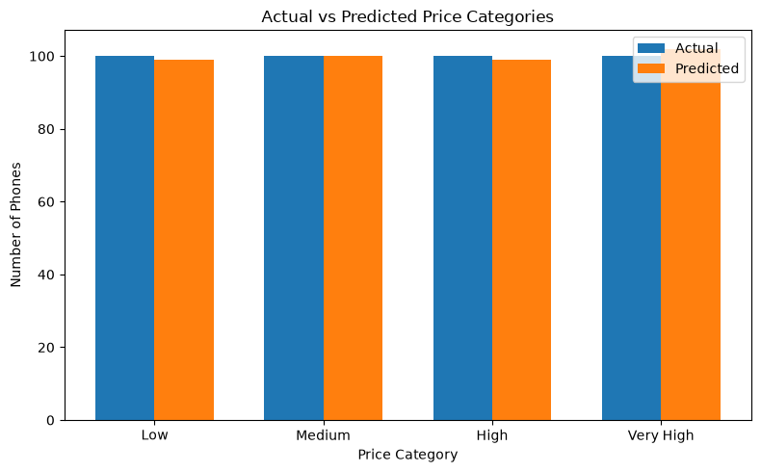
Results
96.5%
0.965
386 / 400
TEST ACCURACY
WEIGHTED F1
CORRECT PREDICTIONS
1 CONFUSION MATRIX
2 ACTUAL VS PREDICTED COUNTS
Diagonal cells are correct predictions; all 14 errors are between neighboring price tiers.
Predicted totals closely track actual totals across the four price tiers.
04 | GROUP 71
Notes:
Source: supplied data_preprocessing_training_evaluation.ipynb, evaluation and confusion-matrix cells. Confusion matrix rows are actual labels and columns are predicted labels: [[98,2,0,0],[1,96,3,0],[0,2,94,4],[0,0,2,98]]. Accuracy=0.965; weighted precision=0.9650; weighted recall=0.965; weighted F1=0.9650. The notebook’s single held-out sample prediction was class 3 (Very High Cost), matching the actual class.

Slide 5
Learnings
WHAT WORKED
TEAM ROLES
• 96.5% accuracy on a balanced 400-phone test set
• F1 stayed between 0.94 and 0.98 across all four tiers
• Imputation and scaling were fitted on training data only
Ashish Kumar — Executive Lead
Gavini Jitesh Yadav — PPT Lead
Mrinalika Singh — Video Lead
Meenakshi — Documentation Lead
LIMITS & NEXT STEPS
• One stratified train/test split; no cross-validation or baseline comparison
• All 14 errors were between neighboring price tiers
• Next: cross-validate, compare models, and test on newer phone data
AI-use disclosure: We used ChatGPT to learn Git and GitHub commands. Also we used ChatGPT to understand codes plot graphs and maintain the repository. Major portion of the code was done using the practice set 7 and previous python knowledge from AI class and lab sessions
05 | GROUP 71
Notes:
Sources: supplied README.md and both notebooks for project facts. Member 4 is Meenakshi, as specified by the user. AI-use disclosure on this slide was supplied by the user.

