Slide 1
Narzędzia i technologie wspomagające programowanie Edycja 2018

Slide 2

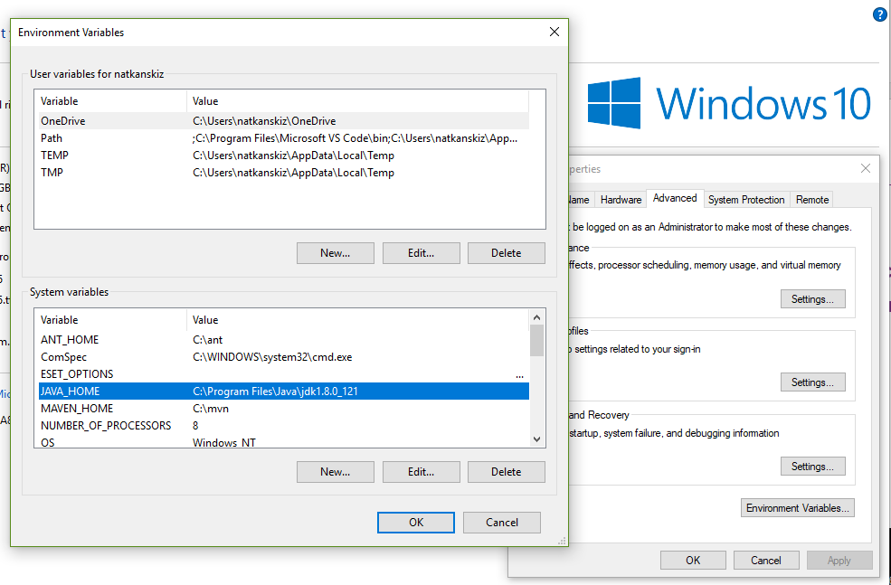
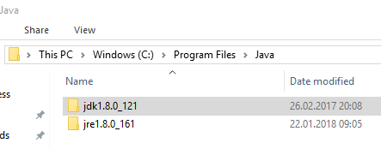
Introductory Exercise
Install newest Java (JRE + JDK!)
Set environment variable: JAVA_HOME in your operating system
Using command line or terminal, type: java -version

Slide 3
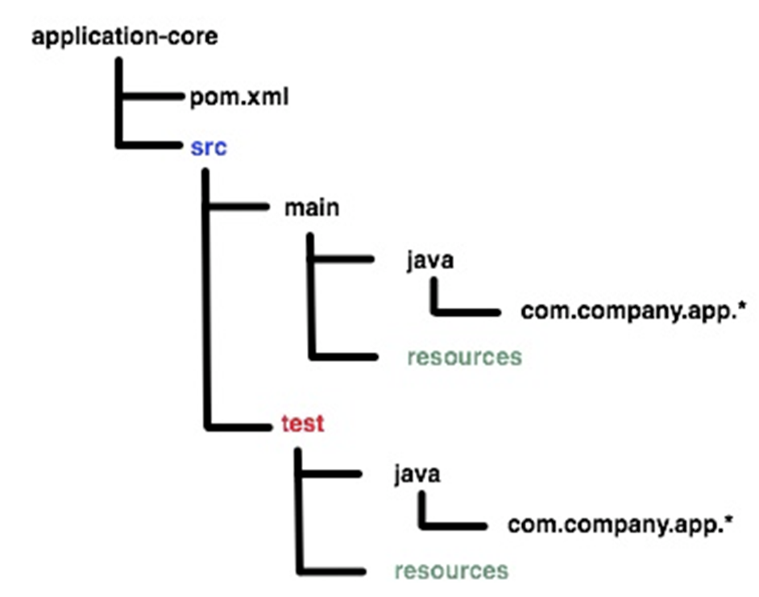

Start your development with Maven!
Advanced build tool to support the developer at the whole process of a software project
Typical developer tasks: compile, tests, pack into JAR, run
Automates creation of the initial folder structure for the Java application
Management of dependencies (no need to manual download of external libraries)
Repository: dependencies can be loaded from the local file system, from the Internet or public repositories
Management of releases
Simple usage: supply project templates (archetypes)
Convention over configuration: avoid as much configuration as possible, by choosing real world default values
Extensible (plugins)
Empower pom.xml

Slide 4
Scaffolding a project with Maven
Maven supports project scaffolding, based on project templates called archetype
Maven comes with number of „ready-to-go” archetypes
Extremely speeds up the development preparation
Type: mvn archetype:generate
A pom should minimum have the following information:
modelVersion
groupId
artifactId
version
<project>
<modelVersion>4.0.0</modelVersion>
<groupId>com.mycompany.app</groupId>
<artifactId>my-app</artifactId>
<version>1</version>
</project>
mvn archetype:generate -DarchetypeArtifactId=maven-archetype-quickstart
-DgroupId=com.companyname.bank
-DartifactId=consumerBanking
-DarchetypeArtifactId=maven-archetype-quickstart
-DinteractiveMode=false

Slide 5
Maven lifecycles, phases, goals
3 built-in build lifecycles:
default - project deployment
clean - project cleaning
site - creation of project's documentation
Each lifecycles is defined by a different list of phases, wherein a phase represents a stage in the lifecycle.
For example, the default lifecycle comprises of the following phases:
validate - check project correctness
compile
test - test the compiled source code using a unit testing
package - take the compiled code and package into distributable format (JAR/WAR)
verify - run any checks on results of integration tests to ensure quality criteria are met
install - install the package into the local repository
deploy - copies the final package to the remote repository for sharing with other developers and projects.
Phase is made up of plugin goals

Slide 6
Maven Exercise
Download maven package
Set environment variable: MAVEN_HOME
Using command line or terminal, check your maven version: mvn -v or mvn --version
Generate project with archetype „quickstart” (default)
Import project into IDE
Review pom.xml
Build package using Maven (using command line)
Add project lombok dependency
Create simple Java class with lombok annotation
Build again using Maven

Slide 7
Project Lombok
Reduce boilerplate code
Generation of constructors, getters/setters, equal and hashCode, toString methods via annotations:
@EqualsAndHashCode
@ToString
@AllArgsConstructor
@Getter
@Setter
Automatic beans creation
@Data
Builder design pattern
@Builder
More: https://projectlombok.org
<dependency>
<groupId>org.projectlombok</groupId>
<artifactId>lombok</artifactId>
<version>1.16.20</version>
<scope>provided</scope>
</dependency>

Slide 8
Another Maven’s key features that are worth to be known
Wrappers
Multi module projects (aggregator)
Profile
Own plugins
Adding goals to life cycle phases
Local/Remote/Central repositories
Read more: http://maven.apache.org/index.html

Slide 9
Gradle
uses script file (build.gradle)
handles two things:
project is made up of different tasks.
task means a piece of work which a build performs (compile classes, create JAR, generate Javadoc, or publish to repository).
uses Groovy language for writing scripts (provides a Domain Specific Language (DSL), for describing builds)
basic predefined tasks:
init
tasks
test
build
clean
learn more: https://guides.gradle.org/ (tutorials)

Slide 10
Gradle Exercise
Download Gradle package
Set environment variable GRADLE_HOME
Check gradle -version
Create new project: gradle init --type java-application
Import project into your IDE
Review build.gradle file
Write custom task
Display all available tasks
Migrate your Maven project into Gradle
Run it!

Slide 11

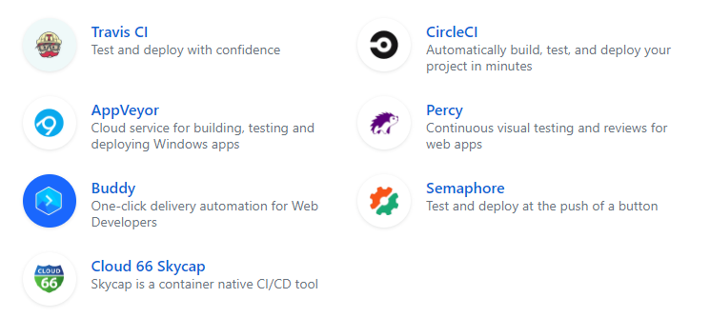
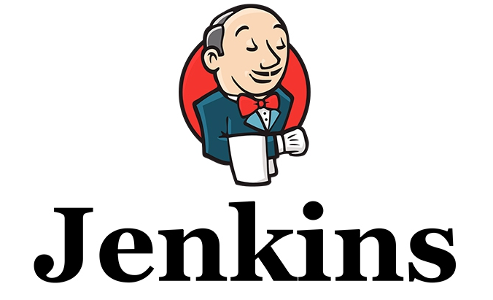
Continuous Integration
Merging all developer working copies with a shared mainline several times a day
Repository stability checks
Regular releases
Reduce of costs
Early error/bug detection

Slide 12
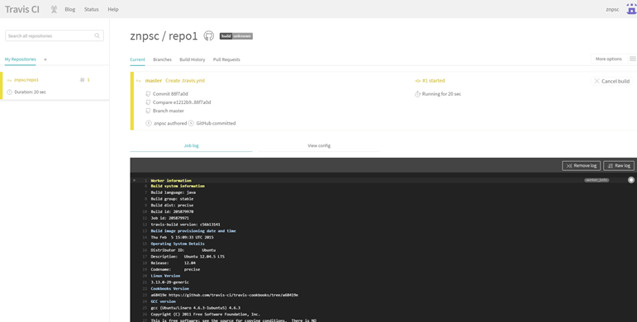
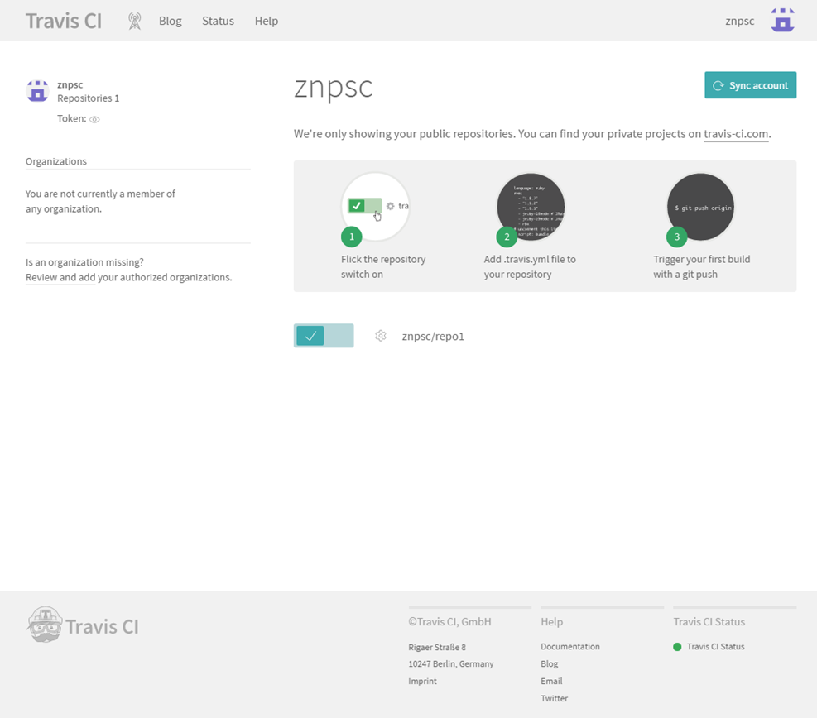
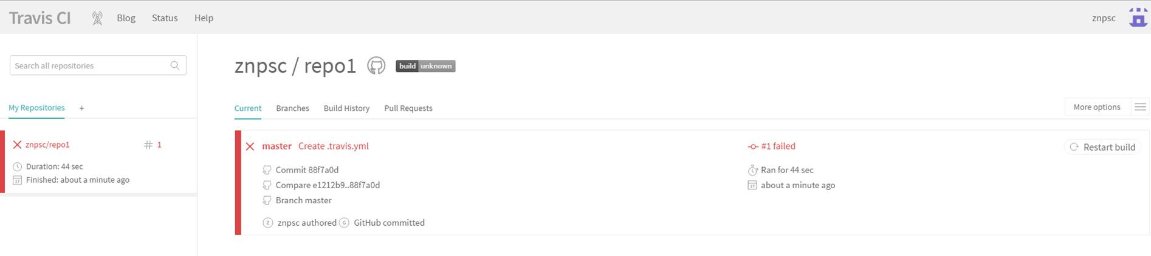
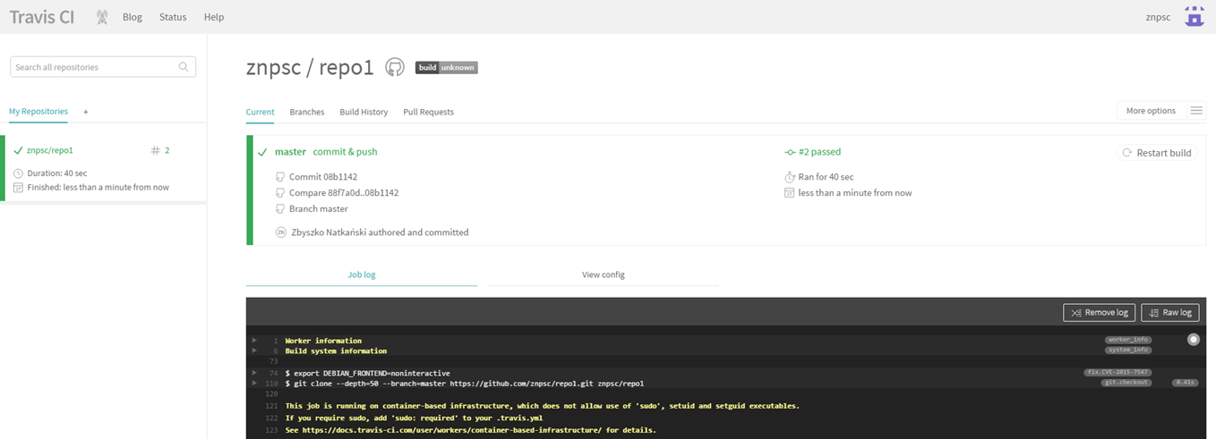
Continuous Integration Exercise
Use Github account and login: https://travis-ci.com
Use synchronize button to download your repositories from GitHub
Activate repository for which you would like to start continuous integration
Add .travis.yml file to your repository
Run Travis CI for your project

Slide 13
Free ebooks
Programming Notes for Professionals books
http://goalkicker.com
Cheat sheets
https://zeroturnaround.com/rebellabs/reports/

