Slide 1
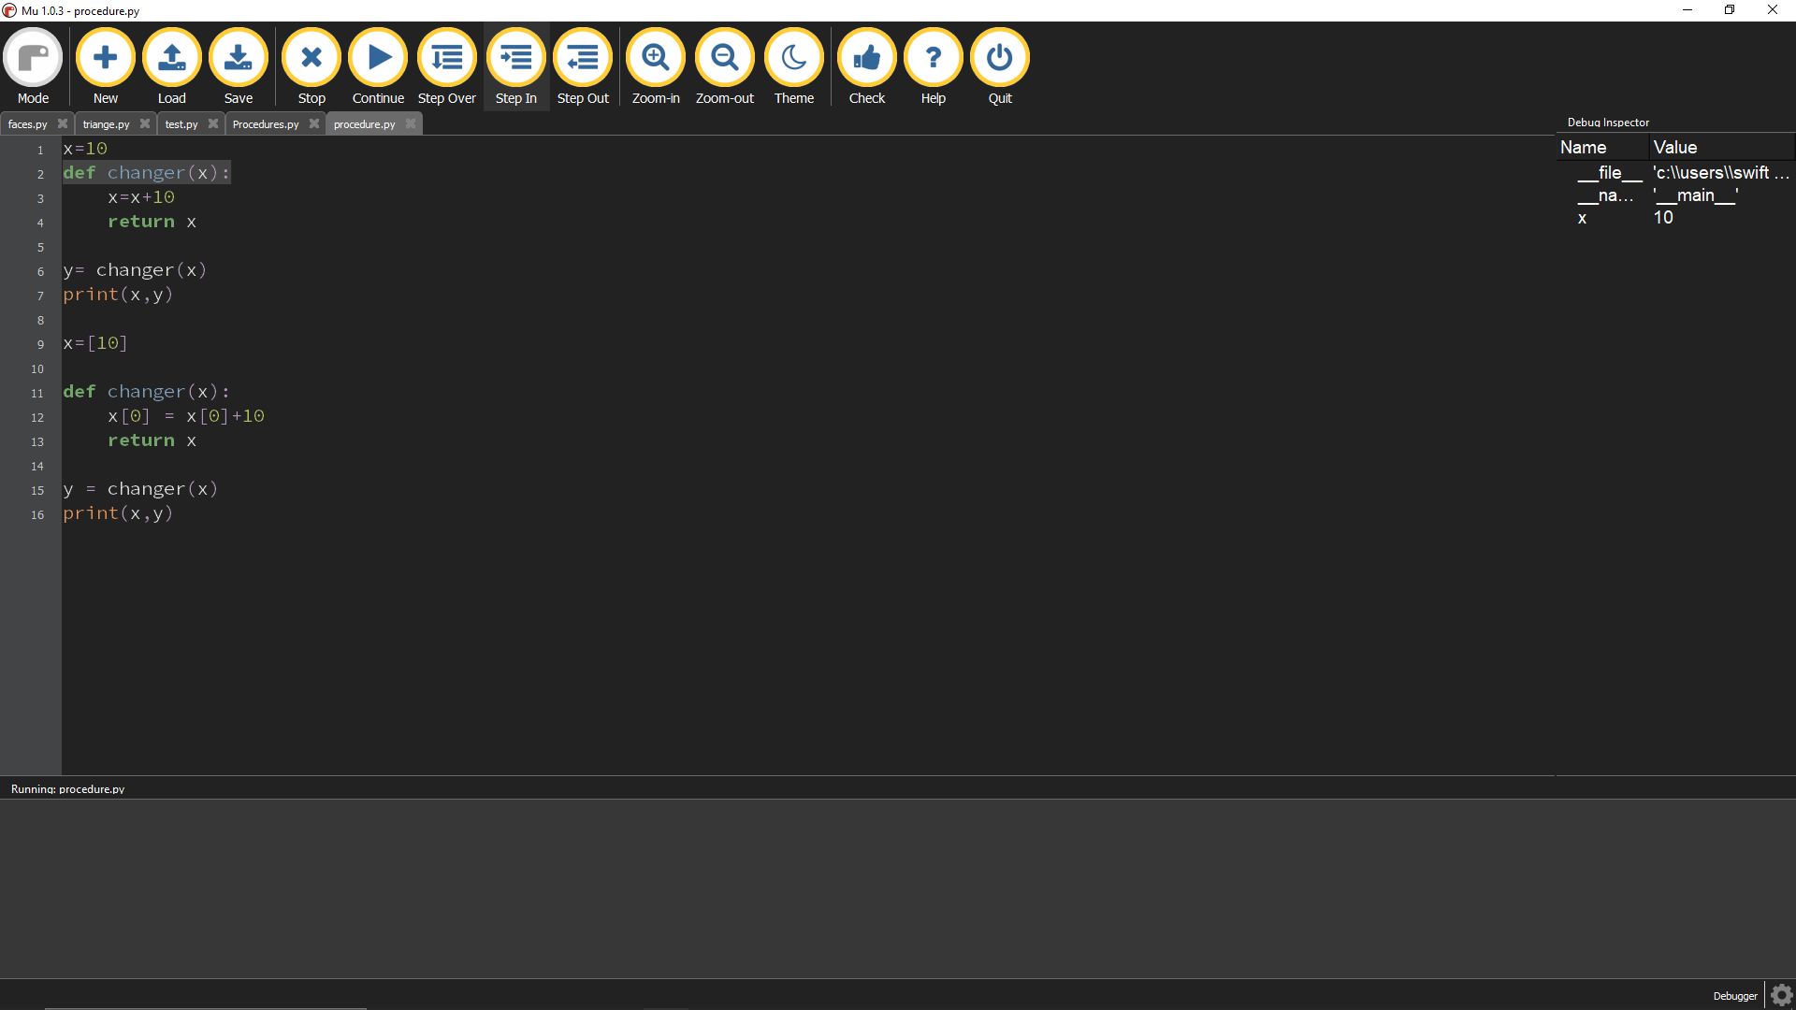
This defines the function changer, which defines itself.

Slide 2

This makes y take the value of the changed x, while not changing the actual value of x.

Slide 3
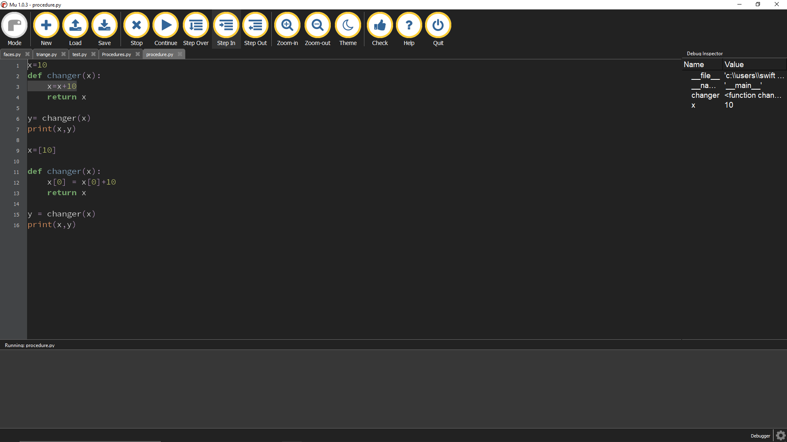
This defines the function so that it adds 10 to the current value of x.

Slide 4

This returns the value of x when it is called upon.

Slide 5

This outputs both the original x value, and the new y value

Slide 6

X is changed to a list that stores a value of 10.
X and Y have both been outputted. X is still it’s original value, while Y has undergone the function.
This is an example of passing by value.

Slide 7
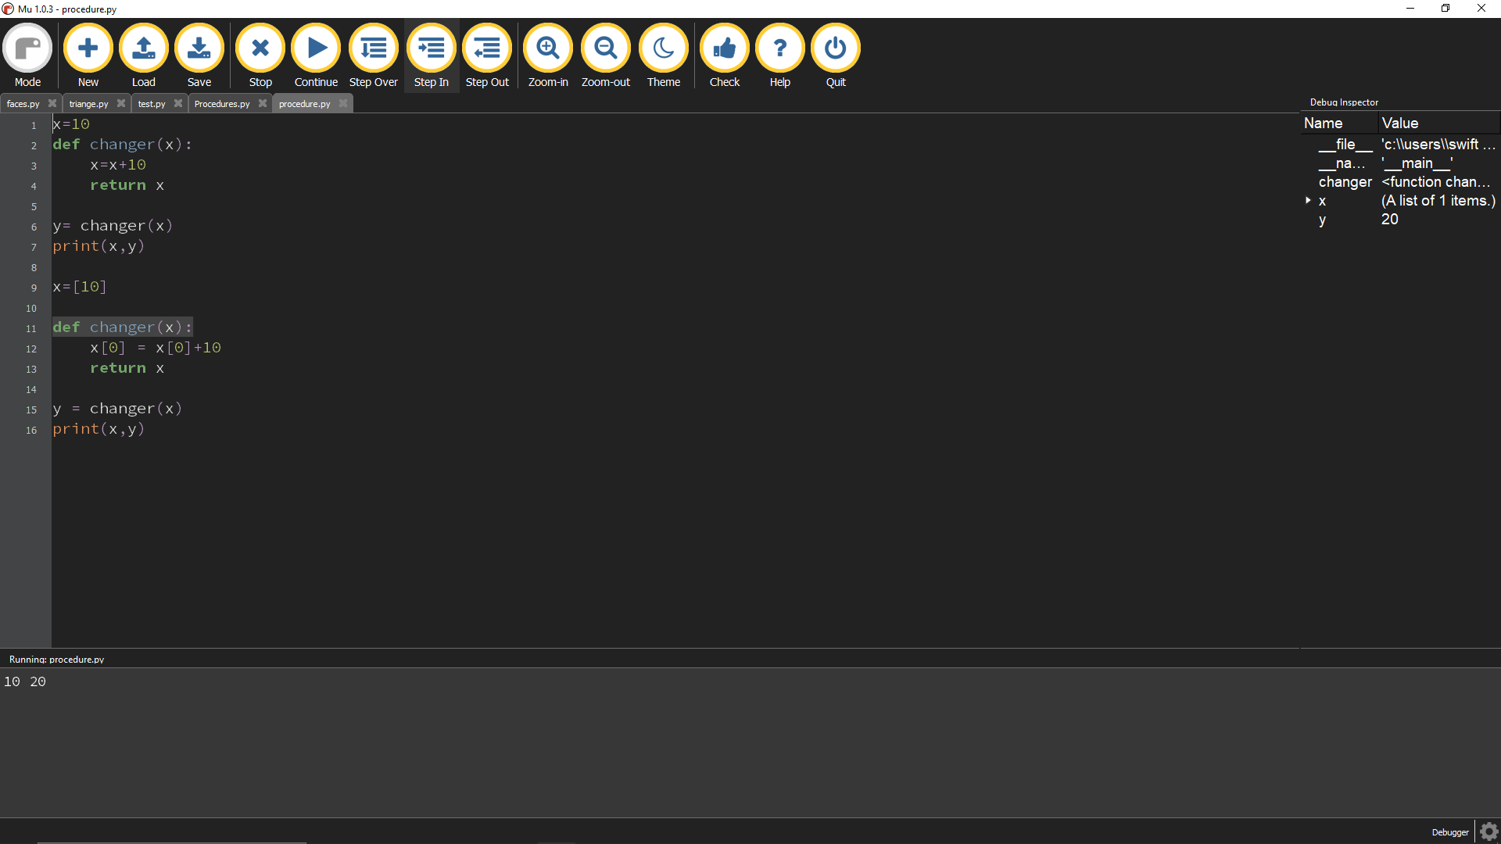
The function is self defined, and will affect X

Slide 8
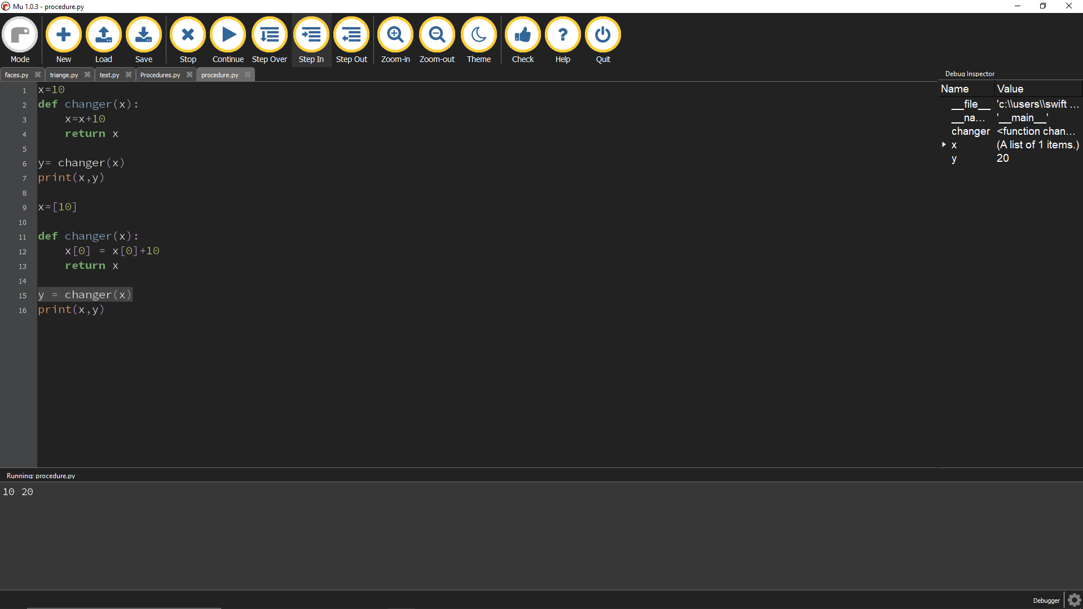
This makes y take the value of the changed X.

Slide 9

This makes the first value of list X increased by 10.

Slide 10

This makes it so that when x is called upon, it is returned to it’s original value. However since X is an array, the function will change X this time.

Slide 11
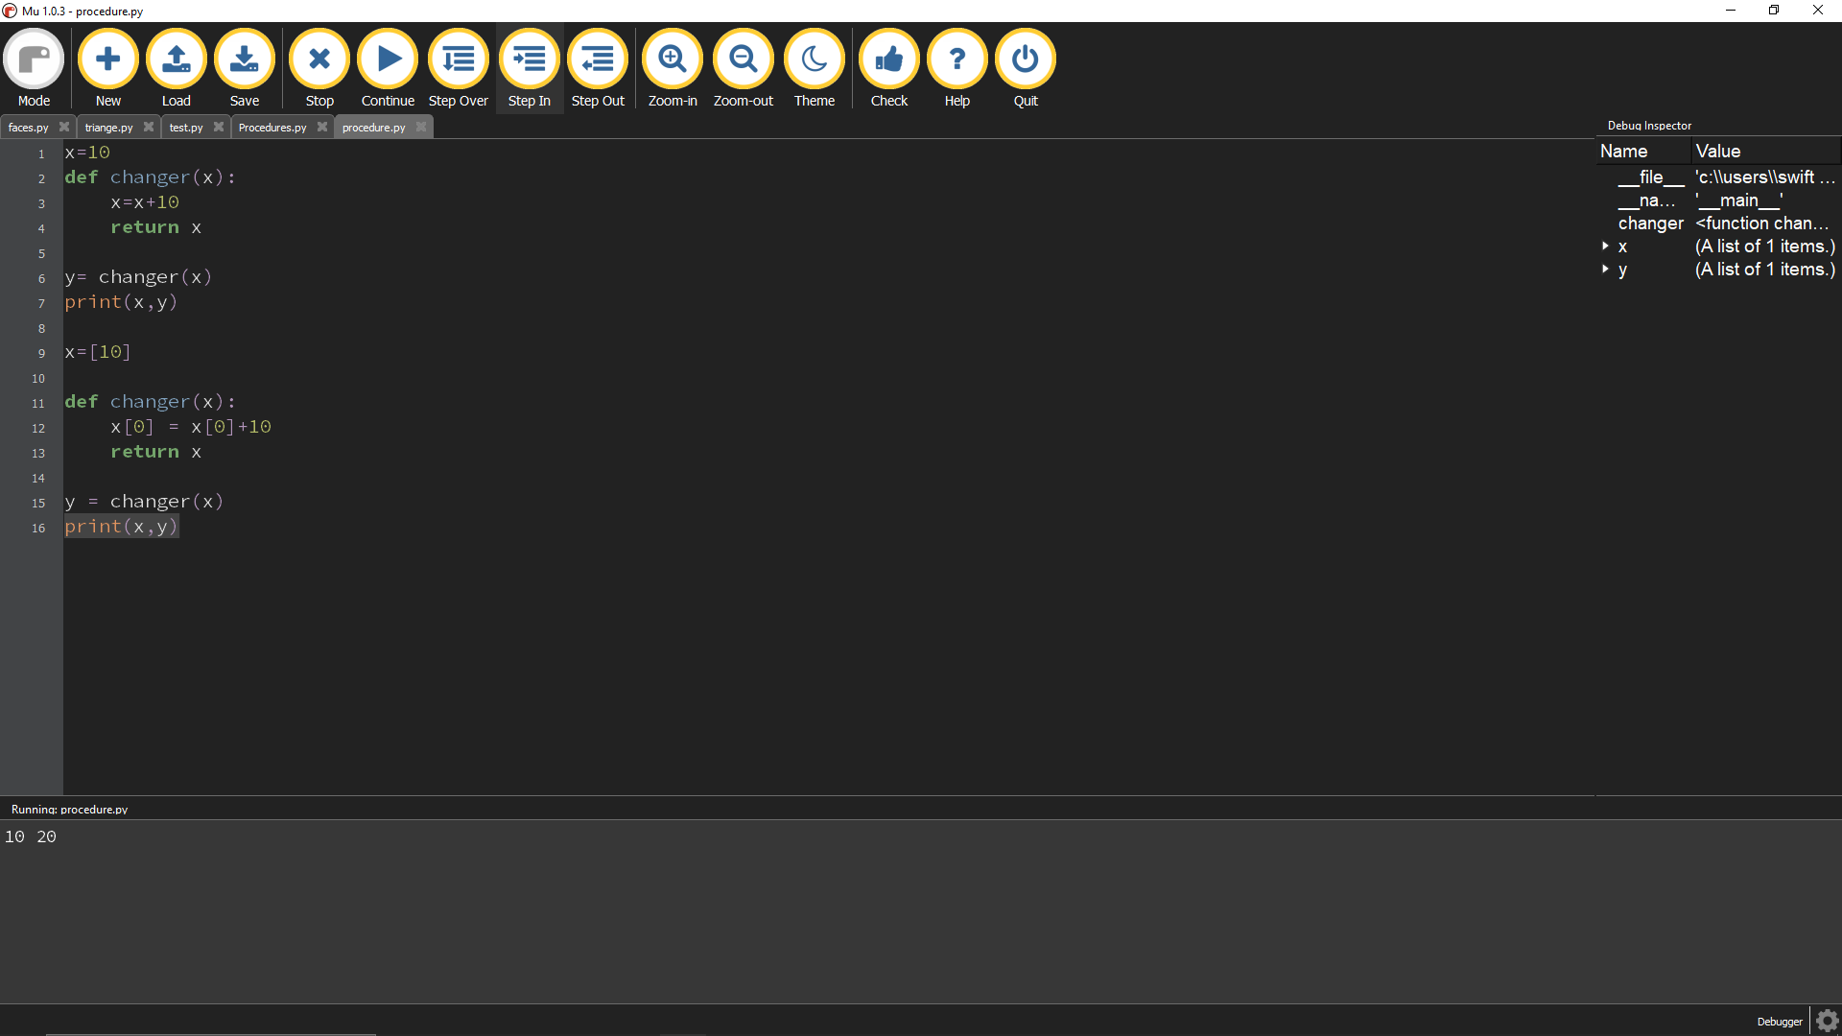
This outputs X and Y, but this time both X and Y have changed.

Slide 12
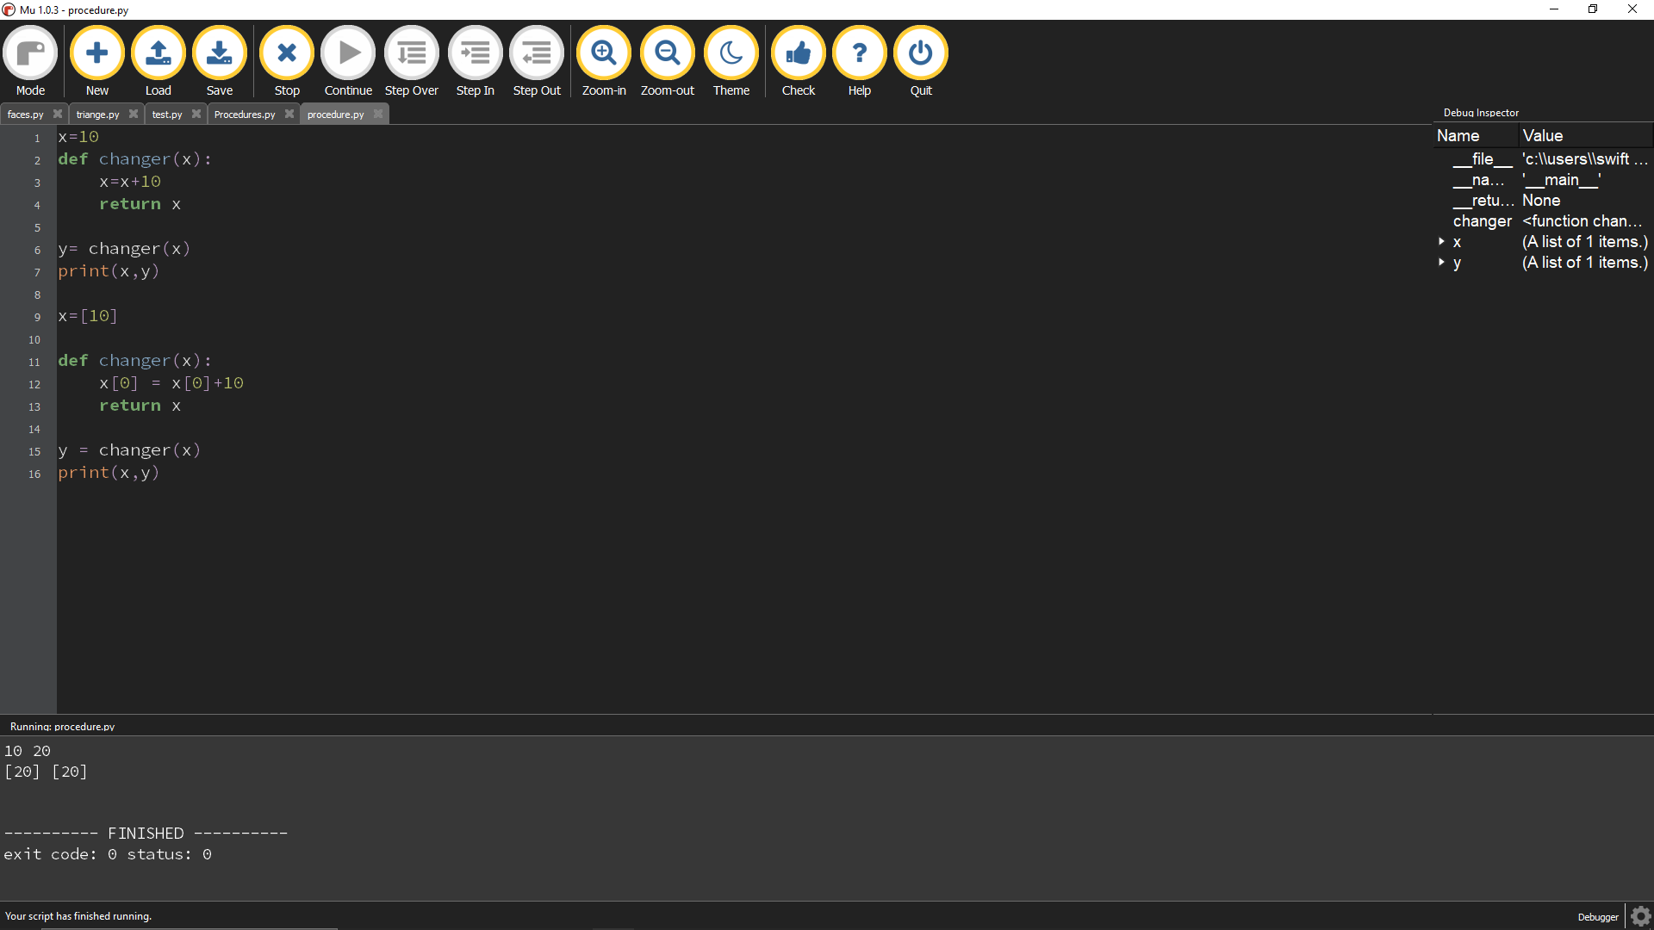
This prints both the new X value and Y value. Both have changed, since an array has changed.
This is an example of passing by reference.

