Slide 1

Student Mobile Usage Detection and Fine Notification System in Restricted areas using Deep Learning Techniques
Presented by Batch – A7
1. Abdul Yaseen : 20481A1201 2. Sai Venkat : 20481A1230
3. Supriya : 20481A1234 4. Udayini : 20481A1223
Under the guidance of
Dr. D.N.V.S.L.S.Indira M.Tech.,Ph.D.
Professor & HOD
Department of Information Technology SESHADRI RAO GUDLAVALLERU ENGINEERING COLLEGE
(An Autonomous Institute with Permanent Affiliation to JNTUK, Kakinada.)
Seshadri Rao Knowledge Village, Gudlavalleru – 521356, Andhra Pradesh

Slide 2
OUTLINE
Abstract
Objectives
Existing System
Literature Survey
Software and Hardware Requirements
Methodolgy
System Design
Results
References

Slide 3
ABSTRACT
Utilizing cutting-edge deep learning algorithms, neural networks, and computer vision technologies,this project actively monitors and detects unauthorized mobile device usage within designated restricted areas. Beyond detection, it captures real-time images of individuals and employs facial recognition to ascertain their identity.
Upon successful identification of an individual using a mobile device in violation of the restricted zone, the system automatically sends a notification to the respective Hod or Academic co-ordinator.This notification includes the individual's name (or) id with the fine rupees and proof of an image.
Key features of this system include adaptability to diverse environments, robustness against false alarms, and seamless integration with existing security infrastructure. By implementing deep learning technology, this project offers a forward-thinking approach to security enforcement.

Slide 4
OBJECTIVES
Detection of Unauthorized Mobile Device Usage: Develop a system capable of actively monitoring designated restricted areas to detect any instances of unauthorized mobile device usage.
Facial Recognition for Identity Verification: Implement facial recognition technology to accurately identify individuals involved in unauthorized mobile device usage within restricted areas.
Automated Notification System: Create an automated notification system that can promptly alert the relevant authorities, such as the Head of Department (HoD) or academic coordinator, when a violation is detected.
Photographic Proof: Include a feature that provides photographic proof of the violation in the notification sent to the authorities, enhancing the transparency of the process.

Slide 5
EXISTING SYSTEM
Access Control Systems: Traditional access control systems, such as card readers and biometric scanners, are commonly used to restrict entry to secure areas. These systems often log entries but may not specifically detect mobile device usage.
Closed-Circuit Television (CCTV) Cameras: Many facilities use CCTV cameras for surveillance. While they can record activities, they may not have the capability to detect mobile device usage or identify individuals.
Intrusion Detection Systems (IDS): IDS are designed to identify unauthorized access or activities within a network or physical space. Some IDS may include elements of intrusion prevention, but they may not specifically address mobile device usage.
Attendance and Biometric Systems: Some institutions use biometric systems for attendance purposes. These systems may track entry and exit times but may not specifically address mobile device usage.

Slide 6
LITERATURE SURVEY
In the exploration of existing research and technologies related to the integration of deep learning, facial recognition, and real-time surveillance in educational institutions for security and compliance, numerous studies have illuminated the efficacy of deep learning algorithms in enhancing security systems. Smith et al. (2018) conducted research that successfully integrated deep learning for real-time object detection, establishing a foundation for advanced surveillance solutions [1].
Jones et al. (2019) further expanded on this, emphasizing the role of deep learning in improving overall security measures within educational settings. This collective body of work signifies the potential of cutting-edge technologies to contribute significantly to the security landscape within educational settings [2]
Facial recognition technology, a crucial component of identity verification, has been a subject of extensive study in educational environments. Johnson et al. (2019) discussed the implementation of facial recognition systems, emphasizing the need for accuracy and privacy safeguards [3].

Slide 7
LITERATURE SURVEY
The findings were reinforced by recent research conducted by Martinez et al. (2021), which highlighted advancements in facial recognition algorithms, particularly in addressing ethical and privacy considerations in educational security implementations [4].
The ethical implications of facial recognition technologies have been critically analyzed by Smith et al. (2018), emphasizing privacy concerns associated with their implementation in educational institutions. The study provides insights into the necessity for ethical considerations and privacy safeguards when deploying advanced security technologies in educational settings. This perspective has been reinforced by the works of Garcia et al. (2020) and Anderson et al. (2021), who explored the ethical dimensions of facial recognition technologies in educational contexts, offering nuanced insights into the intersection of technology and privacy [15] [16].

Slide 8
SOFTWARE AND HARDWARE
Hardware Requirements:
Operating system : Windows 7 or 7+
RAM : 4 GB
Hard disc or SSD : More than 256 GB
Processor : Intel 3rd generation or high
Software Requirements:
Software’s : Python 3.6 or high version
Deep learning frame work : TensorFlow, PyTorch, or Keras to build and train the CNN models.
Facial Recognition Software : Open CV
Front end : HTML, CSS

Slide 9
METHODOLGY
Deep Learning-Based Detection: The system will employ advanced deep learning algorithms and computer vision techniques to actively monitor designated restricted areas for unauthorized mobile device usage.
Facial Recognition for Identity Verification: When unauthorized mobile device usage is detected, the system will identify the face of the individuals involved.
Automated Notification System: Upon detecting a violation, the system will trigger an automated notification to the responsible authorities, such as the Head of Department (HoD) or academic coordinator.
Photographic Proof: The notification sent to authorities will include photographic proof of the violation, enhancing transparency and accountability.

Slide 10
METHODOLGY
Deep Learning-Based Detection: (YOLO)
Prior detection systems repurpose classifiers or localizers to perform detection. They apply the model to an image at multiple locations and scales.High scoring regions of the image are considered detections.
YOLO use totally different approach.
Apply a single neural network to the full image. This network divides the image into regions and predicts bounding boxes and probabilities for each region.These bounding boxes are weighted by the predicted probabilities.
YOLO use Darknet network.

Slide 11
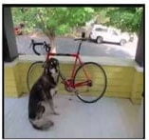
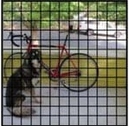
METHODOLGY
Working Process of YOLO :
Step 1 : Grid Division
The YOLO network splits the input image into a grid of SxS cells.
Each grid cell predicts B number of bounding boxes and their objectness score along with their class predictions.
Step 2 : Bounding Boxes Prediction
Coordinates of B bounding boxes –YOLO predicts 4 coordinates for each bounding box(bx,by,bw,bh) with respect to the corresponding grid cell.
bx represents the x-coordinate of the center of the bounding box.
by represents the y-coordinate of the center of the bounding box.
bw represents the width of the bounding box.
bh represents the height of the bounding box.

Slide 12
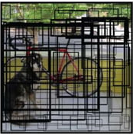
METHODOLGY
Step 3 : Objectness Score
Indicates the probability that the cell contains an object.
Object confidence represents the likelihood that an object is present within a bounding box. It is determined by the intersection over union (IoU) between the predicted and ground truth bounding boxes.
Step 4 : Class Prediction
Class prediction –if the bounding box contains an object, the network predicts the probability of K number of classes.
The predicted bounding boxes may look something like as follow.

Slide 13
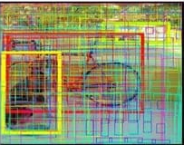
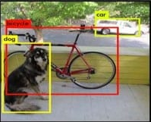
METHODOLGY
Finally, the Objectness score for the bounding box and the class prediction are combined into one final score that shows probability that this bounding box contains a specific type of object
It turns out that most of these boxes will have very low confidence scores, so only keep the boxes whose final score is above some threshold.
Step 5 : Non-Maximum Suppression
Non-maximum Suppression (NMS) intends to cure the problem of multiple detection of the same image.

Slide 14



METHODOLGY
Non-maximum Suppression or NMS uses the very important function called “Intersection over Union” , or IoU.
Intersection Union
Find the coordinates(xi1,yi1,xi2,yi2) of the intersection of two boxes where:
xi1=maximum of the x1 coordinates of the two boxes
yi1=maximum of the y1 coordinates of the two boxes
xi2=maximum of the x2 coordinates of the two boxes
yi2=maximum of the y2 coordinates of the two boxes

Slide 15
METHODOLGY
The area of intersection by this formula
area_intersection=(xi2 - xi1)*(yi2 - yi1)
Calculate the area union
union_area=(area of box 1 + area of box 2) - area_intersection
Therefore IoU= area_intersection/union_area
Implement non-max suppression , the steps are
Select the box that has the highest score.
Compute its overlap with all other boxes , and remove boxes that overlap it more than a certain threshold which we call IoU_threshold.
Go back to above two steps and iterate until there are no more boxes with a lower score than the currently selected box.

Slide 16
METHODOLGY
Face recognization for identity verification : (LBPH Algorithm)
Local Binary Pattern (LBP) is a simple yet very efficient texture operator which labels the pixels of an image by thresholding the neighborhood of each pixel and considers the result as a binary number.
It was first described in 1994 (LBP) and has since been found to be a powerful feature for texture classification.
It has further been determined that when LBP is combined with histograms of oriented gradients (HOG) descriptor, it improves the detection performance considerably on some datasets.
Using the LBP combined with histograms we can represent the face images with a simple data vector.

Slide 17
METHODOLGY
Step by Step Process of LBPH Algorithm :
Step 1 : Image Grayscale Conversion
Convert the input image to grayscale to make processing easy and to reduce the complexity.
Step 2 : Image Division into Cells
Divide the grayscale image into non-overlapping cells. The size of the cells is a critical parameter and can be adjusted based on the characteristics of the textures you are trying to capture.
Step 3 :Local Binary Pattern Calculation:
For each pixel in each cell:
Create a binary pattern by comparing the intensity of the pixel with its neighboring pixels.
A common approach is to use a 3x3 pixel neighborhood. Compare the intensity of the center pixel with its 8 neighbors.

Slide 18
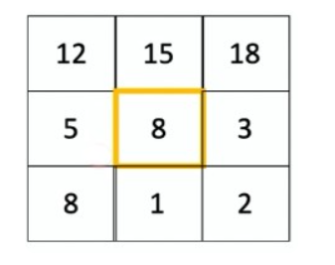
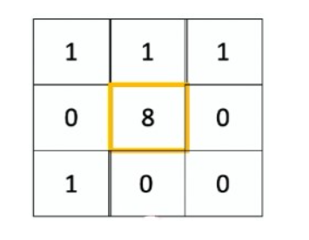
METHODOLGY
For Example :
Binary
intensity comparison
If the intensity of the neighbour is greater than or equal to the intensity of the center pixel,
assign a value of 1;
otherwise, assign 0.

Slide 19


METHODOLGY
The Other formula for the local binary pattern Calculation:
Where ic corresponds to the value of the center pixel (xc,yc)
Where in is the value of the eight surround pixels
Function s(x) is defined as :

Slide 20
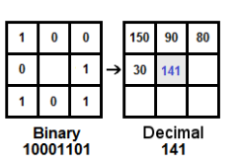
METHODOLGY
Step 4 : Decimal Conversion
Convert the binary pattern obtained for each pixel in the cell to a decimal value. This results in a sequence of decimal values for each cell.
Step 5 : Calculation and concatenation of histograms
Create a histogram for each cell by counting the occurrences of each decimal value in the cell.
Concatenate the histograms of all cells to form a feature vector for the entire image.
The length of this feature vector is determined by the number of bins in the histograms

Slide 21
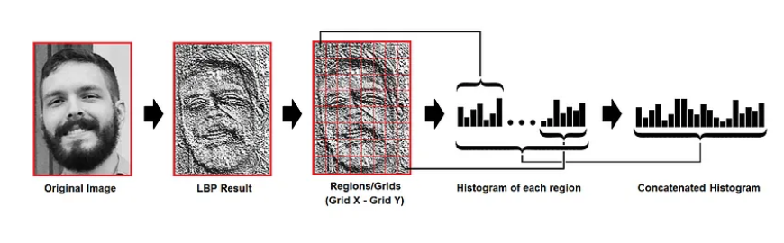
METHODOLGY
Step 6 : Image Classification
Here we use svm,knn etc… for texture classification to predict the class of the image

Slide 22
METHODOLGY
Flow chart for LBPH Algorithm :
Start
Input Face Image
Divide Face Image into Blocks
Calculate Histogram for Each Block
Face image Processed
Combining LBPH Histograms into Single Histogram
Recognition Result
End

Slide 23
METHODOLOGY
Automated Notification System :
By Using GSM hardware we are sending notification to the respected hod and identified student
Photographic proof :
Use the Telegram Bot API to send this proof image to the Head of Department (HOD).
Create a Telegram bot using the BotFather on Telegram and obtain the bot token.

Slide 24
BLOCK DIAGRAM
Webcam
Person
Frame Extraction
Detects
Frame
No
Yes
Mobile detection Model
Frame
Person Recognisation Model
Faculty/Other
Student
Message
+
Proof of an Image

Slide 25
SYSTEM DESIGN
System
Detect Mobile Usage in Restricted Area
uses
uses
<<include>>
Administrators
Student
Recognize Face
uses
uses
<<include>>
Send Notification with proof of an image and ID
Use case diagram for “Student Mobile Usage Detection and Fine Notification System in Restricted areas using Deep Learning Techniques”.

Slide 26
Student mobile usage system
Face recognition system
Notification system
Student
Coordinator
Start mobile usage
Detect mobile usage
Request face recognition
Recognize face
Request to generate notification
Notification ready
Send notification(image and ID)
Student mobile usage system
Face recognition system
Notification system
Student
Coordinator

Slide 27
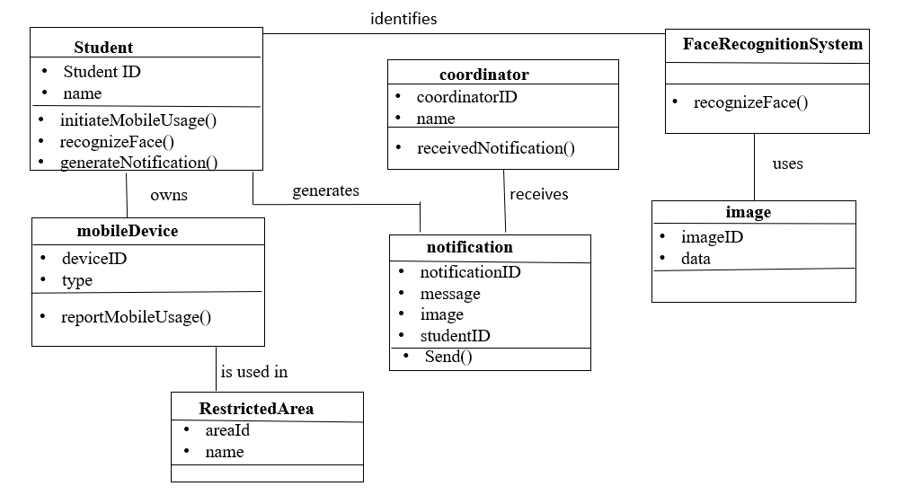
SYSTEM DESIGN
sends
Class diagram for “Student Mobile Usage Detection and Fine Notification System in Restricted areas using Deep Learning Techniques”.

Slide 28
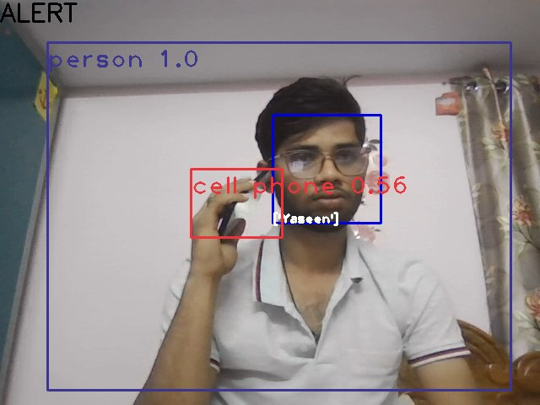
RESULTS
Fig. 1 : Individual identified using a mobile device within surveillance zones(Face Recognized)

Slide 29
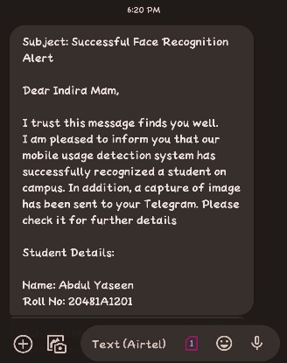
RESULTS
Upon detecting unauthorized mobile usage and successful face recognition, the system automatically triggers a message containing the student's ID and name, providing swift and accurate notification to the designated personnel.
Fig. 2: Text message sent to management concerning individual's mobile device usage.

Slide 30
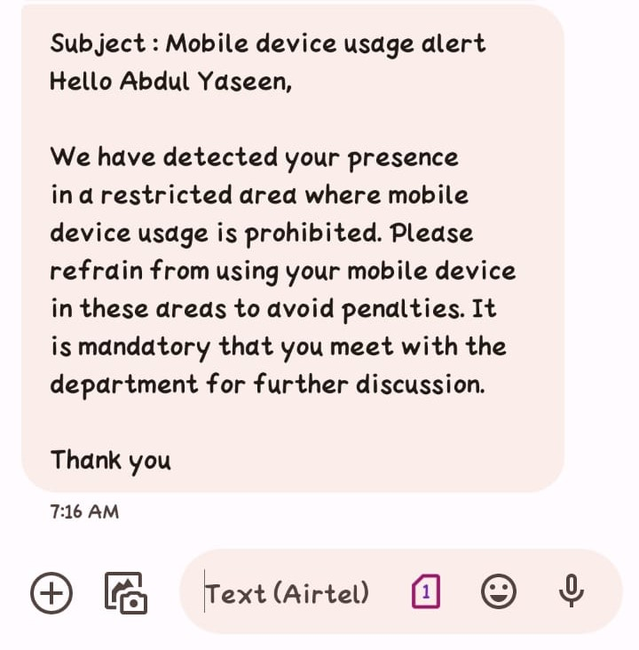
RESULTS
Fig. 3: Text message sent to Student concerning individual's mobile device usage.

Slide 31
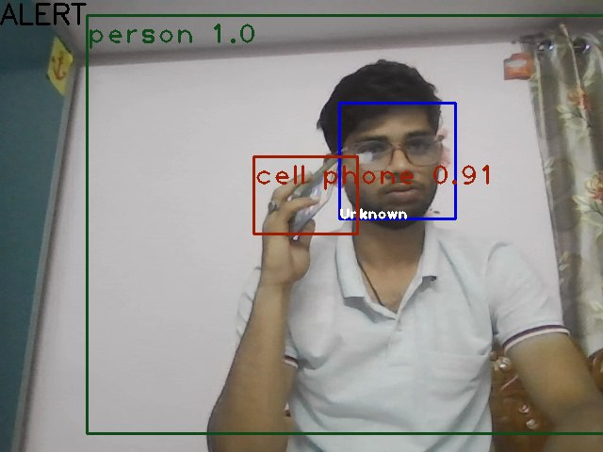
RESULTS
Fig. 4 : Individual identified using a mobile device within surveillance zones(Face not Recognized)

Slide 32
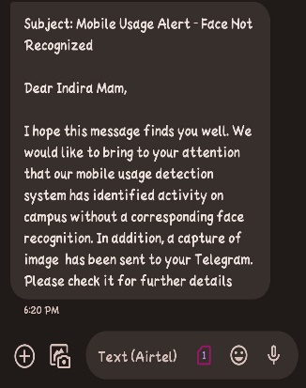
RESULTS
In the event of detecting unauthorized mobile device usage without successful face recognition, the system promptly sends a notification conveying that the face could not be identified.
Fig. 5: Text message sent to management concerning individual's mobile device usage.

Slide 33
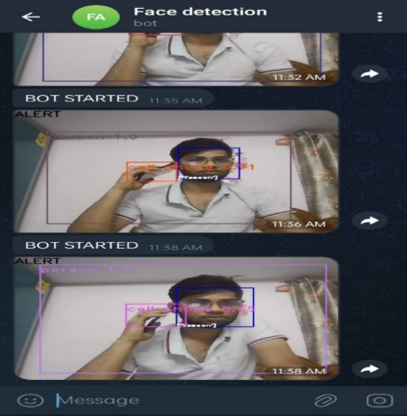
RESULTS
Upon detection of unauthorized mobile device usage within restricted areas, the system automatically sends a proof image to the management via the FaceDetection Telegram bot named 'facedetection'.
Fig. 6: Sending an image of an individual to the management Telegram bot.

Slide 34
REFERENCES
[1] “Mobile percentage of traffic in india,” bit.ly/30cbNAi, 2020.
[2] S. Mittal et al., “A survey of techniques for improving efficiency of
mobile web browsing,” CPE, vol. 31, no. 15, pp. e5126, 2019.
[3] “Number of apps available in leading app stores as of 4th quarter 2019,”
https://bit.ly/2wPeJbA, 2020.
[4] J. Clement, “Mobile social media- statistics & facts,” https://www.
statista.com/topics/2478/mobile-social-networks/, 2019.
[5] J. J. Rolison et al., “What are the factors that contribute to road accidents? an assessment of law enforcement views, ordinary drivers’
opinions, and road accident records,” Accident Analysis & Prevention,
vol. 115, pp. 11–24, 2018.
[6] S. Mittal and S. Vaishay, “A survey of techniques for optimizing deep
learning on gpus,” JSA, 2019.
[7] S. Mittal, “A Survey of FPGA-based Accelerators for Convolutional
Neural Networks,” Neural computing and applications, vol. 32, no. 4,
pp. 1109–1139, 2020.
[8] “State farm distracted driver detection,” 2016, https://bit.ly/32dbrfy.
[9] R. Torres et al., “A deep learning approach to detect distracted drivers
using a mobile phone,” in ICANN, 2017, pp. 72–79

Slide 35
THANK YOU

