Slide 1

Recognizing Nutrient Deficiency in Paddy Crop using Neural Networks
by
K. J. Bharath Kumar
Roll No. 204G1A0520
N. Hari Krishna
Roll No. 214G5A0505
P. Nandini
Roll No. 204G1A0564
M. Gnapika Bai
Roll No. 204G1A0533
Under the guidance of
Mr. P. Veera Prakash M.Tech, (Ph.D), MIEI, MCSI
Assistant Professor & HOD
Department of Computer Science and Engineering
Srinivasa Ramanujan Institute of Technology
(Autonomus)
2023 - 2024

Slide 2
Review 0 Comments
How do you identify the symptoms?
Methodologies to obtain/identify deficiency?
Are you proposing only nutrient deficiency or any other additionals?
Which algorithm is most suitable?

Slide 3
Review 1 Comments
Review the project title.
Define the implementation process briefly.

Slide 4

Contents
Review-0 Comments
Review-1 Comments
Abstract
Problem statement
Objectives of Project
Literature survey for first objective
Objective-1(Design & Implementation)
Literature survey for second objective
Objective-1(Design & Implementation)
Proposed Work-(Methods to be followed for proposed system)
References
GitHub Link
Queries

Slide 5
Abstract
In the economic landscape of India, agriculture stands as a pivotal sector encompassing both plant cultivation for food production and the management of domesticated animals. Nutrient management forms a cornerstone of agricultural practices, profoundly influencing crop growth and productivity. Just as with other crops, rice is susceptible to diseases, pests, and nutrient deficiencies, necessitating continuous advancements in agricultural techniques to bolster output.
In this context, a notable transformation has swept through agriculture, aiming to amplify yields. Focusing on rice, a vital food source, this study captures images of paddy plant leaves, subsequently subjecting them to MobileNetV2 algorithm, a Convolutional Neural Network (CNN) processing. By employing image processing methodologies, a model is constructed to identify various deficiencies present in the leaves. Notably, the proposed approach leverages color and textural characteristics to effectively detect and categorize inadequacies. The integration of CNN technology offers a potent avenue for promptly identifying nutrient insufficiencies within leaves. This proactive identification equips farmers with the information needed to undertake timely corrective measures. Ultimately, this research contributes to the evolution of agriculture by facilitating the detection and rectification of nutrient-related challenges, thereby fostering improved crop health and overall agricultural productivity.

Slide 6
Problem Statement
In India's agriculture-driven economy, nutrient management is pivotal for crop production. Rice, a key crop, faces issues like diseases and nutrient deficiencies. Agricultural practices are evolving to improve output. This study employs Convolutional Neural Networks (CNNs) to process rice leaf images, aiming to develop a model that detects nutrient deficiencies based on color and texture.
The challenge is to swiftly and accurately identify these deficiencies, enabling timely corrective action by farmers. This research seeks to enhance agricultural practices by providing a tool for optimizing crop health and productivity in rice cultivation.

Slide 7
Objectives of Project
Research Objective-1: Develop a smart system using CNNs to spot nutrient problems in rice leaves quickly and precisely, aiding farmers in timely corrective actions.
Research Objective-2: Evaluate the real-world potential of the Deep CNN-based solution to detect nutrient deficiencies in rice crops, enhancing crop health management practices.

Slide 8
Literature survey for first objective
s.no | Publisher/Journal | Title | Authors Name | Year of Publication | Summary of the paper
[1] | International Journal of Recent Technology and Engineering (IJRTE) | Machine Learning Based Nutrient Deficiency Detection in Crops. | 1.Amritha T 2.Gokulalakshmi T 3.Umamaheshwari P 4.T Rajasekar | 2020 | This research Machine Learning Based Nutrient deficit detection in crops attempts to create an automated robotic vehicle that identifies nutrient deficit in crops just by collecting an image of the crop plants leaves. The captured images is then processed by using the convolutional neural networks (CNN).
Algorithms | DataSets | Improvements
CNN model along with Canny operator. | --- | The amount of fertilizer for the corresponding nutrient deficiency is also displayed. Thus, entire agricultural work can be integrated in a single system.
Additional Summary

Slide 9
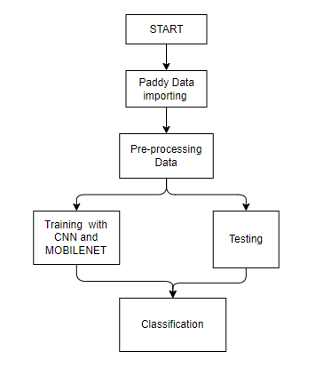
Design and Implementation for first objective
Fig 1 : Block Diagram

Slide 10
Design and Implementation for first objective
We are aimed to recognize the given image using deep learning. We are assuming we are already having a pre-trained model in our Tensorflow which we will be using to Recognize images. So, we will be using Keras of Tensorflow to import architectures which will help us to recognize images and to predict the image in a better way using coordinates and indexing, we will be using TensorFlow as a tool.
Mobilenet is a model which does the same convolution as done by CNN to filter images but in a different way than those done by the previous CNN. It uses the idea of Depth convolution and point convolution which is different from the normal convolution as done by normal CNNs. This increases the efficiency of CNN to predict images and hence they can be able to compete in the mobile systems as well. Since these ways of convolution reduce the comparison and recognition time a lot, so it provides a better response in a very short time and hence we are using them as our image recognition model.

Slide 11
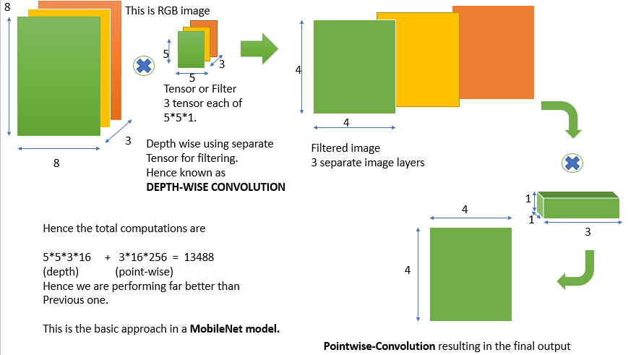
Design and Implementation for first objective

Slide 12

Design and Implementation for first objective
Applying MobileNet Algorithm

Slide 13
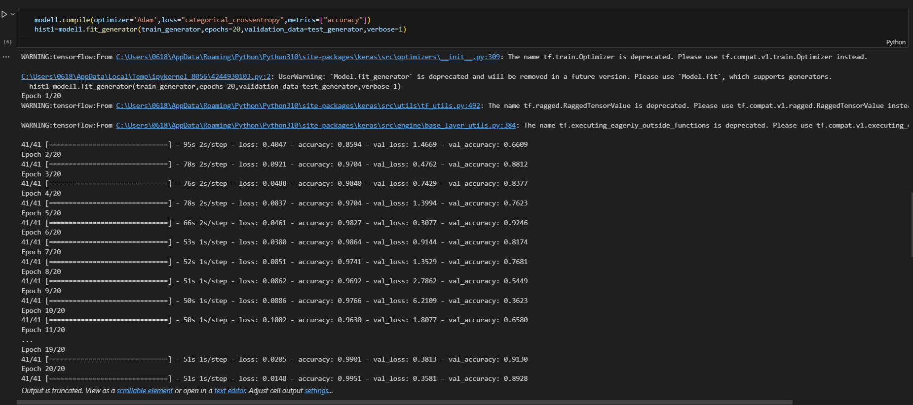
Design and Implementation for first objective

Slide 14

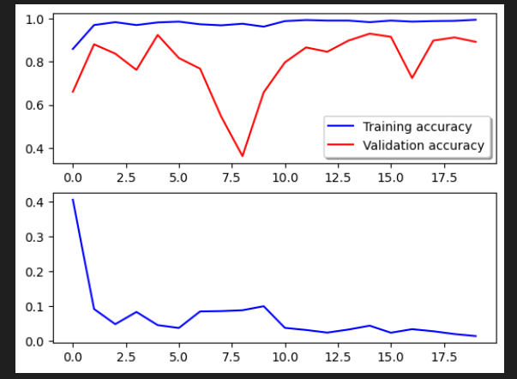
Design and Implementation for first objective
Graphs

Slide 15

Design and Implementation for first objective
Model Saving

Slide 16
Design and Implementation for second objective
Since the images can be seen as a matrix of pixels and each pixel describes some of features of the image, so these technologies uses filters to filter out certain set of pixels in the images and results in the formation of output predictions about images.
CNN uses lot of pre-defined and stored filters and does a convolution (X) of that filter with the pixels matrix of the image. This results in filtering the image’s objects and comparing them with a large set of pre-defined objects to identify a match between them. Hence in this way these models are able to predict the image.
But these technologies requires a high GPU to increase the comparison rate between millions of data which cannot be provided by any mobile device.
Hence, here comes in action what is known as MobileNet.

Slide 17
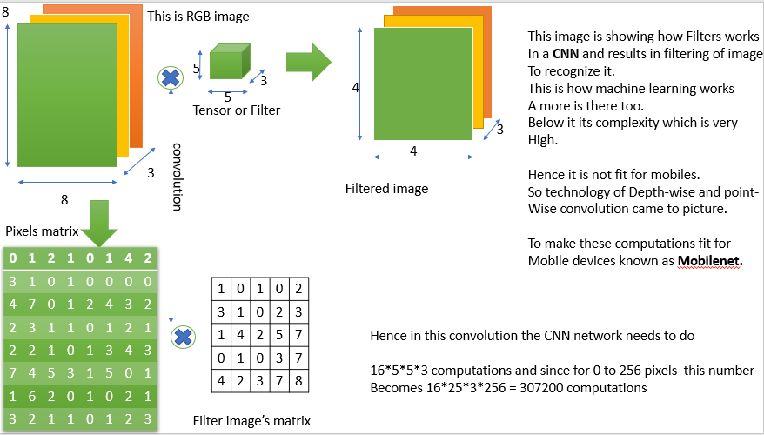
Design and Implementation for second objective

Slide 18
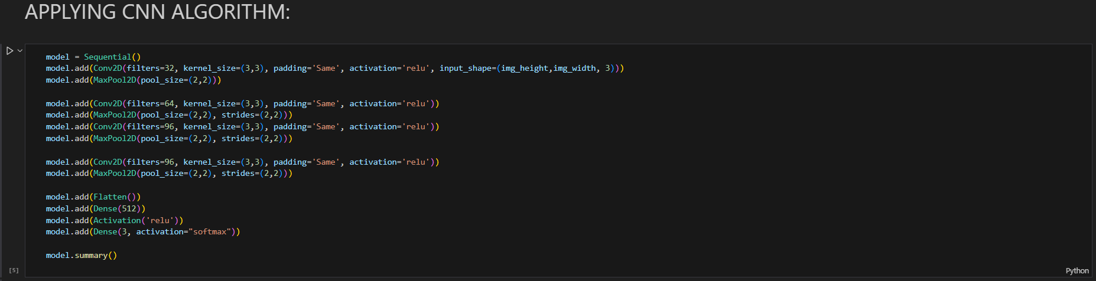
Design and Implementation for second objective
Applying CNN Algorithm

Slide 19
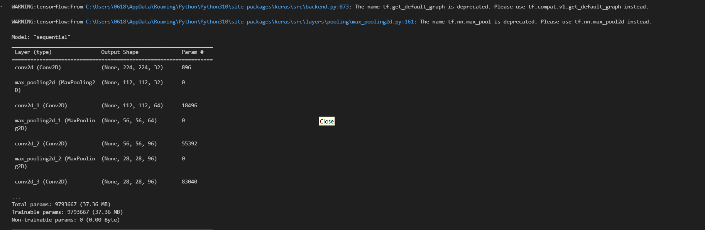
Design and Implementation for second objective
Applying CNN Algorithm

Slide 20
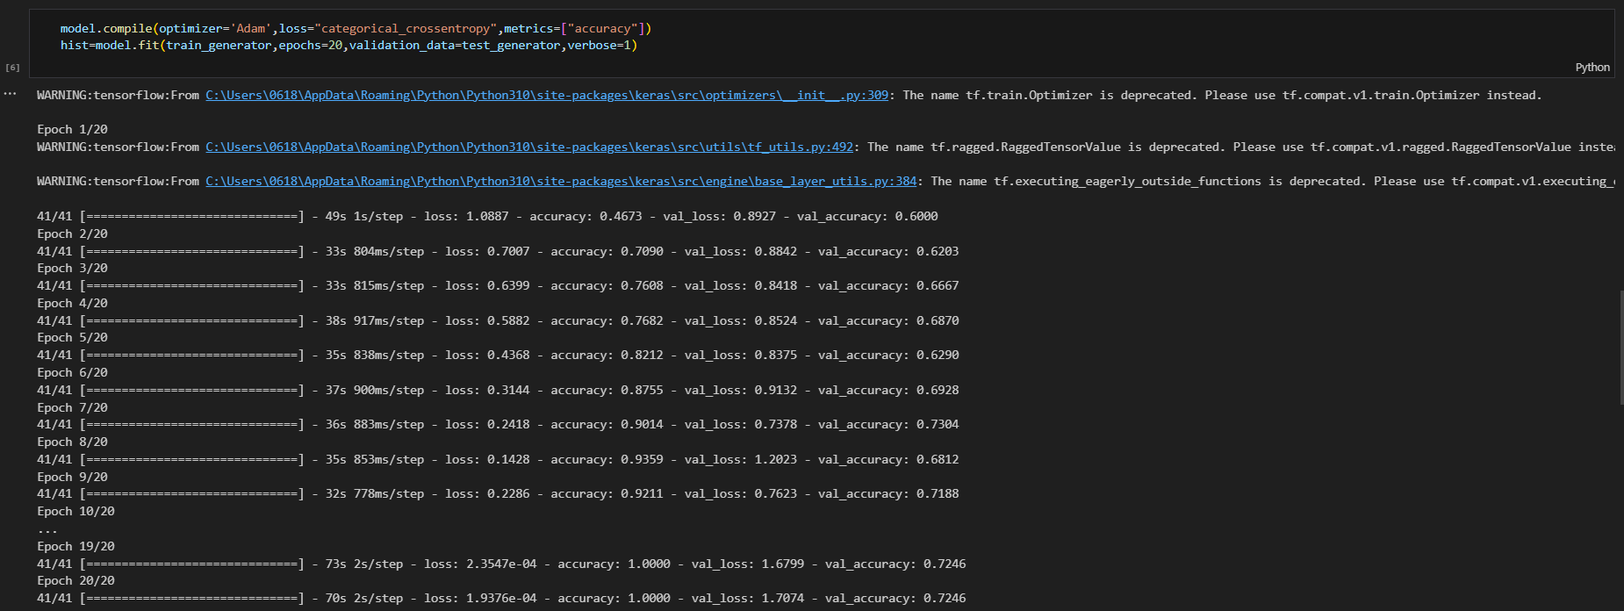
Design and Implementation for second objective
Applying CNN Algorithm

Slide 21

Design and Implementation for second objective
Graphs

Slide 22
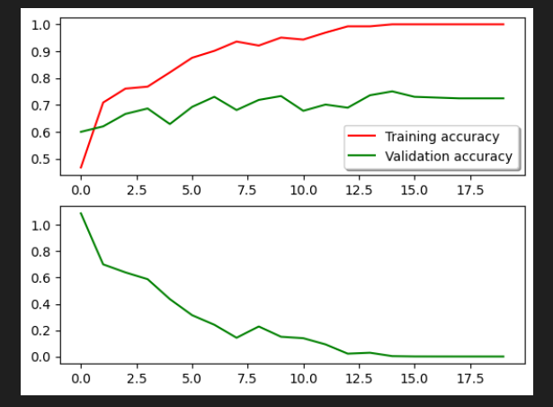
Design and Implementation for second objective
Graphs

Slide 23
Design and Implementation for second objective

Slide 24
Literature survey for second objective
s.no | Publisher/Journal | Title | Authors Name | Year of Publication | Summary of the paper
[2] | ICIC Express Letters | PLANT NUTRIENT DEFICIENCY USING DEEP CONVOLUTIONAL NEURAL NETWORKS. | 1.Lili Ayu Wulandhari 2.Alexander Agung Santoso Gunawan 3.Arie Qurania 4.Prihastuti Harsani 5.Triastinurmiatiningsih Ferdy Tarawan 6.Riska Fauzia Hermawan | 2019 | This paper proposes a deep convolutional neural network to diagnose condition based on image of plants. The experimental results show that fine tuning approach achieves the best accuracy, namely 96% and 86% for training and testing.
Algorithms | DataSets | Improvements
CNN model along with Inception-Resnet architecture | ImageNet Dataset | The model is re-trained using okra plant images data. A few experiments are conducted by changing the hyperparameter such as learning rate and epochs.
Additional Summary

Slide 25
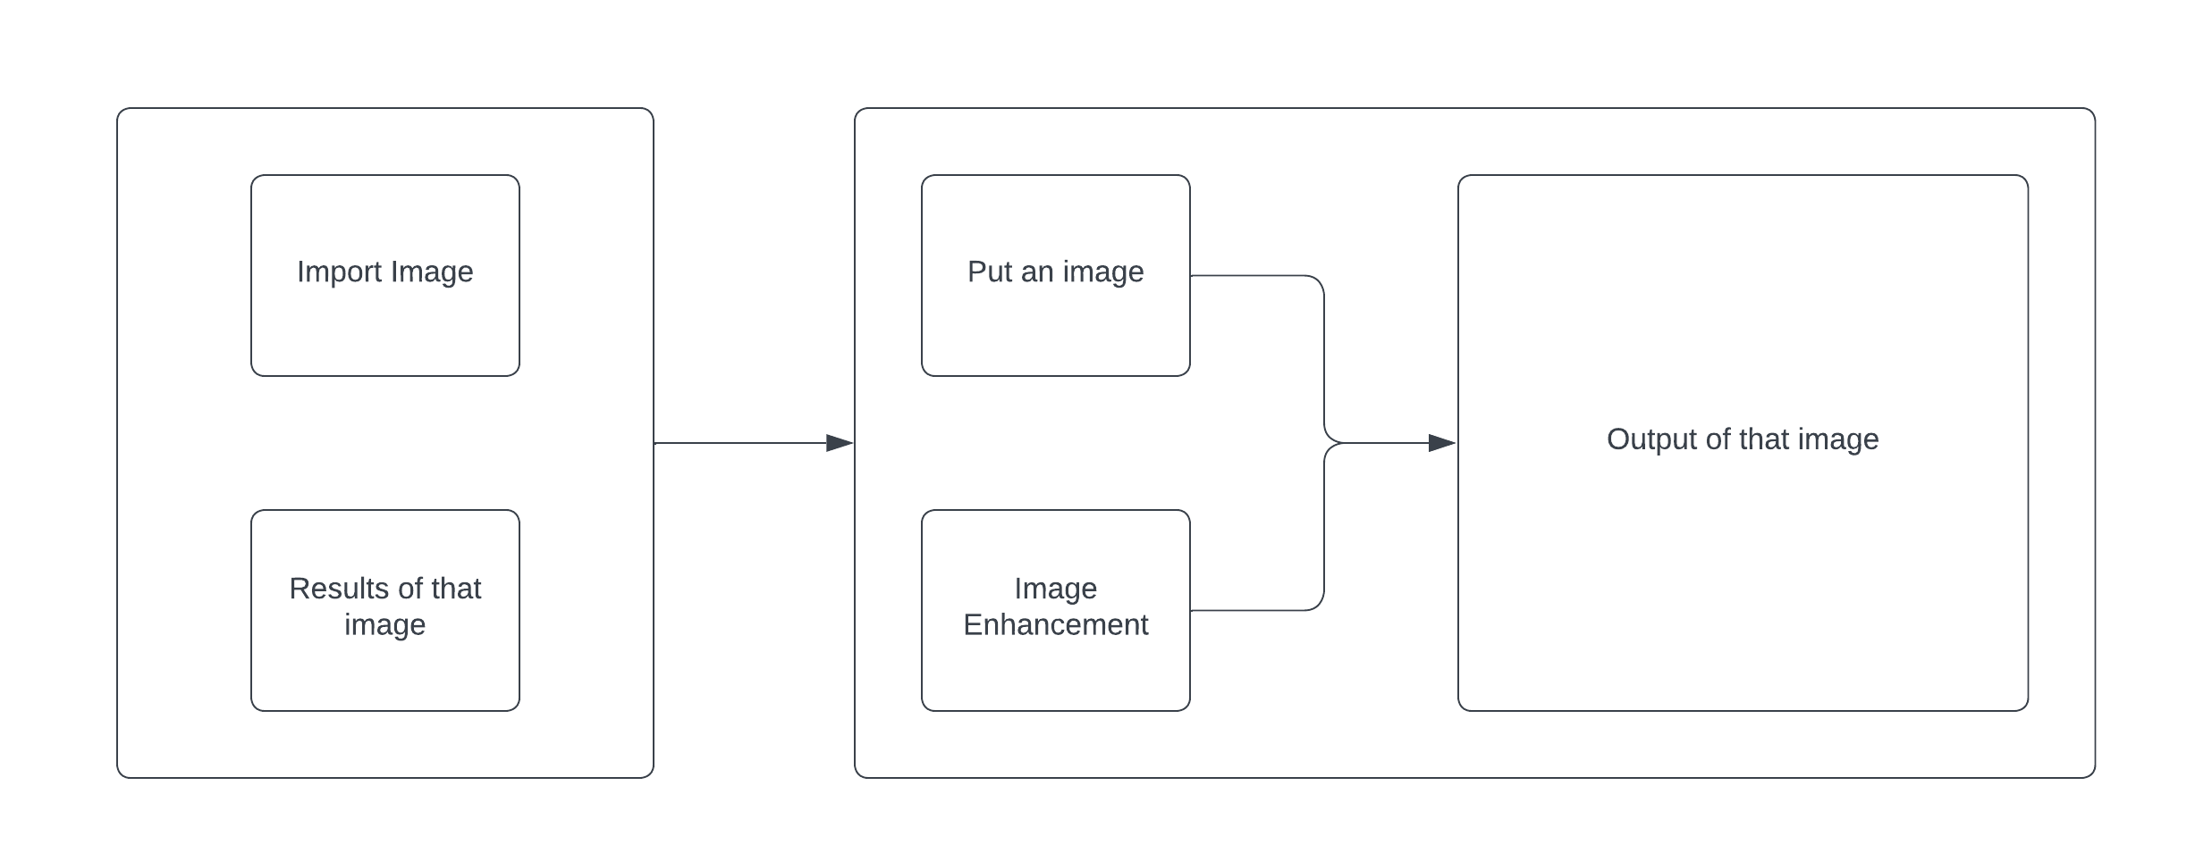
Design and Implementation for second objective
Fig 3 : GUI Interface

Slide 26
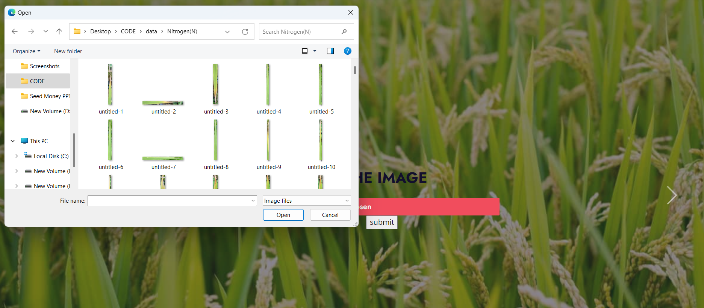
Design and Implementation for second objective

Slide 27
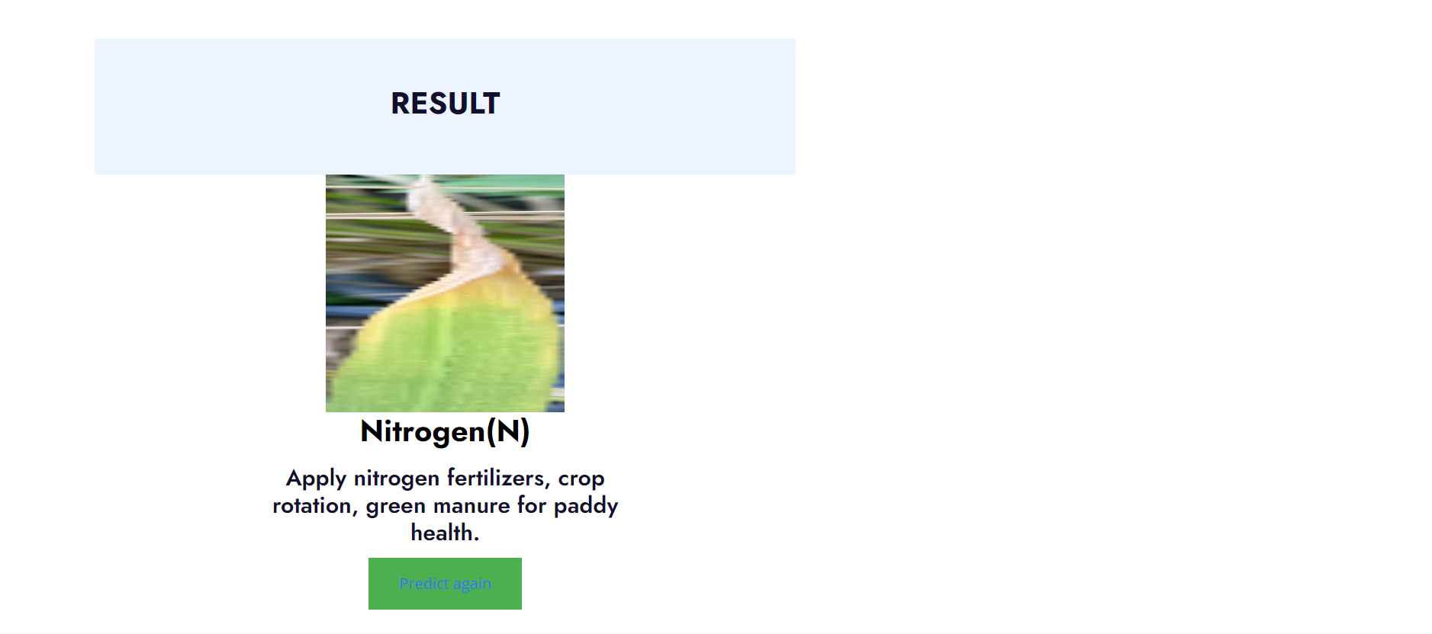
Design and Implementation for second objective

Slide 28
Literature survey
s.no | Publisher/Journal | Title | Authors Name | Year of Publication | Summary of the paper
[3] | Auckland University of Technology | The Comprehension Review on Detection of Macro Nutrients Deficiency in Plants based on the Image processing Technique. | 1.Lia Kamelia 2.Titik Khawa Binti Abdul Rahman 3.Hoga Saragih 4.Reni Haerani | 2020 | This paper discusses various methods used in the detection of nutrient deficiencies in plants based on visual images. This research will support the growth of agriculture automation equipment and system in more approaches
Algorithms | DataSets | Improvements
PSNR, MSE, RMSE | - | The image acquisition will use the smartphone camera to facilitate the farmers identifying the nutrient deficiency symptoms.
Additional Summary

Slide 29
Literature survey
s.no | Publisher/Journal | Title | Authors Name | Year of Publication | Summary of the paper
[4] | Total Environement Research themes | Protecting the environment from pollution through early detection of infections on crops using deep belief network in paddy. | 1.A. Pushpa AthisayaSakila Rani 2.N. Suresh Singh | 2022 | This study proposes an automatic classification system using artificial intelligence and image processing. The proposed work provide a specificity, precision, sensitivity, F1-score and accuracy of 97.1%, 97.6%, 96.2%, 96.8% and 98.1%.
Algorithms | DataSets | Improvements
AI & ML | Kaggle data set | Precise identification of reasons for infection allows farmers to use specific control methods with less toxic chemicals or through eco-friendly methods.
Additional Summary

Slide 30
Literature survey
s.no | Publisher/Journal | Title | Authors Name | Year of Publication | Summary of the paper
[5] | IEEECON | Identification of plant nutrient deficiencies using convolutional neural networks. | 1.Ukrit Watchareerutai 2.Pavit Noinongyao 3. Chaiwat Wattanapaiboonsuk 4. Puriwat Khantiviriya 5. Sutsawat Duangsrisai | 2018 | This study proposes a method divides an input leaf image into small blocks. The results indicate the superiority of the proposed method over trained humans in nutrient deficiency identification.
Algorithms | DataSets | Improvements
CNN, Machine Learning | A dataset consisting of 3000 leaf images was collected and used for experimentations. | Next step include but not limit to further analysis on the time factor. Other factors including nutrient mobility and leaf age etc which can affect the symptoms would also be considered to improve reliability of identification.
Additional Summary

Slide 31
Literature survey
s.no | Publisher/Journal | Title | Authors Name | Year of Publication | Summary of the paper
[6] | International Research Journal of Engineering and Technology (IRJET) | Detection of nutrient deficiencies in crops using support vector machines (SVM). | 1.Vijay J. Kadam 2. T. B. Mohite-Patil | 2022 | This study proposes to build a model to detect various types of deficiencies in the leaves. The proposed system presents an effective method for detecting using colour-texture analysis and k-means clustering
Algorithms | DataSets | Improvements
Colour-texture analysis, K-means clustering | - | Segmentation training and classification and finally identification. This project proposes a valuable approach which supports the accurate detection of nutrients which are deficient in the plant leaves.
Additional Summary

Slide 32
Proposed System
The proposed system aims to revolutionize nutrient deficiency detection in paddy crops by introducing an innovative approach leveraging neural networks, specifically convolutional neural networks (CNNs).
The system involves the analysis of images captured from paddy fields, enabling the automatic identification of subtle signs indicative of nutrient deficiencies.
The neural network is trained on a diverse dataset, allowing it to learn complex patterns associated with various nutrient deficiencies. The user-friendly interface facilitates seamless interaction, allowing farmers to upload images and receive instant reports on their crops' nutritional status. Unlike the existing system, the proposed approach offers a non-invasive, real-time, and accurate solution to nutrient deficiency monitoring

Slide 33
References
[1].Amritha T, Gokulalakshmi T, Umamaheshwari P, T Rajasekar M.Tech, “Machine Learning Based Nutrient Deficiency Detection in Crops”, International Journal of Recent Technology and Engineering (IJRTE), ISSN: 2277-3878, Volume-8 Issue-6, March 2020.
[2].Lili Ayu Wulandhari, Alexander Agung Santoso Gunawan, Arie Qurania, Prihastuti Harsani, Triastinurmiatiningsih Ferdy Tarawan, Riska Fauzia Hermawan, “PLANT NUTRIENT DEFICIENCY DETECTION USING DEEP CONVOLUTIONAL NEURAL NETWORK”, ICIC Express Letters Volume 13, Number 10, October 2019.
[3].Lia Kamelia, Titik Khawa Binti Abdul Rahman, Hoga Saragih, Reni Haerani, “The Comprehensive Review on Detection of Macro Nutrients Deficiency in Plants Based on The Image Processing Technique”, Auckland University of Technology, December 2020.

Slide 34
References (Contd…)
[4].A. Pushpa Athisaya Sakila Rani, N. Suresh Singh, “Protecting the environment from pollution through early detection of infections on crops using the deep belief network in paddy”, Total Environment Research Themes 3-4 (2022) 100020.
[5].Ukrit watchareeruetai, Pavit Noinongyao, Chaiwat Wattanapaiboonsuk,
Puriwat Khantiviriya, Sutswat Duangsrisai, “Identification of plant Nutrient
Deficiencies Using Convolutional Neural Networks”, IEECON 2018
[6].Mr. Vijay J. Kadam, Prof. Dr. T.B. Mohite-Patil, “DETECTION OF
NUTRIENT DEFICIENCIES IN CROPS USING SUPPORT VECTOR
MACHINE (SVM)”, International Research Journal of Engineering and
Technology (IRJET), Volume: 09 Issue: 08 | Aug 2022.

Slide 35

Git Hub Dashboards of each student
GitHub Link : 204G1A0520/CSE-2020-24-Batch-A16 (github.com)

Slide 36
Any Queries?

