Slide 1

An Android Application for Enhancing Agri-Tourism and Wetlands Conservation Through Farmer-Consumer Engagement
by
Gousiya P
Roll No. 204G1A0534
Anand B
Roll No. 204G1A0511
Manoj Reddy C
Roll No. 204G1A0554
Bramha Teja K
Roll No. 204G1A0524
Under the guidance of
Mrs. G. Nagaleela M.Tech
Assistant Professor
Department of Computer Science and Engineering
Srinivasa Ramanujan Institute of Technology
Autonomous
Rotarypuram Village, B K Samudram Mandal, Ananthapuramu – 515701.
2023-2024

Slide 2
Contents
An Android Application for Enhancing Agri-Tourism and Wetland Conservation Through Farmer-Consumer Engagement
Abstract
Introduction
Literature Survey
Existing System
Proposed System
Planning
Design
Implementation
Research Paper
References
Srinivasa Ramanujan Institute of Technology

Slide 3
Abstract
An Android Application for Enhancing Agri-Tourism and Wetland Conservation Through Farmer-Consumer Engagement
To improve agricultural wetlands conservation and development, a wide range of positive measures should be undertaken. Sustainable tourism in agricultural wetlands, when properly managed and developed, plays a major part in protecting wetlands and supporting those working in and around wetlands through jobs and increasing incomes. The system will communicate with the farmers to visit their fields and the user will gain the knowledge in crop science. The culture of the villages. Lack of capacity of receiving tourists, viewable product processing and valuable farm commodities, and well-educated practitioner are barriers to effective development of Agri-tourism in wetlands. In consideration of agricultural wetland characteristics, these barriers can be overcome with government rational plans, visit able plants and take-away commodities, and professional practitioners’ cultivation.
Keywords:Agri-Tourism, Wetlands Conservation, Sustainable Tourism, Agricultural Commodities, Android App, Knowledge exchange, Community Engagement.
Srinivasa Ramanujan Institute of Technology

Slide 4
Introduction
An Android Application for Enhancing Agri-Tourism and Wetland Conservation Through Farmer-Consumer Engagement
Wetlands are valuable because they clean the water, recharge water supplies, reduce flood risks, and provide fish and wildlife habitat.
In addition, wetlands provide recreational opportunities (such as hunting, fishing, and boating), aesthetic benefits, sites for research and education, and commercial fishery benefits.
With the rapid social development, tourism is widely recognized as among the world’s largest industries with strongest development momentum and largest scale in global economy.
Tourism is one of wetland values, next to water regulation, flood control, or climate mitigation. And, wetland tourism supports those working in and around wetlands, through job and income creation.
Moreover, Agri-tourist experience the idyllic countryside with the atmosphere of rusticity, silence and smells of farms and villages.
Srinivasa Ramanujan Institute of Technology

Slide 5
Literature survey
An Android Application for Enhancing Agri-Tourism and Wetland Conservation Through Farmer-Consumer Engagement
Karthik Dharamkar, Palve Gajanand[1] It can contribute to the overall income, cash flow and profitability of a farm by providing alternative income via farm products, and farming activities Presently, the urban population has been going for agri-tourism as a way of relief from the daily routine of big cities. For this reason, it is one of the most dynamic emerging markets in our country.
Nicole Vaugeois, Shannon Bence, Anna Romanova[2] paper is based on the trend, if recognized by farmers, could be used to create new revenue for agriculture through agri‐tourism. The purpose of this manual is to provide step by‐step guidance for farmers who are interested in engaging in agritourism. It presents a number of tools and strategies to design and create memorable farm‐based experiences that can attract and satisfy visitors. The guide also profiles numerous examples of agri‐tourism ventures to encourage innovation within the industry.
Srinivasa Ramanujan Institute of Technology

Slide 6
Literature survey
An Android Application for Enhancing Agri-Tourism and Wetland Conservation Through Farmer-Consumer Engagement
Yan Lui, Min Zhou[3] The paper is based on Lack of capacity of receiving tourists, viewable product processing and valuable farm commodities, and well-educated practitioner are barriers to effective development of agro-tourism in wetlands. In consideration of agricultural wetland characteristics, these barriers can be overcome with government rational plans, visit able plants and take-away commodities, and professional practitioners’ cultivation.
Lucian Ionel Cioca; Ramona Giurea; Ioan Achim Moise; Ilaria Precazzini; Marco Ragazzi; Elena Cristina Rada 2017 [4] A technological appliance that assures a good combustion process development together with a proper utilization and maintenance of the whole system assume a significant role. A correct attention to the entire process reduces therefore the emissions' dangerousness and improves the energy efficiency in exploiting the fuel's heat value
Srinivasa Ramanujan Institute of Technology

Slide 7
Literature survey
An Android Application for Enhancing Agri-Tourism and Wetland Conservation Through Farmer-Consumer Engagement
Chandra Sekhar [5]This paper also discussed about Agrotourism is an economic strategy aimed at assisting villagers in establishing alternative sources of income and preserving their cultures. Agrotourism integrates agricultural and touristic activities. he benefits of agro-tourism are widely acknowledged by both the urban and rural communities. However, there are some problems in the way these centres are developed. In order to overcome these issues, the government should support the efforts of the farmers in developing such centres.
Srinivasa Ramanujan Institute of Technology

Slide 8
Existing System
An Android Application for Enhancing Agri-Tourism and Wetland Conservation Through Farmer-Consumer Engagement
Now a days the people don’t know the science of crops, the system will explain the theoretical terms for the students. The farming growth is also reduced. The Existing system will be the user can view the details of the crops and the user have to search for that places that is not possible for the user.
Disadvantages:
Today most of people don’t know farmer.
The interested people also not able to connect with farmers.
The proper location of farmer is not able to find.
Srinivasa Ramanujan Institute of Technology

Slide 9
Proposed System
An Android Application for Enhancing Agri-Tourism and Wetland Conservation Through Farmer-Consumer Engagement
To resolve the issues in the previous system, we developed a new android application with significant improvements.
The proposed system contains the following facilities over the present system:
The proposed system the user will register and view framers crops and the details of farmer and book the slots to spend time with framer by providing the details of the date and no. of. persons and no. of. Days. The farmer is going to view that details and the farmer will accept or reject the booking.
Advantages:
It is inexpensive as the cost of food, accommodation, recreation and travel is least in the Agri-tourism due to occurrence in natural setting.
The urban population are developing interest in agriculture as they are having roots in villages which is making them curious to learn rural lifestyle.
Srinivasa Ramanujan Institute of Technology

Slide 10
Planning
An Android Application for Enhancing Agri-Tourism and Wetland Conservation Through Farmer-Consumer Engagement
Objective
The main objective of this project is to create a seamless and efficient Android App that facilitates the interaction between users and farmers.
Performance
Complaints will get solved accurately and reduces time consumption.
Srinivasa Ramanujan Institute of Technology

Slide 11
Planning
An Android Application for Enhancing Agri-Tourism and Wetland Conservation Through Farmer-Consumer Engagement
Functional Requirements
Admin: He will login with his email and password. He can add the farmers and view farmers.
Farmer: He will login with email and password. He will add the crop information and view the tourism people. He can view history of the crop information also.
User: He will register by providing some details after that the user can login with his email and password. The user view crop information and farmer details then he can book a slot with farmers and view the status and location of that farmers
Non-Functional Requirements
Security
Reliability
Usability
Portability
Srinivasa Ramanujan Institute of Technology

Slide 12
Planning
An Android Application for Enhancing Agri-Tourism and Wetland Conservation Through Farmer-Consumer Engagement
System Requirements:
Hardware Requirements:
RAM : 8GB
Hard Disk : 1TB
Processor: i3/Intel Processor
Software Requirements:
IDE : Android Studio
Plugin : Kotlin
SDK : Android
JDK : Java
OS : Windows 10
Database : My SQL/ PHP
Srinivasa Ramanujan Institute of Technology

Slide 13
Planning
An Android Application for Enhancing Agri-Tourism and Wetland Conservation Through Farmer-Consumer Engagement
Methodology
This project uses Agile methodology. In that we use scrum agile methodology.
Scrum is characterized by cycles or stages of development, known as sprints.
It has four stages: Planning, Implementation, Testing and review.
Advantages:
This Methodology has ability to change and adapt with and satisfy the changing needs in short term.
Requires less documentation.
Srinivasa Ramanujan Institute of Technology

Slide 14
Planning
An Android Application for Enhancing Agri-Tourism and Wetland Conservation Through Farmer-Consumer Engagement
Admin Modules:
Dashboard
Add Farmers
View Farmers
View User
Logout
Srinivasa Ramanujan Institute of Technology

Slide 15
Planning
An Android Application for Enhancing Agri-Tourism and Wetland Conservation Through Farmer-Consumer Engagement
User Modules 1.Login 2.Dashboard
Search Places
View Crop info and
Farmer info
Add Booking
History
Logout
Srinivasa Ramanujan Institute of Technology

Slide 16
Planning
An Android Application for Enhancing Agri-Tourism and Wetland Conservation Through Farmer-Consumer Engagement
Farmer modules 1.Login 2.Dashboard
Add Crops
View Crops
View request
Update Status
Logout
Srinivasa Ramanujan Institute of Technology

Slide 17
Planning
An Android Application for Enhancing Agri-Tourism and Wetland Conservation Through Farmer-Consumer Engagement
Work Schedule
S.No | Development Stage | Duration
1. | Domain and Title | 1 week
2. | Literature Survey | 2 weeks
3. | Planning | 1 week
4. | Design | 1 week
5. | Requirements Gathering | 1 week
6. | Testing | 3 weeks
7. | Implementation | 4 weeks
Srinivasa Ramanujan Institute of Technology

Slide 18
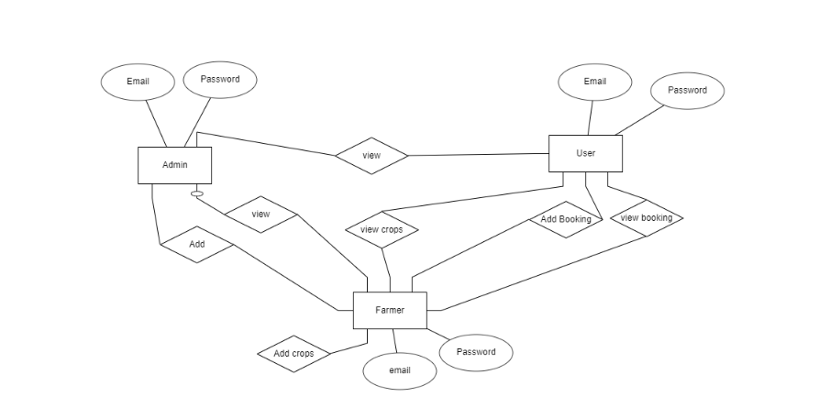
Design - ER Diagram
An Android Application for Enhancing Agri-Tourism and Wetland Conservation Through Farmer-Consumer Engagement
The ER diagram was created to help grasp the entire scenario. It was used to conceive the phenomena, actions, and interactions between numerous entities, as well as to arrive at the precise requirements in a complete manner.
Srinivasa Ramanujan Institute of Technology

Slide 19
An Android Application for Enhancing Agri-Tourism and Wetland Conservation Through Farmer-Consumer Engagement
Design - Use Case Diagram
Srinivasa Ramanujan Institute of Technology

Slide 20
Design - Activity Diagram
An Android Application for Enhancing Agri-Tourism and Wetland Conservation Through Farmer-Consumer Engagement
Srinivasa Ramanujan Institute of Technology

Slide 21
Design - Sequence Diagram
An Android Application for Enhancing Agri-Tourism and Wetland Conservation Through Farmer-Consumer Engagement
Srinivasa Ramanujan Institute of Technology

Slide 22
An Android Application for Enhancing Agri-Tourism and Wetland Conservation Through Farmer-Consumer Engagement
Design - System Architecture
Search Places
View Crop info and farmer info
Add Booking
History
Register
User
Add Farmers
View Farmers
View user
Data base
Login
Admin
Farmer
Add Crops
View crops
View request
Update status
Srinivasa Ramanujan Institute of Technology

Slide 23
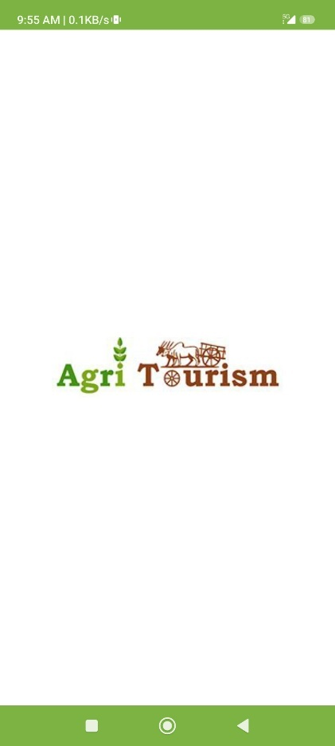
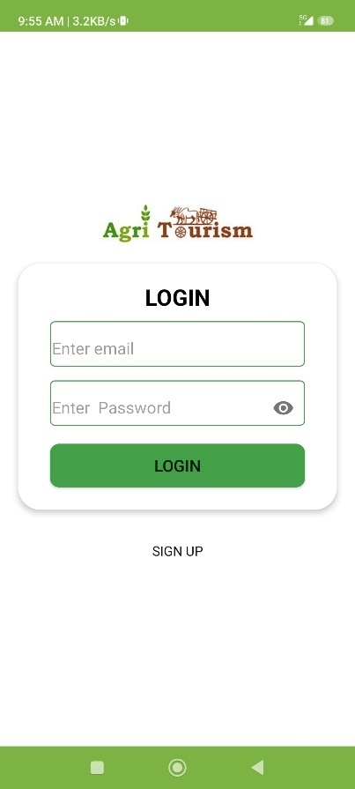
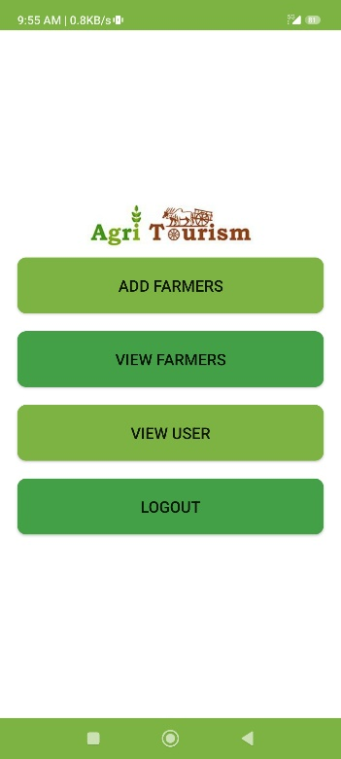
An Android Application for Enhancing Agri-Tourism and Wetland Conservation Through Farmer-Consumer Engagement
Implementation
Output Screens:
Srinivasa Ramanujan Institute of Technology

Slide 24
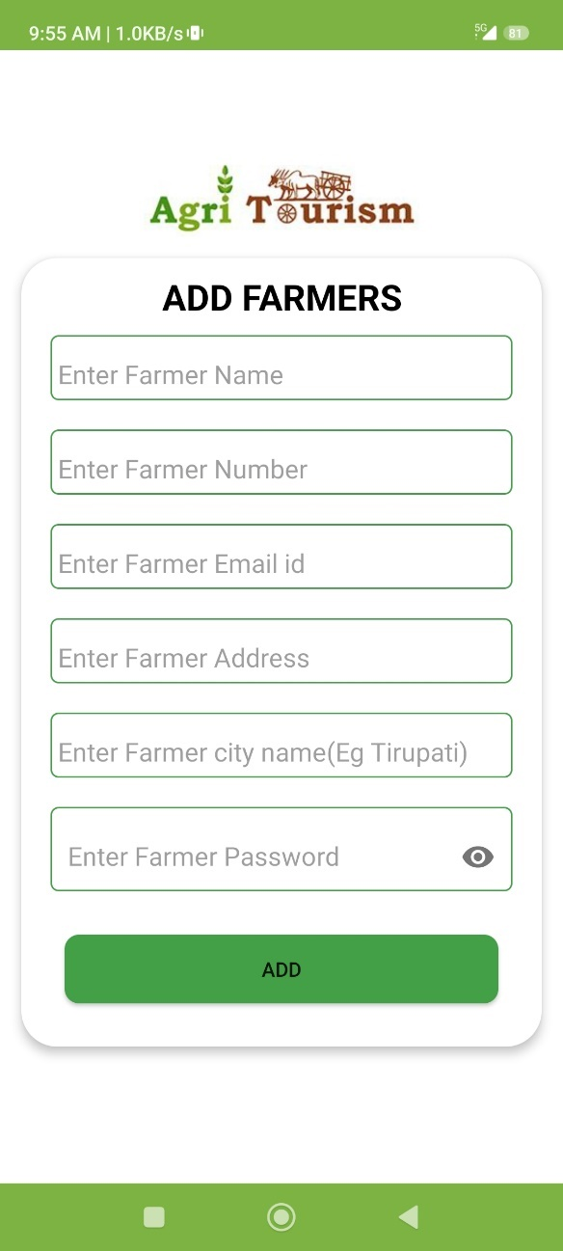
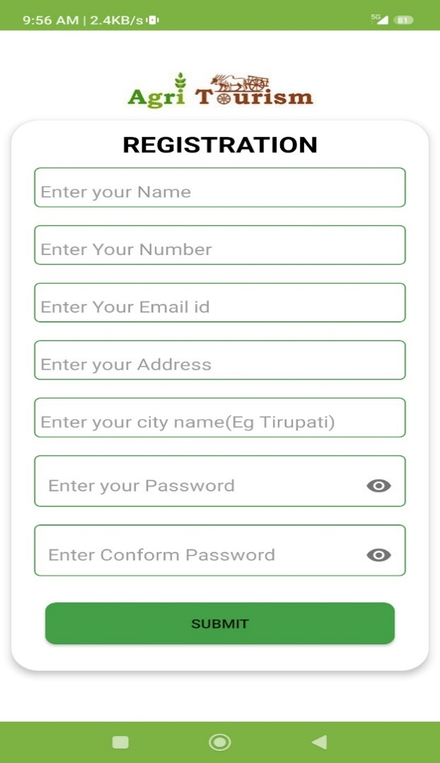
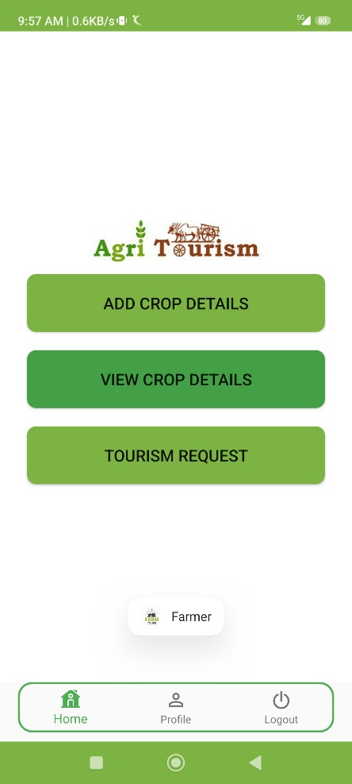
Implementation
An Android Application for Enhancing Agri-Tourism and Wetland Conservation Through Farmer-Consumer Engagement
Srinivasa Ramanujan Institute of Technology

Slide 25
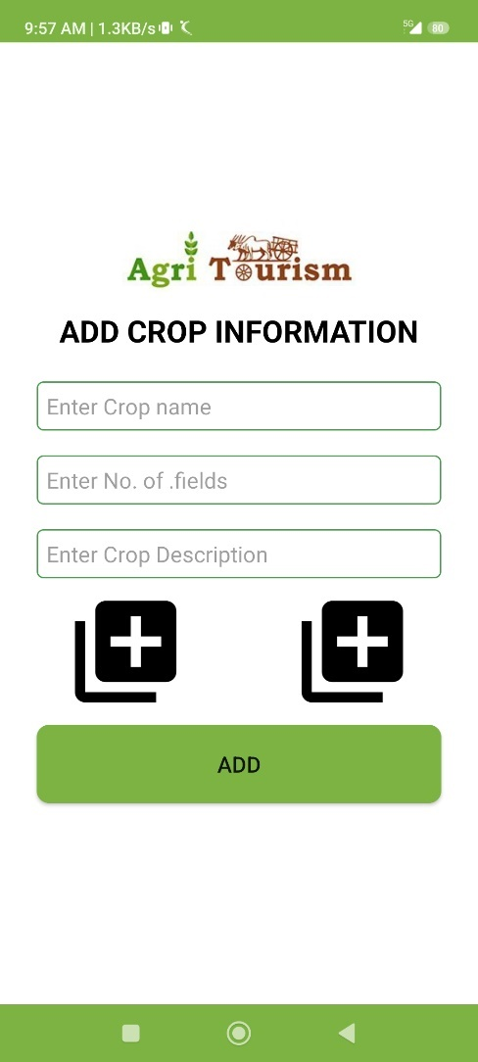
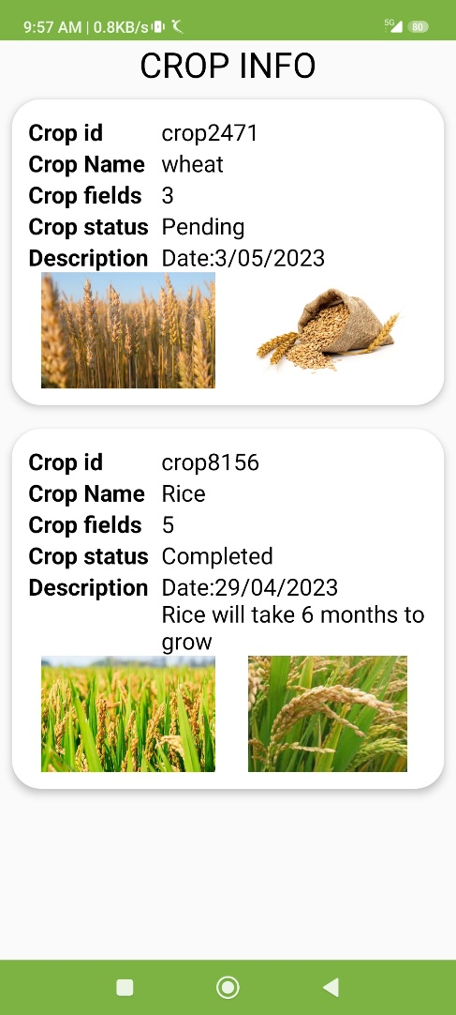
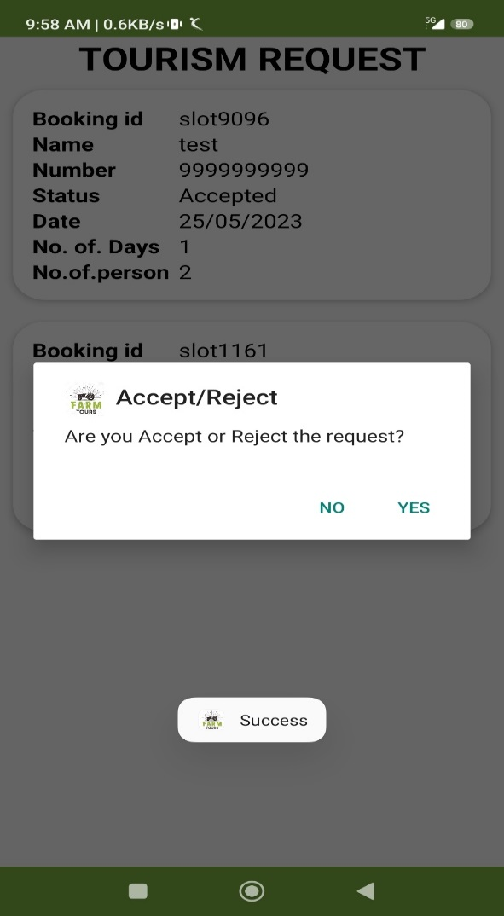
Implementation
An Android Application for Enhancing Agri-Tourism and Wetland Conservation Through Farmer-Consumer Engagement
Srinivasa Ramanujan Institute of Technology

Slide 26
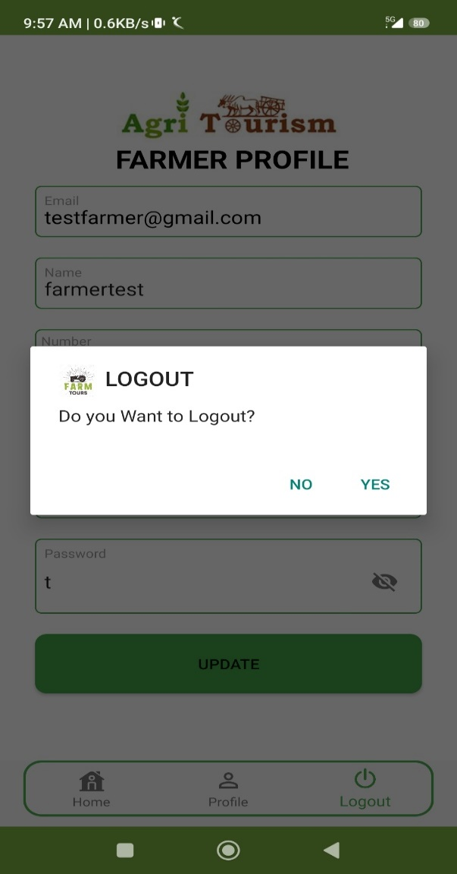
Implementation
An Android Application for Enhancing Agri-Tourism and Wetland Conservation Through Farmer-Consumer Engagement
Srinivasa Ramanujan Institute of Technology

Slide 27
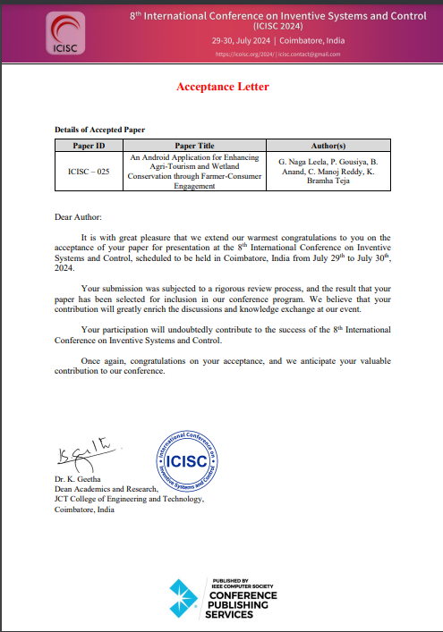
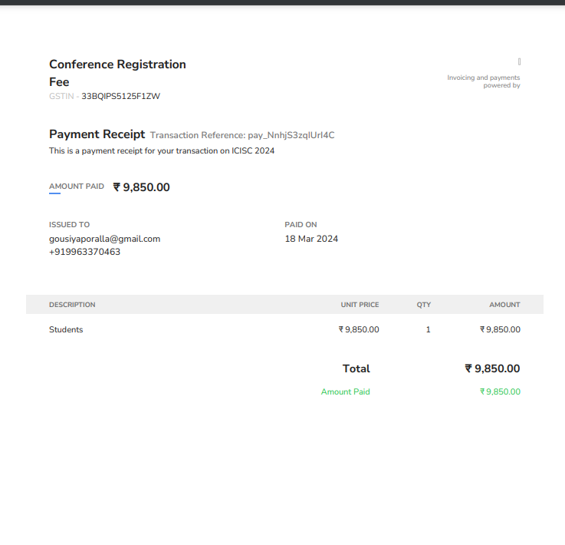
An Android Application for Enhancing Agri-Tourism and Wetland Conservation Through Farmer-Consumer Engagement
Research Paper
Research Paper
Srinivasa Ramanujan Institute of Technology

Slide 28
References
An Android Application for Enhancing Agri-Tourism and Wetland Conservation Through Farmer-Consumer Engagement
[1]. Karthik Dharamkar,Palve Gajanand,"Agritourism",2017
[2]. Nicole Vaugeois,Shannon Bence,Anna Romanova,"Farm Diversification Through Agri-tourism",2018
[3]. Yan Liu; Min Zhou,"Agro-tourism in Wetlands",2013
[4]. Lucian Ionel Cioca; Ramona Giurea; Ioan Achim Moise; Ilaria Precazzini; Marco Ragazzi; Elena Cristina Rada,"Local environmental impact of wood combustion in agro-tourism structures",2017
[5]. chadda.D,Bhakare.S, Socio-economic implications of agri-tourism in India,2011.
Srinivasa Ramanujan Institute of Technology

Slide 29
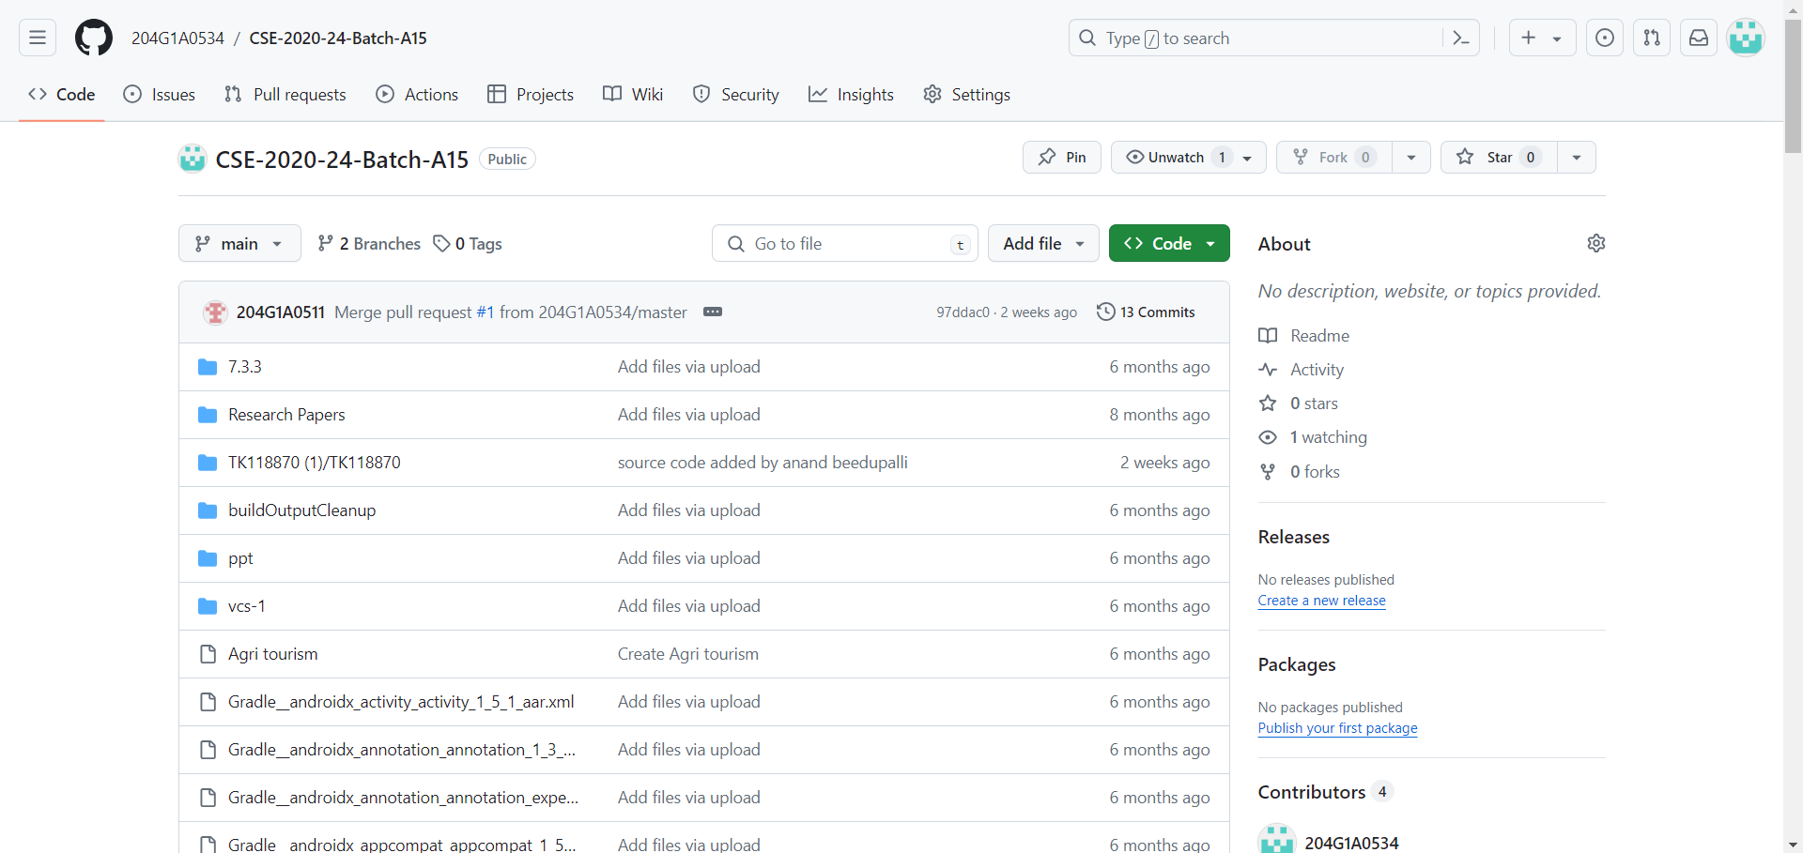
Git Hub DashBoard
An Android Application for Enhancing Agri-Tourism and Wetland Conservation Through Farmer-Consumer Engagement
Srinivasa Ramanujan Institute of Technology

Slide 30
Git Hub Link
An Android Application for Enhancing Agri-Tourism and Wetland Conservation Through Farmer-Consumer Engagement
https://github.com/204G1A0534/CSE-2020-24-Batch-A15.git
Srinivasa Ramanujan Institute of Technology

Slide 31
An Android Application for Enhancing Agri-Tourism and Wetland Conservation Through Farmer-Consumer Engagement
Thank You!!!
Srinivasa Ramanujan Institute of Technology

