Slide 1

Tactile Navigation Support for Blind Individuals
by
M. Joshika
Roll No. 204G1A0545
H. Arshia Parveen
Roll No. 204G1A0515
K. Hemanth Reddy
Roll No. 214G5A0506
G. Akshaya
Roll No. 214G5A0501
Under the guidance of
Dr. B. HariChandana M.Tech.Ph.D
Associate Professor
Department of Computer Science and Engineering
Srinivasa Ramanujan Institute of Technology
(Autonomous)
2023 - 2024

Slide 2

Contents
Abstract
Problem statement
Objectives of Project
Literature survey for first objective
Literature survey for second objective
Proposed Work -(Methods to be followed for proposed system)
References
GitHub Link
Queries

Slide 3
Abstract
Sighted individuals possess the ability to navigate their surroundings with ease and utilize their visual facility to promptly identify potential hazards. Conversely, individuals who are visually impaired are unable to perceive the external environment, traverse independently, or discern danger. Moreover, they may occasionally feel distressed and wish to notify their family or friends of their location via text. So, the primary challenge faced by visually impaired individuals is their reliance on others, as even their closest relatives may not always be able to provide adequate care. To address this issue, a "Smart Stick" would be developed utilizing the "Internet of Things". Using a variety of sensors, including ultrasonic, soil moisture, RF, and GSM modules, the Smart Stick empowers blind people to be independent and gives them a sense of normalcy.
Keywords: Smart Stick, User Notification Setup, Location.

Slide 4
Problem Statement
Blind persons always struggle with their daily tasks since they are unable to see even a single thing.
When using a standard blind stick, blind persons have trouble recognizing stairs and obstacles surrounded by them.
By making the use of smart blind stick, we can hear alert noises to identify stairs and obstacles.

Slide 5
Objectives of Project
Research Objective-1:To develop a model that will enable blind persons to navigate both familiar and unfamiliar places without the use of guides.
Research Objective-2:To create a user-friendly interface that makes use of tactile feedback and sensations that are simple for blind users to grasp and interpret, enabling them to make independent.

Slide 6
Literature survey for first objective
This paper outlines the creation of a walking stick for a person who is vision impaired utilizing an ultrasonic sensor. The blind person is alerted by a buzzer, and obstructions in their path are detected by the HC-SR04 ultrasonic sensor module. The main component in this system is the PIC microcontroller 16F877A. The blind can travel safely with the aid of this walking stick. It is capable of detecting obstructions between 5 and 35 cm away. However, this technology was unable to identify stairs and damp surfaces.[1]

Slide 7
Literature survey for second objective
The authors of this study also presented a novel walking assistance for the blind that enables blind people to travel. Along with object and water sensors, the blind stick also has an ultrasonic sensor and voice module. The sensor sends information to the Arduino UNO while detecting impediments. The Arduino UNO decides whether the obstruction is close enough after processing the data. If the barrier is not closing the circuit, nothing will happen. If the obstruction is nearby, the Arduino UNO will send out a voice alarm. However, this system only provides a single voice notification when it detects movement of the barrier at a distance of 50 cm.[2]

Slide 8
Contd…
This paper outlines about GPS, which is a satellite navigation system used to determine the ground position of an object when GSM modem receiver message microcontroller will process the message which is saved in it. Then, it will get the location of stick from the GPS modem and transmit the location to GSM modem to sender. GPS will update the location of stick and automatically save the location in Microcontroller.[3]

Slide 9
Proposed System
The proposed system is capable of detecting the surroundings for various barriers of different sizes and producing the required auditory using the buzzer. When damp surfaces are detected, it might alert the user by vibratory sounds and also enable to send SMS based on the user's location in an emergency or when they are having trouble. When the stick is misplace, the user can find the stick by using an RF remote control.

Slide 10
References
[1]. Naiwrita Dey, Ankita Paul, Pritha Ghosh, Chandrama Mukherjee, Rahul De,
Rahul De, “Ultrasonic Sensor Based Smart Blind Stick”, International
Conference on Current Trends toward Converging Technologies,
Coimbatore, India, 978-1-5386-3702-9/18 2018.
[2]. Md.Adil, TaiyabaShadaka Rafa, Jannatul Ferdoush, Abir Mahmud, Abhijit
Pathak,” An IoT based Voice Controlled Blind Stick to Guide Blind People”,
International Journal of Engineering Inventions, Volume 9, Issue 1
[Jan 2020].
[3]. Somnath koley, Ravi Mishra, ”Voice operated outdoor navigation system for
visually impaired persons”, International Journal of Engineering Trends and
Technology- Volume3Issue2- 2012.

Slide 11
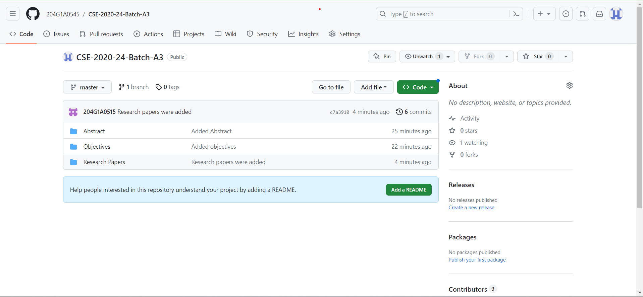
Git Hub Dashboards of each student
Git Hub Link : https://github.com/204G1A0545/CSE-2020-24-Batch-A3.git

Slide 12
Any Queries?

