Slide 1

IPL Match Winning Analysis With Player Stats
by
S . Mohammad Faraz
Roll No. 204G1A0558
G . Mounesh
Roll No. 204G1A0560
H. Bhagya Lakshmi
Roll No. 204G1A0519
C. Ganesh Kumar Reddy
Roll No. 204g1A0531
Under the guidance of
Mrs. P. Rohini M .Tech.
Assistant Professor
Department of Computer Science and Engineering
Srinivasa Ramanujan Institute of Technology
( Autonomus)
2023 - 2024

Slide 2

Contents
Review-0 Comments
Abstract
Problem statement
Objectives of Project
Literature survey for first objective
Objective-1(Design & Implementation
Literature survey for second objective
Objective-2 (Design & Implementation)
Proposed Work -(Methods to be followed for proposed system)
References
GitHub Link
Queries

Slide 3
Review 0 Comments
Work on the title of the project and have an idea on whether it is a prediction or analysis that is performing on the IPL match winning.
Collect more literature papers and do more literature survey on the project after analyzing on the proposed system mentioned.
Maintain clear objective.

Slide 4
Abstract
The Indian Premier League (IPL), a globally acclaimed Twenty20 cricket tournament, the Project research examines the impact of player statistics on IPL match outcomes. We explore how metrics like batting averages, bowling economy rates, and fielding skills influence team victories. Using data analysis and machine learning, we find a strong connection between specific player stats and match results, enabling real-time predictions. These findings provide valuable insights for teams and fans, fostering data-driven strategies and deeper game appreciation while upholding ethical cricket analytics principles.

Slide 5
Problem Statement
Investigate the relationship between player form and their historical performances in IPL matches, and develop a model to predict which players are likely to have the most impact in a given match.
Develop a machine learning model that predicts the outcome of IPL matches with a focus on ground-specific statistics, including historical team performance at different venues.

Slide 6
Objectives of Project
Assess Statistical Relationships: Analyze the statistical relationships between player and venue-specific data to accurately predict the outcomes of IPL matches
Develop a Holistic Model: Create an integrated model that combines historical player and venue statistics to provide a comprehensive understanding of the factors influencing IPL match outcomes
Contribute to Sports Analytics: To conduct a comprehensive research study that combines historical player and venue-specific statistics to develop an advanced predictive model for IPL match-winning analysis, with the aim of enhancing the understanding of how player performance and venue characteristics collectively influence match outcome.

Slide 7
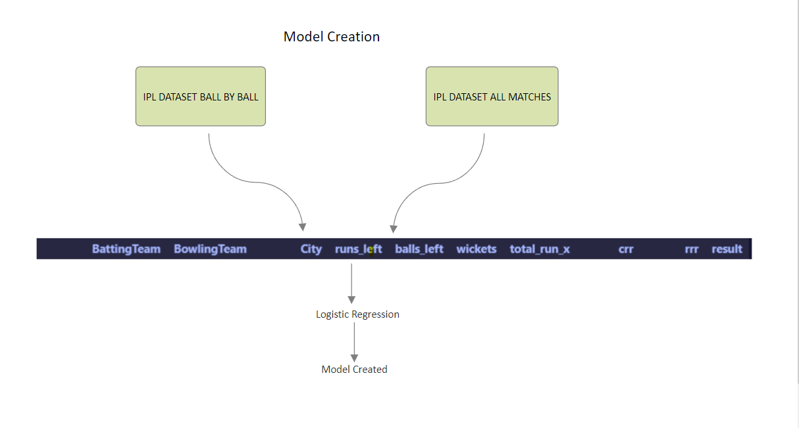
Design and implementation of first objective

Slide 8
Continued…
The technologies we used in the project are:
Python
PyCharm IDE
Visual Studio Code IDE
Streamlit Module
Pickle
Pandas
matplotlib

Slide 9
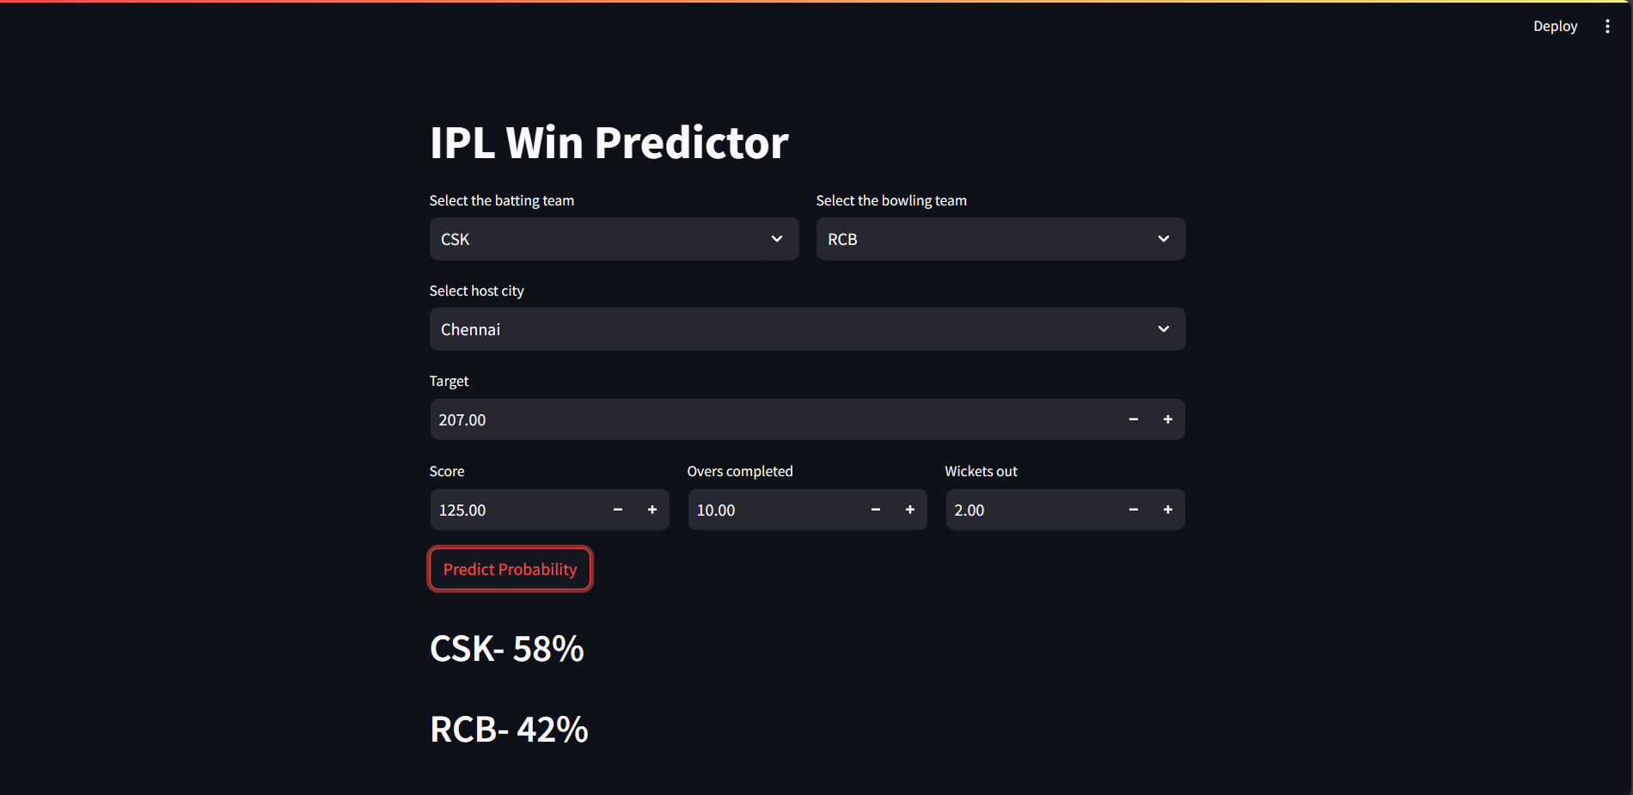
Continued…

Slide 10
Literature survey for first objective
[1] Kansal et al. , predicted player evaluation in IPL based on the 2008-2019 datasets using Data Mining Technique. Data mining algorithms are used which gives evaluation using player statistics assessing a player's performance, predicted about how to select a player in the IPL, based on every player’s performance history using algorithms like decision tree, Naïve Bayes.
[1]Agrawal et al. , used Support Vector Machine (SVM) and Naïve Baiyes classifiers with accuracies of 95.96%, 97.97% and 98.98% respectively, to predict the probability of the winner of the matches.

Slide 11
Design and implementation of second objective
Here we take the points of the batsman who is in the strike and also the strike bowler so that the win probability and the analysis will keep on changing depending upon the batsman and the bowler.
Now depending upon the points given to the batsman and the bowler our probability keeps on changing which helps us in keeping the cricket analysis interesting.
We can implement by taking the playing XI of the both teams and giving them the points in the CSV file so that which makes the easier probability much closer to the real life situation.
With the introduction of the players stats the user can have interactive real life probability of the match who might win the watch.

Slide 12
Literature survey for second objective
[2] Kaluarachchi et al. , predicted match outcome using home ground, time of the match, match type, winning the toss and then batting first by using Naïve Bayes classifier To possess, the ability to rank players well, using the novel ranking approach and another one which is done using advanced techniques. It also possesses the feature to predict the outcome of a match, based on the players who are part of the current playing 11.
[2] Wright , predicted the possible fixture for a cricket match based on the various venue, teams, number of holidays between each match in a fair and efficient manner.

Slide 13
Proposed System
The proposed system explains about the fervent fan engagement that by Allocating rating to players commensurate with their performance by the player stats , by using Random Forest regression classification, Decision tree classification and SVM(Support-Vector Machine) Classification either of them in order to built up the optimal accuracy compare to existing Projects and also to grab the attraction of users.
We are introducing the “Player Points ” , ”Venue Stats” in order to develop the fluctuations in the prediction percentage based on the player in the crease and how capable of finish it of the game

Slide 14
References
[1]Haseeb Ahmad, Ali Daud, Licheng Wang, Haibo Hong, Hussain Dawood and Yixian Yang, Prediction of Rising Stars in the Game of Cricket, IEEE Access, Volume 5, PP. 4104 – 4124, 14 March 2017
[1]Prince Kansal, Pankaj Kumar, Himanshu Arya, Aditya Methaila, Player valuation in Indian premier league using data mining technique, International Conference on Contemporary Computing and Informatics (IC3I), 27-29 Nov 2014,
[2] Amal Kaluarachchi, S. Varde Aparna, CricAI: A classification-based tool to predict the outcome in ODI cricket, 2010 Fifth International Conference on Information and Automation for Sustainability, 17-19 Dec. 2010.

Slide 15
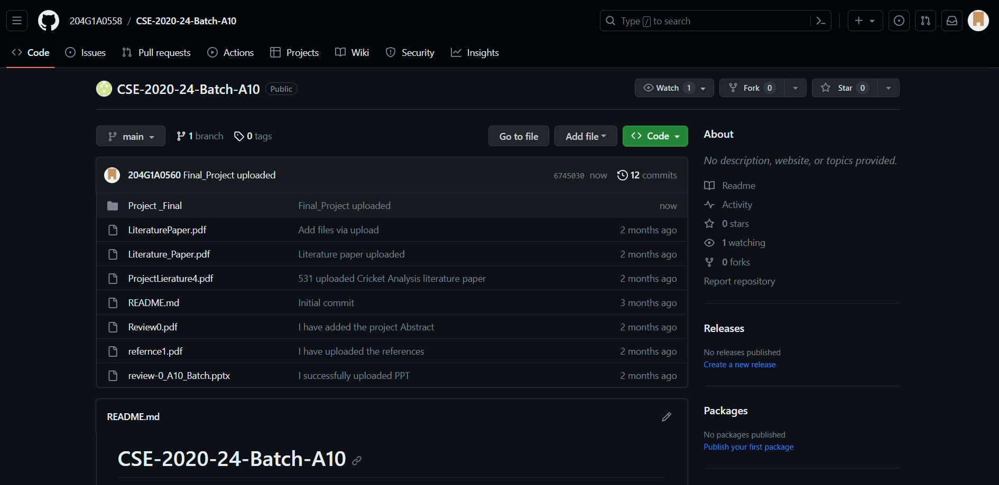
Git Hub Dashboards of each student
https://github.com/204G1A0558/CSE-2020-24-Batch-A10.git

Slide 16
Any Queries?

