Slide 1

Multilingual Sentiment Analysis on Product Reviews and Recommendations
by
Mastan Vali S
Roll No. 204G1A0555
Abhiram D
Roll No. 204G1A0502
Annapurna A
Roll No. 204G1A0513
Amrutha G
Roll No. 204G1A0510
Under the guidance of
Mrs. M. Soumya M.Tech, (Ph.D)
Assistant Professor
Department of Computer Science and Engineering
Srinivasa Ramanujan Institute of Technology
Autonomous
Rotarypuram Village, B K Samudram Mandal, Ananthapuramu – 515701.
2023-2024

Slide 2

Contents
Abstract
Introduction
Literature Survey
Existing System
Proposed System
Planning
Design
Implementation
Research Paper
References

Slide 3
Abstract
In the global e-commerce landscape, navigating the tapestry of multilingual product reviews requires accurate sentiment analysis beyond mere translation. Our novel system empowers businesses to understand customer emotions across diverse languages (Telugu, Hindi, and English) using deep learning-powered sentiment analysis. Our system leverages Convolutional Neural Networks (CNNs) and Recurrent Neural Networks (RNNs) to capture the nuances of each language, achieving an average accuracy of 85% for sentiment classification, far exceeding surface-level interpretations. This rich understanding informs a sophisticated recommendation engine that suggests products based on individual preferences and the emotional context expressed in reviews. Our unique feature, sentiment-aware filtering, prioritizes recommendations with overwhelmingly positive reviews in the user's native language, fostering trust and engagement. Our system demonstrably: (1) accurately classifies sentiment in multiple languages with 85% accuracy, (2) personalizes product recommendations based on sentiment insights, and (3) proactively addresses negative feedback through sentiment-aware filtering. By bridging the gap between sentiment analysis and personalized recommendations, our system paves the way for deeper customer engagement, personalized online experiences, and ultimately, enhanced business success in the multilingual e-commerce sphere, potentially revolutionizing how businesses interact with their global customers.
Keywords: Multilingual sentiment analysis, E-commerce personalization, Recommendation systems, Deep learning, Global e-commerce, Product reviews, CNN, RNN, NLP.

Slide 4
Introduction
In the busy online marketplace, people from the different languages share their thoughts and feelings in reviews. We've created a special system that uses advanced technology to understand not just "what" customer’s feel but also "why."
Our system promises a personalized experience, enhancing customer engagement, and bringing success to businesses in the global e-commerce market.
Our system dives deep into the emotions, achieving over 85% accuracy in understanding sentiments in Telugu, Hindi, and English. Our technology, uses Convolutional Neural Networks (CNNs) and Recurrent Neural Networks (RNNs) to capture the subtleties of each language, uncovering hidden emotions.
Our project aspires to redefine the very essence of personalized recommendations in the multilingual e-commerce landscape, forging deeper connections between businesses and their global customers.
Beyond sentiment analysis, our project pioneers a revolutionary recommendation engine, one that goes beyond the conventional boundaries of personalized product suggestions.

Slide 5
Literature survey
Wu Guanchen, Minkyu Kim, Hoekyung Jung[1], have propose a personalized recommendation system that takes into account both user purchase criteria and sentiment analysis of product reviews. The authors likely propose a recommendation system that incorporates user-specific preferences and sentiments expressed in product reviews to generate personalized recommendations. The system may leverage machine learning or collaborative filtering techniques to model user preferences and product sentiments. It presents experimental results demonstrating the effectiveness of the proposed recommendation system in providing personalized recommendations.
Wang, H., Zhao, M., & Tang, Y[2], have clearly explained about a hybrid personalized recommendation system that leverages both user demographics and item attributes to provide tailored recommendations. The system may utilize collaborative filtering techniques, content-based filtering, or hybrid approaches to generate personalized recommendations. It potentially introduces a novel method that enhances recommendation accuracy and relevance by integrating diverse sources of information.

Slide 6
Literature survey
Li, X., Wu, X., & Zhang[3], enhance collaborative filtering-based personalized recommendation systems by incorporating emotion-aware content analysis. The system may use collaborative filtering to model user-item interactions and generate initial recommendations, and then incorporate emotion-aware content analysis to refine these recommendations based on the emotional content of items. Emotion-aware content analysis could involve sentiment analysis or emotion recognition techniques to understand the emotional impact of items on users.
Cambria, E., Mareteans, A., Fabbri, P., & Santana, R[4], introduces SenticNet 3, a tool designed for lexical semantics that operates across multiple languages. It builds upon previous versions of SenticNet to provide enhanced capabilities in understanding the meaning of words and concepts. SenticNet 3 may utilize machine learning techniques and natural language processing algorithms to extract semantic information from ConceptNet and construct a resource for lexical semantics.

Slide 7
Literature survey
Prof. Annapoorna B R, Akhil Rautela, Anurag Verma[5], aims to propose a hybrid deep learning model for multilingual sentiment analysis, focusing on analyzing sentiment in textual data written in multiple languages. The model is likely to leverage techniques such as Recurrent Neural Networks (RNNs), Convolutional Neural Networks (CNNs), or Transformer-based architectures. It may include comparisons with baseline models or existing state-of-the-art approaches to showcase the superiority of the proposed method. The findings of the paper may have implications for various applications, including social media monitoring, customer feedback analysis, and opinion mining in diverse linguistic contexts.

Slide 8
Existing System
Existing sentiment analysis systems employ lexicon-based, machine learning, or hybrid approaches to analyze text sentiment. Lexicon-based methods use sentiment dictionaries, while machine learning models like SVM and CNNs learn from labeled data. Product recommendation systems, on the other hand, utilize collaborative filtering, content-based filtering, or hybrid techniques to suggest items to users based on preferences and item attributes. Despite advancements, challenges remain in handling multilingual data and providing personalized recommendations, motivating the development of a multilingual sentiment analysis and recommendation system in your project.
Disadvantages of Existing System:
Difficulty capturing sarcasm, irony, and context-specific sentiments.
Costly and time-consuming acquisition of labeled training data.
Cold start problem for new users and items, data sparsity, and scalability issues.

Slide 9
Proposed System
The Problem Statement revolves around analyzing the sentiment on product reviews and recommending the products based on those reviews. The goal of the project is to provide the best sentiment analysis for the product reviews and providing the recommendations for the product based on the sentiment we get from the products.
In the modern e-commerce landscape, analyzing sentiments across multiple languages in product reviews and leveraging the insights to offer personalized recommendations remains a critical challenge.
We need a smart solution that can fill this gap and provide businesses with useful insights to better engage customers and in strategic decision making.

Slide 10
Proposed System
The objectives of this proposed system are
To accomplish the project's purpose, the following particular objectives have been established.
Create a multilingual sentiment analysis model capable of analyzing sentiments expressed in product reviews across different languages.
Design and implement a recommendation system that utilizes the sentiment analysis results to provide personalized product recommendations to users.
The following are the boundaries that have established in the proposed system which defines scope.
A user can get the sentiment for the product reviews on multiple languages such as Hindi, English, Telugu.
Based on the sentiment given by the system, the product recommendations would be given to the user.

Slide 11
Planning
Objective
The main objective of this project is to help the user in creating a multilingual sentiment analysis capable of analyzing sentiments expressed in product reviews across different languages to provide personalized product recommendations to users.

Slide 12
Planning
Functional Requirements
User required to enter username and password to login.
Customer can enter the review for the product in the website.
System calculate the Sentiment for the review provided by the customer.
The customer get the personalized product recommendations based on the sentiment given by the system.
Non-Functional Requirements
Security
Reliability
Usability
Portability

Slide 13
Planning
System Requirements:
Hardware Requirements:
RAM : 8GB
Hard Disk : 500GB
Processor : i5
Software Requirements:
Operating system : Windows OS 10
Coding Language : Python
IDE : Pycharm IDE
GUI : Flask

Slide 14
Planning
Methodology
Our system tackles the challenges of multilingual sentiment analysis and personalized recommendations through a novel deep learning approach that leverages both CNNs and RNNs.
The steps in the methodology are Data Collection, Language Extraction, Model architecture, Recommendation engine, Evaluation metrics
Advantages:
This Methodology provides valuable insights for refining marketing strategies and campaigns.
Improve customer support processes to address recurring issues based on the severity of sentiment expressed in reviews.

Slide 15
Planning
Work Schedule
S.No | Development Stage | Duration
1. | Domain and Title | 1 week
2. | Literature Survey | 1 week
3. | Planning | 2 weeks
4. | Design | 2 week
5. | Testing | 3 weeks
6. | Implementation | 4 weeks

Slide 16
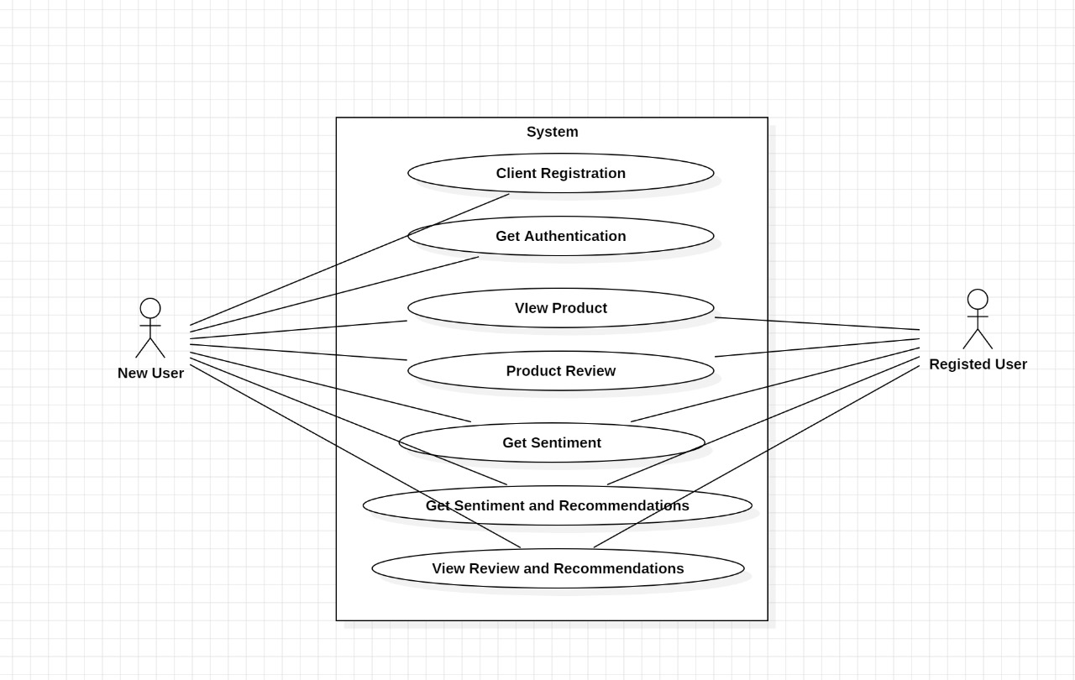
Design - Use Case Diagram
A use case diagram is a visual representation of the interactions between users and a system, depicting how users interact with the system's functionalities.

Slide 17
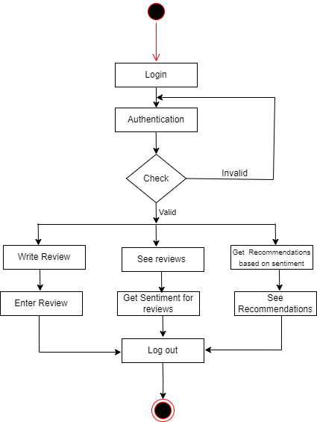
Design - Activity Diagram for User

Slide 18
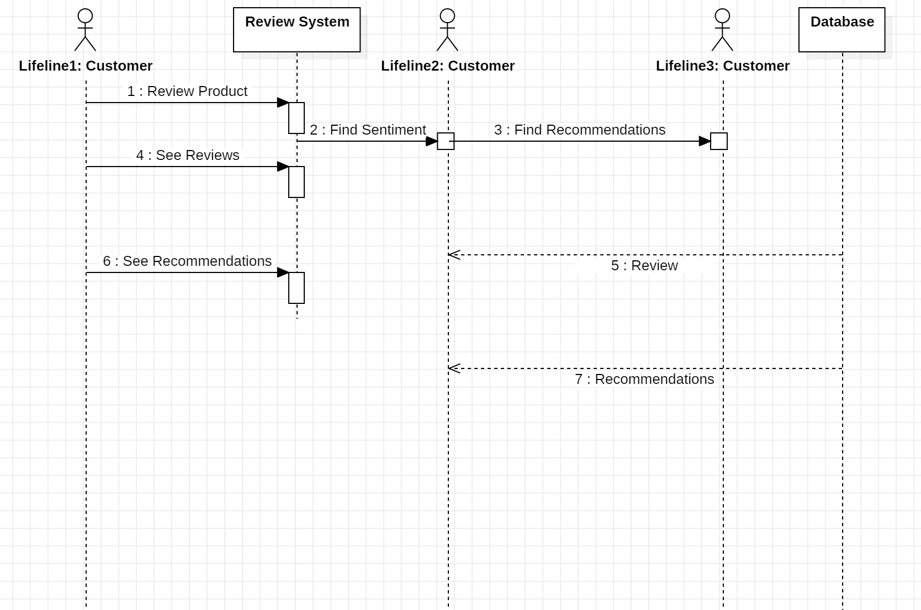
Design - Sequence Diagram

Slide 19
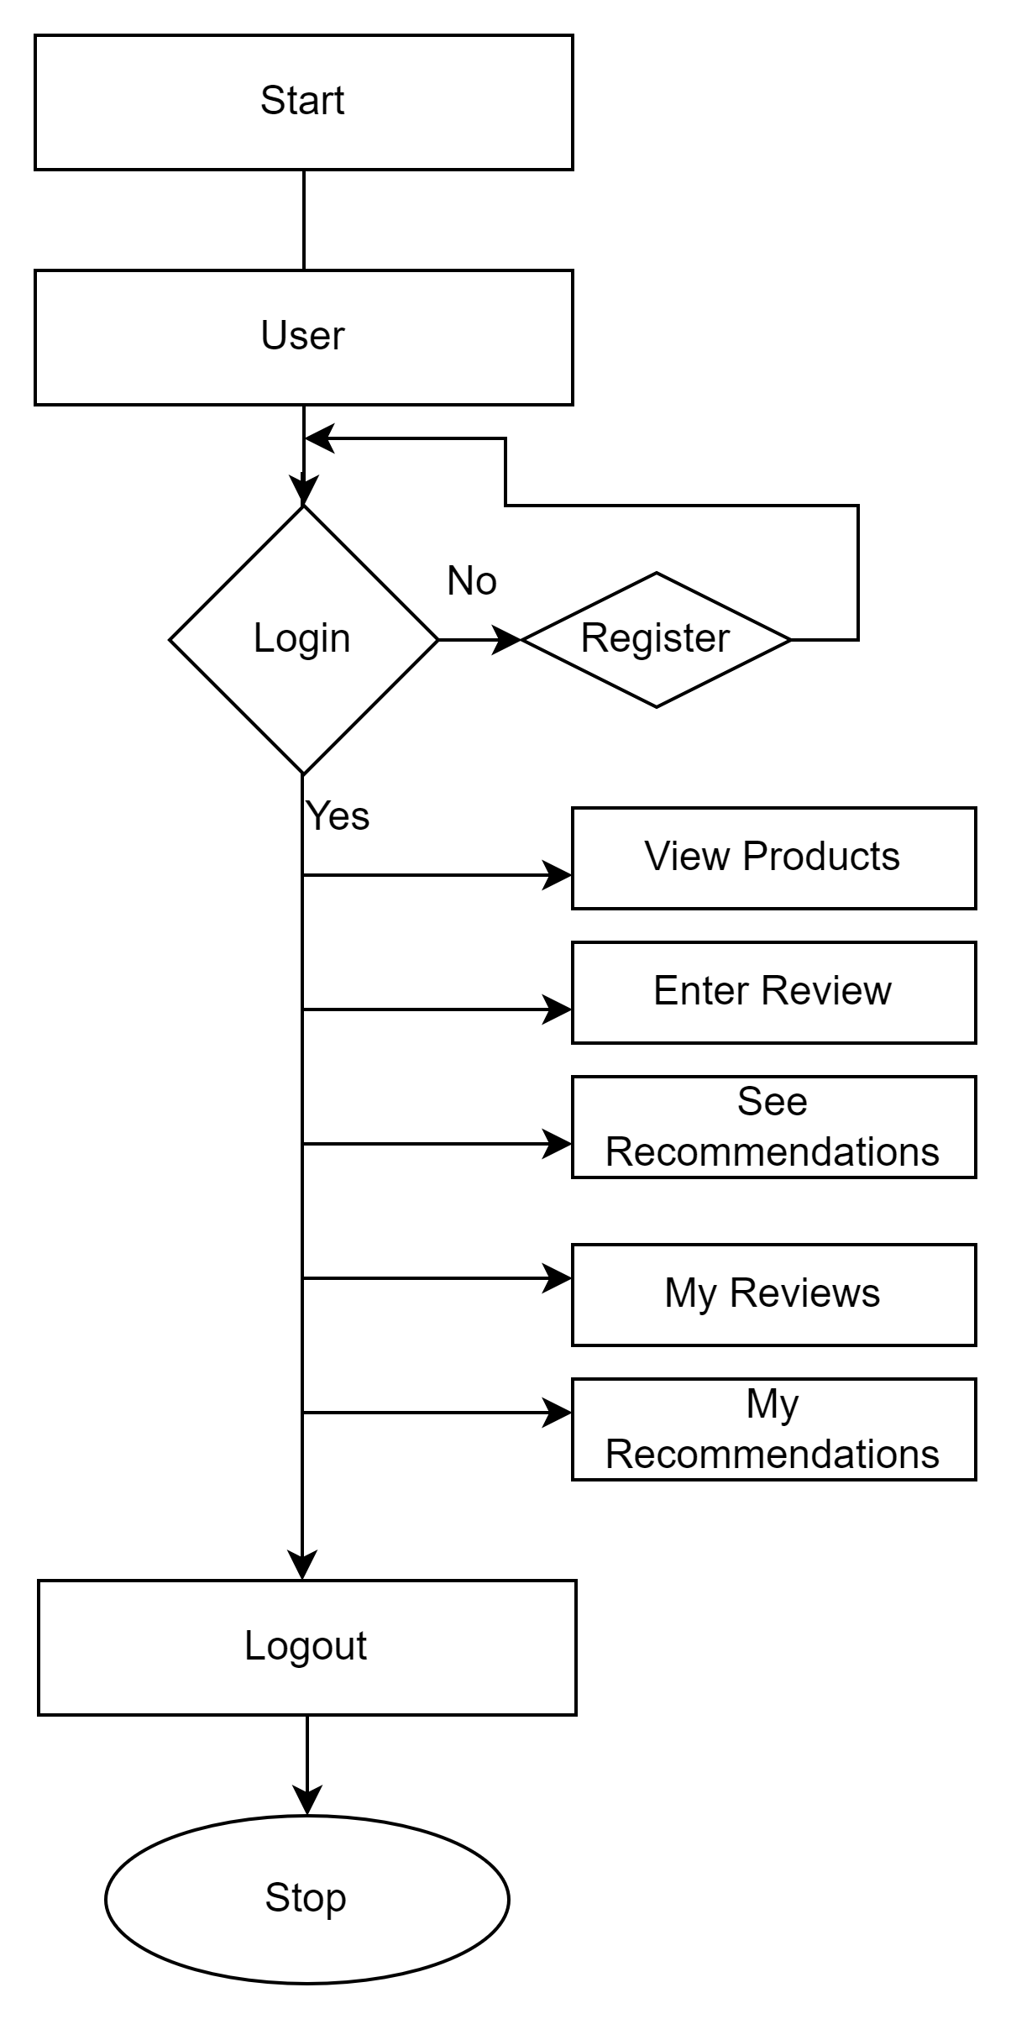
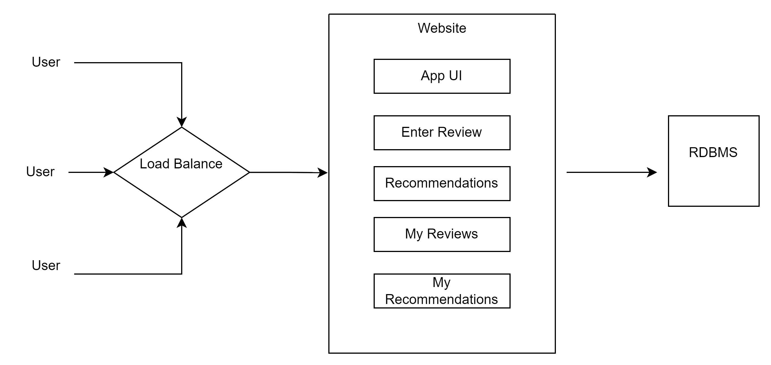
Design - System Architecture

Slide 20
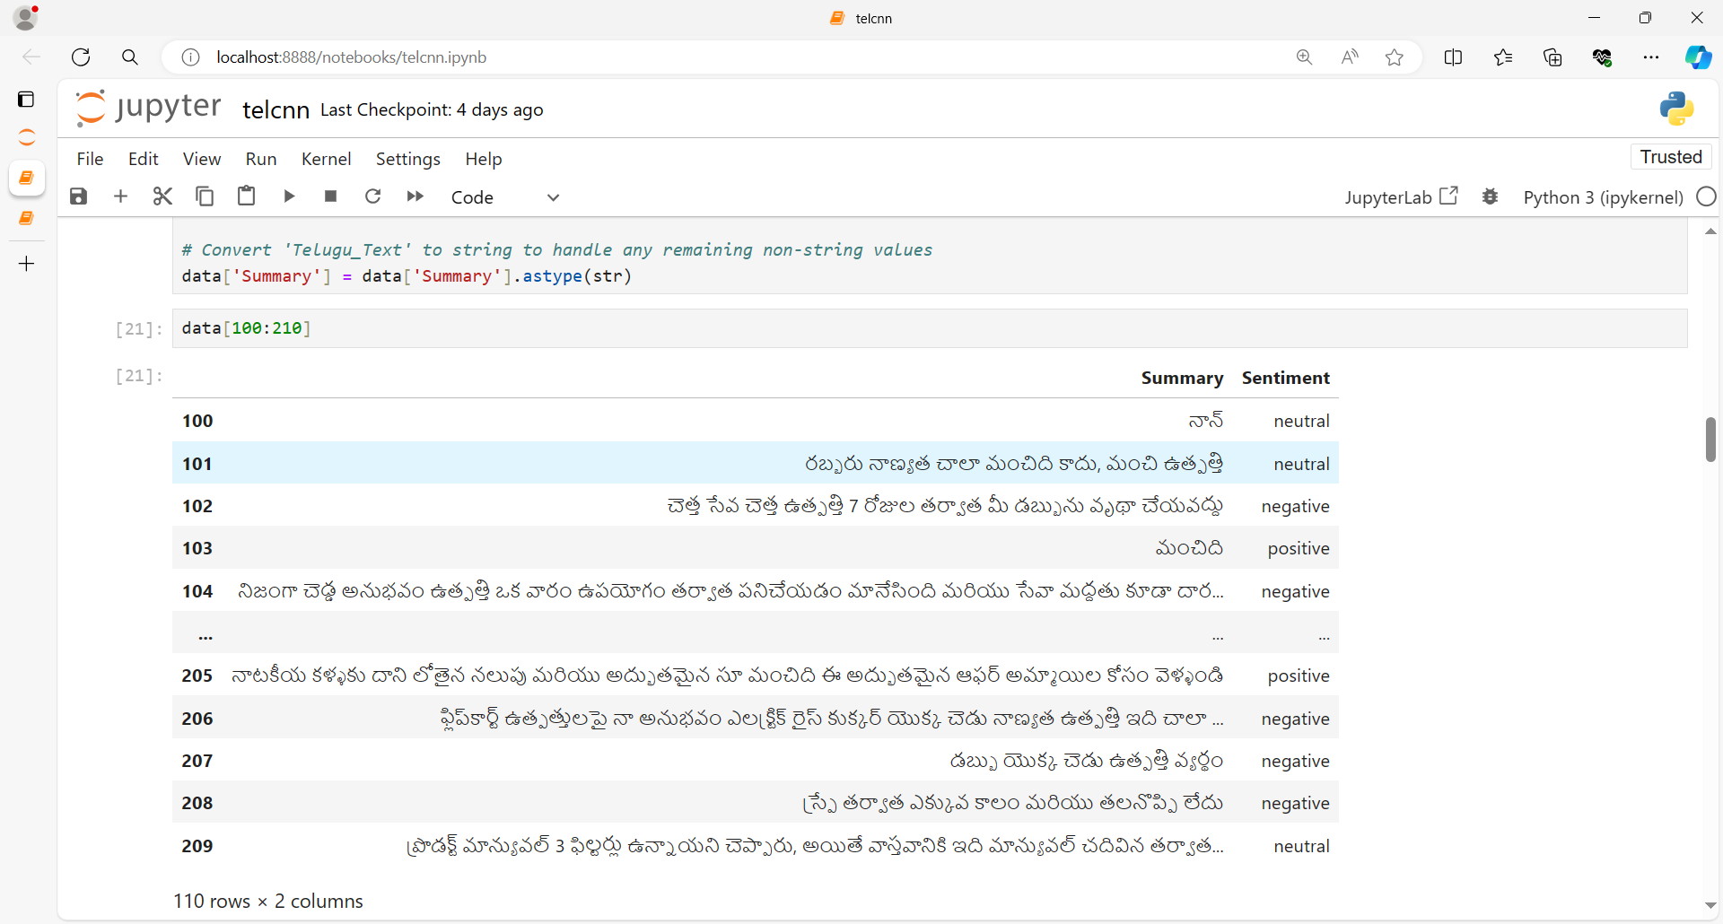
Implementation

Slide 21
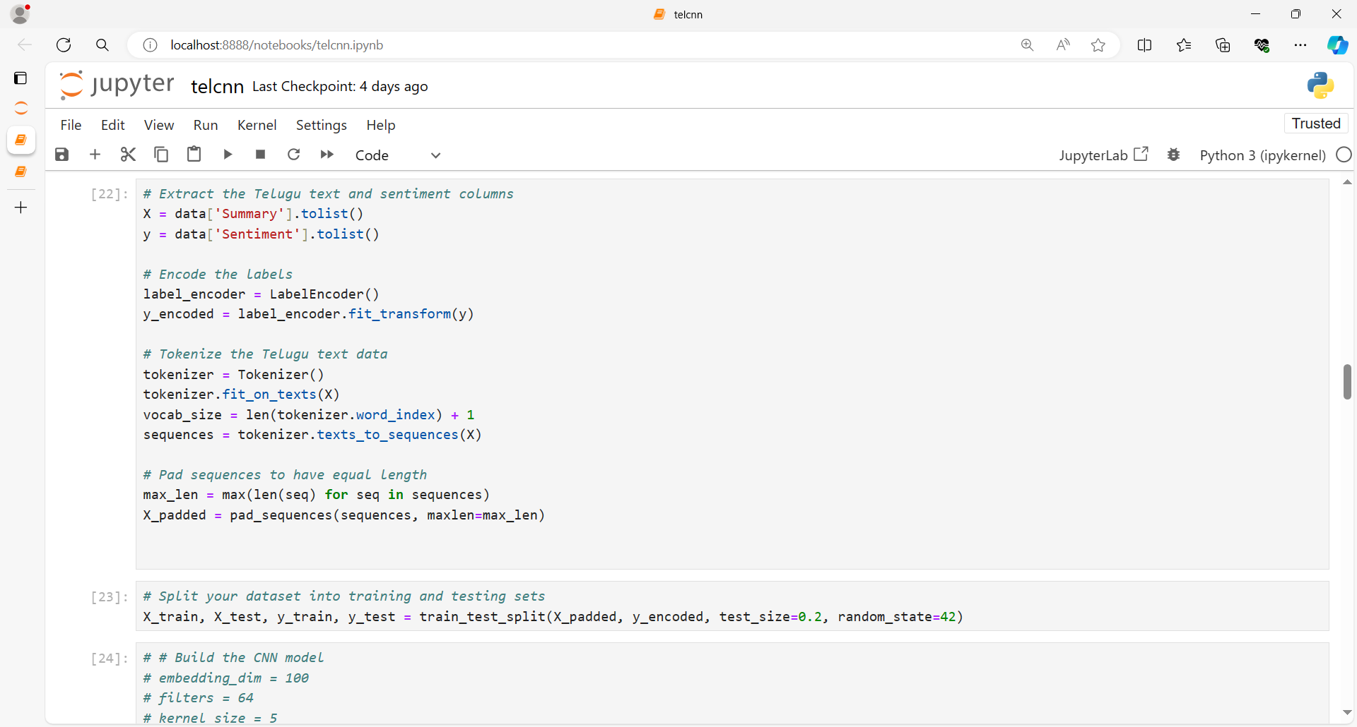
Implementation

Slide 22
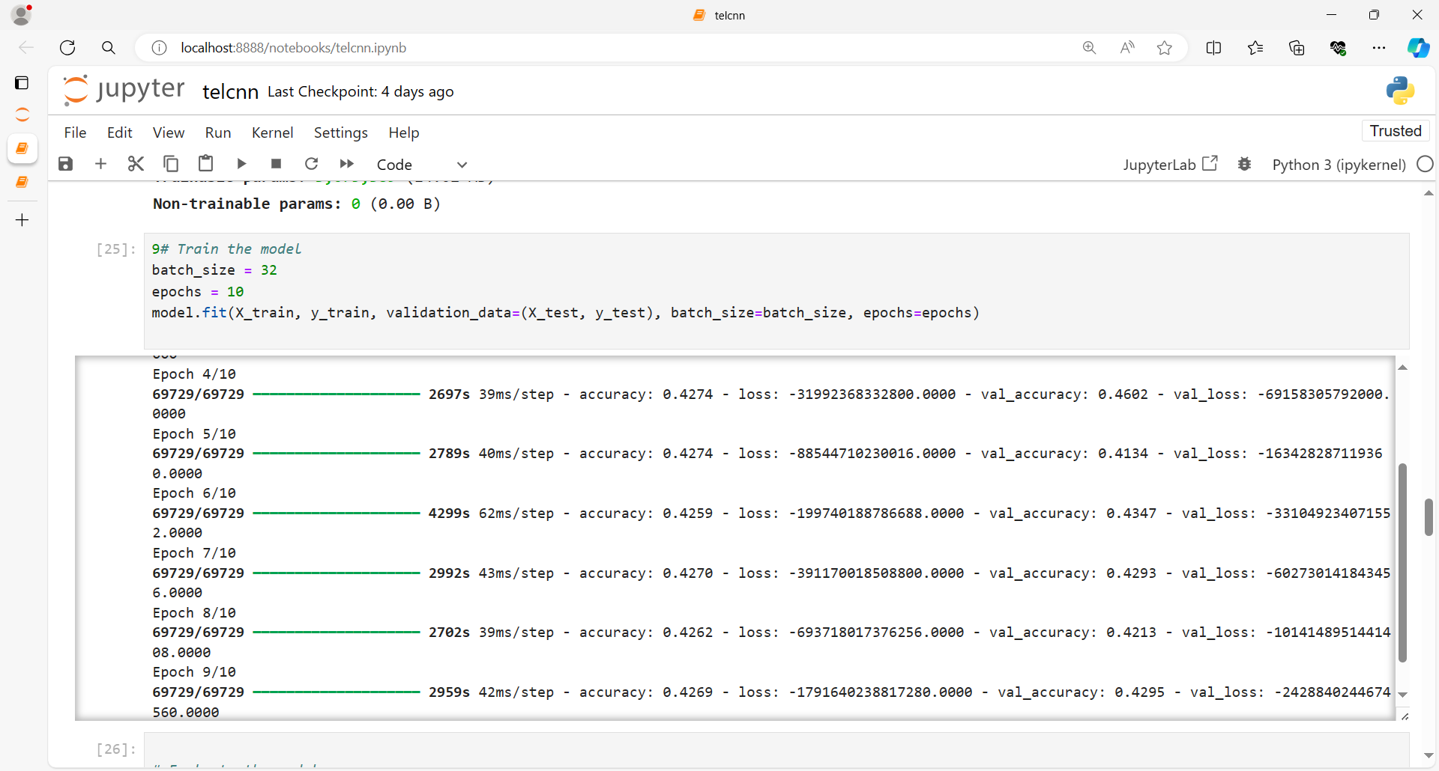
Implementation

Slide 23
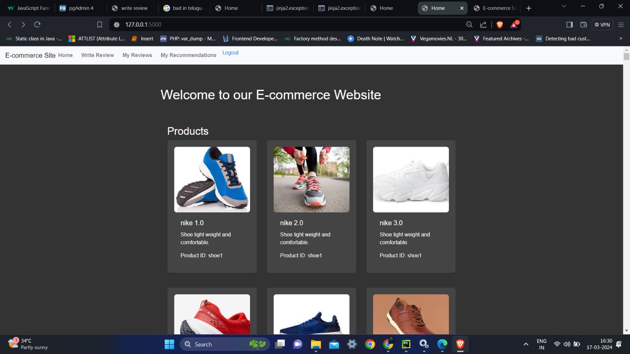
Implementation

Slide 24
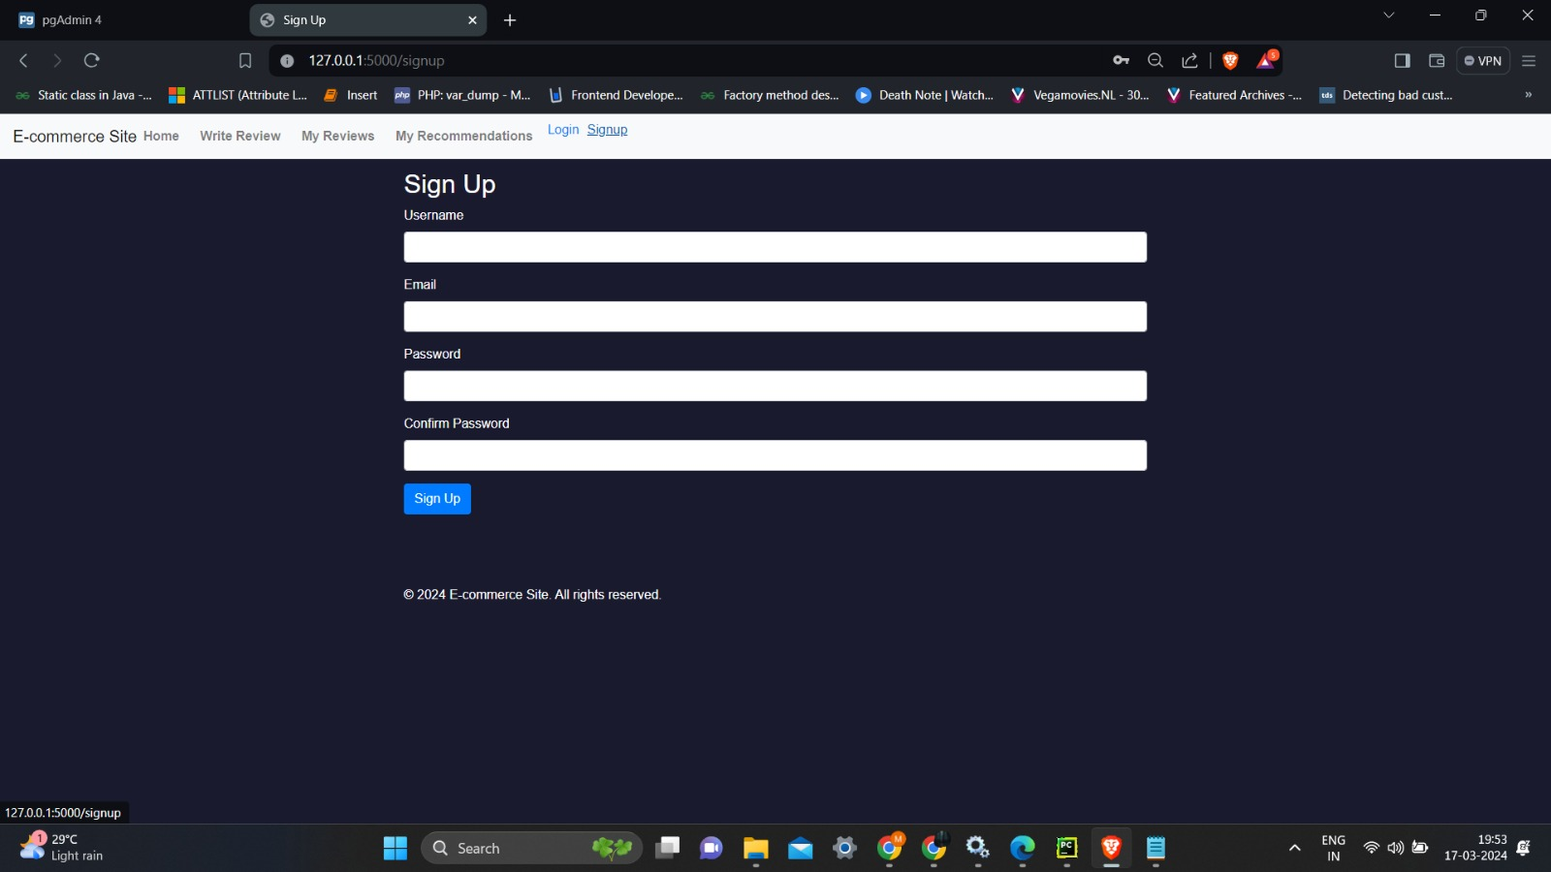
Implementation

Slide 25
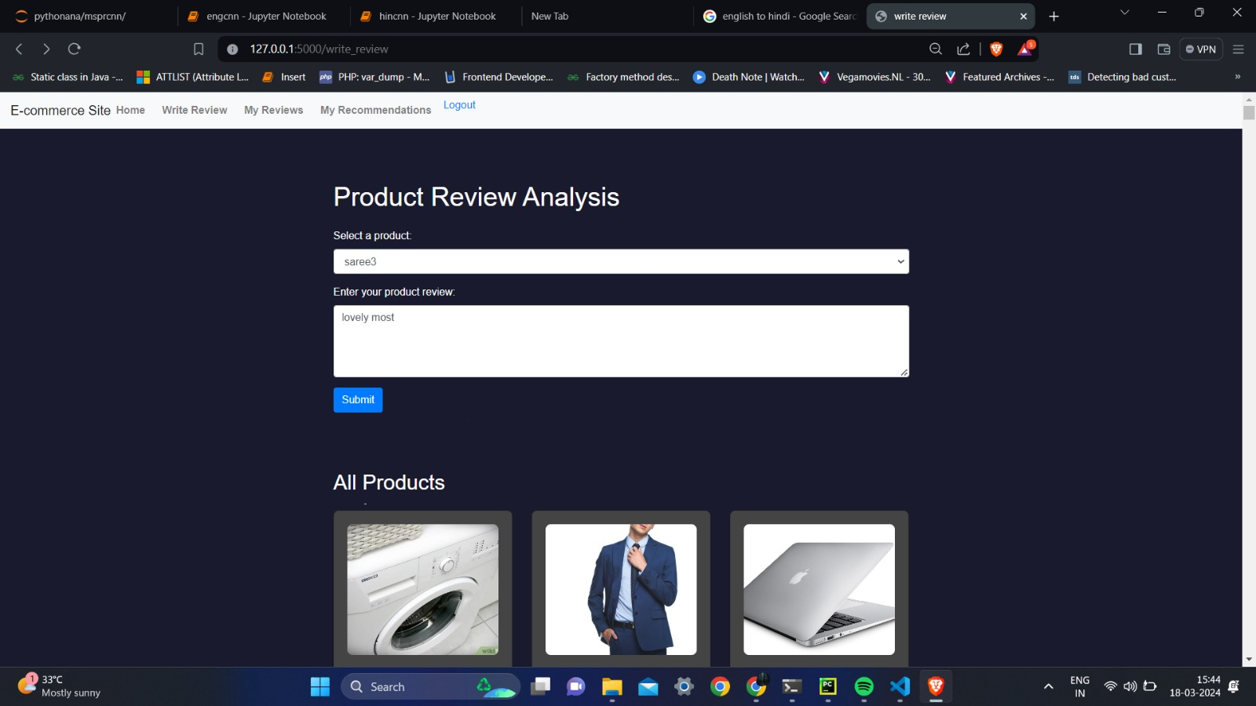
Implementation

Slide 26
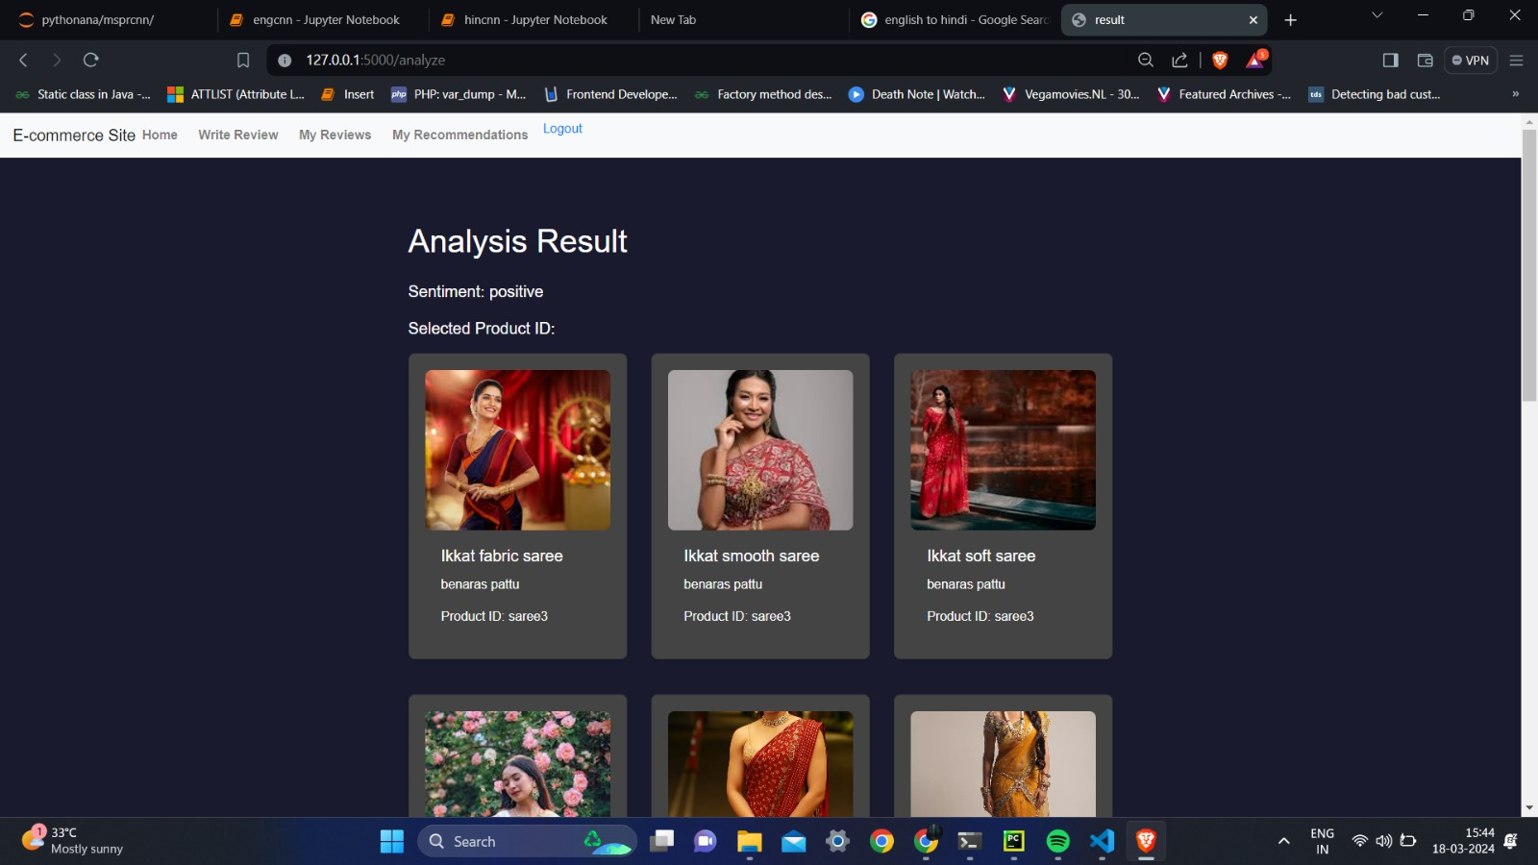
Implementation

Slide 27
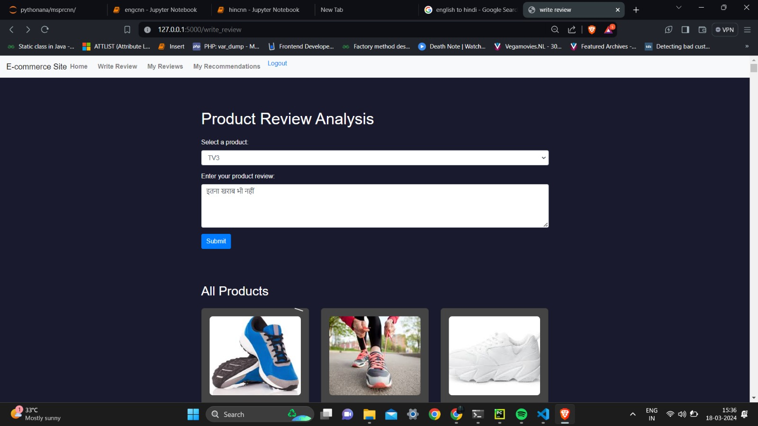
Implementation

Slide 28
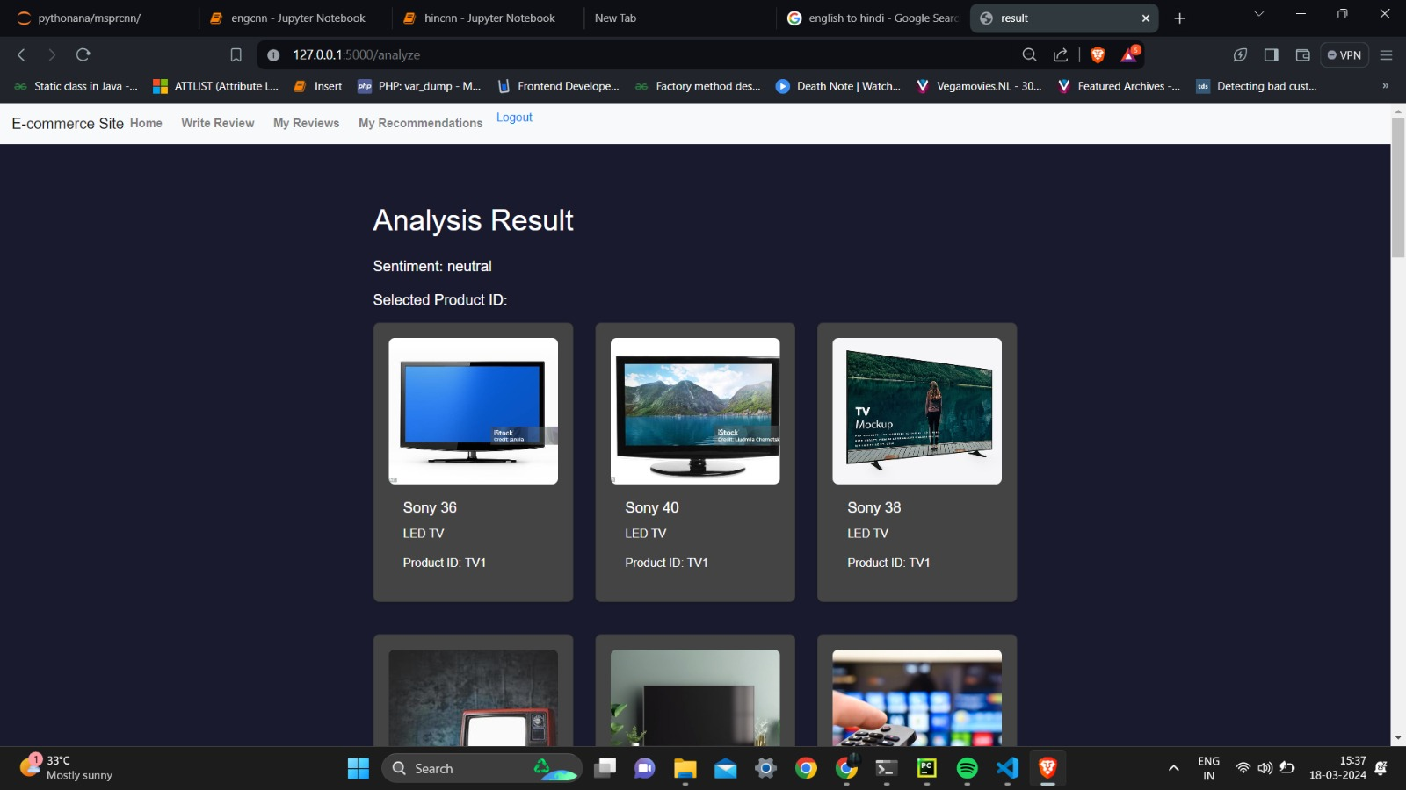
Implementation

Slide 29
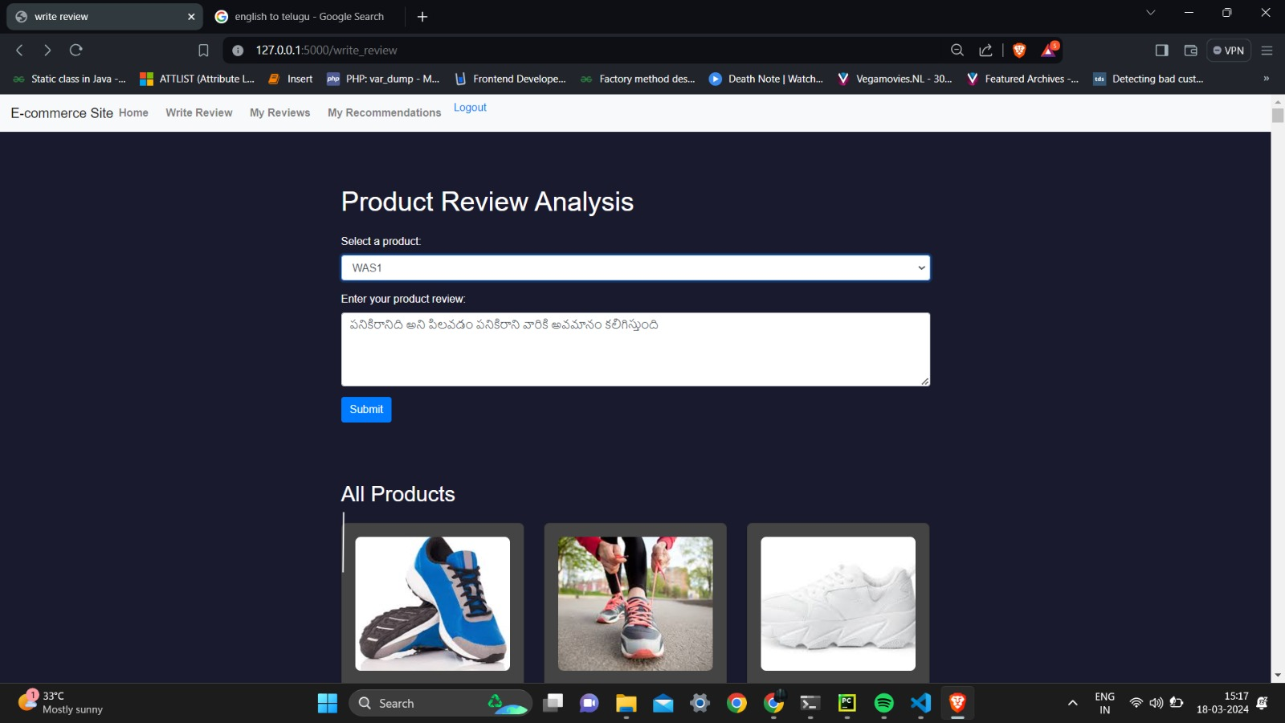
Implementation

Slide 30
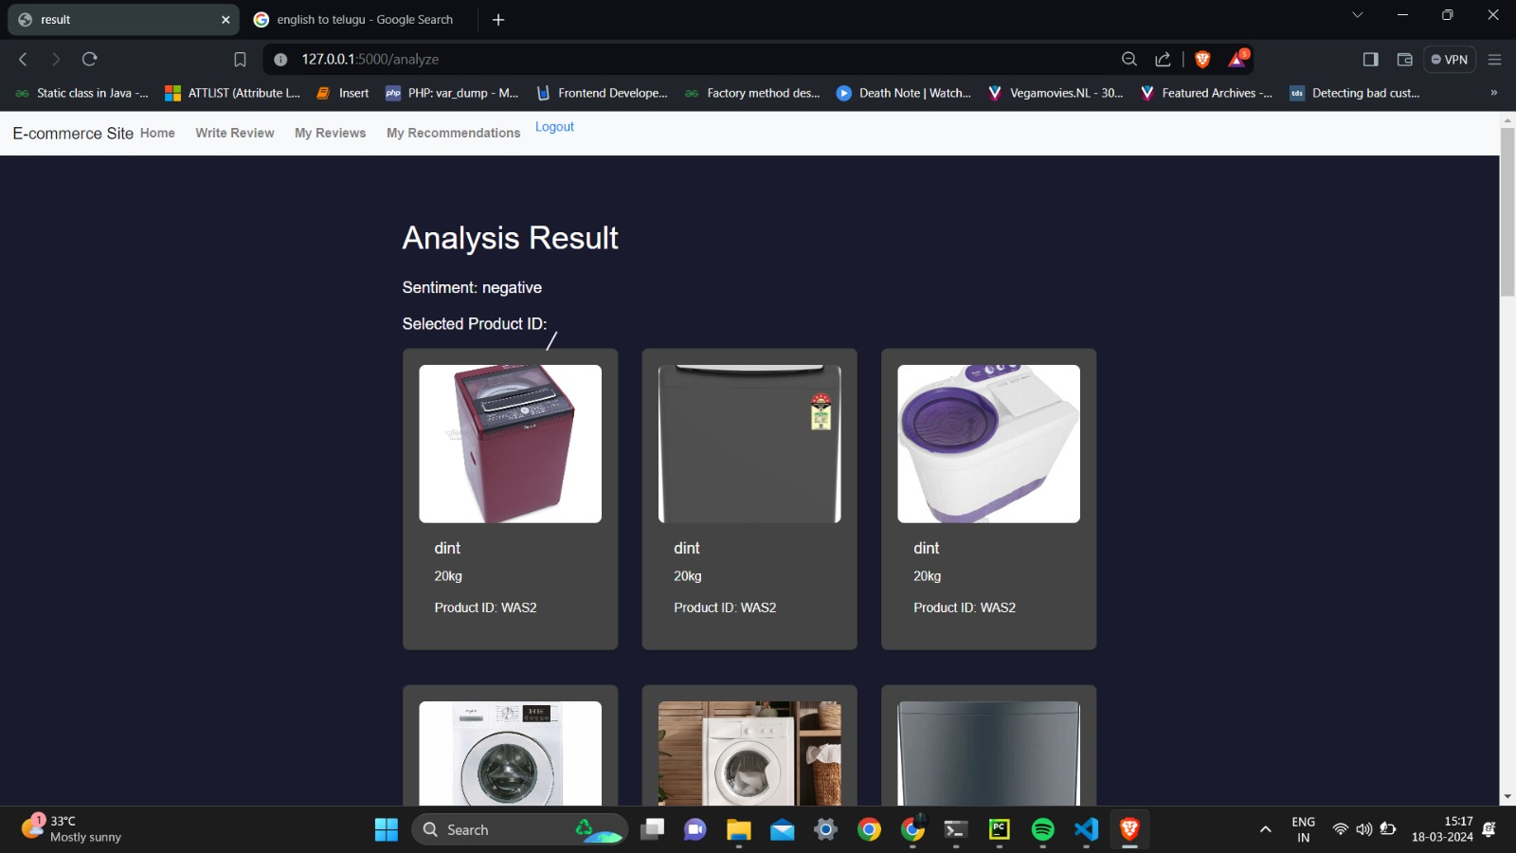
Implementation

Slide 31
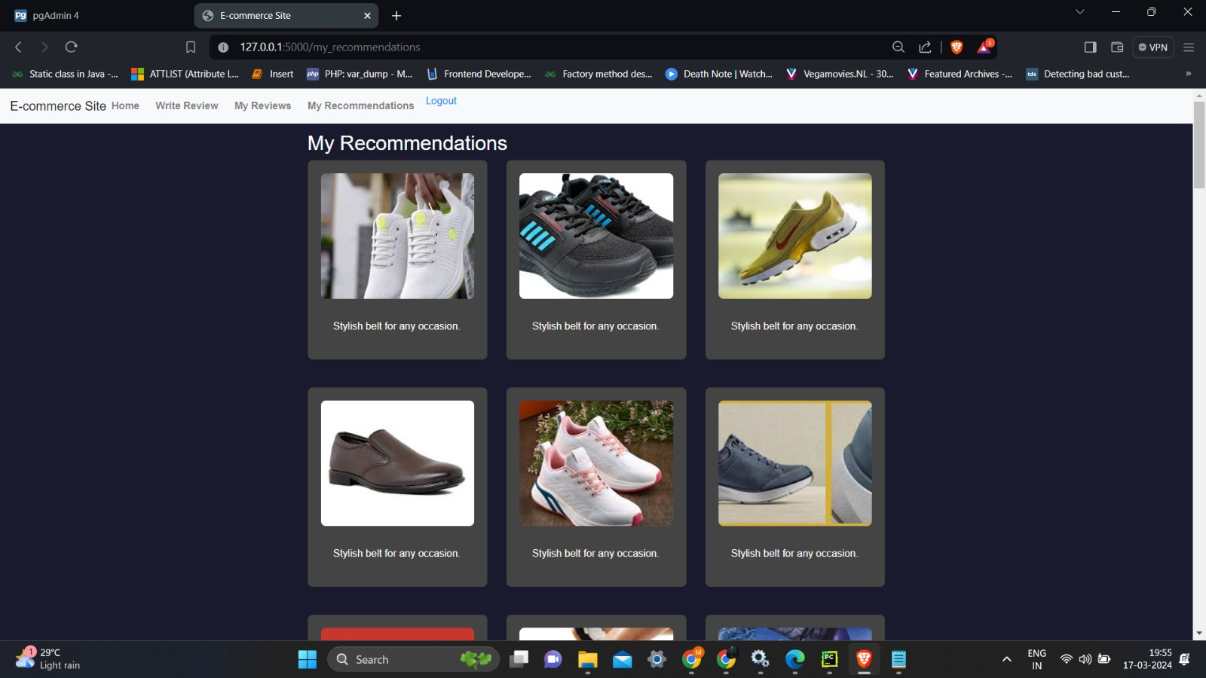
Implementation

Slide 32
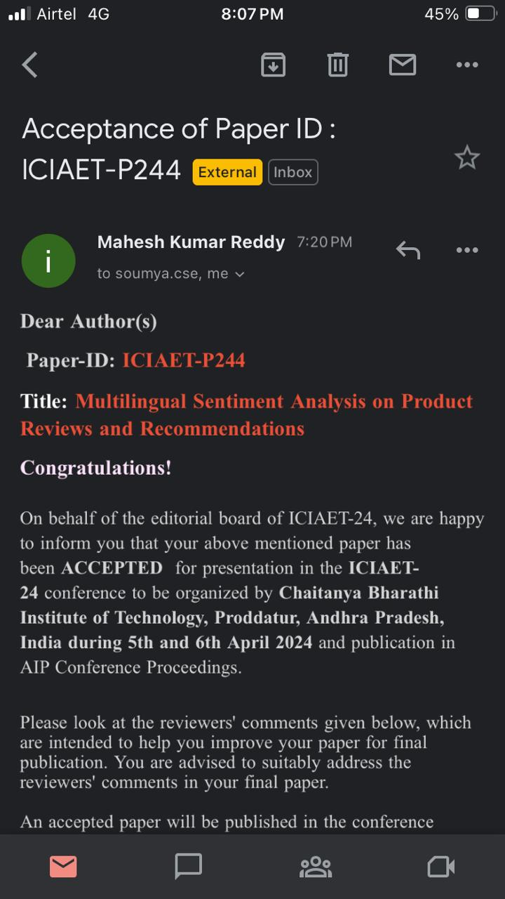
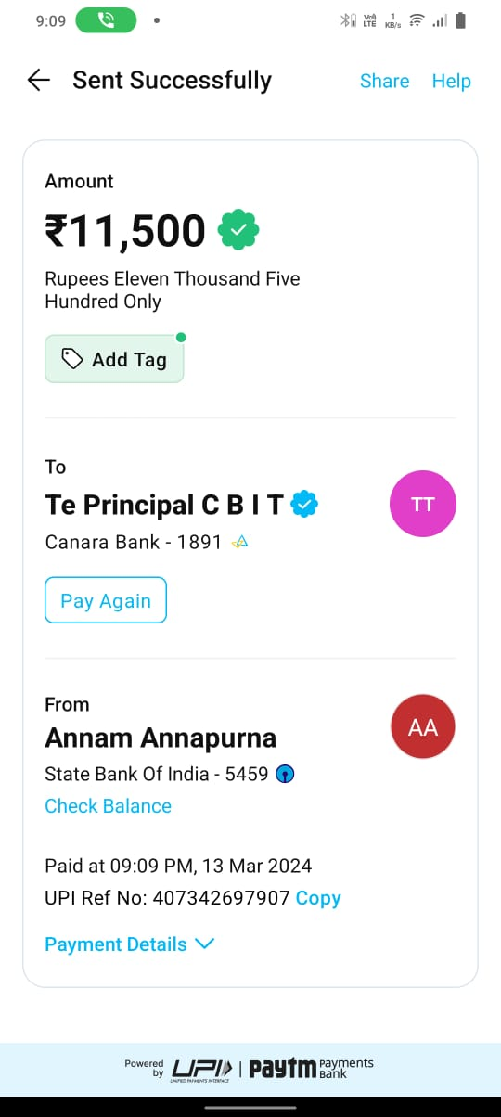
Research Paper
Research Paper

Slide 33
References
[1] Prof. Annapoorna B R, Akhil Rautela, Anurag Verma, Aditya Kumar Mishra, Dishant
Kumawat. "Hybrid Deep Learning Model for Multilingual Sentiment Analysis."
International Research Journal of Engineering and Technology (IRJET), Volume 09, Issue
05, May 2022, Pages 144-150.
[2] Wu Guanchen, Minkyu Kim, Hoekyung Jung. "Personal customized recommendation
system reflecting purchase criteria and product reviews sentiment analysis." International
Journal of Electrical and Computer Engineering (IJECE), Vol. 11, No. 3, June 2021, Pages
2399-2406.
[3] Singh, S., Singh, J., & Kumar, M. (2023). "Deep learning for multilingual sentiment
analysis: A comparative study." Applied Artificial Intelligence, 37(1), 1-17.

Slide 34
References
[4] Liu, P., Wu, Y., & Zhou, M. (2022). "RNN-based sentiment analysis of formal reviews in
multiple languages." International Journal of Computational Intelligence Systems, 15(1),
154-167.
[5] Sun, C., Wu, S., & Li, M. (2021). "Do languages dream in different colors? A survey of
multilingual sentiment analysis." ACM Computing Surveys, 54(4), 1-43.

Slide 35
Links
Github Link
https://github.com/204G1A0555/CSE2024-A5
Research Paper Link
https://github.com/204G1A0555/CSE2024-A5/blob/main/ICIAET-P244%20(1).pdf

Slide 36
Thank You!!!

