Slide 1

Automatic Saline Monitoring System &Dashboard Using IoT
by
R. Pallavi
Roll No. 204G1A0569
M. Sai Kiran
Roll No. 204G1A0586
C. Vamsi
Roll No. 214G5A0512
G. Sreekar Vamsi krishna
Roll No. 204G1A05A1
Under the guidance of
P. Shajahan M.Tech.
Assistant Professor
Department of Computer Science and Engineering
Srinivasa Ramanujan Institute of Technology
(Autonomous)
2023 - 2024

Slide 2

Contents
Abstract
Problem statement
Objectives of Project
Literature survey for first objective
Literature survey for second objective
Proposed Work -(Methods to be followed for proposed system)
References
GitHub Link
Queries

Slide 3
Abstract
Since the healthcare industry has grown quickly, it is important to maintain patient monitoring levels and saline bottle closures properly. Patient monitoring and air embolism, however, are not given enough focus. With the help of an Arduino Uno and an IoT platform called Blynk, a "LED-Photodiode based system" keeps track of saline bottles. In order to prevent tragic accidents and complications, the system warns nurses and doctors when the saline level reaches a critical level.
Innovative health monitoring systems are being created with less human intervention and are affordable in both rural and urban regions. These technologies are designed to solve issues quickly and enable nurses to check saline levels even from the control room. In order to determine the liquid's condition and determine whether the bottle is empty, the system uses level sensors.
Notes:
Don’t directly enter into the point, noooo tech words both para

Slide 4
Problem Statement
Air embolism is a serious and potentially life-threatening problem that can happen during medical procedures. Even though medical technology has improved and safety measures are better, air embolism is still a big worry in healthcare.
Sometimes, air embolism can happen because of the people taking care of patients, like nurses and caretakers, might not be paying full attention. This is a challenge because small mistakes can lead to big problems.
The aim is to reduce the chances of air embolism and to improve healthcare and make sure patients are getting the best possible care.
Notes:
Make first as two point…..no aim

Slide 5
Objectives of Project
To monitor the saline level strategic accidents and complications, like air embolism issue due to inattentiveness of nurses in healthcare sector.
To combat the preoccupation of the nurses and caretakers who are busy monitoring patients in hospitals.
Notes:
Bottle empty

Slide 6
Literature survey for first objective
Automatic saline monitoring has been investigated using a variety of approaches[1]. There have also been suggested electromechanical alternatives, such as using springs as weight sensors and Arduino-based systems with IR sensors for level monitoring.
When saline levels are in danger, these designs are meant to warn medical personnel. Our novel method employs LEDs and photodiodes as sensors and detectors along with a sophisticated clamping mechanism for tube control.
The cost-effective usage of photodiodes and LEDs, together with the intricate clamping mechanism, is where the innovation lies. Combining these two provides a dependable method for automatic

Slide 7
Literature survey for second objective
Global population growth has increased the need for cutting-edge health monitoring systems that are economical for both urban and rural locations and require less human intervention[2]. In order to remotely monitor saline flow rates, this work focuses on developing an advanced saline level monitoring system that makes use of an affordable sensor and a GSM modem. The device can be used in remote public hospitals to monitor the saline droplets on each patient's bed.
The technique is practical and inexpensive, resulting in fewer frequent visits to the patient's bedside and improving patient care. The paper also discusses the integration of wireless technologies and presents a wireless patient monitoring system concept based on ECG sensors. Mobile apps for showing patient data and LCD indications for saline levels are also highlighted. Despite the technology

Slide 8
Proposed System
The traditional approach is to have the supporters of the patient continuously monitor the saline bottle in the hospital, even at night.
The proposed system monitor’s the saline bottles over an application using IOT and trigger’s a notification when the saline level goes down beyond critical level to overcome the difficulty of the existing system.
The proposed system uses LED Photodiodes, Arduino controllers and other application.
Notes:
Use the chat gpt…add more points……

Slide 9
References
[1].Mihir Tilak, Darshan Bhor, Amey More and Dr . Gajanan nagare, “IoT based Smart Saline Bottle for Healthcare”, International Journal of Engineering Research & Technology(IJERT), vol. 10, pp. 944-948, Jun. 2021.
[2].Kriti Ojha, Jatin Parihar, Gouri Brahmankar, “IoT Based Saline Level Monitoring System”, Journal of Science and Technology, vol. 6,pp. 125-130, Aug. 2021.

Slide 10
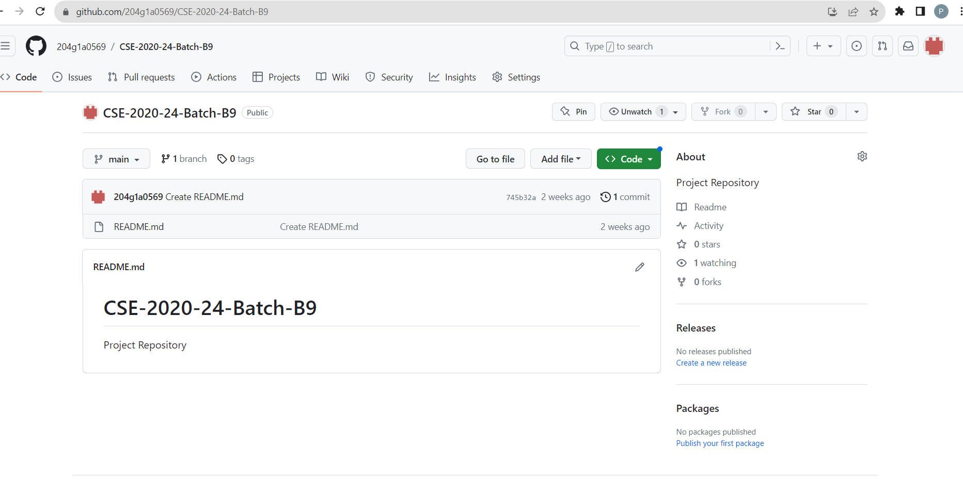
Git Hub Dashboards of each student
Git hub Dashboard

Slide 11
Any Queries?

