Slide 1

Student Placement Prediction using Naive Bayes Algorithm
by
V. Prathyusha
Roll No. 204G1A0573
D. Nazeema
Roll No. 204G1A0567
N. Sathish Babu
Roll No. 204G1A0594
R. Raj Kiran
Roll No. 204G1A0576
Under the guidance of
Mr. C. Lakshminatha Reddy M.Tech (Ph.D)
Assistant Professor
Department of Computer Science and Engineering
Srinivasa Ramanujan Institute of Technology
(Autonomus)
2023 - 2024

Slide 2

Contents
Abstract
Problem statement
Objectives of Project
Literature survey for first objective
Literature survey for second objective
Proposed Work -(Methods to be followed for proposed system)
References
GitHub Link
Queries

Slide 3
Abstract
The aim of this project is to analyze the standards of students and to predict the possibility of placement. It’s a student assessment on the basis of his academic skills, innovations, research and development capabilities. Doing this can help students as well as academics to boost students standards. Also it helps us to design our course and extra training on the basis of it for maximum benefits to students.
Creating a dataset for this is not easy because motivating students to share their information is a challenging task. For the prediction of placement possibility we use the dataset prepared from the survey and different types of Naive Bayes Algorithm, which is a Supervised Machine Learning Algorithm. Naïve Bayes Classifier is one of the most effective and simplest algorithms to implement for supervised labeled dataset.

Slide 4
Problem Statement
This project seeks to assess student’s academic standards, innovation, and research capabilities to predict their placement potential, aiming to elevate both student achievements and academic strategies.
However, gathering a comprehensive dataset proves challenging due to the difficulty in motivating students to share information, hindering the effective utilization of Naive Bayes Algorithm for predicting placement possibilities.

Slide 5
Objectives of Project
To perform a Data Analysis using data science techniques on the selected dataset and train Naive Bayes Machine learning model to predict the placement of student.
By understanding the dataset's features, extracting useful features of student placement dataset, preforming data pre-processing, finding necessary features that helps for the prediction, training model using different parameters of the model, testing model using performance metrics can bring the model to maximum accuracy.

Slide 6
Literature survey for first objective
Naive bayes classification technique is used to predict the class of the graduate student and how the other attributes affects the performance.[4]
Once Predictive model is created, it is necessary to check how accurate it is, The Accuracy of the predictive model is calculated based on the precision, recall values of classification matrix.[2]
The Naive Bayes classifier technique is used when dimensionality of the inputs is high. This is a simple algorithm but gives good output than others. This classifier is used to predict the dropout of the students by calculating the probability of each input for a predictable state.[3]

Slide 7
Literature survey for second objective
Identify the dataset you'll use for your analysis. This could include student-related features like academic scores, skills, internships, extracurricular activities, and placement outcomes.[1]
Explore techniques for visualizing data distributions, correlations, and identifying patterns.[2]
The data preprocessing includes attribute selection, cleaning missing values, and splitting the dataset into training and testing.[4]

Slide 8
Proposed System
This project proposes a student placement prediction model that uses the Naive Bayes method to determine the likelihood of students being placed.
This methodology aids an organization's placement cell in identifying prospective students and paying attention to and improve their technical and interpersonal abilities.
For this we do data preprocessing which helps to make compatible data structure for the model. we need to build the model with studied hyperparameters and test them with different variables of hyperparameters. This phase is called testing and validation.

Slide 9
References
Mohana Bangale 1 , Shubham Bavane2 , Akshay Gunjal3 , Rohit Dandhare4 , Sudhir D. Salunkhe5, “A Survey on Placement prediction system using machine learning” Department of Information Technology, Volume 5 Issue 2 –FEBRUARY 2019.
Ajay Kumar Pal, Saurabh Pal, “Classification Model of Prediction for Placement of Students” I.J.Modern Education and Computer Science, 2013, 11, 49-56.
C. Anuradha , T. Velmurugan,“FEATURE SELECTION TECHNIQUES TO ANALYSE STUDENT ACADAMIC PERFORMANCE USING NAÏVE BAYES CLASSIFIER ”
Dr. Kajal Rai,“ STUDENTS PLACEMENT PREDICTION USING MACHINE LEARNING ALGORITHMS ”South Asia Journal of Multidisciplinary Studies SAJMS June 2022.

Slide 10
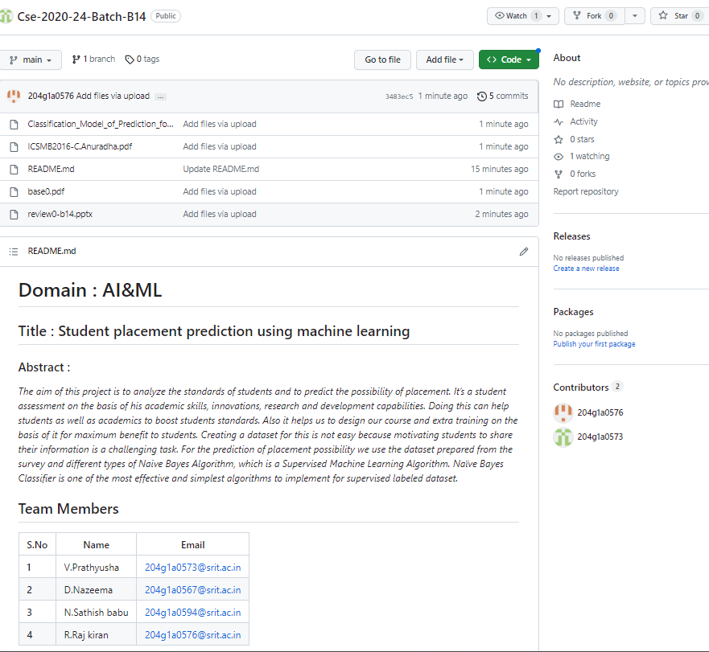
Git Hub Dashboards of each student

Slide 11
Any Queries?

