Slide 1

Towards a generic OGC API Async Recommendation OGC Code Sprint London 14—16. September 2022
Secure Dimensions GmbH
Holistic Geosecurity
Andreas Matheus
Secure Dimensions GmbH

Slide 2
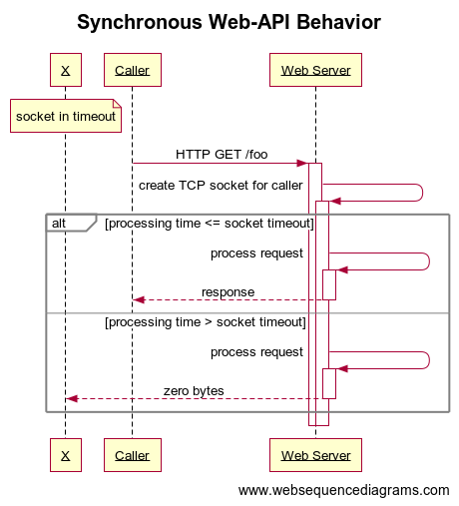
Synchronous Web-API Behavior
OK
Problem
Notes:
title Synchronous Web-API Behavior
note over X: socket in timeout
Caller->+Web Server: HTTP GET /foo
Web Server->+Web Server: create TCP socket for caller
alt processing time <= socket timeout
Web Server->+Web Server: process request
Web Server-->-Caller: response
else processing time > socket timeout
Web Server->+Web Server: process request
Web Server-->-X: zero bytes
end

Slide 3
Synchronous Web-API -- Technical Restrictions --
Send and receive in same TCP socket pair
Consequence: Response is due BEFORE socket timeout happens
Caller can set socket timeout, but this has no effect in Reverse-Proxy setup (e.g. Nginx + upstream)
The response must be send back BEFORE the default socket latency is reached! – typically 30s
But users won’t even wait that long. So response should come back within approx. 10s!

Slide 4
Critical example of OGC API where Synchronous may not work!
From Testbed 17: (Encrypted) GeoPackage with large Feature Collection
GeoPackage aka SQLite is a binary file that must be fully created on the server side BEFORE the first byte of the response can be sent back to the caller
Danger that socket timeout happens BEFORE GeoPackage file is created!
Danger that server resources (involved in creating the GeoPackage) are wasted
Danger of DoS as repeated requests may consume all available server resources!

Slide 5
Asynchronous Web-API Behavior
Ensure that SOME response is send back to the caller BEFORE the socket timeout happens!
The continuation protocol typically depends on the API’s semantics. Two basic variations exist:
The caller continuous to be the active part (polling)
E.g. 303 “See Other” with a URI to a status monitor to be used by the caller to get more information. Protocol and data structure typically not standardized.
The service is the active part (push)
E.g. 202 “Don’t call us – we’ll call you”
=> But how to tell the client what will happen next?

Slide 6
Testbed 18 Recommendation (Secure and Asynchronous Catalogue Task)
Caller shall use “Prefer” to indicate the preference for the response
RFC 7240 semantics (wait for synchronous response or “I am able to handle async continuation)
Testbed 18 proposal is that the HTTP header includes a “callback” or “callbackId”
Prefer: respond-async, wait=10, callback=https://ogc.demo.secure-dimensions.de/sms/subscriptions/4711
Prefer: respond-async, wait=10, callbackId=4711
More details in OAB issue 1162

Slide 7
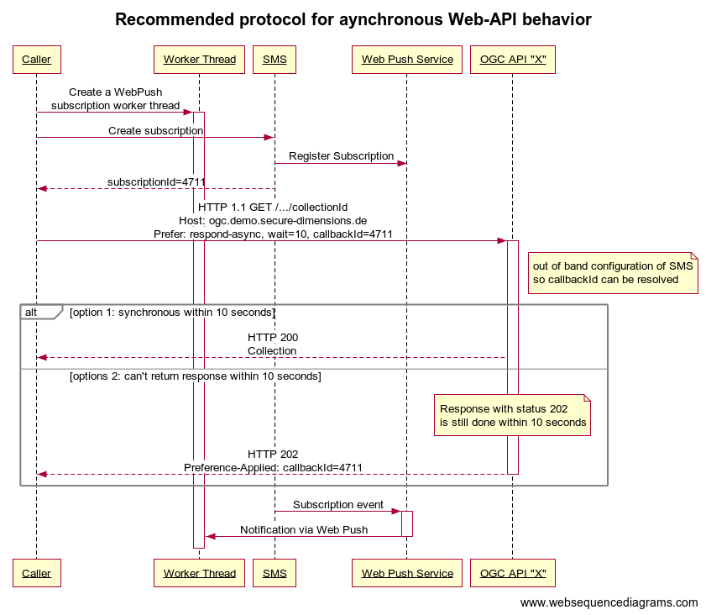
Sequence Example for Web Push
Notes:
title Recommended protocol for aynchronous Web-API behavior
Caller->+Worker Thread: Create a WebPush\nsubscription worker thread
Caller->SMS: Create subscription
SMS->Web Push Service: Register Subscription
SMS-->Caller: subscriptionId=4711
Caller->+OGC API "X": HTTP 1.1 GET /.../collectionId\nHost: ogc.demo.secure-dimensions.de\nPrefer: respond-async, wait=10, callbackId=4711
note right of OGC API "X": out of band configuration of SMS\nso callbackId can be resolved
alt option 1: synchronous within 10 seconds
OGC API "X"-->Caller: HTTP 200\nCollection
else options 2: can't return response within 10 seconds
note over OGC API "X": Response with status 202\nis still done within 10 seconds
OGC API "X"-->-Caller: HTTP 202\nPreference-Applied: callbackId=4711
end
SMS->+Web Push Service: Subscription event
Web Push Service->-Worker Thread: Notification via Web Push

Slide 8
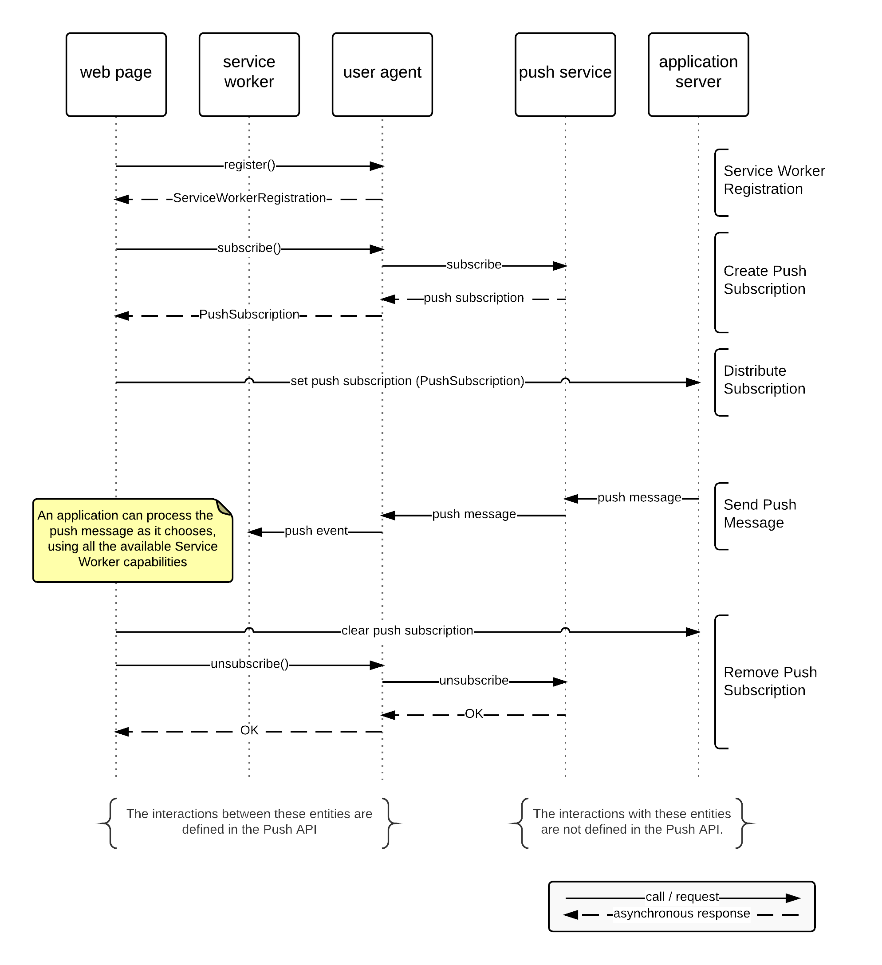
Proposed Contribution during Code Sprint: Web Push
TB18
SMS
TB18 pyCSW
pyCSW:
https://ogc.demo.secure-dimensions.de/pycsw
SMS:
https://ogc.demo.secure-dimensions.de/sms/api
To be implemented during code sprint
Source: https://www.w3.org/TR/push-api/#sequence-diagram

Slide 9
WebPush Notifications require Security ☺
Voluntary Application Server Identification (VAPID) for Web Push
https://datatracker.ietf.org/doc/html/rfc8292
Security Considerations
https://datatracker.ietf.org/doc/html/rfc8292#section-5
https://www.w3.org/TR/push-api/#security-and-privacy-considerations
Pushed content should be …
authentic to the user => signature
confidential to the user => end-to-end encryption

Slide 10
Additional Use Case for Subscription Service
You want to be informed if information changes on the service
Catalogue example:
Notify me if a particular record changes
Notify me if a record is published that I am looking for
Three different kinds of “callback”
Via Email -> To user’s inbox – only a link
Via WebHoock -> To processing endpoint – can receive full resource(s) representations
Via WebPush -> To user’s browser / device – link to obtain resource(s)

Slide 11
Mission!
Generic OGC API Asynchronous behavior
We need a generic Subscription Management API
1) Client to create a subscription
2) User Prefer header linking subscription
3) Server tells what is followed (sync or async with subscription, or nothing at all)
Pattern can be applied to existing infrastructures as Subscription Management API is an extra ”add-on”

Slide 12

Thank You!
It is important, to do security right...
Secure Dimensions GmbH
Holistic Geosecurity
Dr. Andreas Matheus
Waxensteinstr. 28
D-81377 München, Germany
Phone +49 (0)89 38151813-0
Mobile +49 (0)160 1066366
Telefax +49 (0)89 38151813-9
Email am@secure-dimensions.com
Web www.secure-dimensions.com

