Slide 1
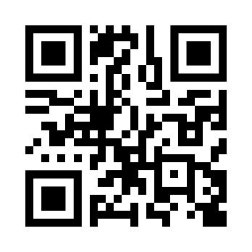
pygeoapi-auth
authentication and authorization for pygeoapi
https://github.com/cartologic/pygeoapi-auth
Youssef Harby

Slide 2
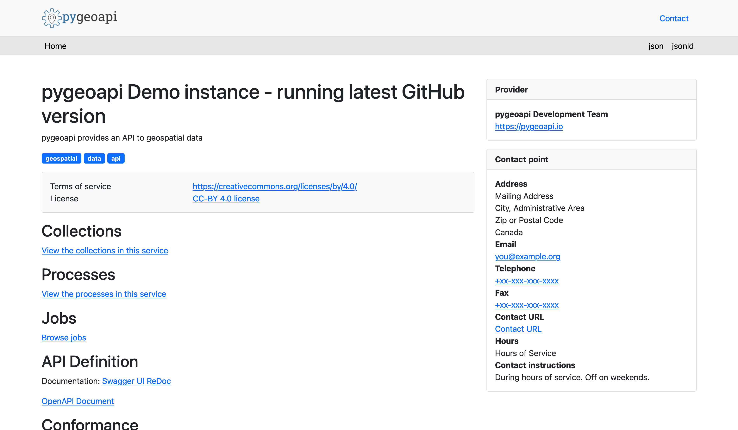


docker run --rm -p 5000:80 geopython/pygeoapi:latest
http://localhost:5000
Host
Container
Port : 5000
Port : 80

Slide 3
But what if I have sensitive data?

Slide 4
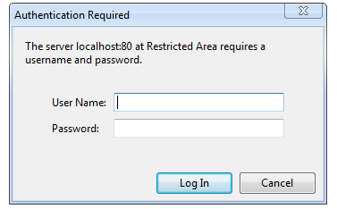


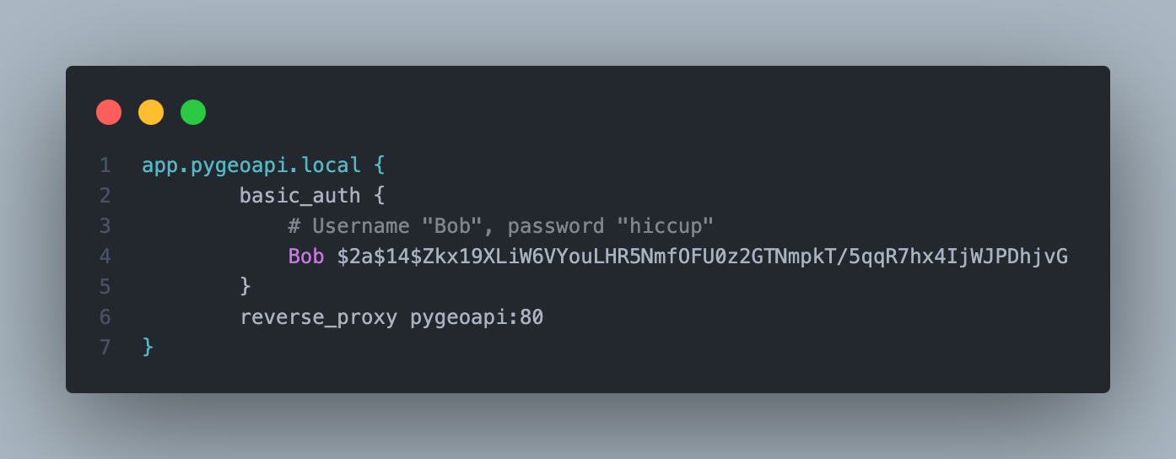
We need to protect it !
Host
Container
Port : 5000
Port : 80
Host
Port : 80
Port: 443
Or any reverse proxy
Port : 80
Port: 443

Slide 5
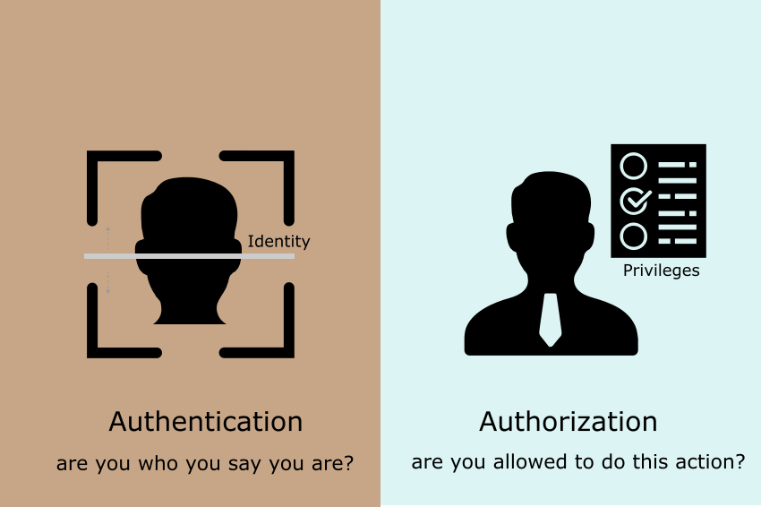


But what about authorization !
Now I know you
Can access any collection/item
Notes:
Image source : https://idratherbewriting.com/learnapidoc/docapis_more_about_authorization.html

Slide 6

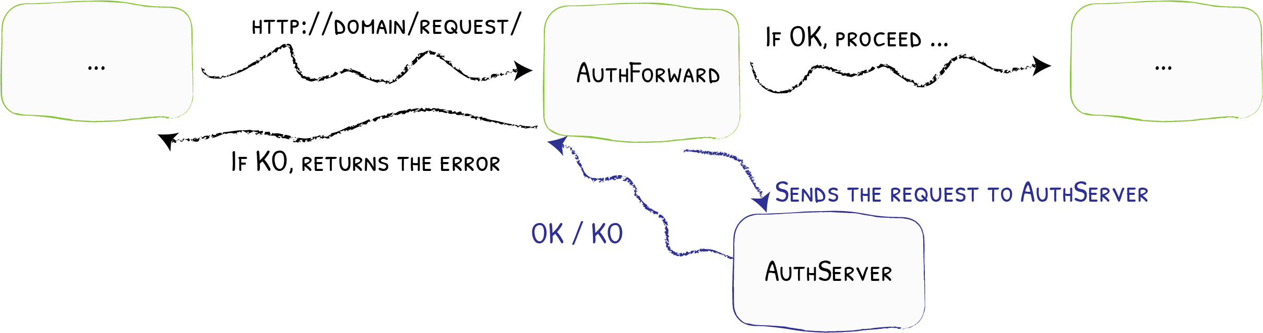

The Solution!
forward authentication
Notes:
Image source : https://doc.traefik.io/traefik/middlewares/http/forwardauth/

Slide 7
Architecture Diagram if HTTP 200 OK
Isolated Docker Network
5
Port : 80
User: yharby
Host
Response
Port: 80
Port: 443
Port: 80
Port: 443
app.pygeoapi.local
app.pygeoapi.local/api/collections/obs
4
1
Response
6
pygeoapi.local
Port : 9001
2
3
HTTP 200 OK
Redirected to authelia with redirect needed endpoint in query params
pygeoapi.local/?rd=https://app.pygeoapi.local/api/collections/obs&rm=GET

Slide 8
Architecture Diagram HTTP 4xx KO
Isolated Docker Network
Port : 80
User: francbartoli
Host
app.pygeoapi.local/api/collections/obs
Port: 80
Port: 443
Port: 80
Port: 443
1
ERROR
4
pygeoapi.local
Port : 9001
2
3
HTTP 4xx KO
Redirected to authelia with redirect needed endpoint in query params
pygeoapi.local/?rd=https://app.pygeoapi.local/api/collections/obs&rm=GET

Slide 9
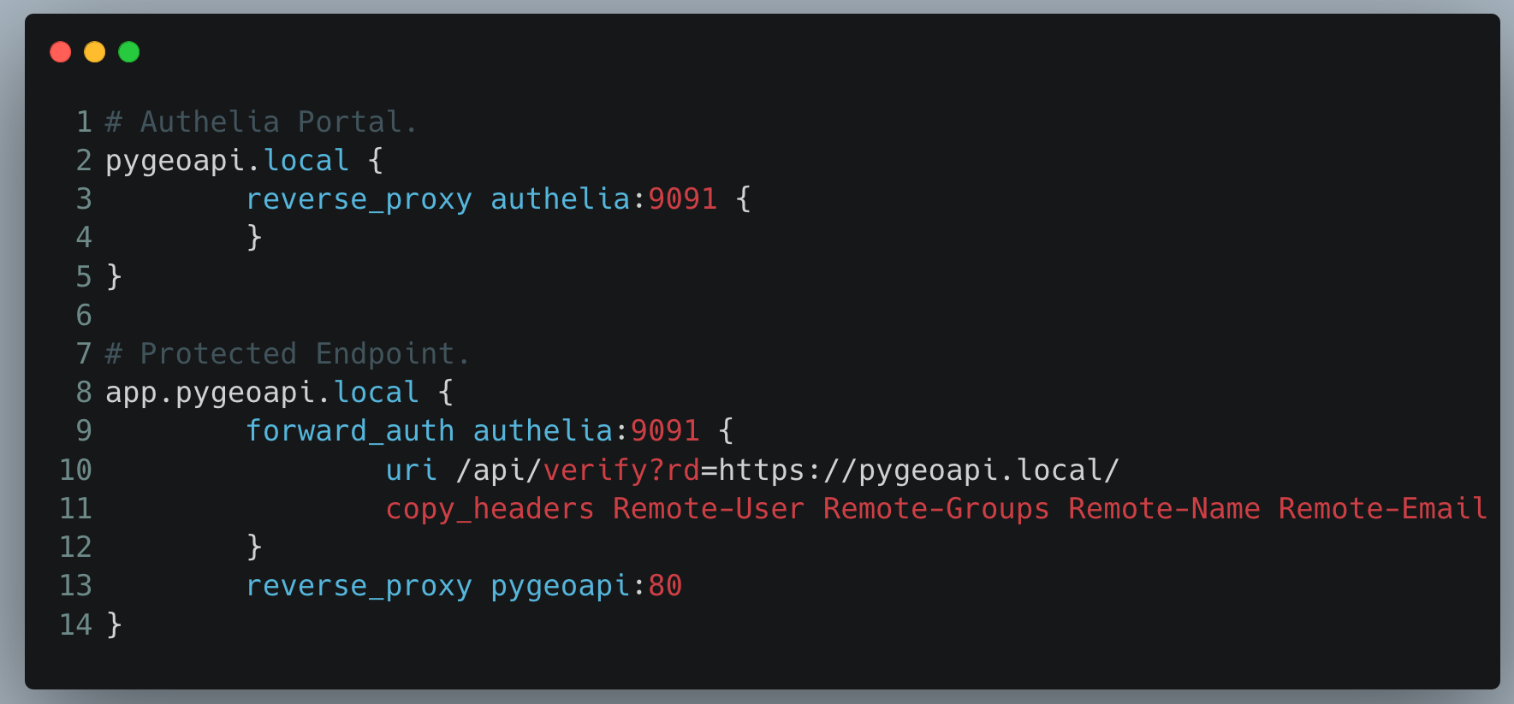

Slide 10
Todo list:
Enable OpenID Connect (https://www.authelia.com/integration/openid-connect/introduction/).
External user authentication (LDAP/Keycloak..etc).
Test against QGIS and other GIS desktop applications.

Slide 11
Q&A

