Slide 1
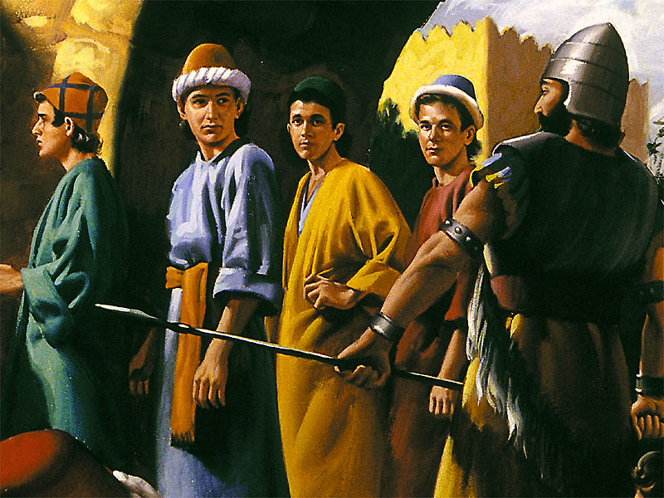
Daniel 1
The Captivity

Slide 2
Why Study Daniel?
Jesus studied it and foretold about the time that Daniel prophesied – the “abomination of desolation” – Mark 13:14 and Matthew 24:15

Slide 3


Why Study Daniel and Rev?
2. Daniel foretold events that would happen up until the end of the world

Slide 4
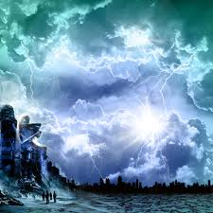
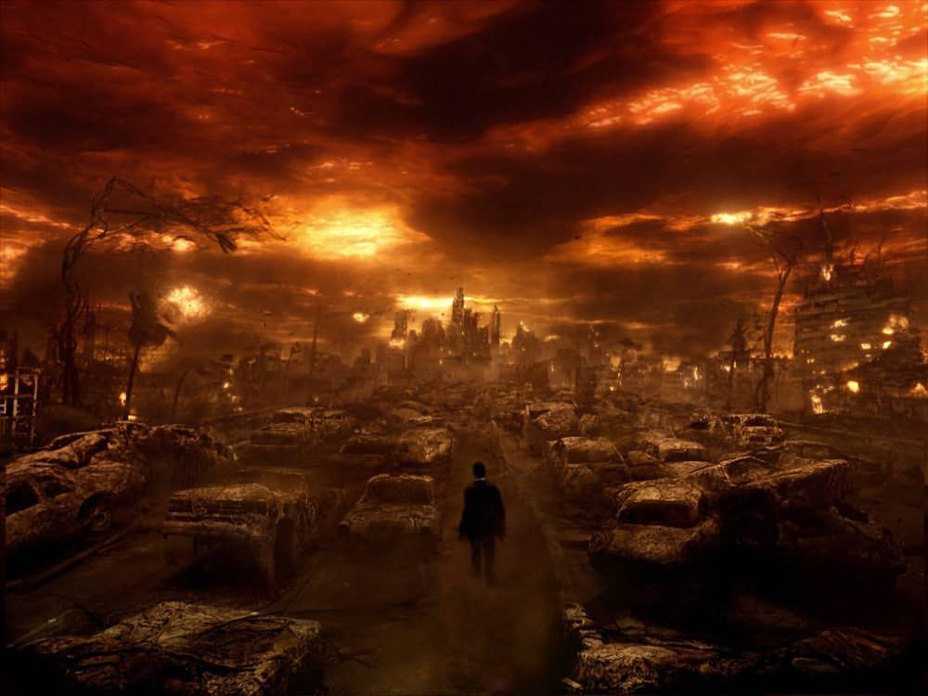
Why Study Daniel and Rev?
3. The prophetic book of Revelation is based on the principles and powers in the book of Daniel

Slide 5
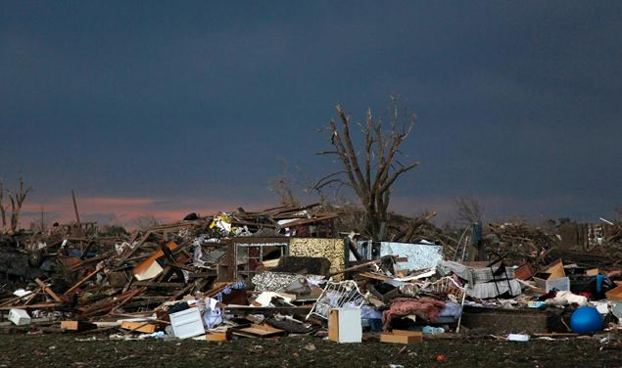
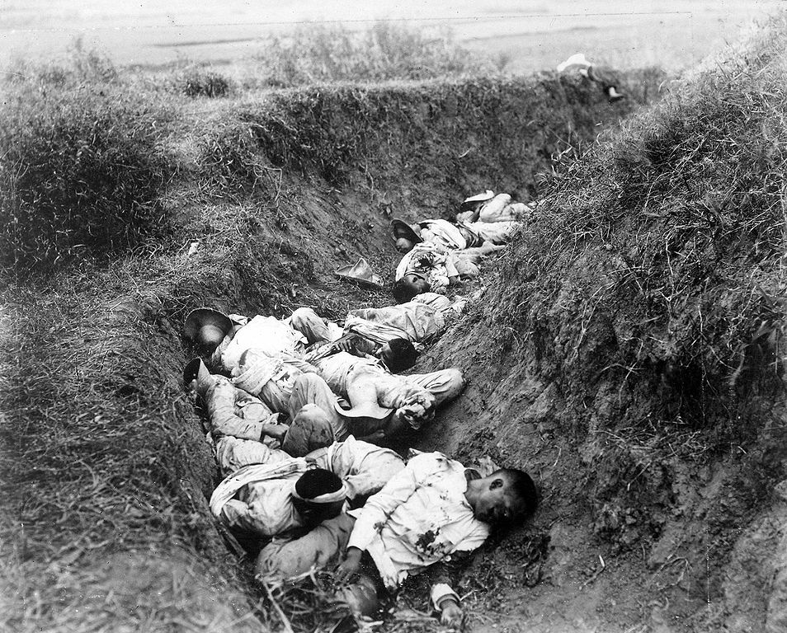
Why Study Daniel and Rev?
You will be more blessed and joyful! (Rev. 1:3

Slide 6
Daniel – Historical Perspective
Daniel was born into an upper-class Jewish family in Judea about 622 B.C.
The Assyrian Empire which had viciously ruled the world for about 300 years was coming to an end
Babylon was coming to be a “world” power at the time Daniel was a boy

Slide 7
Who were the world powers?
There were four kingdoms that were powerful at the time:
1. Babylon – dominant
2. Media
3. Egypt
4. Lydia

Slide 8
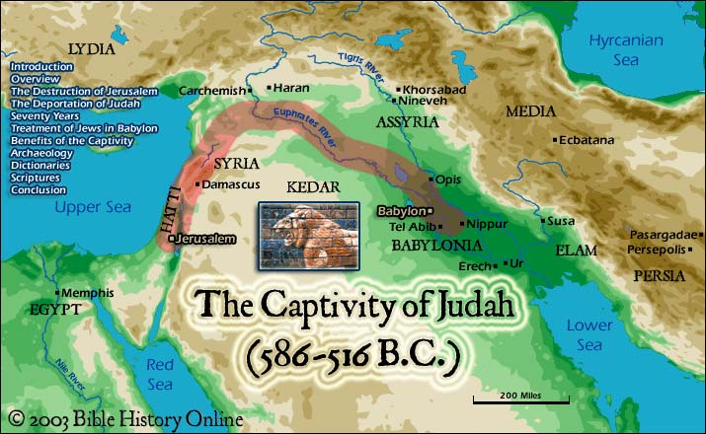

Slide 9
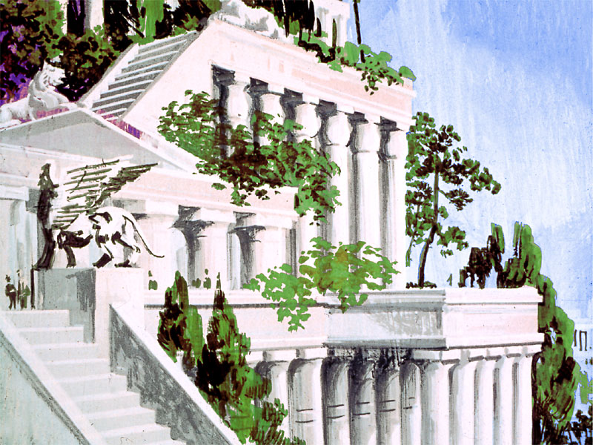
Who was Babylon?
Babylon was located where the famous tower of Babel had once been (Genesis 11) and founded by Nimrod (Gen. 10)
Hammurabi – 1800 B.C. had made it prominent
Assyria had conquered it and it had been part of the Assyrian empire

Slide 10
Who was Babylon?
Between 626 B.C. and 612 B.C. King Nabopolasser crushed the Assyrians and became the founder of “New Babylon”
His son, Nebuchadnezzar II, brought Babylon to its golden age (his name: a prayer to the god Nabu for protection)

Slide 11
Daniel 1 - Background
Nebuchadnezzar defeated the Egyptian army at Carcemish in June, 605 B.C.
This gave him control of Judea and Syria
Then he came to Jerusalem, forced the Jewish king to sign a treaty with Babylon, and as a sign of his victory over the Jewish god – he took some utensils from the temple and a select few youth (Daniel included)

Slide 13
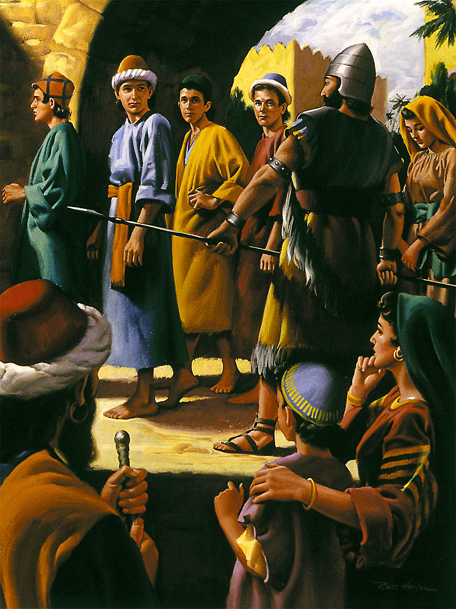
Daniel 1
Daniel 1:1-3; Even though Nebuchadnezzar probably took great pride that it was he who had conquered the Jews – v. 2 states clearly that it was God who “gave” him the victory.

Slide 14
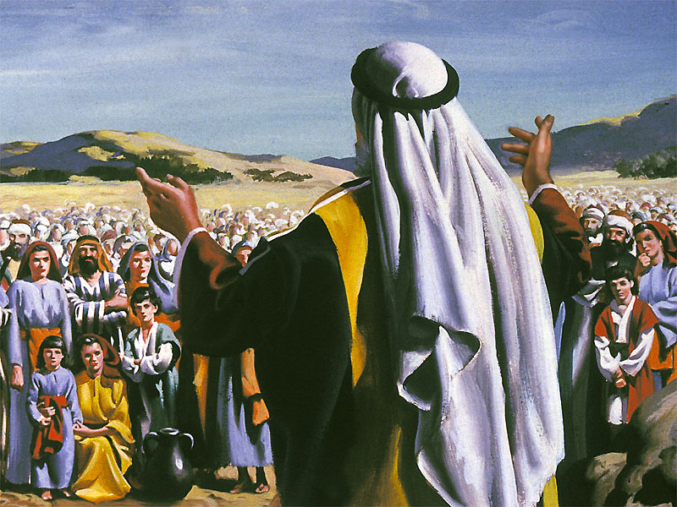
Captivity – why did God do it?
God promised Israel when He took them out of Egypt - Ex. 19:5,6 “If you will obey my voice and keep my covenant, you shall be my own possession among all peoples;…and you shall be to me a kingdom of priests and a holy nation.”

Slide 15
Captivity – why did God do it?
2 Chronicles 36:15-17; The Lord, the God of their fathers, sent word to them through His messengers again and again, because He had pity on His people and His dwelling place. But they mocked God’s messengers, despised His words and scoffed at His prophets until the wrath of the Lord was aroused against His people and there was no remedy…..

Slide 16
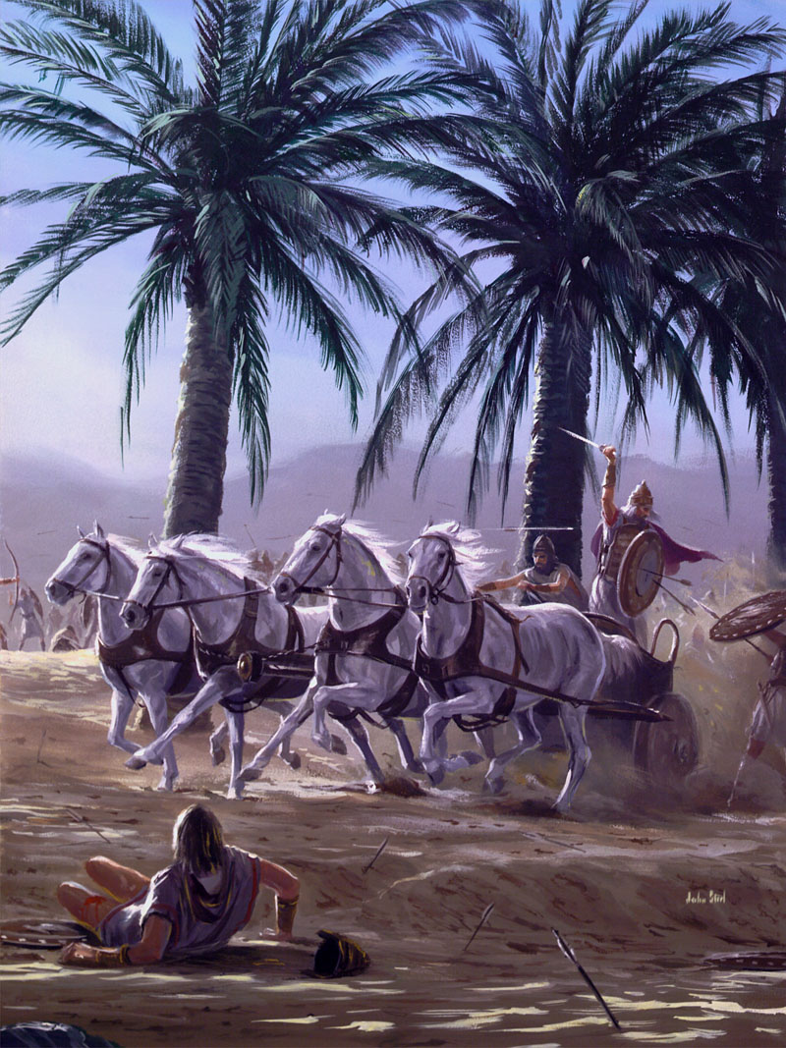
Captivity – why did God do it?
He brought against them the king of the Babylonians, who killed their young men with the sword in the sanctuary, and spared neither young man nor young woman, old man or aged.” 2 Chronicles 36:15-17

Slide 17
What sins did the Jews commit?
Dishonesty
Injustice to the poor
Murder
Breaking the Sabbath and God’s covenant
Sexual immorality (extramarital, premarital, homosexual and bestial)
Worship of Baal and false images of gods
Persecuted the prophets
Listened to false prophets who said “soothing” things
Jeremiah 9:14; 17:19-27; 22:1-5; 28

Slide 18
Did God want to send the Jews into captivity?
Hosea 11:8 – “How can I give you up Ephraim? How can I hand you over, O Israel…my heart recoils within me, My compassion grows warm and tender.”
Ezekiel 33:11 – “Turn back, turn back from your evil ways; for why will you die, O house of Israel.”

Slide 19
The Captivity
722 B.C. – The northern kingdom of Israel is conquered by the Assyrians
605 B.C. – The southern kingdom of Judah is overcome by Babylon
God only gave them up, because their wound was incurable!

Slide 20
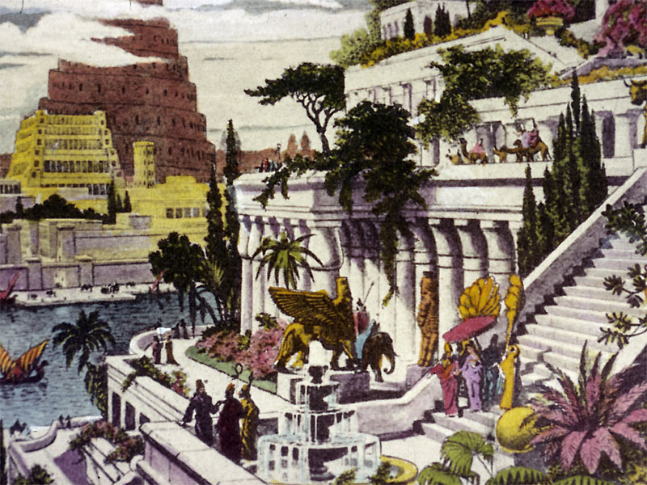
Daniel 1
Daniel marched the 1500 km. with the army for about two months before reaching the beautiful city of Babylon

Slide 21
The return from the captivity
God did promise that he would punish the nation that took them into captivity and that they would return after 70 years. Jer. 25:11,12; 29:1
God even promised that He would write His law on their hearts afterwards and they would follow Him and that He would restore the temple. Ezek. 36:24-28

Slide 22
Daniel 1
Daniel studied:
1. Mathematics (their specialty)
2. Astronomy (advanced)
3. Architecture
4. Business (checks, interest, letters of credit)
5. Languages (Akkadian – Babylonian language; Sumerian – traditional religious language; Aramaic – language of international trade and commerce)

Slide 23
Daniel 1
Vs. 4 – Daniel was found to be “skillful in all wisdom, endowed with knowledge, understanding learning”.
Even though Judah had been corrupt, Daniel had been brought up by reading the Holy Scriptures and had a good education
How can a young man keep his way pure?
“By guarding it according to thy word.” Psalm 119:9

Slide 24
How do we know that Daniel knew the Bible?
He knew that it was not right to eat food sacrificed to idols that were not the true God
He knew the list of unclean meats – Deut. 14
He knew that drinking alcoholic wine is a sin – Lev. 10:1-11
He was faithful and honest – Dan. 6:4
He prayed often – Dan. 2,9

Slide 25
Instruction for youth
Deuteronomy 6:4-7; God told parents to teach their children the law of God when they were sitting in the house, walking on the road – all the time
It is possible that the prophet Jeremiah even instructed him when Daniel was a boy in Jerusalem

Slide 26
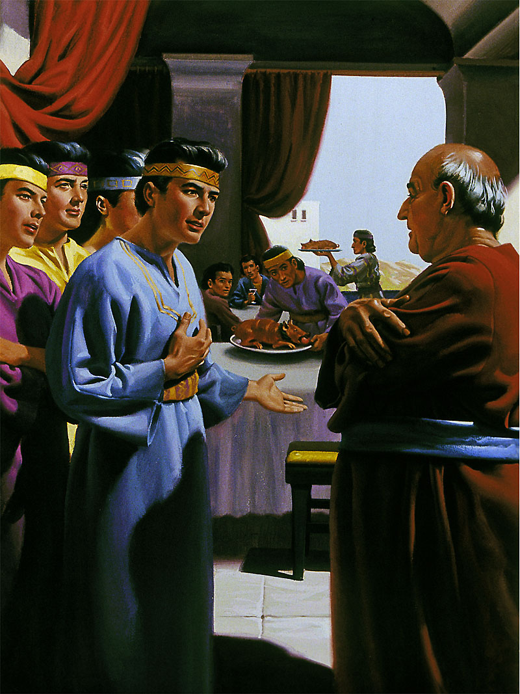
Daniel 1
Daniel 1:5-21
Even though it was a great honor to eat from the table of the king, Daniel and his three friends didn’t compromise

Slide 27
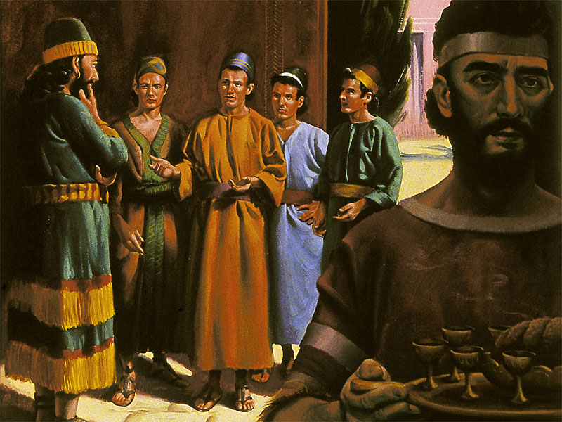
Daniel 1
Daniel and his three friends were ten times better than the others (v. 20)
God rewards people for their faithfulness in keeping His laws

Slide 28
Theme of Daniel
Even though God’s people are located in Babylon, God will give the kingdom to His faithful saints! Dan. 7:27

Slide 29
Next Lesson
Does God know the future?
Daniel 2

